Slide 1
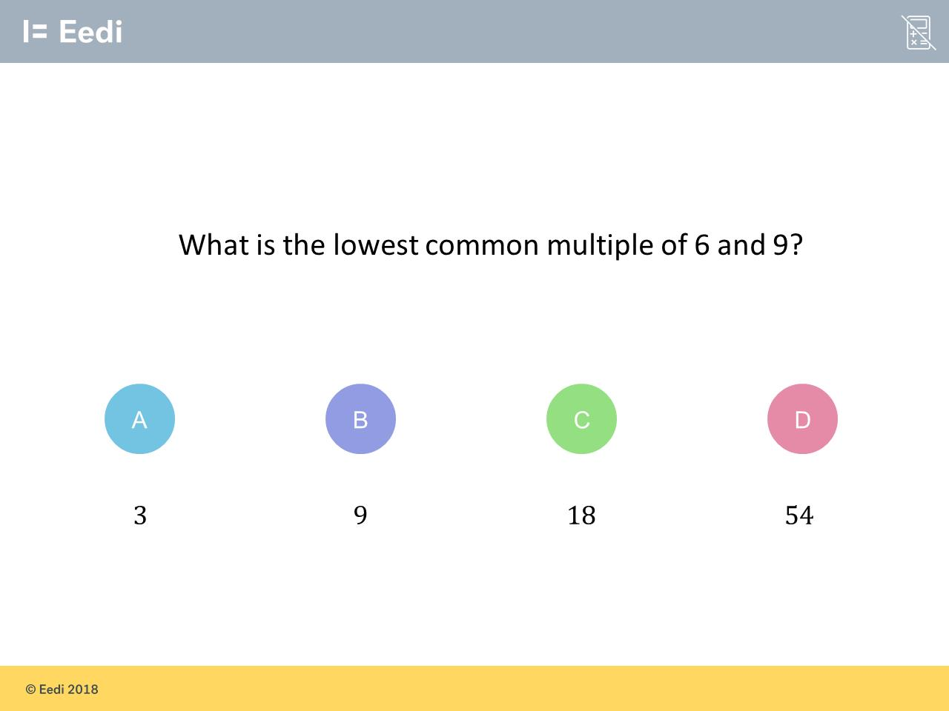
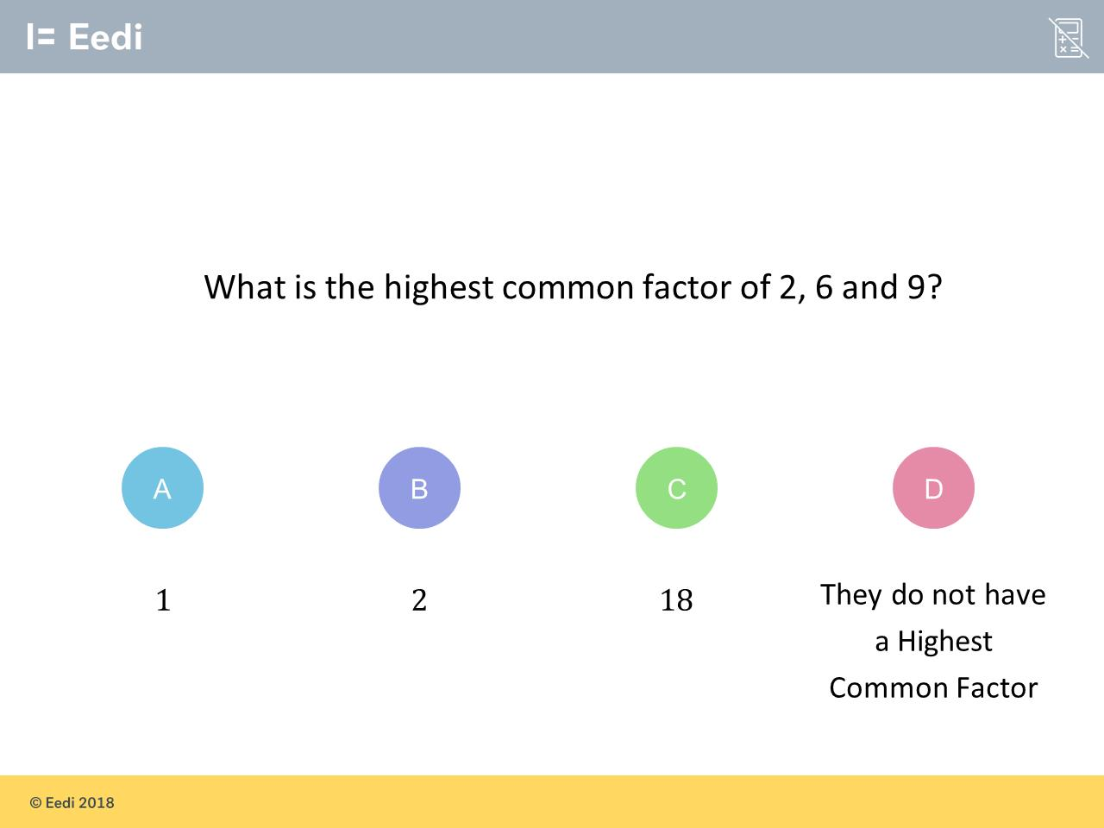
Worst answered question?
Most common wrong answer?

Slide 2
ANSWERS

Slide 3
Worst answered question?

Slide 4
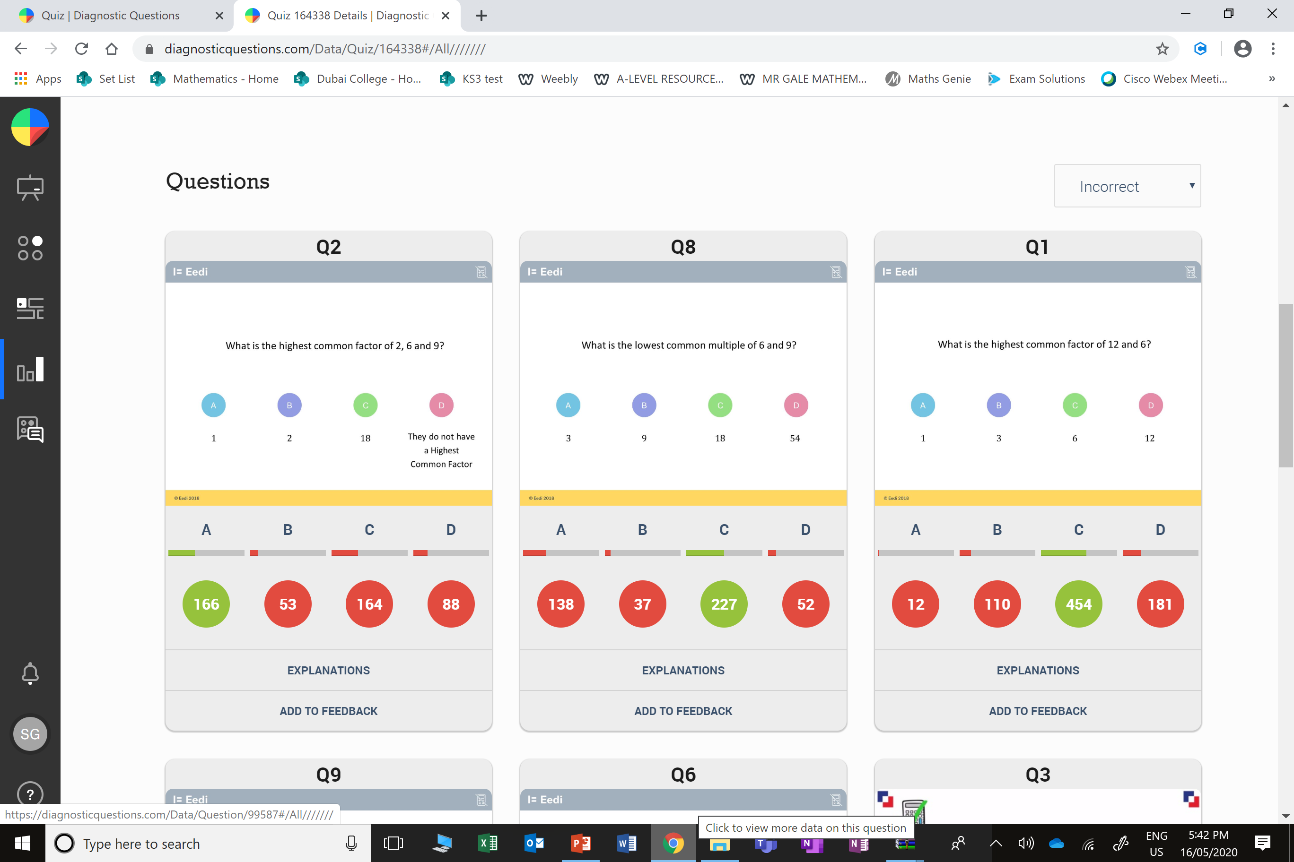
C
The student
found the LCM.

Slide 5
A
The student found the HCF.

