Slide 1
Differentiation
Exponentials and Logs
Chapter 9
(Part 2 of 10)

Slide 2

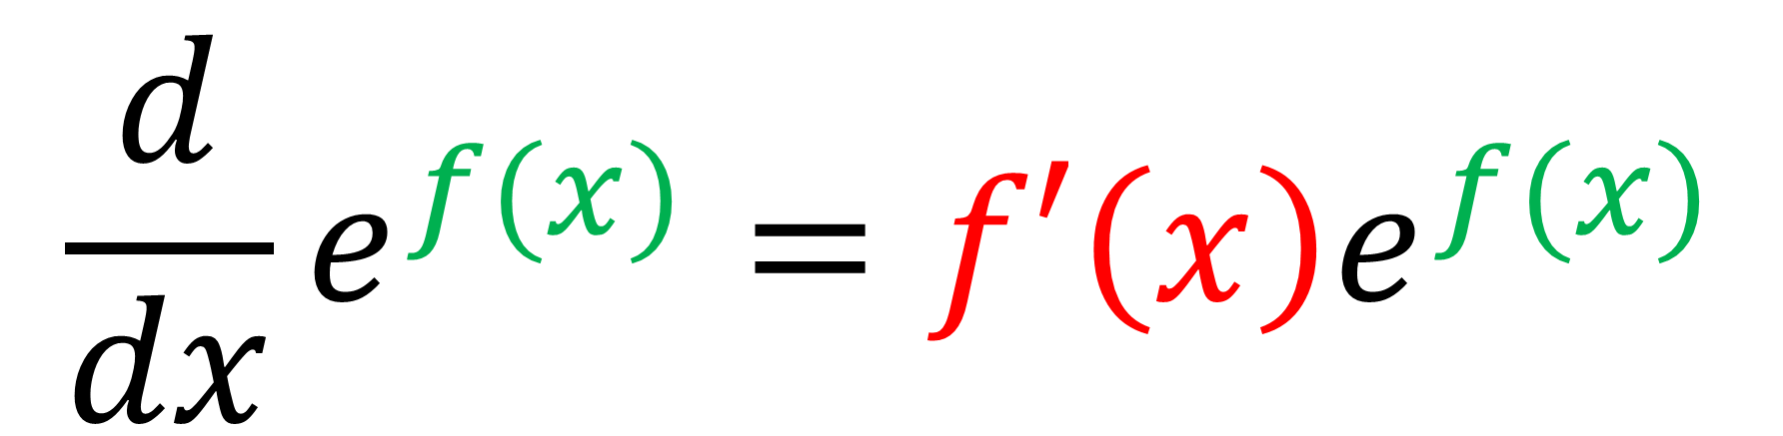
Differentiating $e$
$$\frac{d}{dx}e^{f(x)}=f′\left(x\right)e^{f(x)}$$

Slide 3
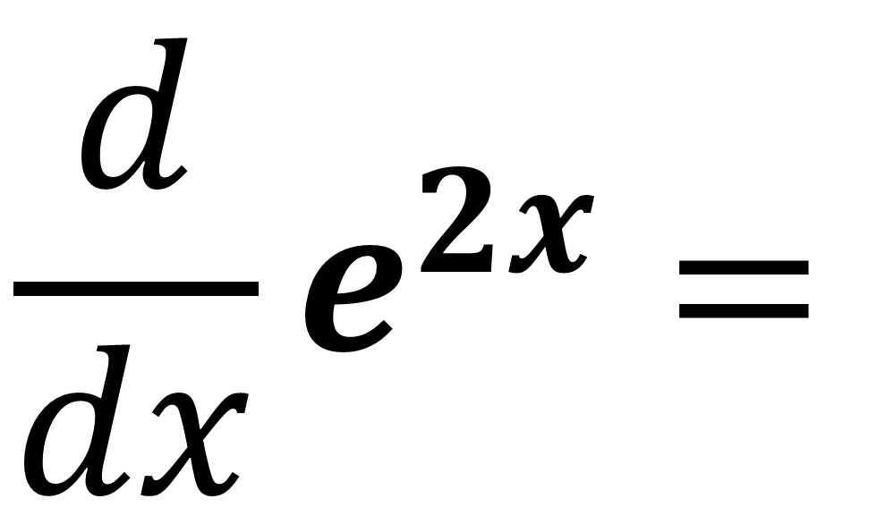
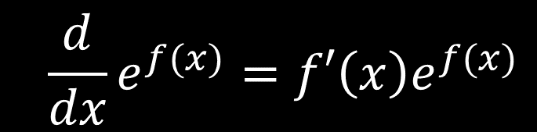
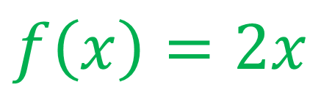
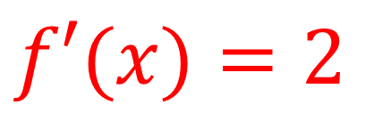
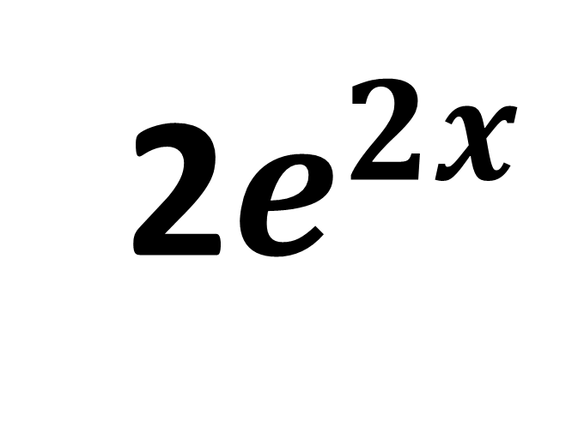
$${\frac{d}{dx}e}^{f(x)}=f′\left(x\right)e^{f(x)}$$
$f\left(x\right)=2x$
$$f′(x)=2$$
$$\frac{d}{dx}e^{2x}=$$
2$e^{2x}$

Slide 4
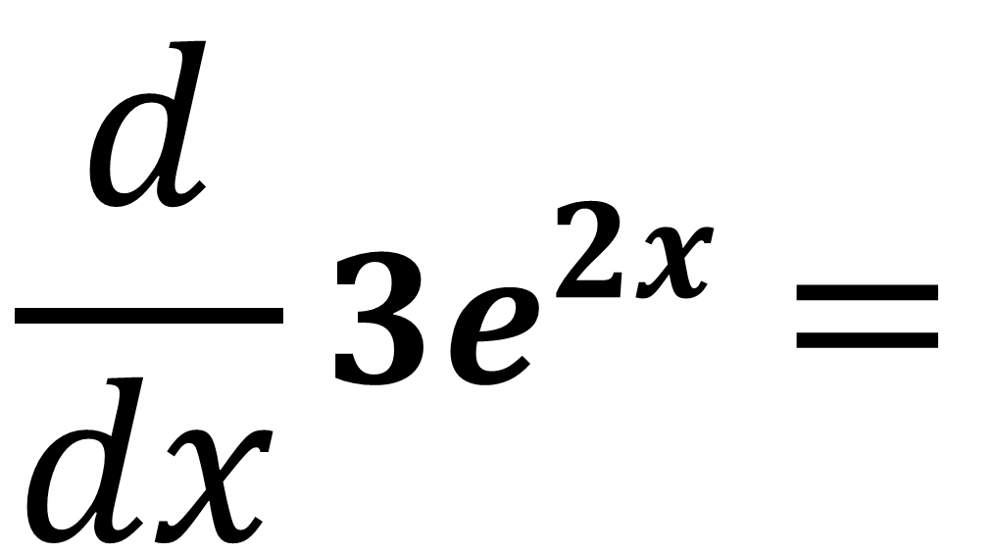
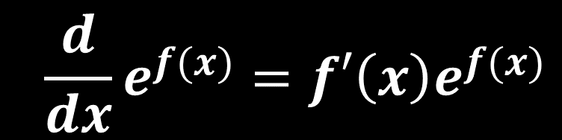
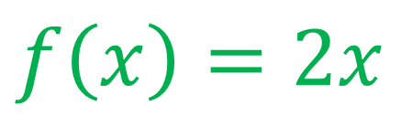
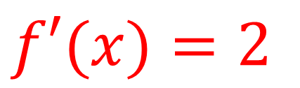
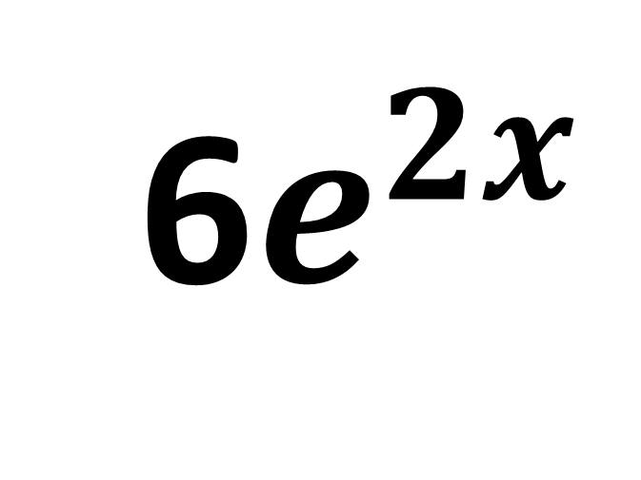
$${\frac{d}{dx}e}^{f(x)}=f′\left(x\right)e^{f(x)}$$
$f\left(x\right)=2x$
$$f′(x)=2$$
$$\frac{d}{dx}{3e}^{2x}=$$
6$e^{2x}$

Slide 5
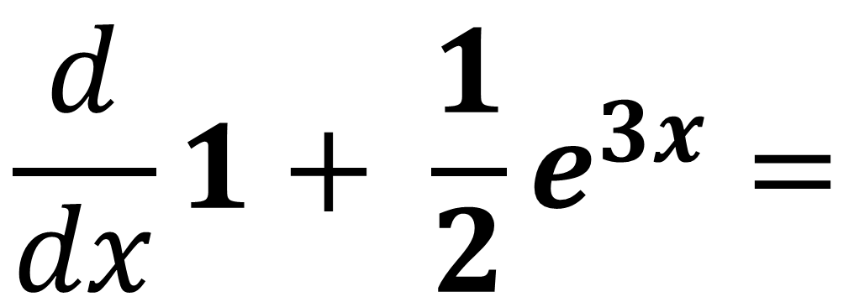
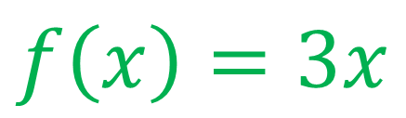
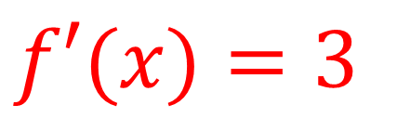
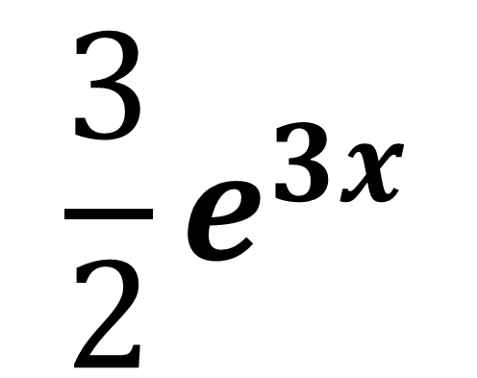
$${\frac{d}{dx}e}^{f(x)}=f′\left(x\right)e^{f(x)}$$
$f\left(x\right)=3x$
$$f′(x)=3$$
$$\frac{d}{dx}{1+ \frac{1}{2}e}^{3x}=$$
$$\frac{3}{2}e^{3x}$$

Slide 6
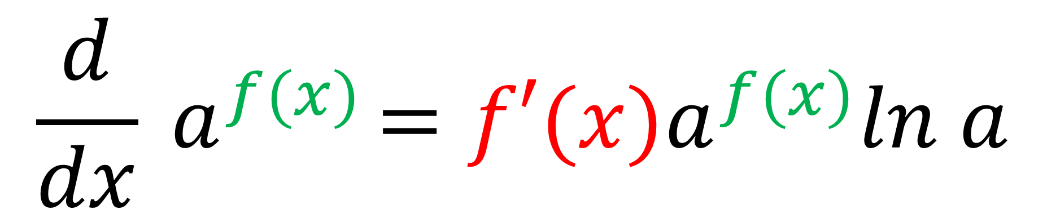
Differentiating Exponentials
$$\frac{d}{dx}{ a}^{f(x)}={f′(x)a}^{f(x)}ln a$$

Slide 7
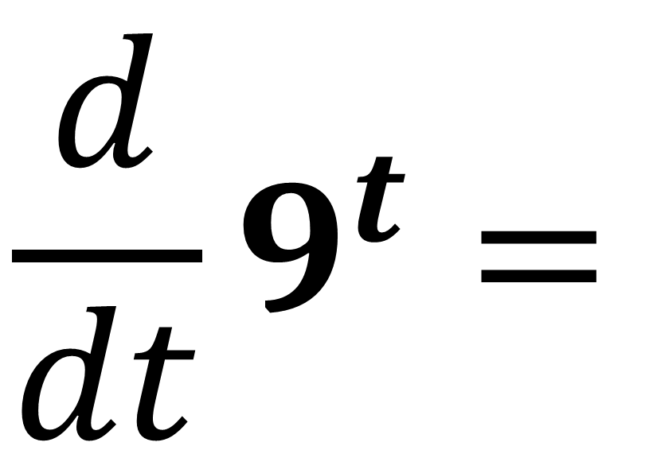
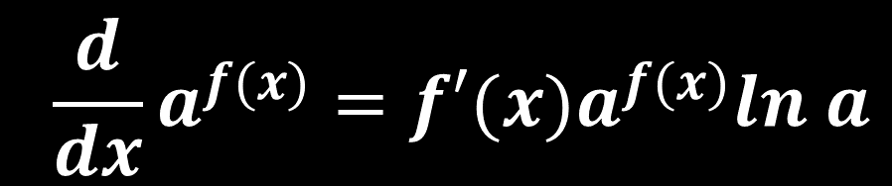
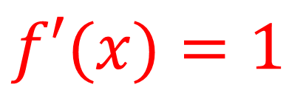
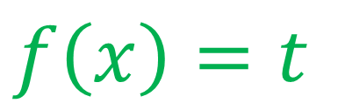
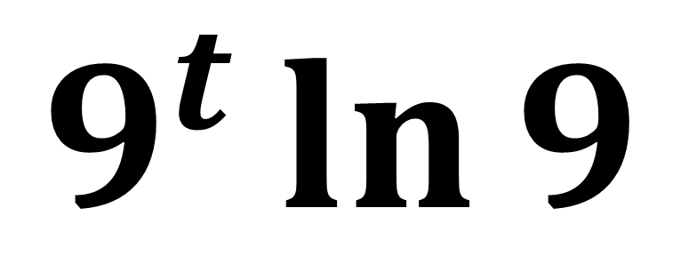
$${\frac{d}{dx}a}^{f(x)}={f′(x)a}^{f(x)}ln a$$
$f\left(x\right)=t$
$$f′(x)=1$$
$$\frac{d}{dt}9^{t}=$$
$$9^{t}\ln{9}$$

Slide 8
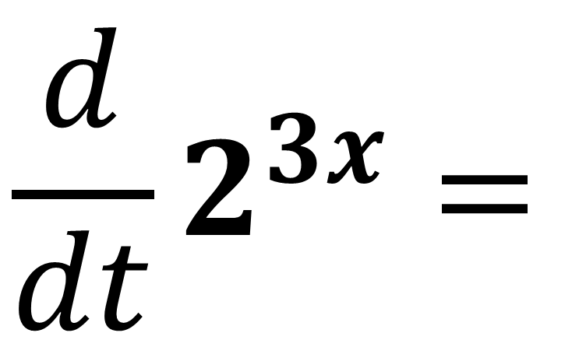
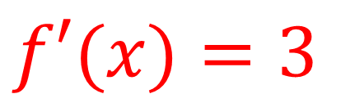
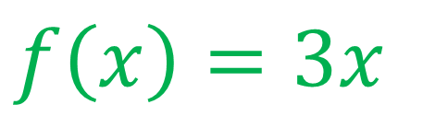
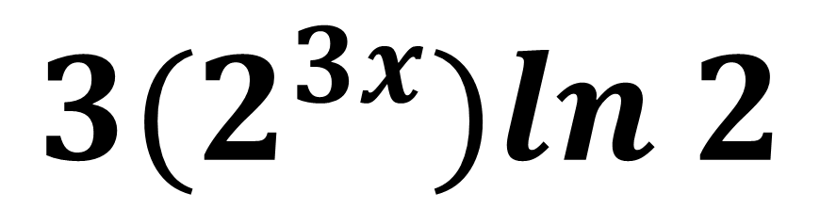
$${\frac{d}{dx}a}^{f(x)}={f′(x)a}^{f(x)}ln a$$
$f\left(x\right)=3x$
$$f′(x)=3$$
$$\frac{d}{dt}2^{3x}=$$
$${3(2}^{3x})ln 2$$

Slide 9
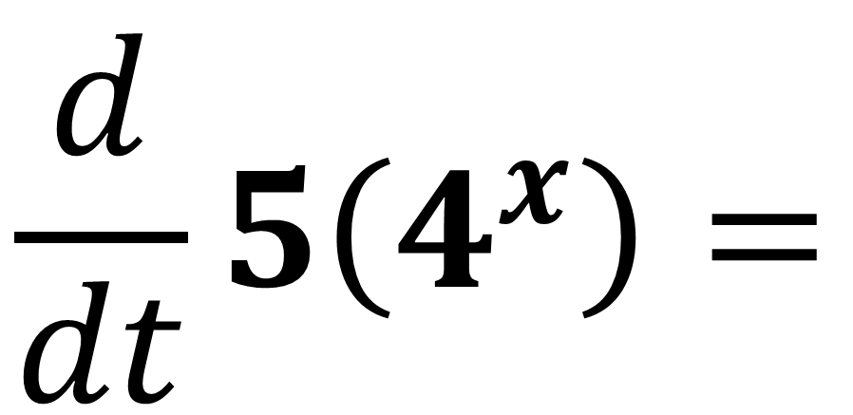
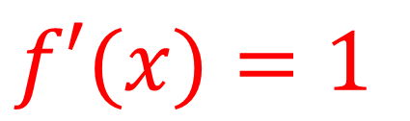
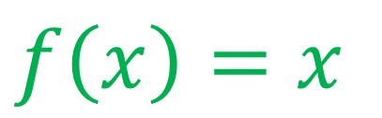
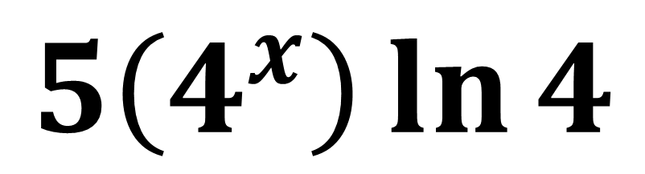
$${\frac{d}{dx}a}^{f(x)}={f′(x)a}^{f(x)}ln a$$
$f\left(x\right)=x$
$$f′(x)=1$$
$$\frac{d}{dt}5\left(4^{x}\right)=$$
$$5\left(4^{x}\right)\ln{4}$$

Slide 10
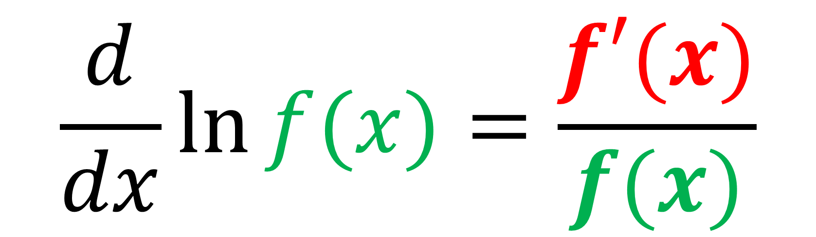
Differentiating Log Functions
$$\frac{d}{dx}\ln{f(x)}=\frac{f′(x)}{f(x)}$$

Slide 11
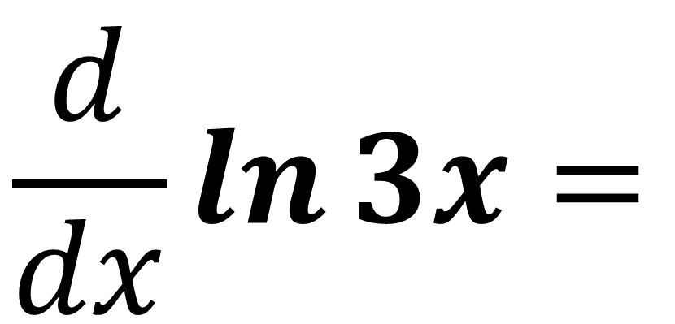
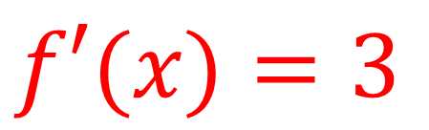
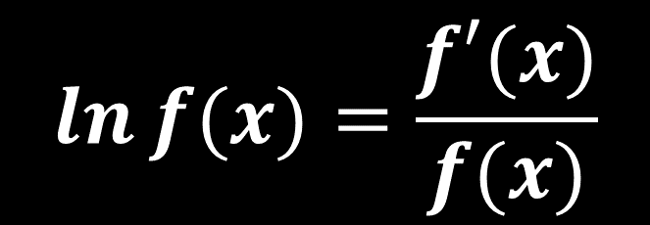

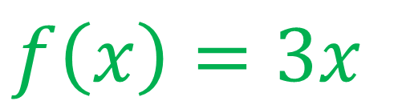
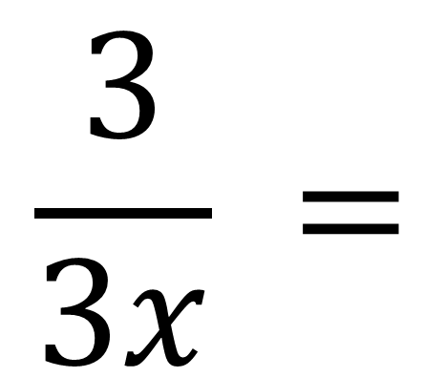
$$\ln{f(x)}=\frac{f′(x)}{f(x)}$$
$f\left(x\right)=3x$
$$f′(x)=3$$
$$\frac{d}{dx}\ln{3x}=$$
$$\frac{3}{3x} =$$
$$\frac{1}{x}$$

Slide 12
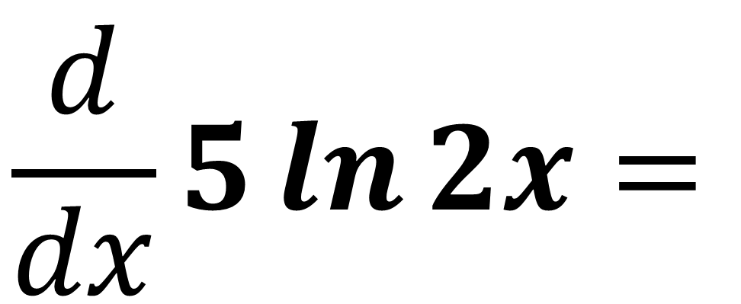
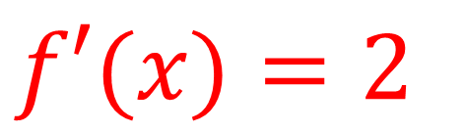
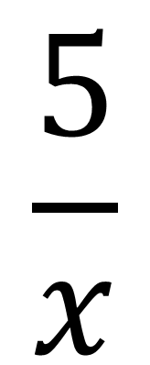
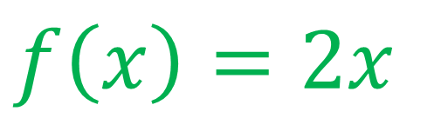
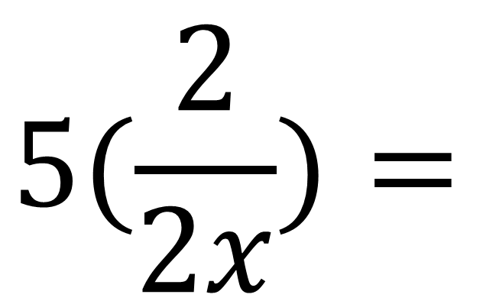
$$\ln{f(x)}=\frac{f′(x)}{f(x)}$$
$f\left(x\right)=2x$
$$f′(x)=2$$
$$\frac{d}{dx}5\ln{2x}=$$
$$5(\frac{2}{2x})=$$
$$\frac{5}{x}$$

Slide 13
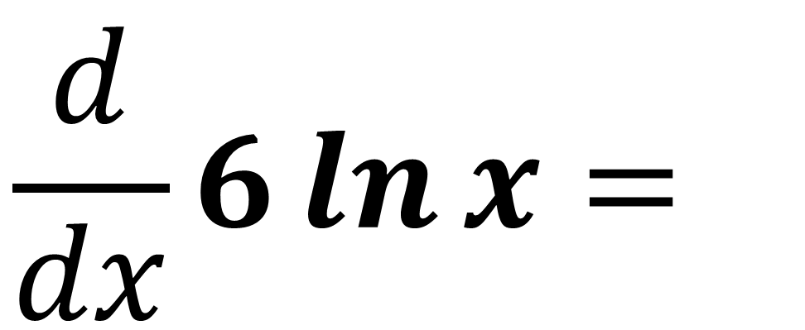
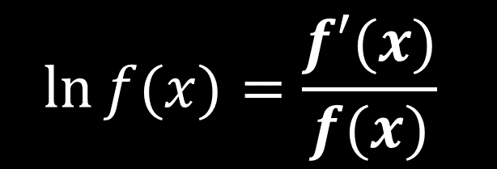
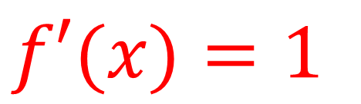
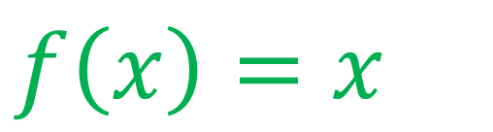
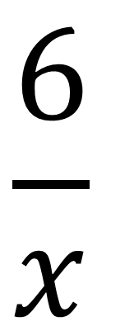
$$\ln{f(x)}=\frac{f′(x)}{f(x)}$$
$f\left(x\right)=x$
$$f′(x)=1$$
$$\frac{d}{dx}6\ln{x}=$$
$$\frac{6}{x}$$

Slide 14
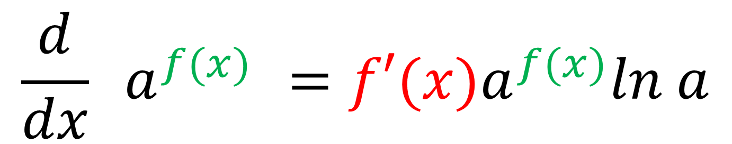
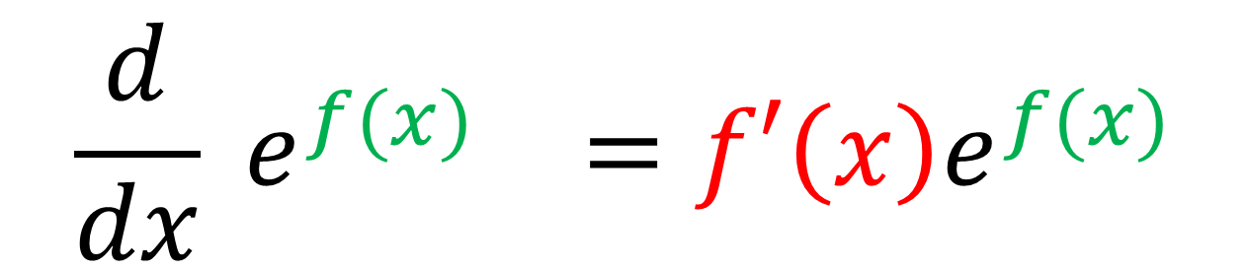
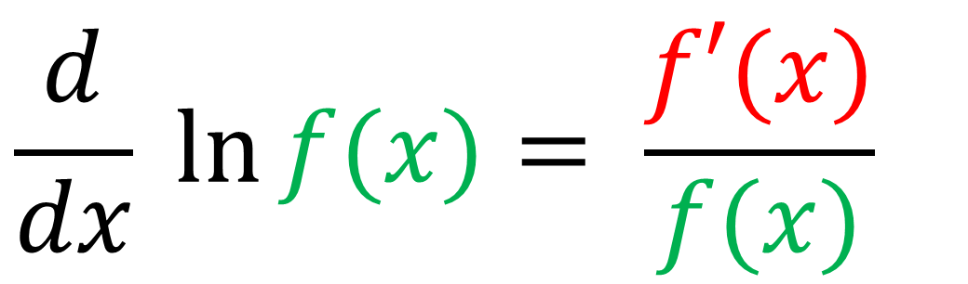
Recap
$$\frac{d}{dx} e^{f(x)} =f′\left(x\right)e^{f(x)}$$
$$\frac{d}{dx}{ a}^{f(x)} ={f′(x)a}^{f(x)}ln a$$
$$\frac{d}{dx}\ln{f(x)}= \frac{f′(x)}{f(x)}$$

Slide 15
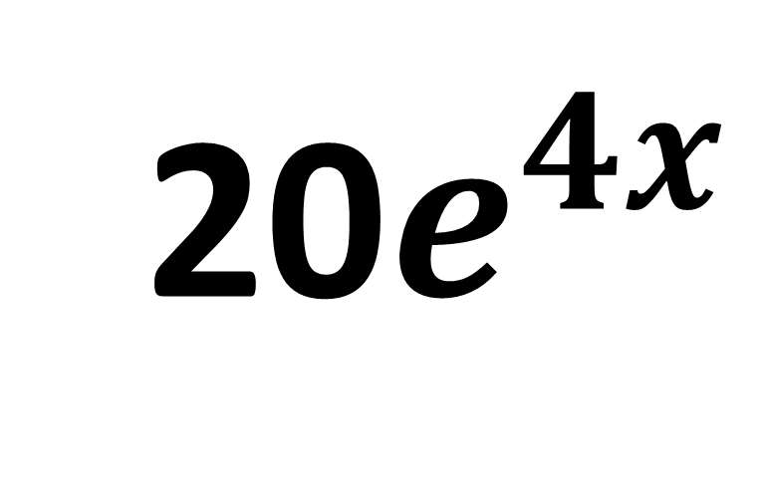
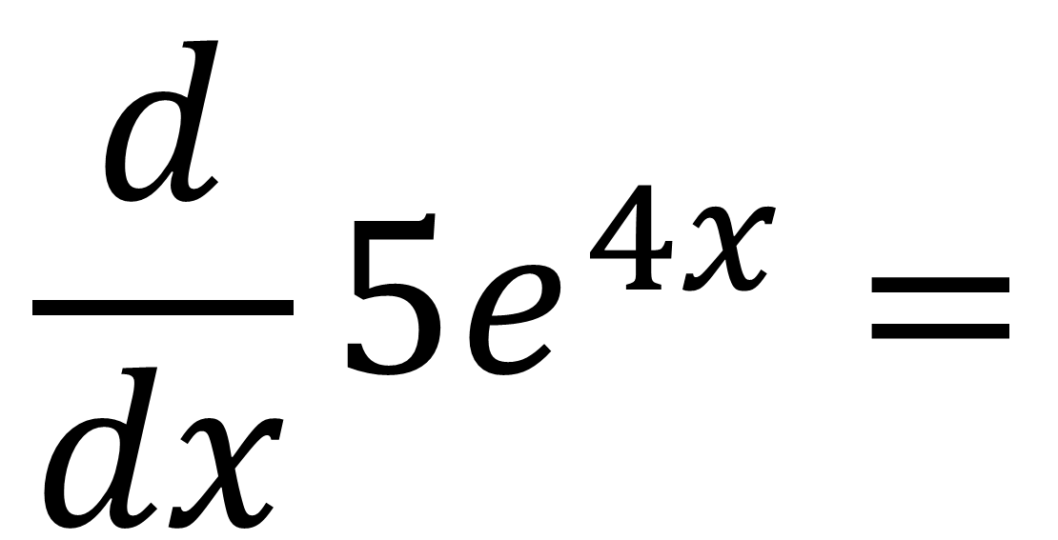
$$\frac{d}{dx}5e^{4x}=$$
20$e^{4x}$

Slide 16


$$\frac{d}{dx}3^{2x}=$$
2$\left(3^{2x}\right)\ln{3}$

Slide 17



$$\frac{d}{dx}\ln{x^{2}}=$$
$$\frac{2x}{x^{2}}=$$
$$\frac{2}{x}$$

Slide 18


$$\frac{d}{dx}e^{−x}=$$
$$−e^{−x}$$

Slide 19



$$\frac{d}{dx}\ln{{3x}^{2}}=$$
$$\frac{6x}{{3x}^{2}}=$$
$$\frac{2}{x}$$

Slide 20


$$\frac{d}{dx}4\left(3^{2x}\right)=$$
8$\left(3^{2x}\right)\ln{3}$

Slide 21



Differentiate ${y=\left(e^{x}+2\right)}^{2}$
$$y=e^{2x}+4e^{x}+4$$
$$\frac{dy}{dx}=2e^{2x}+4e^{x}$$

Slide 22




A rabbit population $P$ after $t$ years can be modelled using
$P=1000(2^{t})$.
Determine after how many years, when the rate of population increase will reach 20,000 rabbits per year.
$$\frac{dP}{dt}=1000\left(2^{t}\right)\ln{2}$$
$$1000\left(2^{t}\right)\ln{2}=20 000$$
$$2^{t}=\frac{20000}{1000\ln{2}}$$
$$2^{t}=\frac{20}{\ln{2}}$$
$$log 2^{t}=log⁡(\frac{20}{\ln{2}})$$
$$t\log{2}=log⁡(\frac{20}{\ln{2}})$$
$$t=\frac{log⁡(\frac{20}{\ln{2}})}{\log{2}}$$
$$t =4.85 years (3sf)$$

Slide 23


A child has headlice and his parents treat it using a special shampoo.
The population $P$ of headlice after $t$ days can be modelled using $P=460\left(3^{−2t}\right)$
Determine the rate of change of headlice after 3 days.
$$\frac{dP}{dt}=−920\left(3^{−2t}\right)\ln{3}$$
When $t=3$,
$$\frac{dP}{dt}=−920\left(3^{−6}\right)\ln{3}$$
$$\frac{dP}{dt}=−1.39 headlice/day$$

