Slide 1
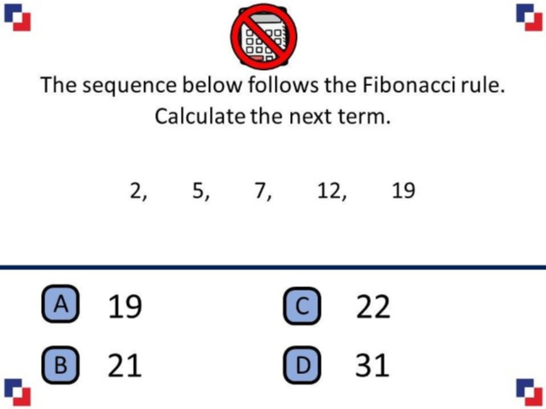
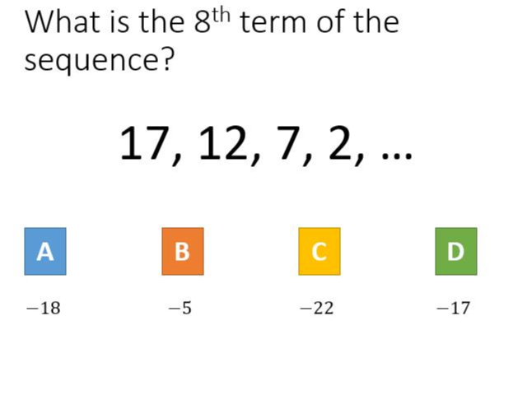
Worst answered question?
Most common wrong answer?

Slide 2
ANSWERS

Slide 3
Worst answered question?

Slide 4
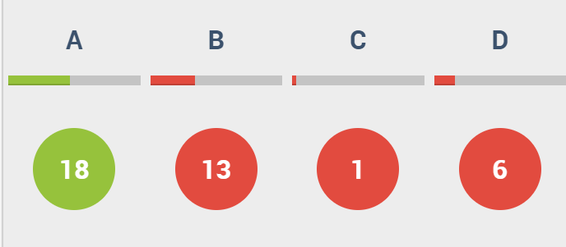
B
They described the term to term rule.

Slide 5
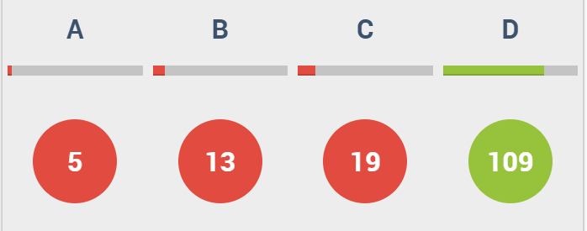
C
They looked at the first increase (+3) and used it to get from 19 to 22 .

