Slide 1
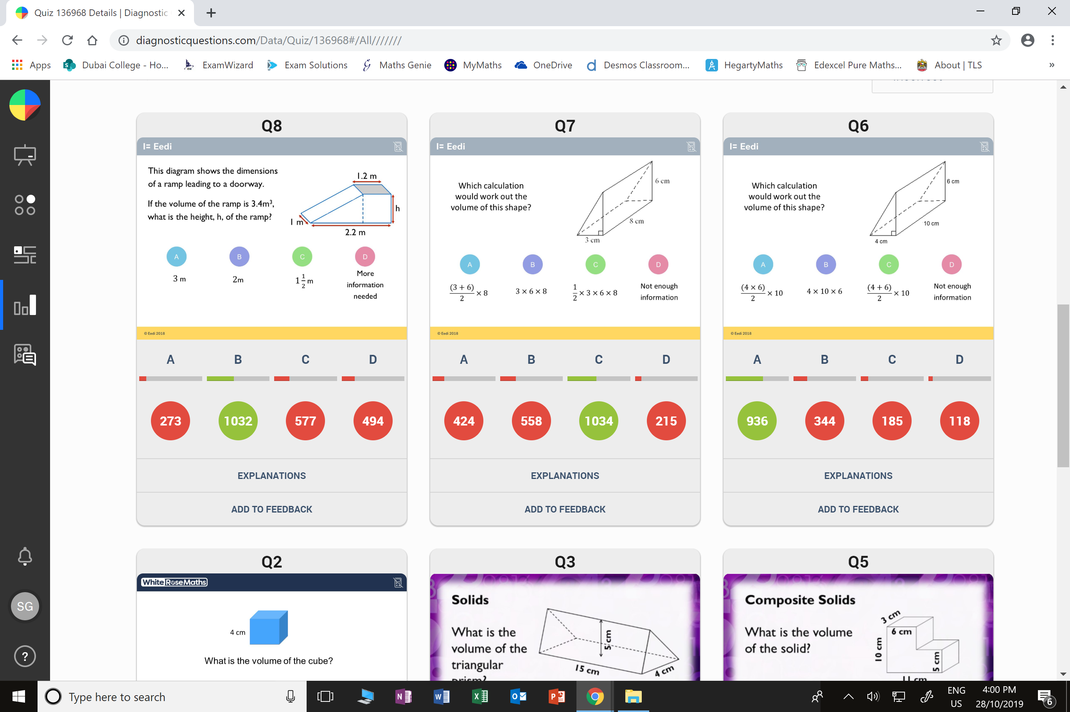
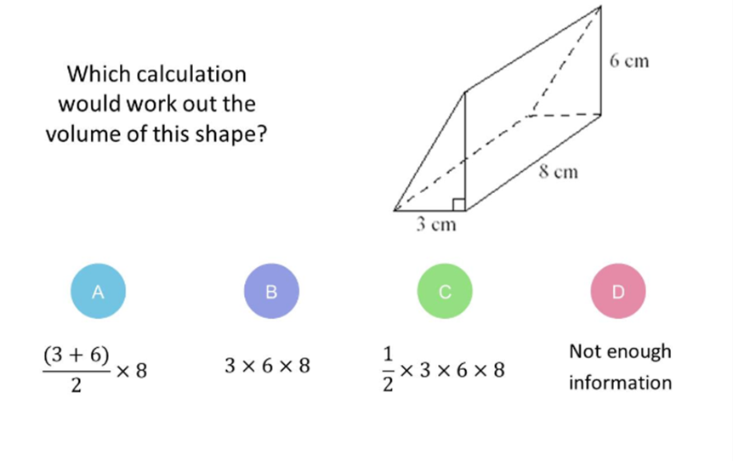
Which question had the lowest percentage of correct answers?
For each question,
what was the most common wrong answer?

Slide 2
ANSWERS

Slide 3
Which question had the lowest percentage of correct answers?

Slide 4
B
The student has forgotten to
divide by 2.

Slide 5
C
The student may have guessed,
or has miscalculated.

