Slide 1
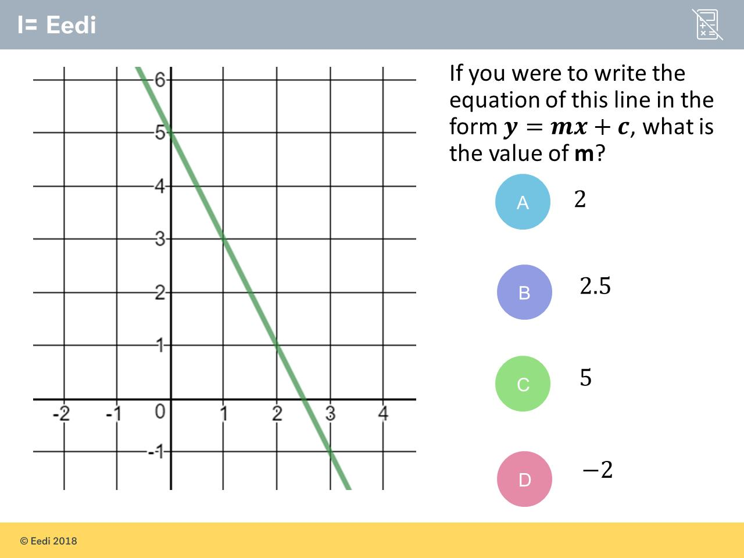
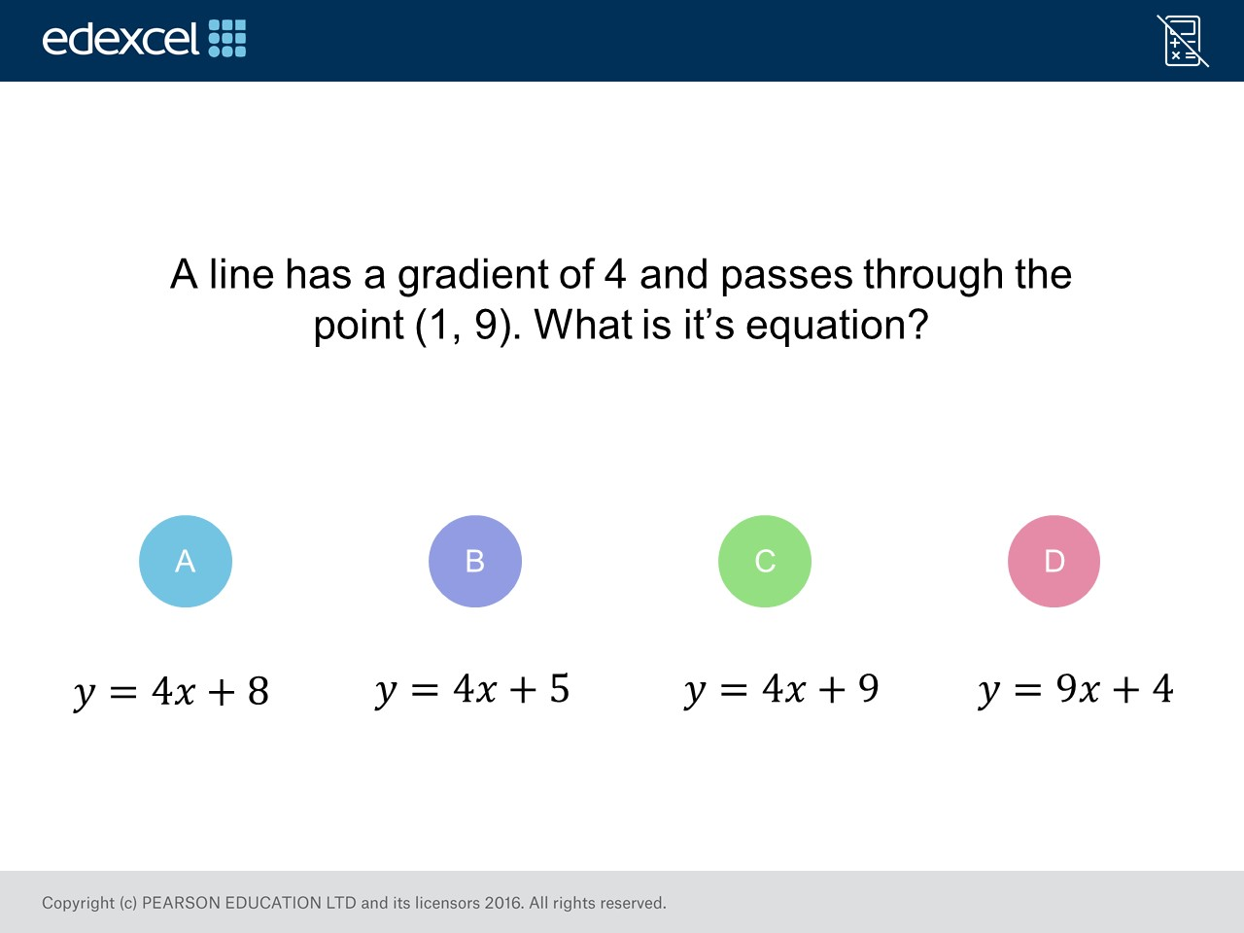
Worst answered question?
Most common wrong answer?

Slide 2
ANSWERS

Slide 3
Worst answered question?

Slide 4
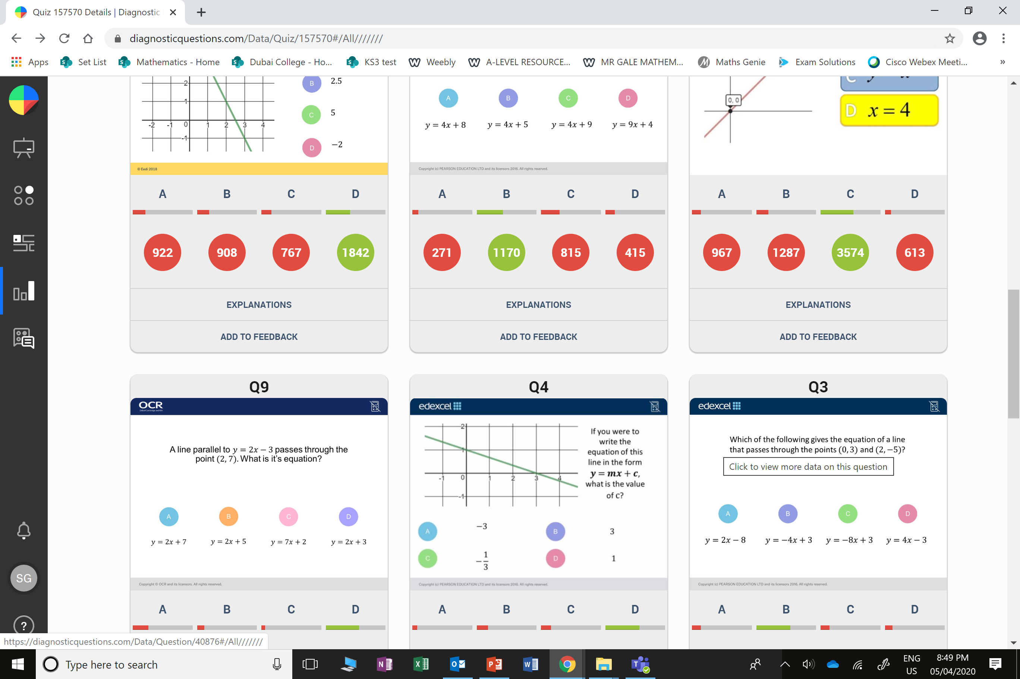
A
They forgot it was a negative gradient.

Slide 5
C
They thought the
co-ordinate
was (0,9).

