Slide 1
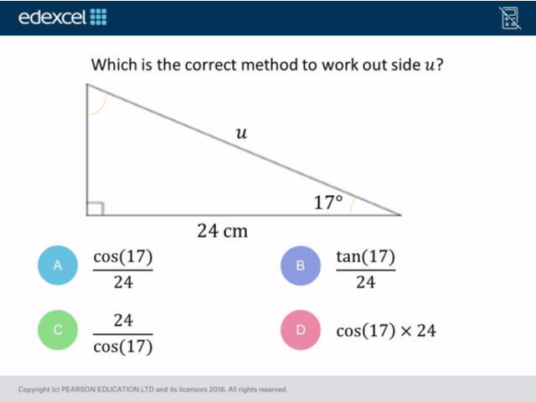
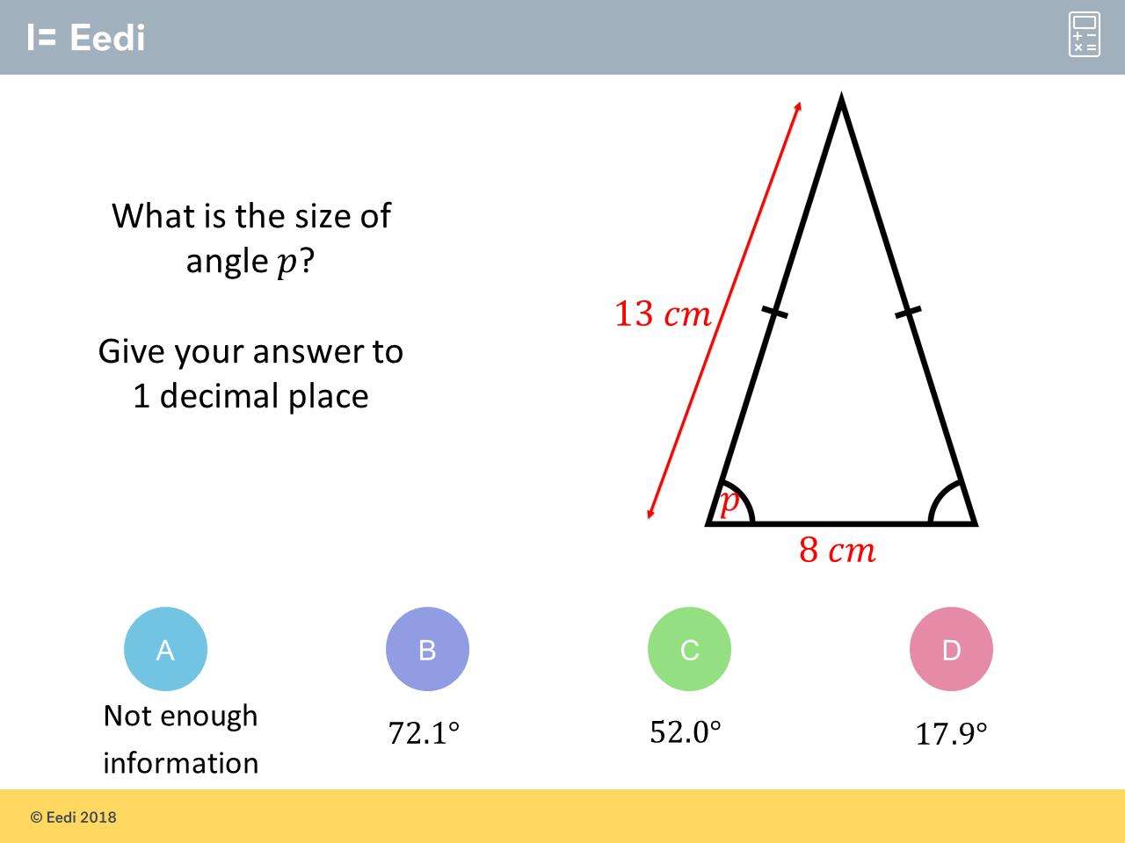
Worst answered question?
Most common wrong answer?

Slide 2
ANSWERS

Slide 3
Worst answered question?

Slide 4
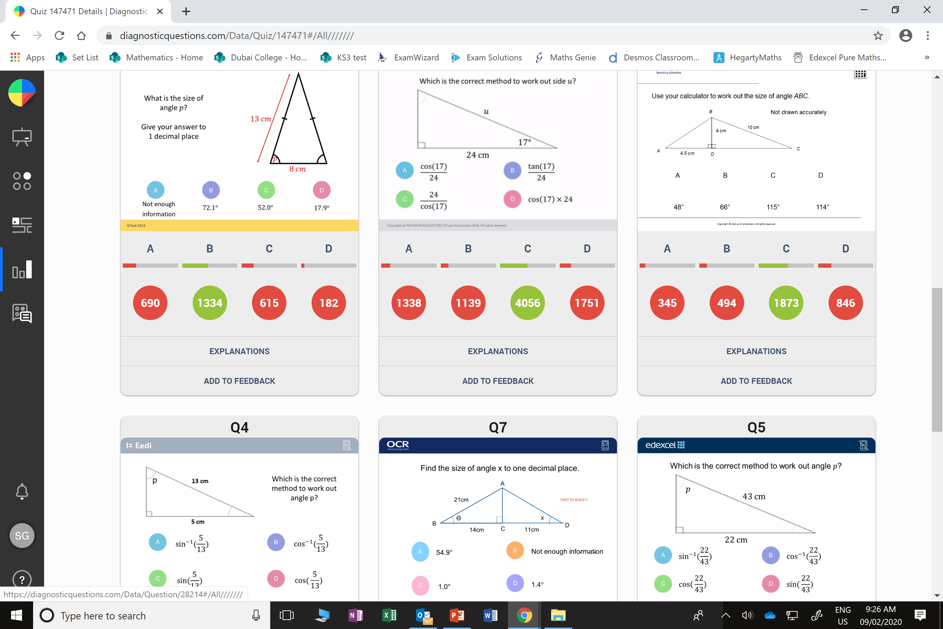
A
They don’t realise they need to slip the triangle up into right angle triangles.

Slide 5
D
They swapped the hypotenuse value with the
opposite value.

