Slide 1
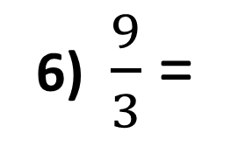
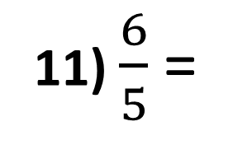
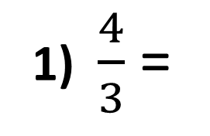
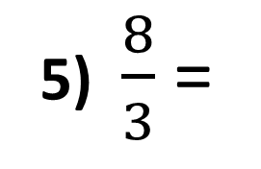
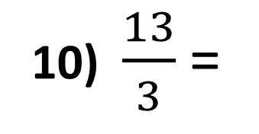
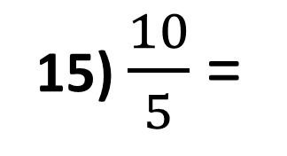
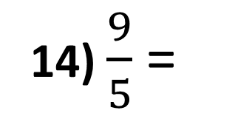
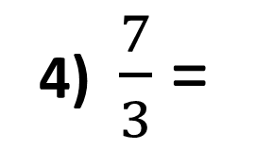
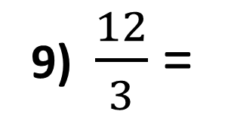
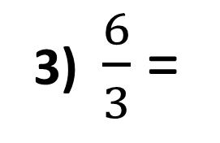
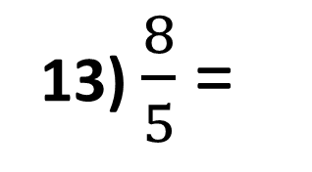
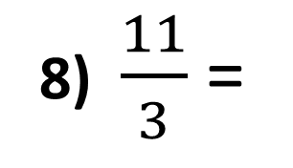
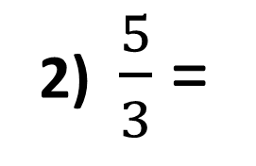
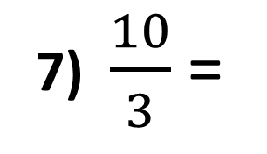
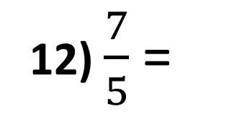
Convert the improper fractions to mixed fractions.
1) $\frac{4}{3}$ =
6) $\frac{9}{3}$ =
11) $\frac{6}{5}$ =
2) $\frac{5}{3}$ =
7) $\frac{10}{3}$ =
12) $\frac{7}{5}$ =
3) $\frac{6}{3}$ =
8) $\frac{11}{3}$ =
13) $\frac{8}{5}$ =
4) $\frac{7}{3}$ =
9) $\frac{12}{3}$ =
14) $\frac{9}{5}$ =
5) $\frac{8}{3}$ =
10) $\frac{13}{3}$ =
15) $\frac{10}{5}$ =

Slide 2
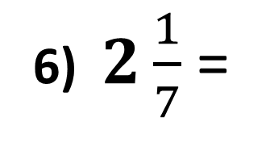
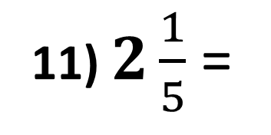
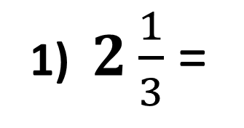
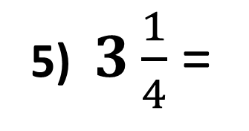
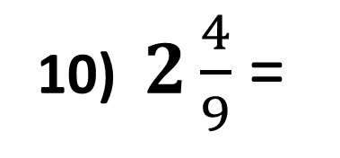
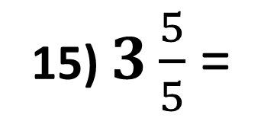
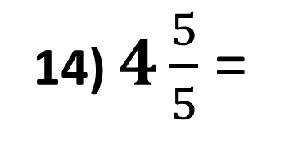
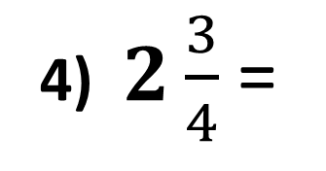
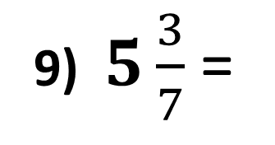
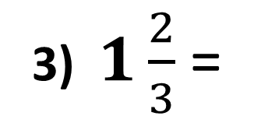
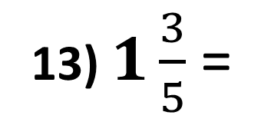
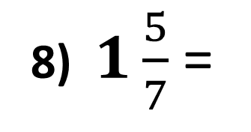
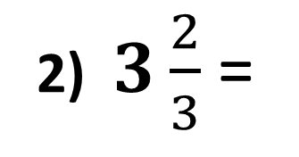
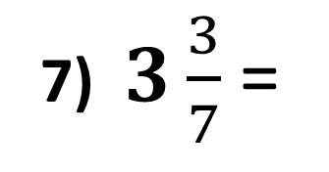
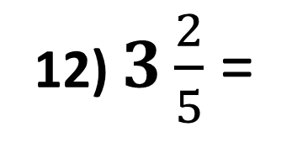
Convert the mixed fractions to improper fractions.
1) $2\frac{1}{3}$ =
6) $2\frac{1}{7}$ =
11) $2\frac{1}{5}$ =
2) $3\frac{2}{3}$ =
7) $3\frac{3}{7}$ =
12) $3\frac{2}{5}$ =
3) $1\frac{2}{3}$ =
8) $1\frac{5}{7}$ =
13) $1\frac{3}{5}$ =
4) $2\frac{3}{4}$ =
9) $5\frac{3}{7}$ =
14) $4\frac{5}{5}$ =
5) $3\frac{1}{4}$ =
10) $2\frac{4}{9}$ =
15) $3\frac{5}{5}$ =

Slide 3
ANSWERS

Slide 4
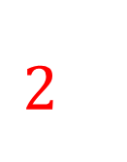
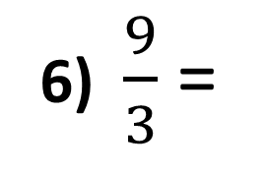
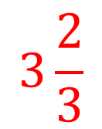
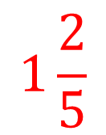
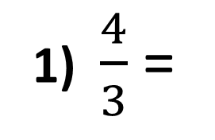
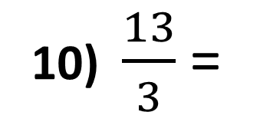
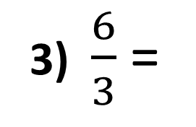
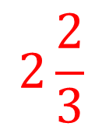
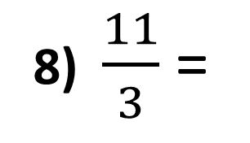
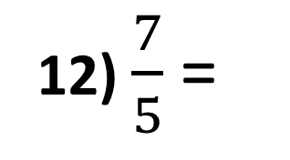
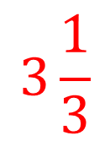
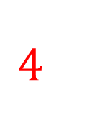
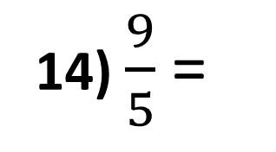
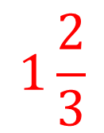
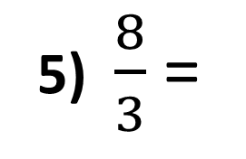
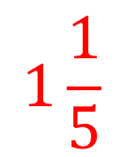
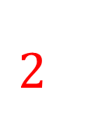
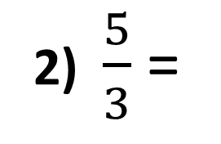
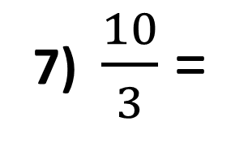
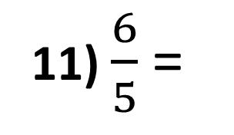










Convert the improper fraction to mixed fraction.
1) $\frac{4}{3}$ =
$$1\frac{1}{3}$$
6) $\frac{9}{3}$ =
$$3\frac{2}{3}$$
11) $\frac{6}{5}$ =
$$1\frac{1}{5}$$
2) $\frac{5}{3}$ =
$$1\frac{2}{3}$$
7) $\frac{10}{3}$ =
$$3\frac{1}{3}$$
12) $\frac{7}{5}$ =
$$1\frac{2}{5}$$
3) $\frac{6}{3}$ =
$$2\frac{2}{3}$$
8) $\frac{11}{3}$ =
$$3\frac{2}{3}$$
13) $\frac{8}{5}$ =
$$1\frac{3}{5}$$
4) $\frac{7}{3}$ =
$$2\frac{1}{3}$$
9) $\frac{12}{3}$ =
$$4\frac{2}{3}$$
14) $\frac{9}{5}$ =
$$1\frac{4}{5}$$
5) $\frac{8}{3}$ =
$$2\frac{2}{3}$$
10) $\frac{13}{3}$ =
$$4\frac{1}{3}$$
15) $\frac{10}{5}$ =
$$2\frac{1}{5}$$

Slide 5















Convert the mixed fractions to improper fractions.
$$\frac{7}{3}$$
$$\frac{1}{7}$$
11) $2\frac{1}{5}$ =
$$\frac{11}{5}$$
1) $2\frac{1}{3}$ =
6) $2\frac{1}{7}$ =
$$\frac{11}{3}$$
$$\frac{24}{7}$$
$$\frac{17}{5}$$
2) $3\frac{2}{3}$ =
7) $3\frac{3}{7}$ =
12) $3\frac{2}{5}$ =
3) $1\frac{2}{3}$ =
$$\frac{5}{3}$$
8) $1\frac{5}{7}$ =
$$\frac{12}{7}$$
$$\frac{8}{5}$$
13) $1\frac{3}{5}$ =
4) $2\frac{3}{4}$ =
$$\frac{11}{4}$$
9) $5\frac{3}{7}$ =
$$\frac{38}{7}$$
$$\frac{25}{5}$$
14) $4\frac{5}{5}$ =
5) $3\frac{1}{4}$ =
$$\frac{13}{4}$$
10) $2\frac{4}{9}$ =
$$\frac{22}{9}$$
15) $3\frac{5}{5}$ =
$$\frac{18}{5}$$

