Slide 1
LO: Solving Equations
(Unknown on Both Sides)

Slide 2
Write an equation
that has unknowns
on both sides?

Slide 3
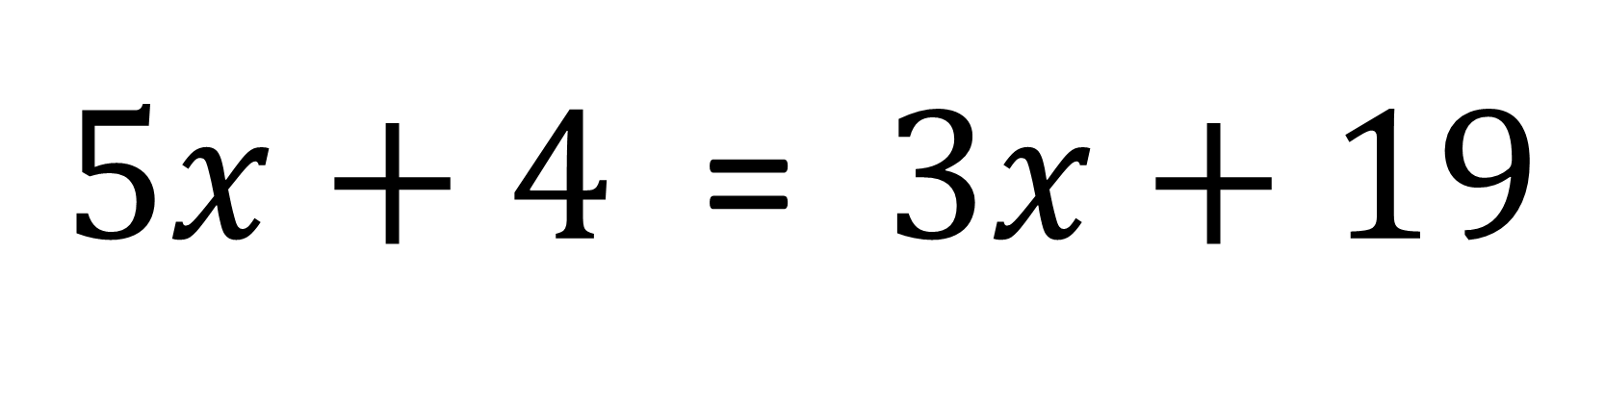
Unknown on Both Sides
or Not
$5x+4$ = $3x+19$
Both Sides

Slide 4
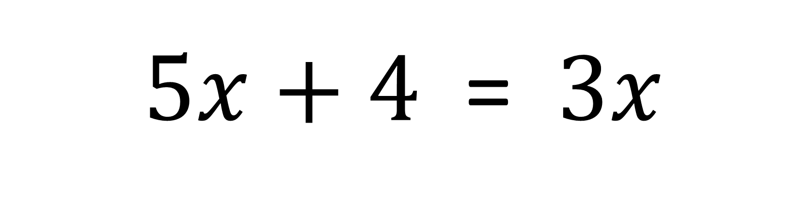
Unknown on Both Sides
or Not
$5x+4$ = $3x$
Both Sides

Slide 5
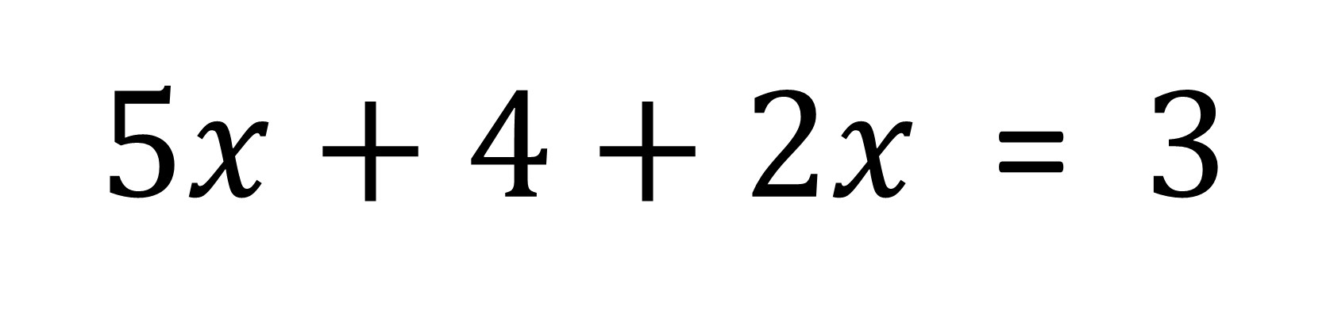
Unknown on Both Sides
or Not
$5x+4+2x$ = $3$
Not

Slide 6
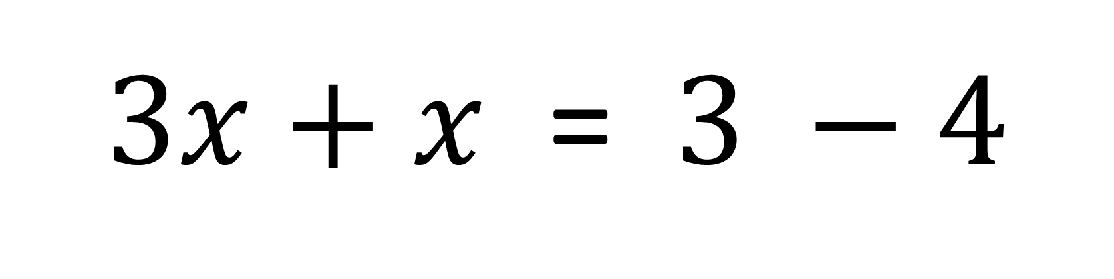
Unknown on Both Sides
or Not
$3x+x$ = $3 −4$
Not

Slide 7
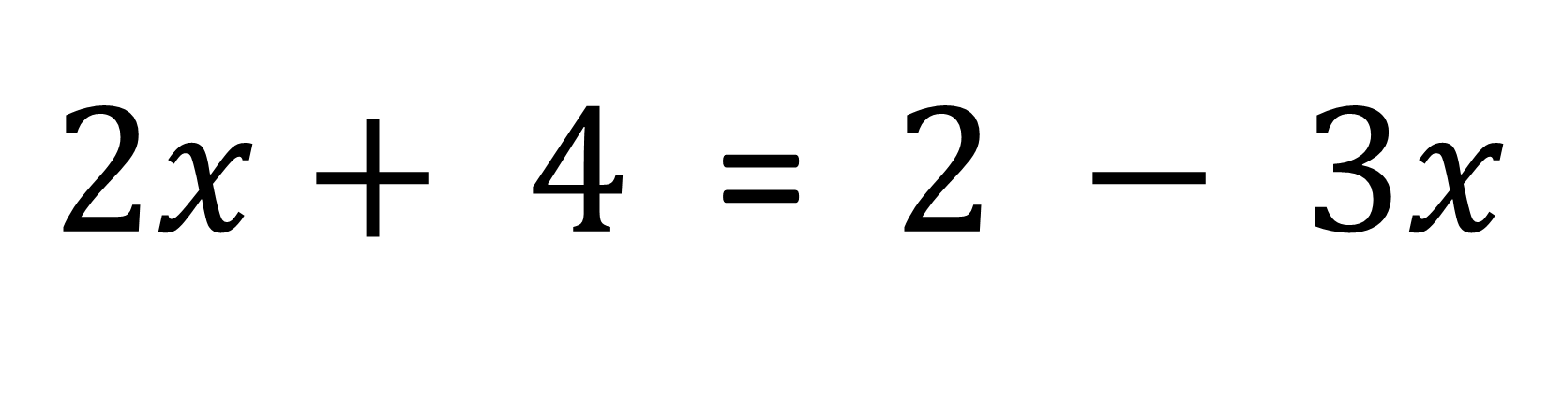
Unknown on Both Sides
or Not
$2x+ 4$ = $2 − 3x$
Both Sides

Slide 8
Balancing Method
3x + 1 = 2x + 4
1
3x + 1 = 2x + 4
x
1
1
x
x
x
x
1
1
1x + 1 = 2x + 3

Slide 9
3x + 2 = x + 5
2x + 2 = x + 5
1
x
1
1
1
x
x
x
2x + 2 = x + 3
1
1
1
2x + 2 = 1.5

Slide 10
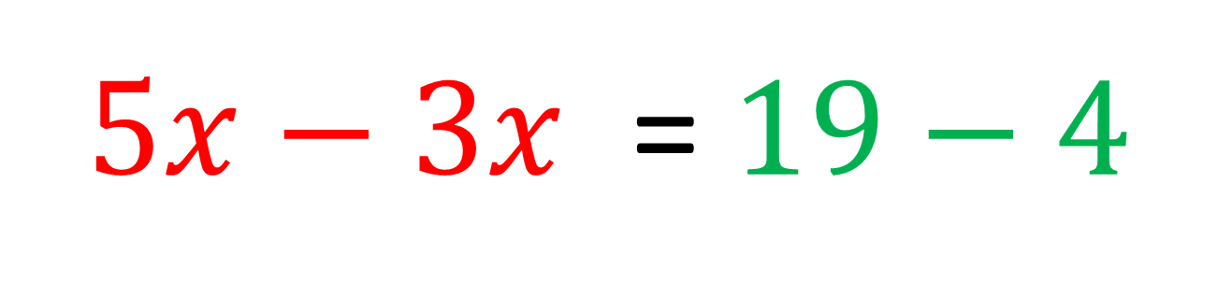
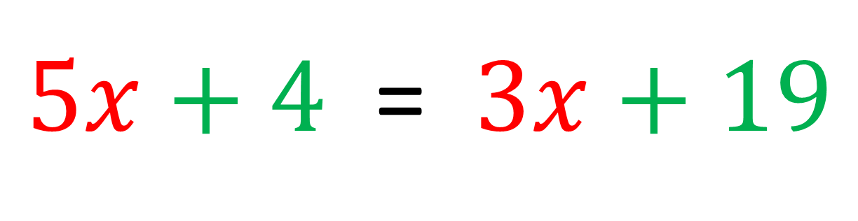
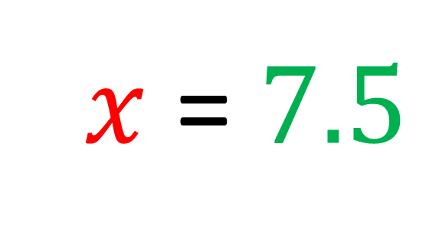
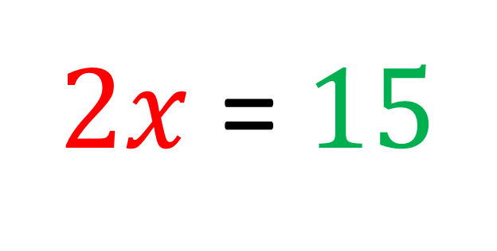
Opposites Method
$5x+4$ = $3x+19$
$5x−3x$ = $19−4$
$2x$ = $15$
$2x$ = $7.5$

Slide 11
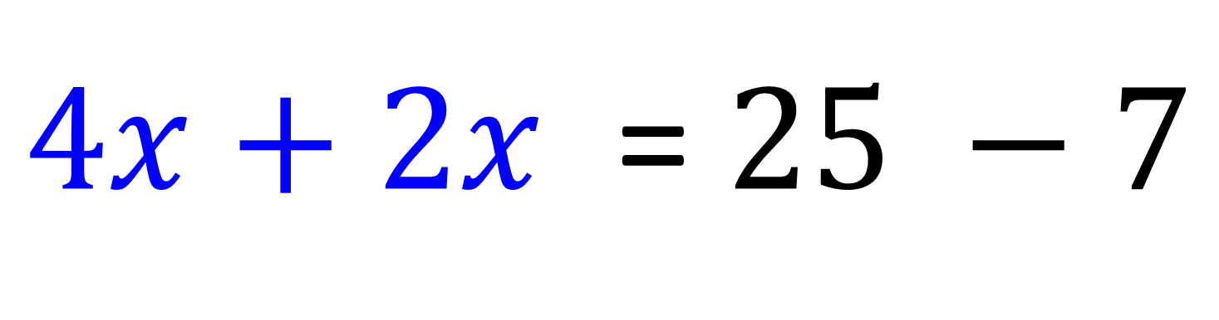
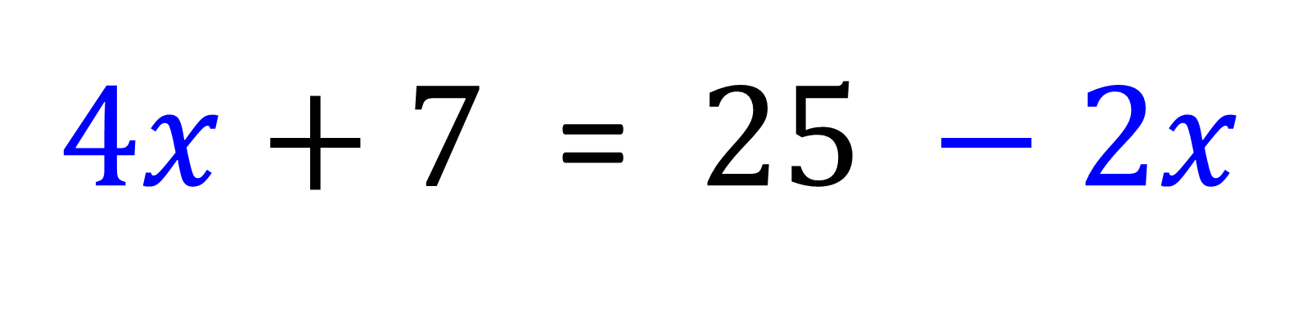
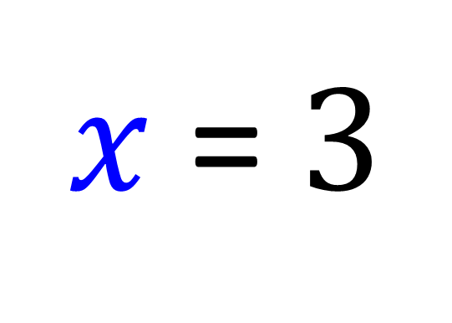
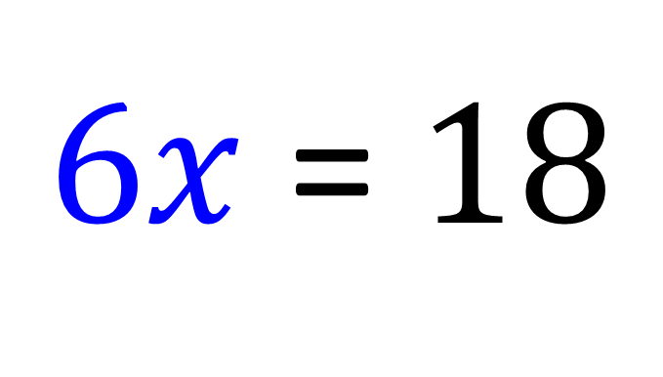
$4x+7$ = $25 −2x$
$4x+2x$ = $25 −7$
$6x$ = $18$
$x$ = $3$

Slide 12
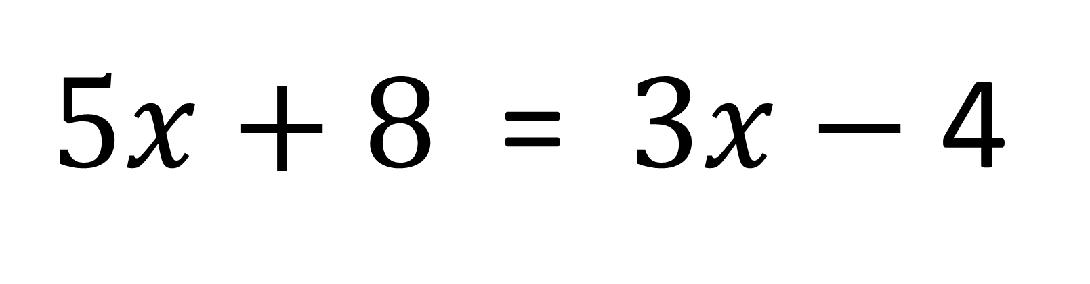
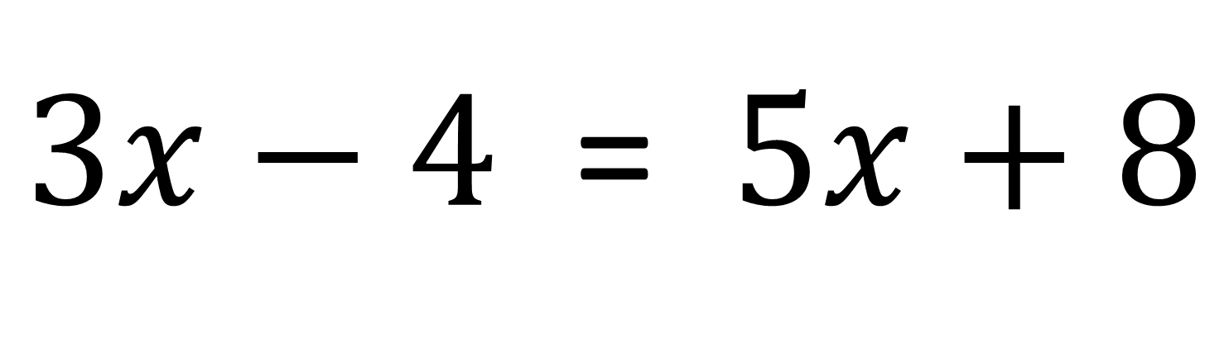
Which question would you prefer
to answer and why?
$3x−4$ = $5x+8$
$5x+8$ = $3x−$4

Slide 13
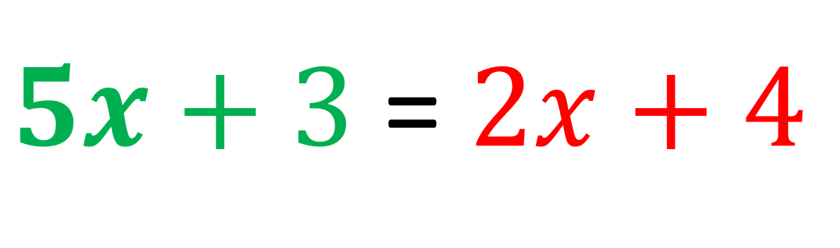
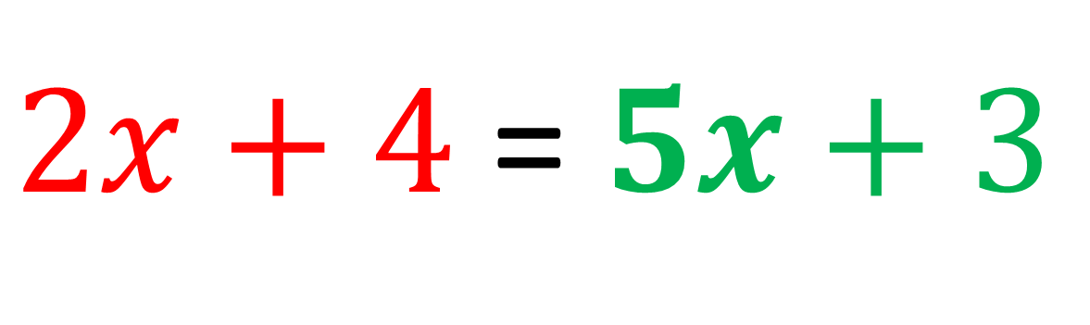
Rewrite the equation with the greatest value of x on the LHS.
$2x+4$ = $5x+3$
$5x+3$ = $2x+4$

Slide 14
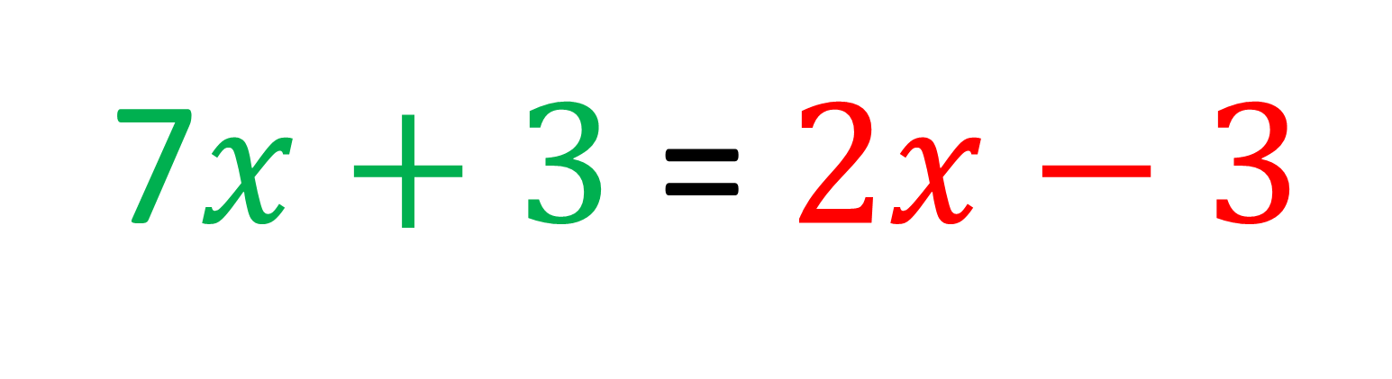
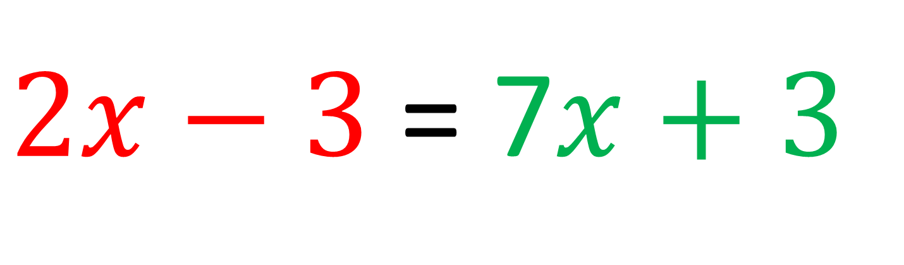
Rewrite the equation with the greatest value of x on the LHS.
$2x−3$ = 7$x+3$
7$x+3$ = $2x−3$

Slide 15
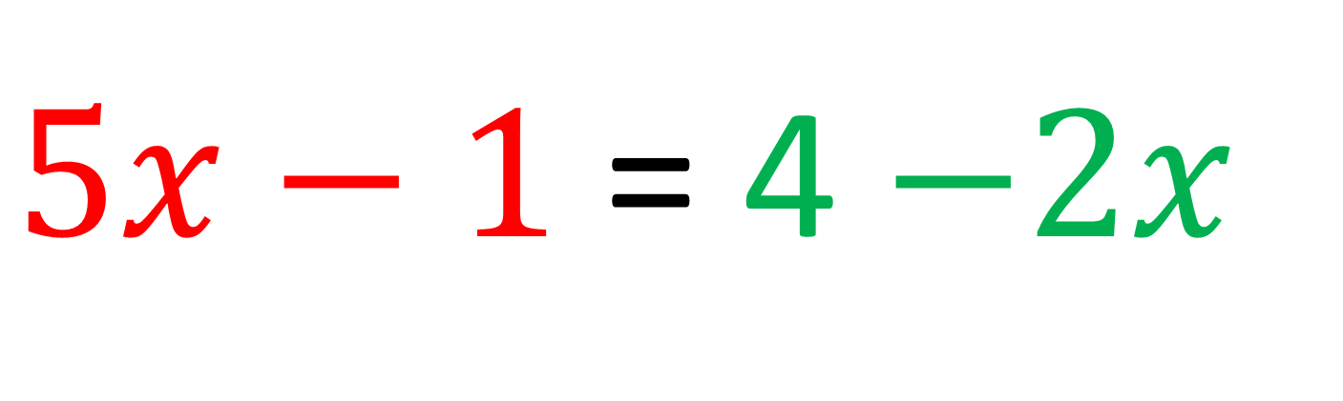
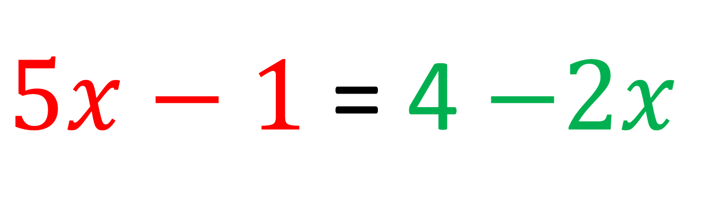
Rewrite the equation with the greatest value of x on the LHS.
$5x−1$ = 4 $−2x$
$5x−1$ = 4 $−2x$

Slide 16
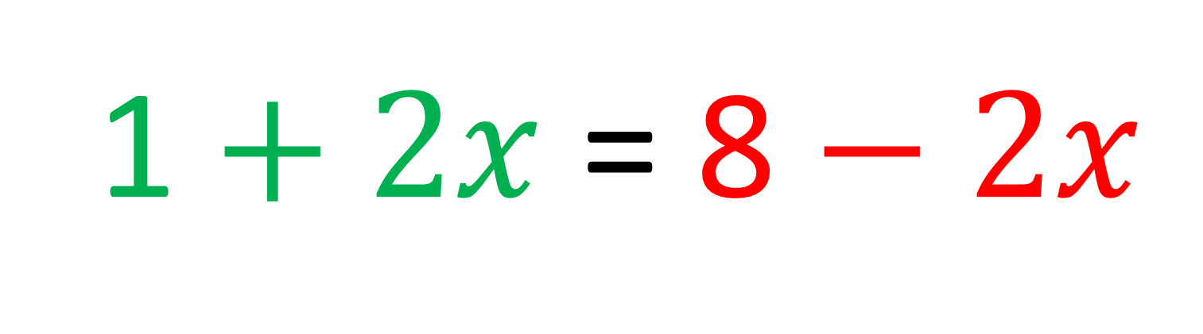
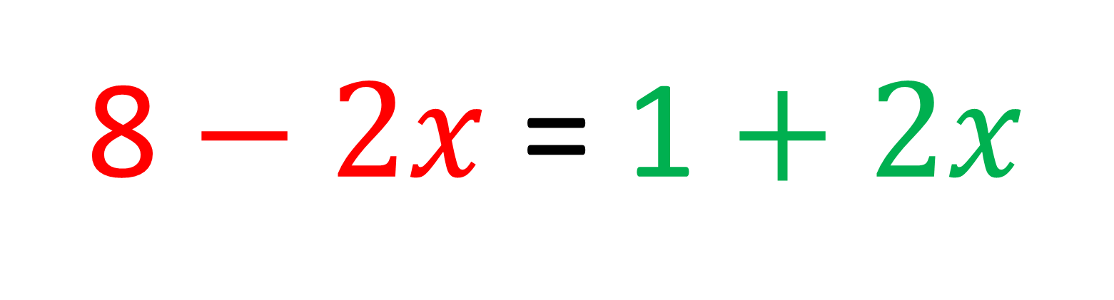
Rewrite the equation with the greatest value of x on the LHS.
8 $− 2x$ = 1 $+ 2x$
1 $+ 2x$ = 8 $− 2x$

Slide 17
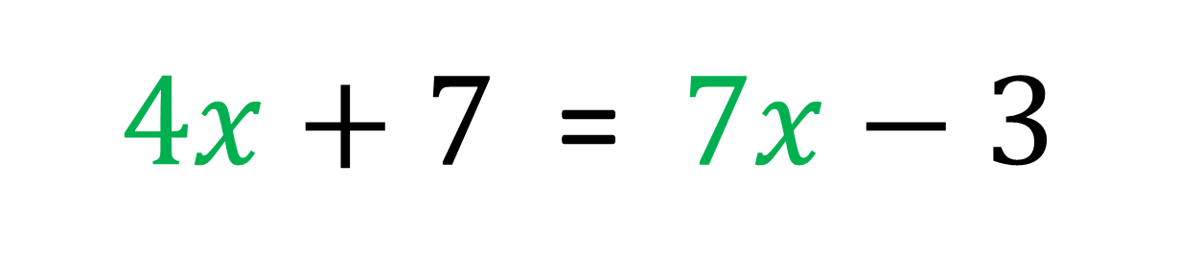
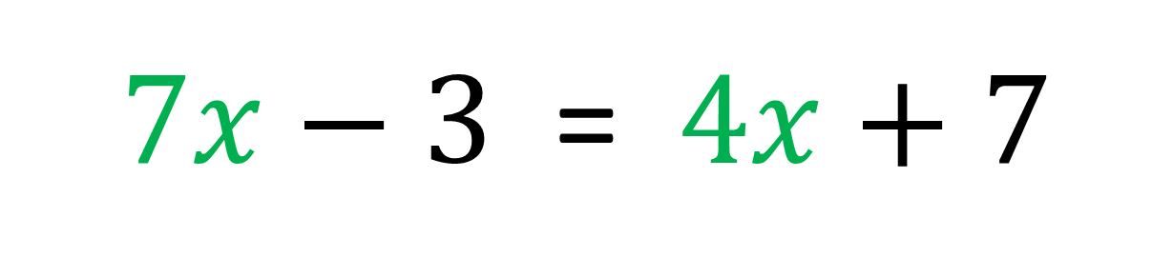
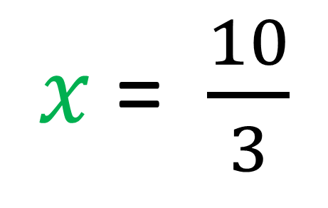
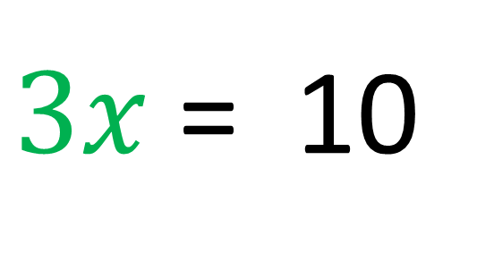
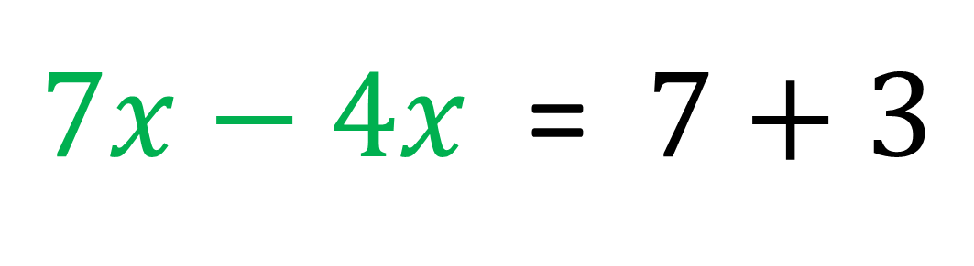
$4x+7$ = $7x−3$
$7x−3$ = $4x+7$
$7x−4x$ = $7+3$
$3x$= 10
$x$ = $\frac{10}{3}$

Slide 18
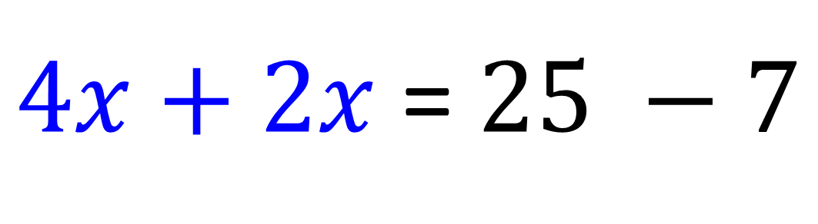
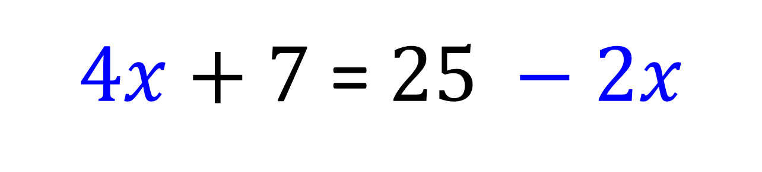
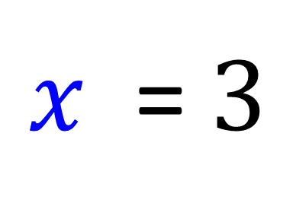
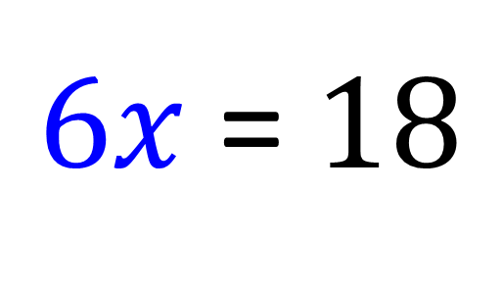
$4x+7$ = $25 −2x$
$4x+2x$ = $25 −7$
$6x$ = $18$
$x$ = $3$

Slide 19
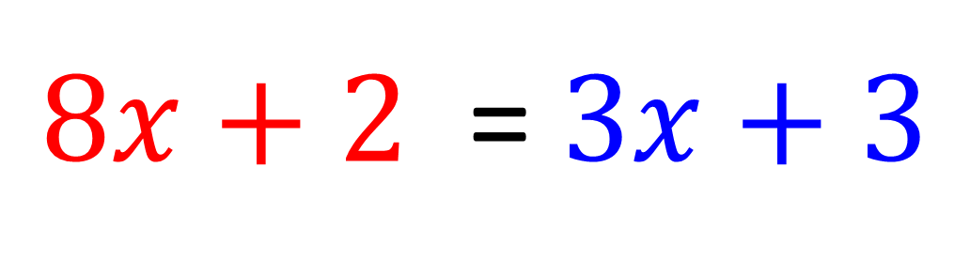
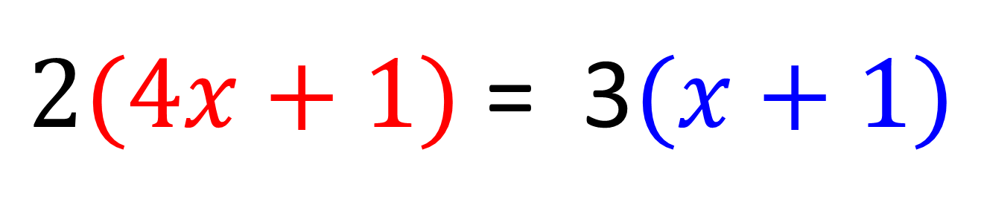
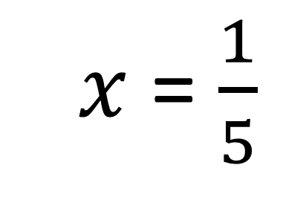
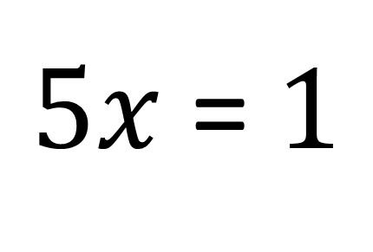
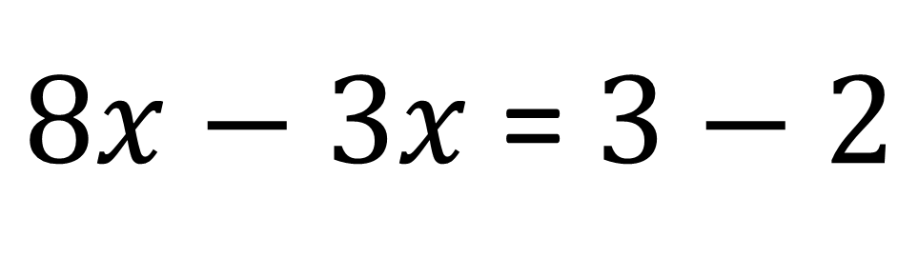
$2(4x+1)$ = 3$(x+1)$
$8x+2$ = $3x+3$
$8x−3x$ = $3−2$
$5x$ = $1$
$5x$ = $\frac{1}{5}$

Slide 20

3(x + 5)
5x – 3
What is the length of the field?

Slide 21
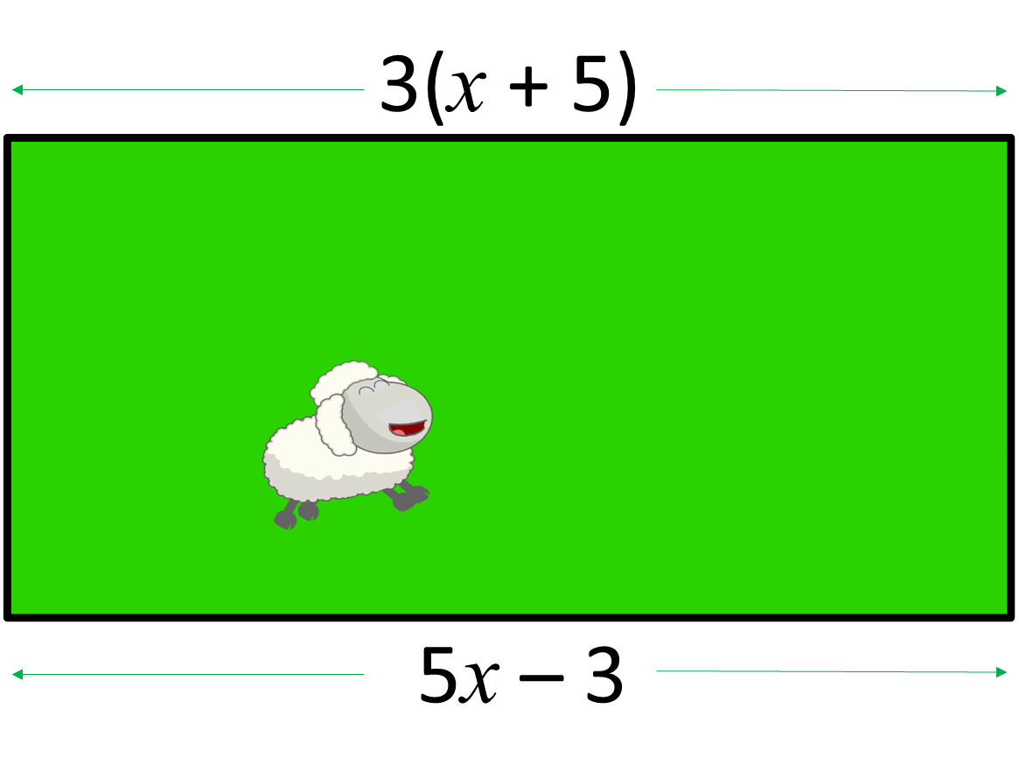
3(x + 5) = 5x – 3
3x + 15 = 5x – 3
– 2x = –18
x = 9
5x – 3 = 5(9) – 3 = 45 – 3 = 42

