Slide 1
FM: Points of Intersection

Slide 2







How can you find the co-ordinate P?
$$y$$
The co-ordinate is at the point of intersection of the two lines.
Therefore, you can solve the equations simultaneously
$$y=3x$$
$$P$$
$$x+2y=4$$
$$x$$
$$O$$
$$Q$$

Slide 3

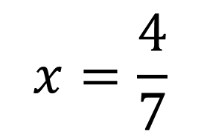


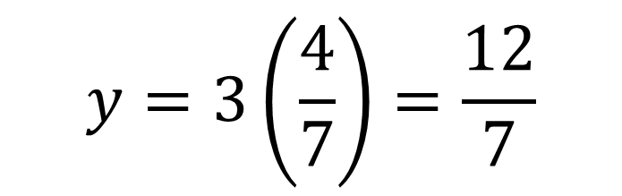




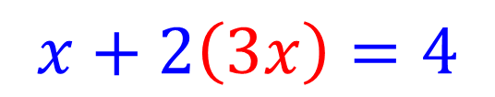

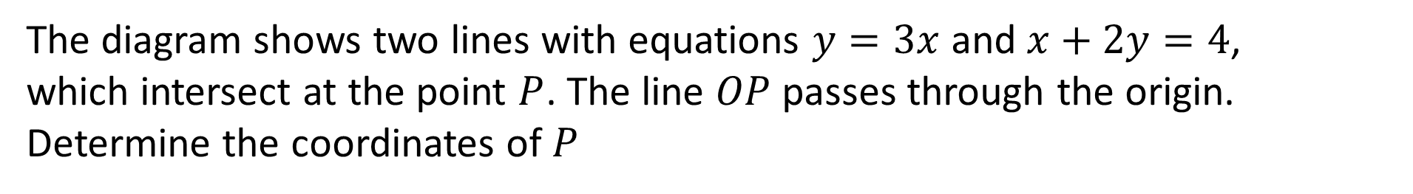
The diagram shows two lines with equations $y=3x$ and $x+2y=4$,
which intersect at the point $P$. The line $OP$ passes through the origin.
Determine the coordinates of $P$
$$x+2\left(3x\right)=4$$
$$y$$
$$y=3x$$
$$7x=4$$
$$P$$
$$x=\frac{4}{7}$$
$$x+2y=4$$
$$y=3\left(\frac{4}{7}\right)=\frac{12}{7}$$
$$x$$
$$O$$
$$Q$$

Slide 4


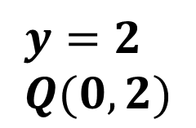


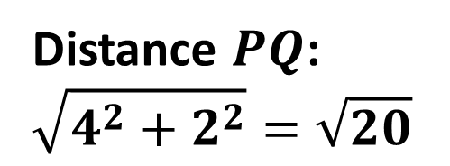




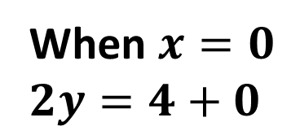
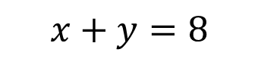


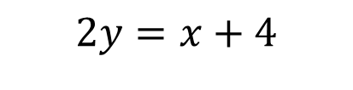


Determine the length of $PQ$.
$$x=8−y$$
$$2y=8−y+4$$
$$y$$
$$3y=12$$
$$2y=x+4$$
$$y=4$$
$$P(4,4)$$
$$x=4$$
When $x=0$
$2y=4+0$
$$P$$
$$y=2 \\ Q(0,2)$$
$$Q$$
$$x+y=8$$
Distance $PQ$:
$$\sqrt{4^{2}+2^{2}}=\sqrt{20}$$
$$x$$
$$O$$

Slide 5


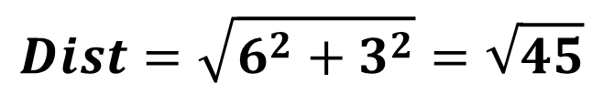


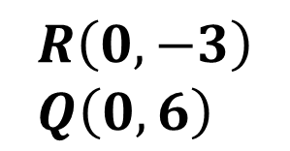
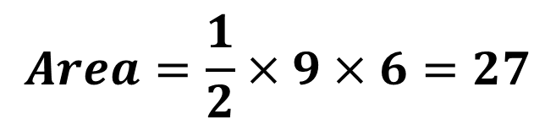

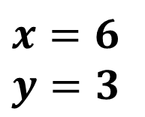



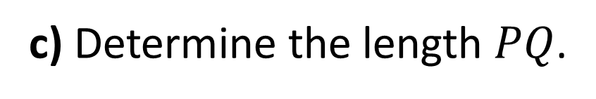
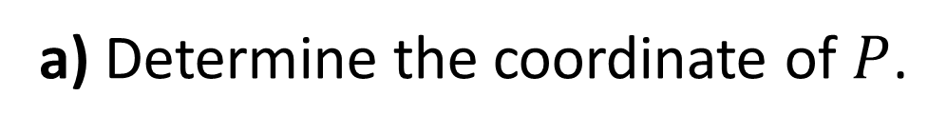


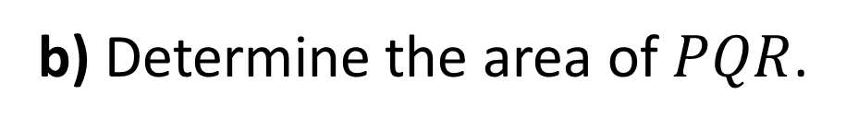
a) Determine the coordinate of $P$.
$$y$$
$$2\left(x−3\right)+x=12$$
$$2y+x=12$$
$$y=x−3$$
$$x=6$$
$$y=3$$
$$Q$$
b) Determine the area of $PQR$.
$$P$$
$$R\left(0,−3\right) \\ Q\left(0,6\right)$$
$$Area=\frac{1}{2}×9×6=27$$
$$O$$
$$x$$
c) Determine the length $PQ$.
$$P\left(6,3\right), Q\left(0,6\right)$$
$$R$$
$$Dist=\sqrt{6^{2}+3^{2}}=\sqrt{45}$$

Slide 6
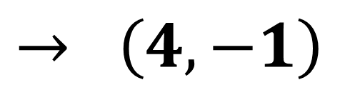
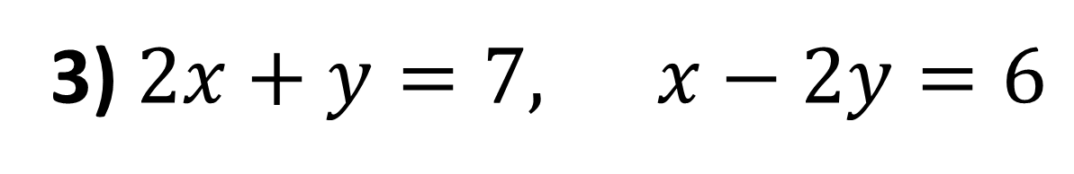
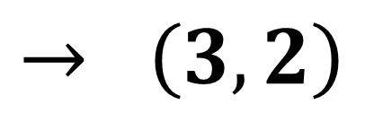
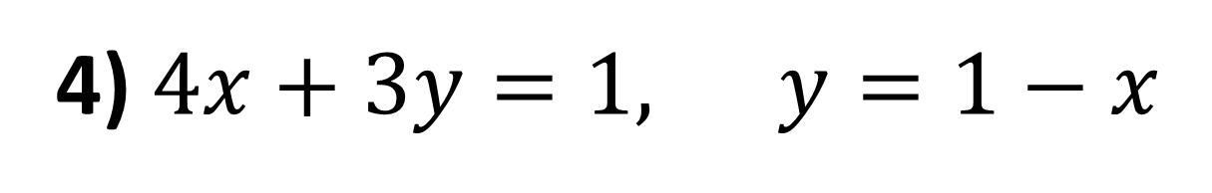
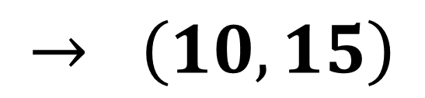
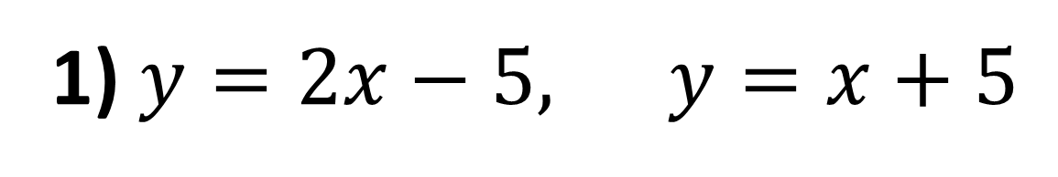
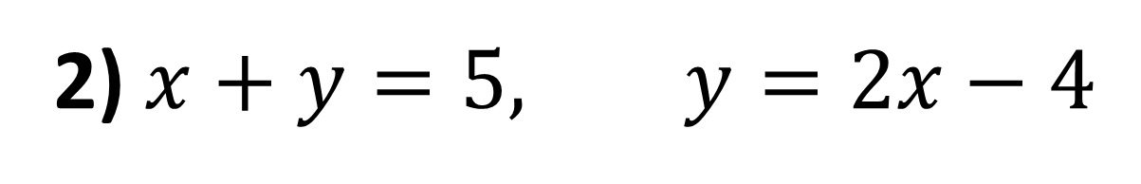
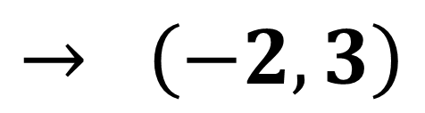
Find the coordinate of the point of intersection between these lines:
1) $y=2x−5,$ $y=x+5$
$$→ \left(10,15\right)$$
2) $x+y=5,$ $y=2x−4$
$$→ \left(3,2\right)$$
3) $2x+y=7,$ $x−2y=6$
$$→ \left(4,−1\right)$$
4) $4x+3y=1,$ $y=1−x$
$$→ \left(−2,3\right)$$

Slide 7
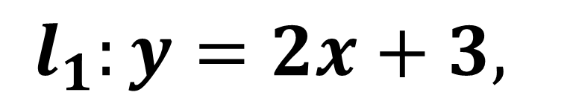
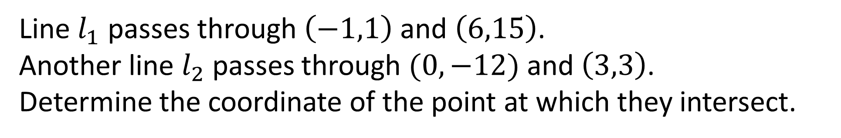
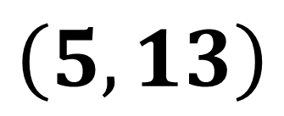
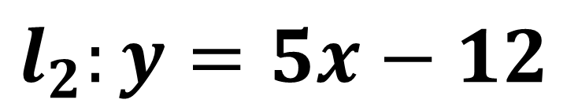
(On provided sheet)
Line $l_{1}$ passes through $\left(−1,1\right)$ and $\left(6,15\right)$.
Another line $l_{2}$ passes through $(0,−12)$ and $\left(3,3\right)$.
Determine the coordinate of the point at which they intersect.
$$l_{1}:y=2x+3,$$
$$l_{2}:y=5x−12$$
$$\left(5,13\right)$$

Slide 8
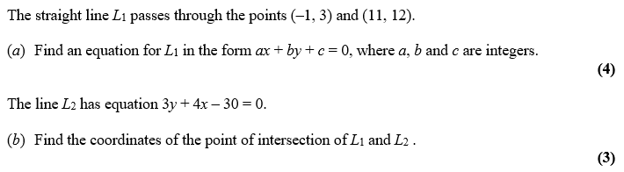
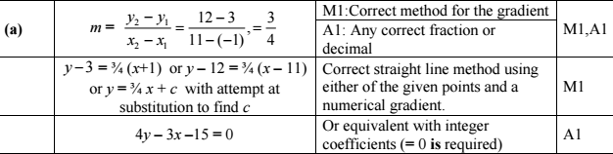

Slide 9
