Slide 1
Normal Distribution
Approximating
Binomial Distribution
Chapter 3
(Part 6 of 7)

Slide 2
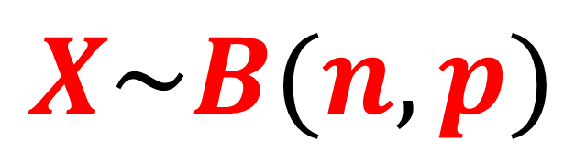
Binomial Distribution
(Discrete Random Variable)
$$X\sim B(n,p)$$
Probability
x
27
28
29
30
31
32
33

Slide 3
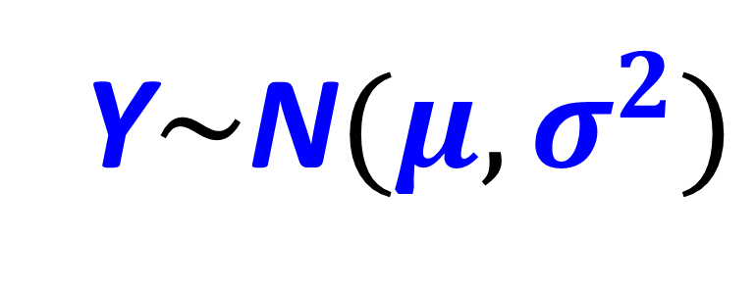
Normal Distribution
(Continuous Random Variable)
Y$\sim$N$(μ, σ^{2})$
Probability
Y
27
28
29
30
31
32
33

Slide 4
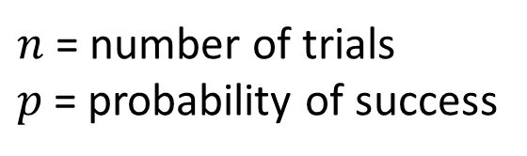
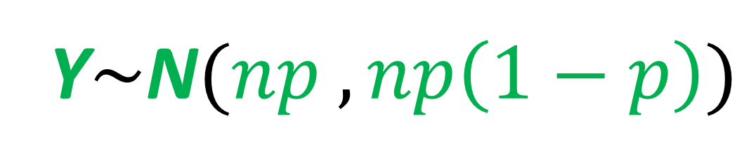
Approximated Normal Distribution
(Continuous Random Variable)
Y$\sim$N$(np ,np\left(1−p\right))$
$n$ = number of trials
$p$ = probability of success
Probability
27
28
29
30
31
32
33
Outcomes

Slide 5
Approximating a Binomial Distribution
Watch the first 4 min and 35 secs
to get an appreciation of using
a normal distribution to
approximate a binomial distribution.
https://youtu.be/z2HoOWn914o

Slide 6
If n is large and p is close to 0.5,
then you can approximate probabilities of a binomial distribution from a normal distribution
Probability
27
28
29
30
31
32
33
Outcomes

Slide 7
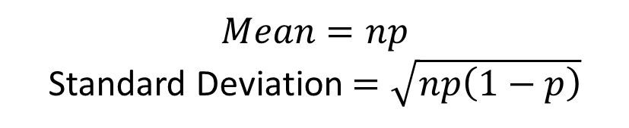
Approximate Normal Distribution
(Continuous Random Variable)
Y$\sim$N$(np ,np\left(1−p\right))$
$$Mean=np$$
Standard Deviation $=\sqrt{np\left(1−p\right)}$
Probability
27
28
29
30
31
32
33
Outcomes

Slide 8

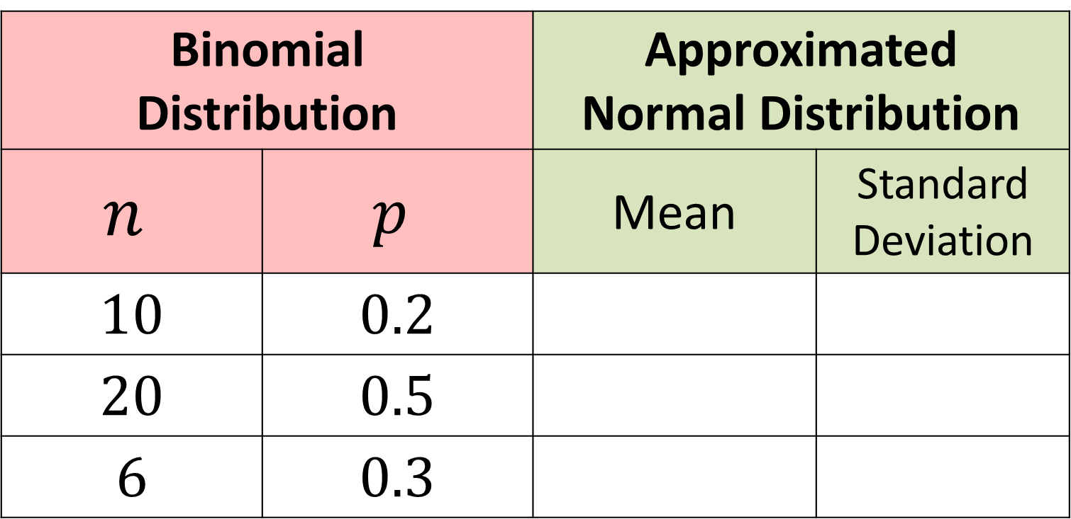

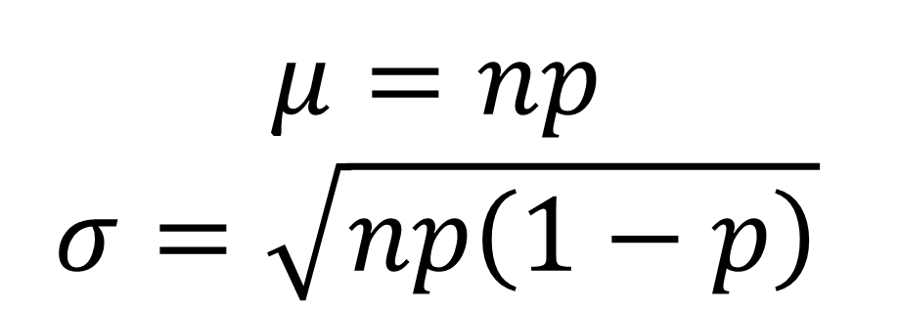




$$μ=np$$
$$σ=\sqrt{np\left(1−p\right)}$$
Binomial Distribution |  | Approximated Normal Distribution
$$n$$ | $$p$$ | Mean | Standard Deviation
$$10$$ | $$0.2$$
$$20$$ | $$0.5$$
$$6$$ | $$0.3$$
$$2$$
$$1.6$$
$$10$$
$$5$$
$$1.8$$
$$1.26$$

Slide 9
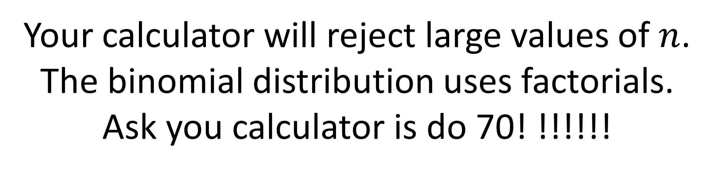
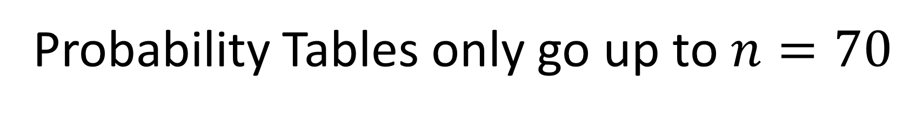
Why use a normal approximation?
Probability Tables only go up to $n=70$
Your calculator will reject large values of $n$.
The binomial distribution uses factorials.
Ask you calculator is do 70! !!!!!!

Slide 10
Continuity Correction
There is one final problem of approximating a binomial distribution from a normal distribution
that you need to be aware of.
How do you use continuous data to describe discrete data?

Slide 11










Probability
27
28
29
30
31
32
33
Outcomes
$$28.5≤X<29.5$$
$$30.5≤X<31.5$$
$$27.5≤X<28.5$$
$$29.5≤X<30.5$$
$$31.5≤X<32.5$$
$$X=28$$
$$X=29$$
$$X=30$$
$$X=31$$
$$X=32$$

Slide 12




Continuity Correction
Discrete:
$$P(X<32)$$
Continuous:
$$P(X<31.5)$$
27 28 29 30 31 32 33
Discrete:
$$P(X≤29)$$
Continuous:
$$P(X<29.5)$$
27 28 29 30 31 32 33

Slide 13




Continuity Correction
Discrete:
$$P(X>28)$$
Continuous:
$$P(X≥28.5)$$
27 28 29 30 31 32 33
Discrete:
$$P(X≥31)$$
Continuous:
$$P(X≥30.5)$$
27 28 29 30 31 32 33

Slide 14
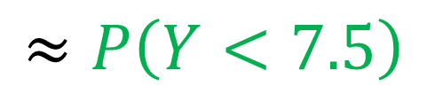
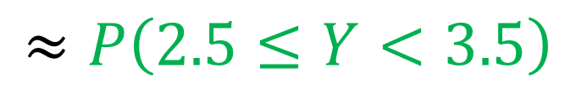
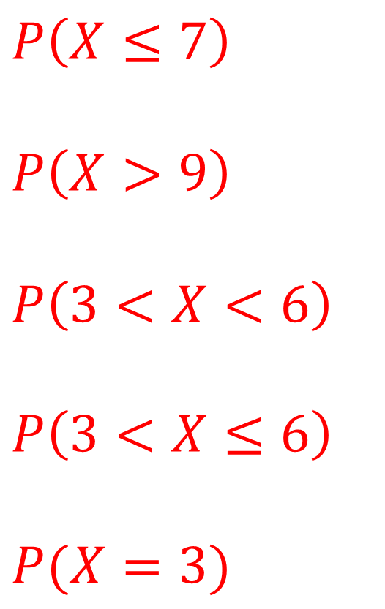
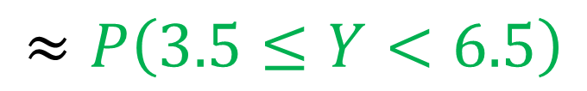
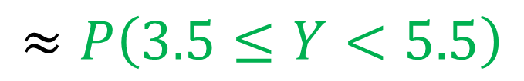
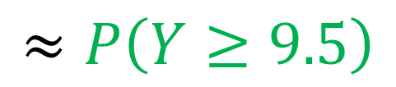
Discrete
Continuous
$$P\left(X≤7\right) \\ P\left(X<10\right) \\ P\left(X>9\right) \\ P\left(1≤X≤10\right) \\ P\left(3<X<6\right) \\ P\left(3≤X<6\right)$$
$$P\left(3<X≤6\right)$$
$$P(X=3)$$
$$≈P\left(Y<7.5\right)$$
$$≈P\left(Y≥9.5\right)$$
$$≈P\left(3.5≤Y<5.5\right)$$
$$≈P\left(3.5≤Y<6.5\right)$$
$$≈P\left(2.5≤Y<3.5\right)$$

Slide 15
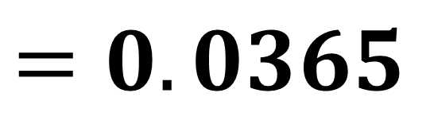
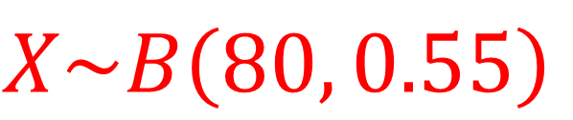
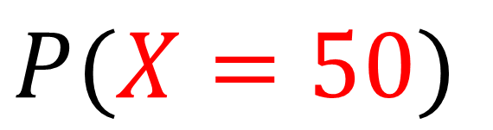
For a particular type of flower bulbs, 55% will produce yellow flowers. A random sample of 80 bulbs is planted.
a) Calculate the actual probability that there are exactly 50 flowers.
b) Use a normal approximation to find a estimate that there are exactly 50 flowers.
$$X\sim B\left(80, 0.55\right)$$
$P(X=50)$
a
Binomial PD
X = 50
N = 80
P = 0.55
$$=0.0365$$

Slide 16

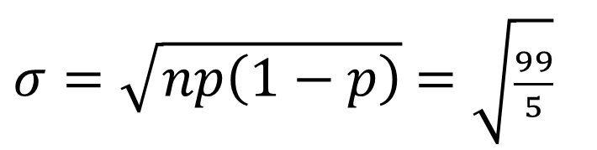
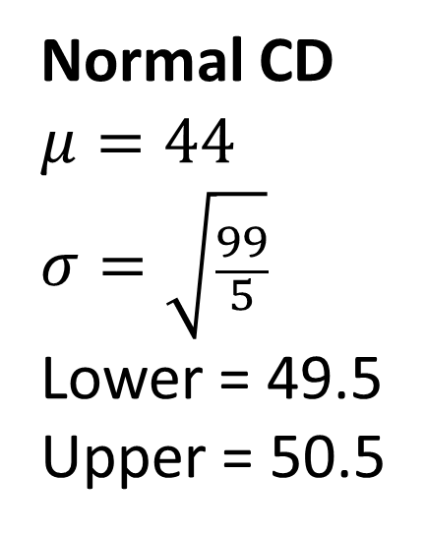
For a particular type of flower bulbs, 55% will produce yellow flowers. A random sample of 80 bulbs is planted.
b) Use a normal approximation to find a estimate that there are exactly 50 flowers.
Normal CD
$$μ=44$$
$$σ=\sqrt{\frac{99}{5}}$$
Lower = 49.5
Upper = 50.5
b
$$P\left(X=50\right)≈P\left(49.5≤Y<50.5\right)$$
$$μ=np=80(0.55)=44$$
$σ=\sqrt{np\left(1−p\right)}$ $=\sqrt{\frac{99}{5}}$
$$P\left(49.5≤Y<50.5\right)=0.0362 (3sf)$$

