Slide 1

Start at any card and the following the trail until you get back to the start.
Don’t forget to record your route.

Slide 2
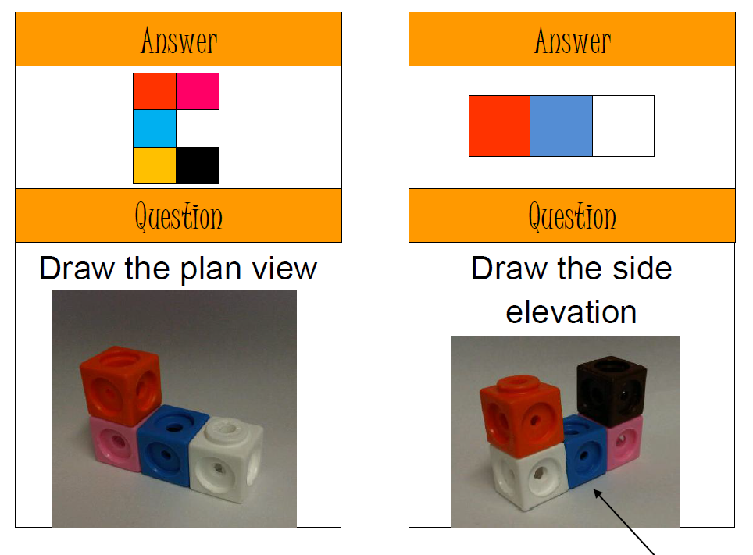
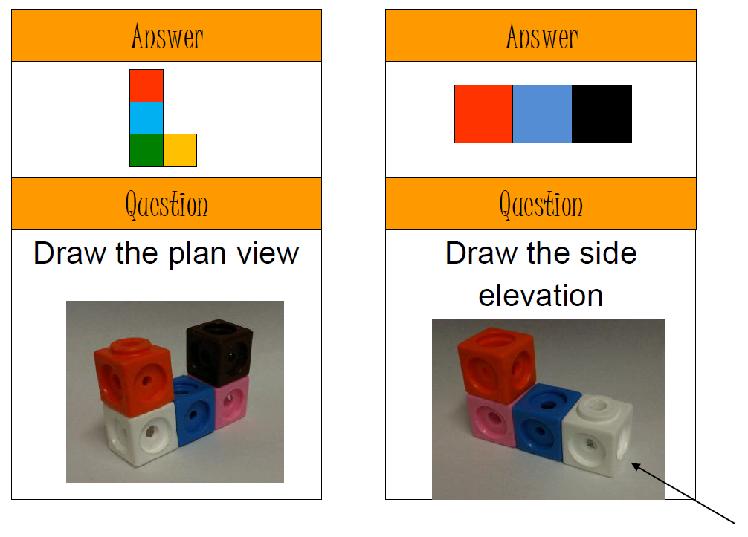
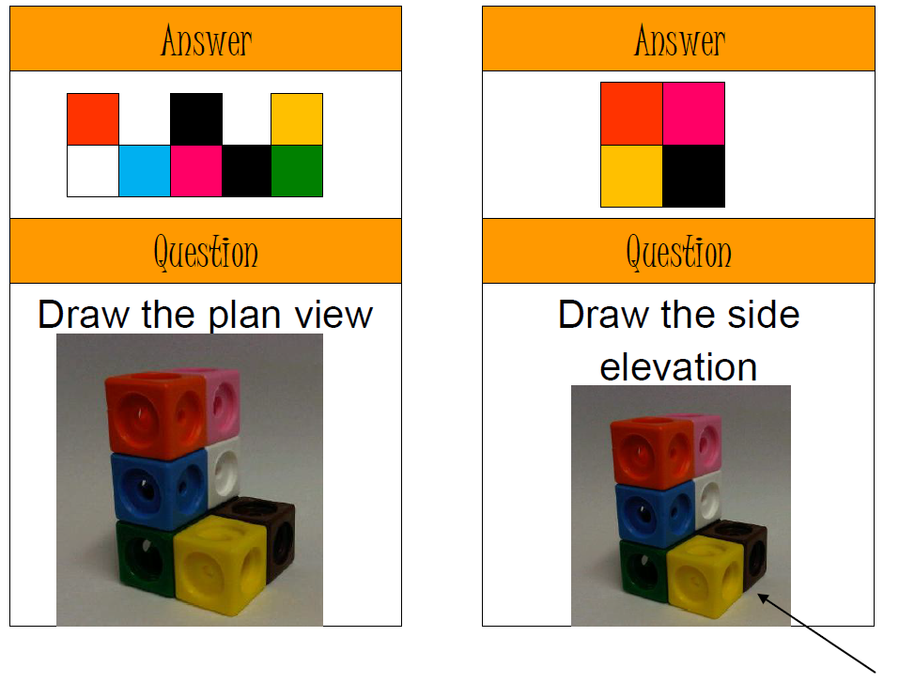
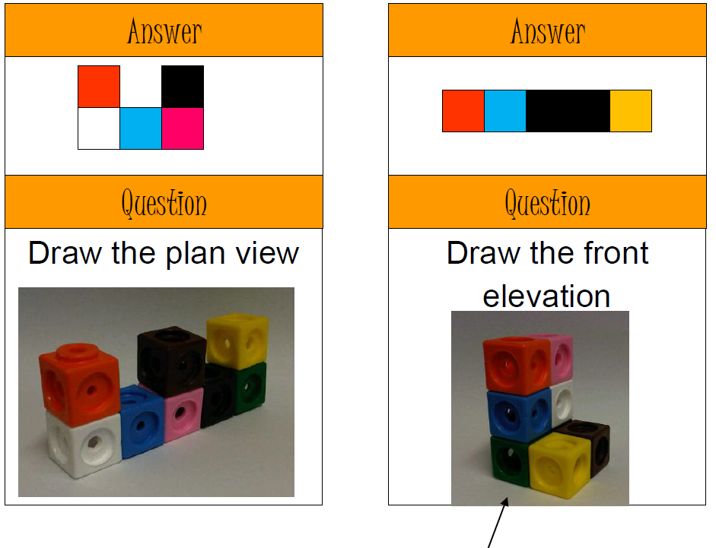
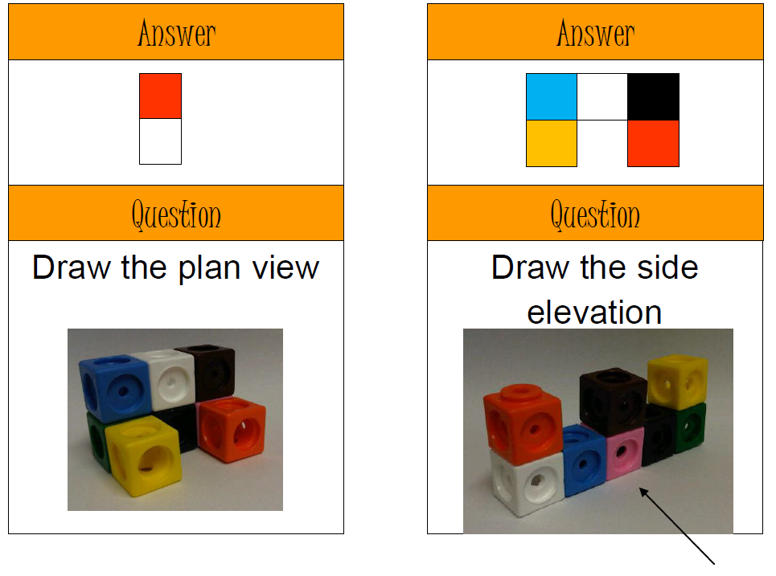
Card 1
Card 4
Card 7
Card 3
Card 5
Card 8
Card 10
Card 6
Card 2
Card 9

Slide 3
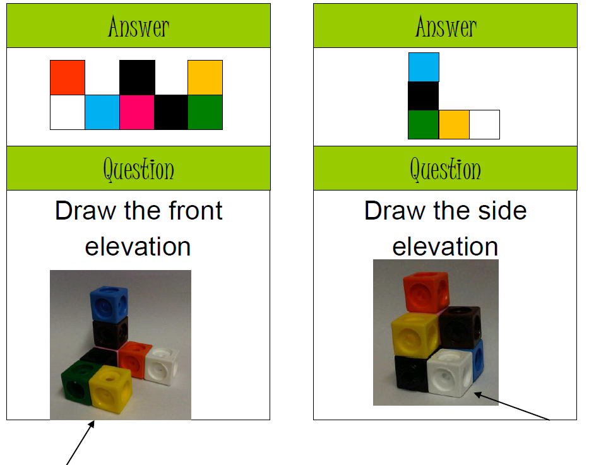
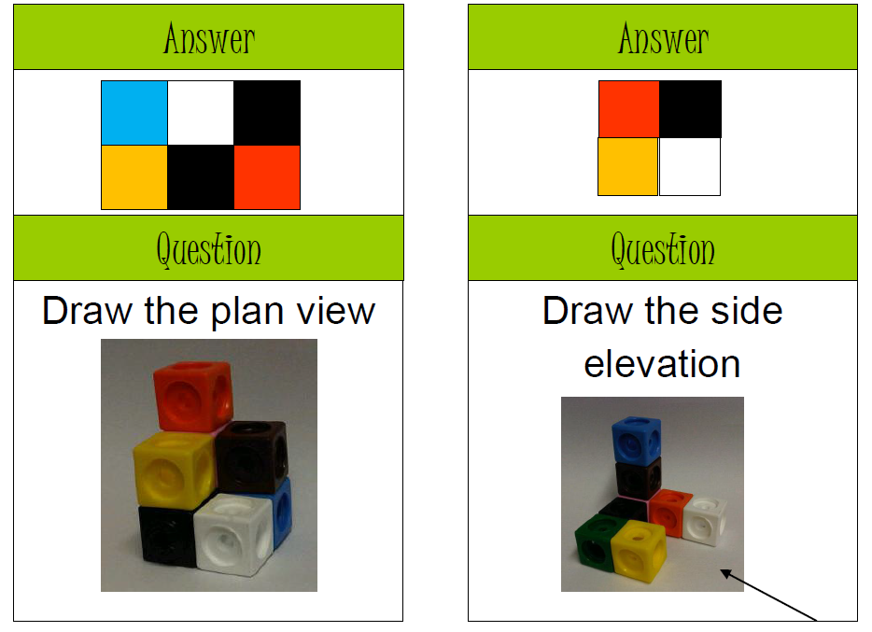
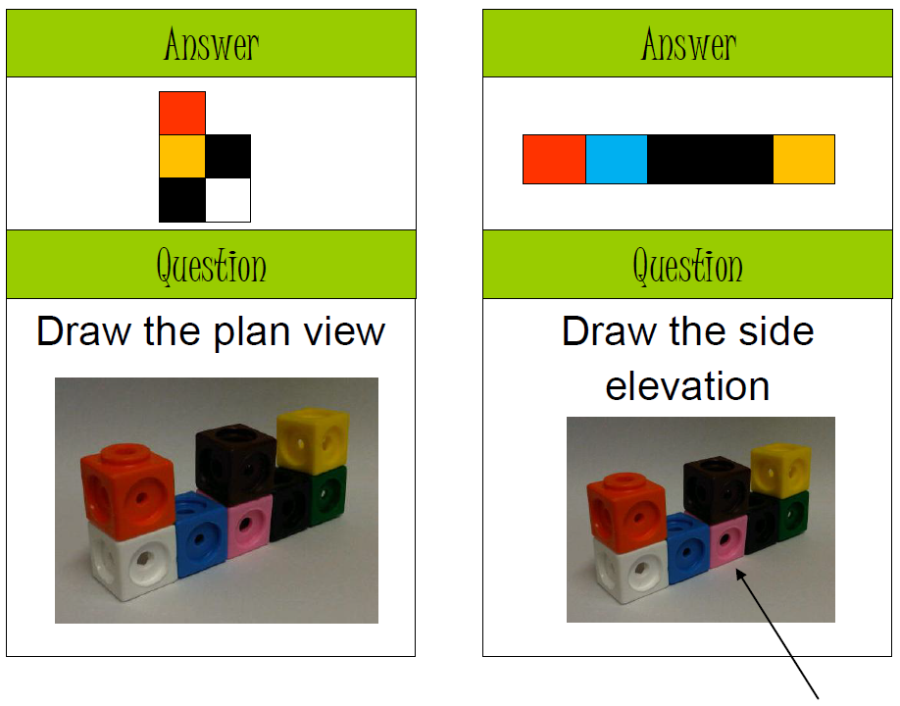
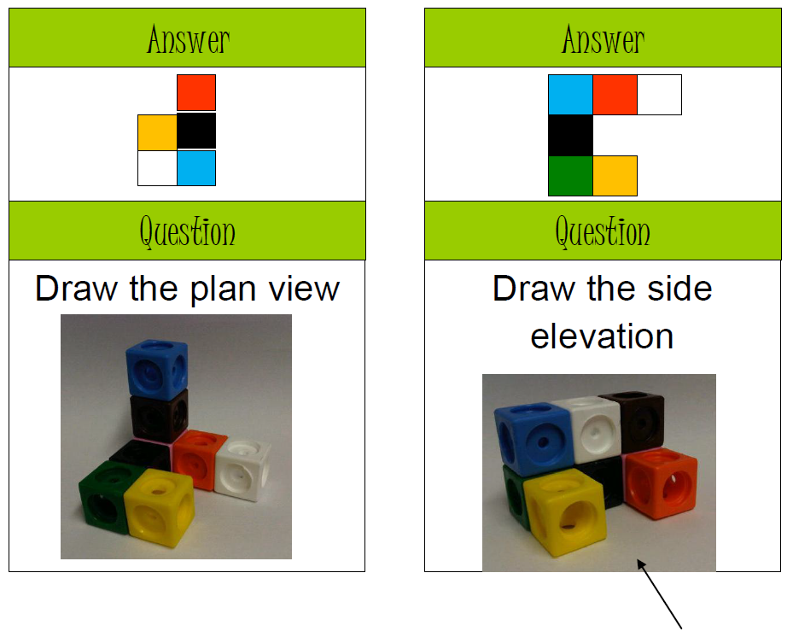
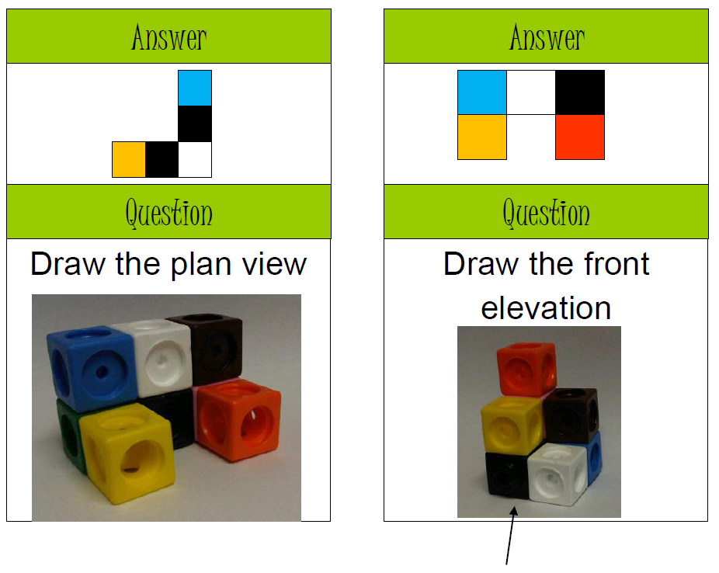
Card 4
Card 10
Card 3
Card 2
Card 1
Card 8
Card 7
Card 9
Card 5
Card 6

Slide 4
ANSWERS

Slide 5
Card 1
Card 4
Card 7
Card 3
Card 5
Card 8
Card 10
Card 6
Card 2
Card 9
1
4
10
6
8
7
5
9
2
3

Slide 6
Card 4
Card 10
Card 3
Card 2
Card 1
Card 8
Card 7
Card 9
Card 5
Card 6
1
8
4
10
3
7
5
2
3
9

