Slide 1
Quadratics
Solving Quadratics
Chapter 2
(Part 1 of 4)

Slide 2
What makes a quadratic
a quadratic?
A quadratic equations has a power of 2 and nothing higher.

Slide 3
There are three ways of
solving a quadratic equation.
- Factorising
- Quadratic Formula
- Completing the square

Slide 4
Solving Quadratic Equations
What should a quadratic equation
be equal to so that it is in
the easiest form to solve?
ZERO

Slide 5
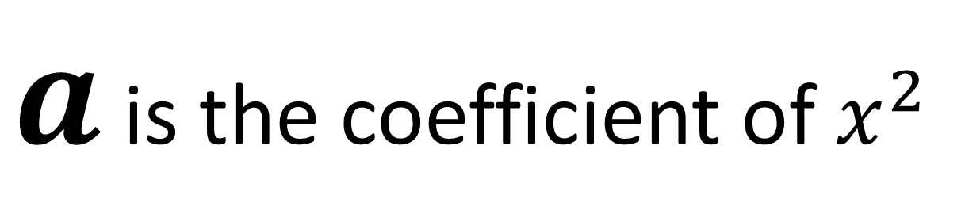


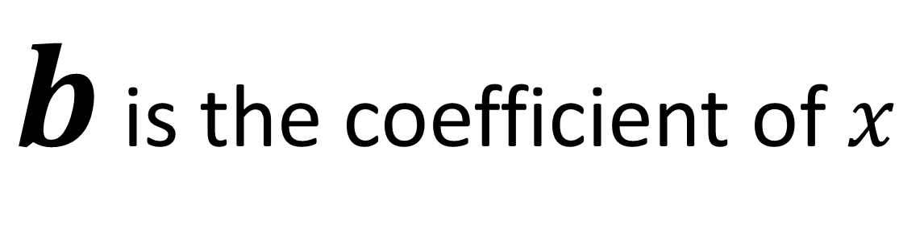
$ax^{2}+bx+c=0$
$a$ is the coefficient of $x^{2}$
$b$ is the coefficient of $x$
$c$ is the constant

Slide 6
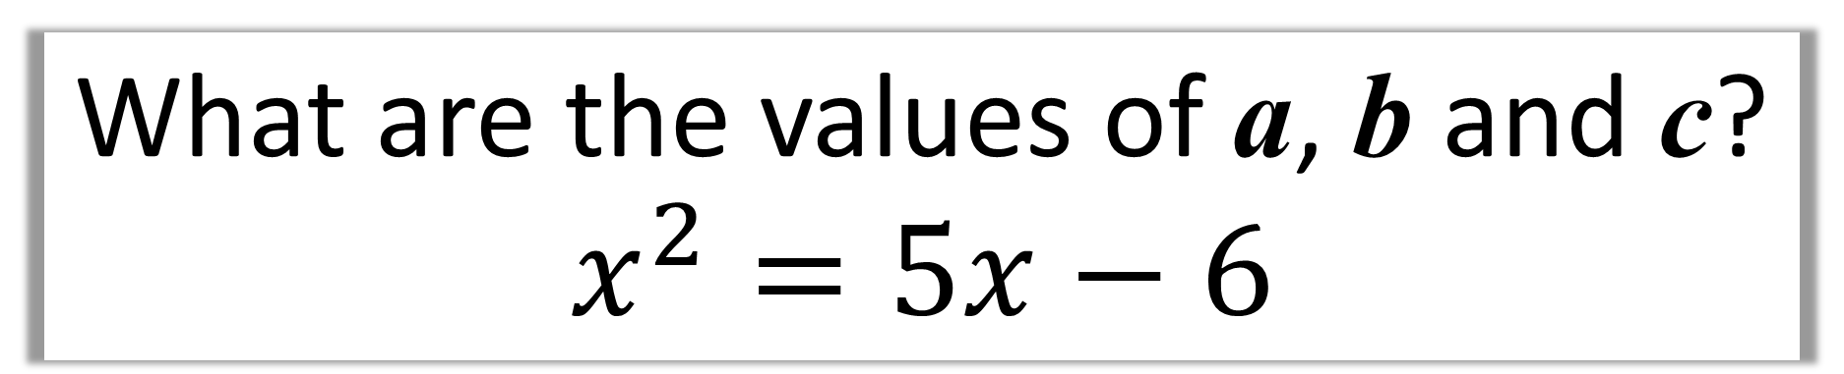
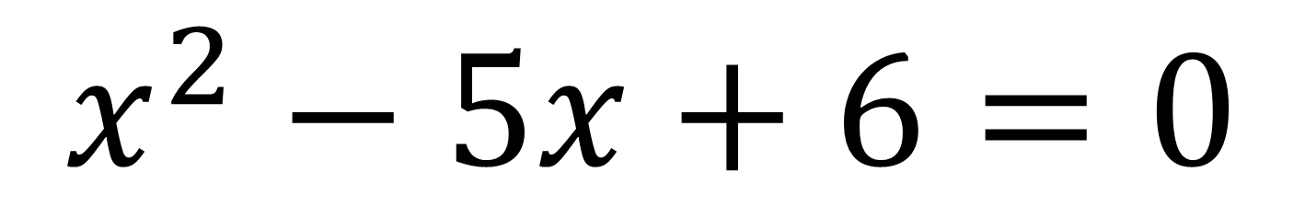
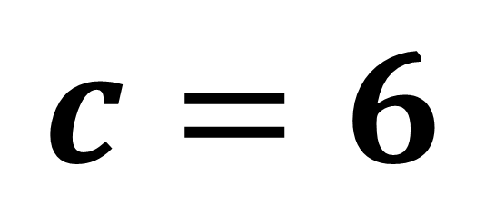
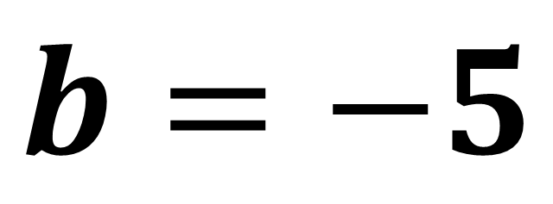
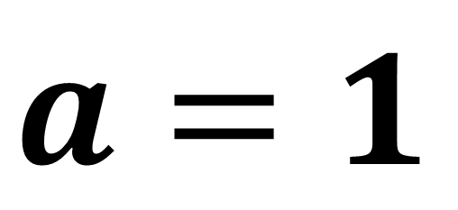
What are the values of a, b and c?
$$x^{2}=5x−6$$
$$x^{2}−5x+6=0$$
$a=1$
$$b=−5$$
$$c=6$$

Slide 7
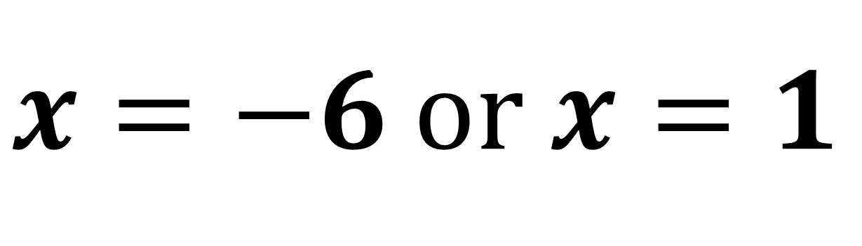
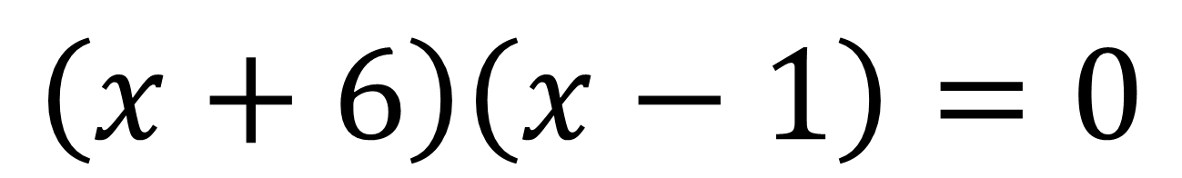
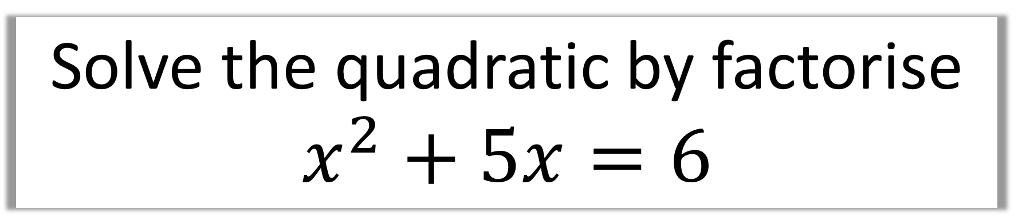
Solve the quadratic by factorise
$$x^{2}+5x=6$$
$$\left(x+6\right)\left(x−1\right)=0$$
$x=−6$or $x=1$

Slide 8
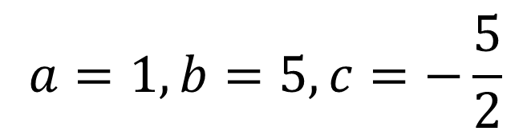
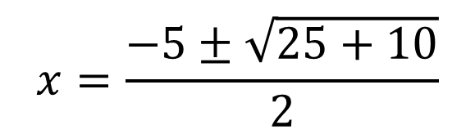
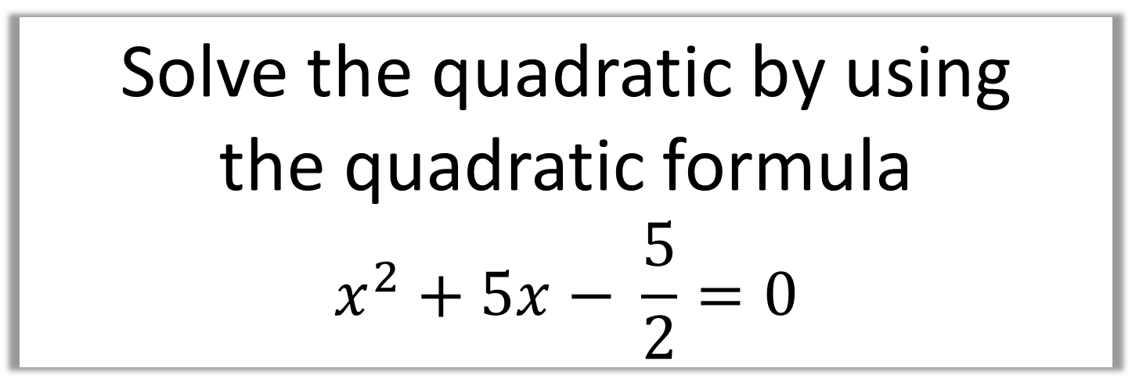
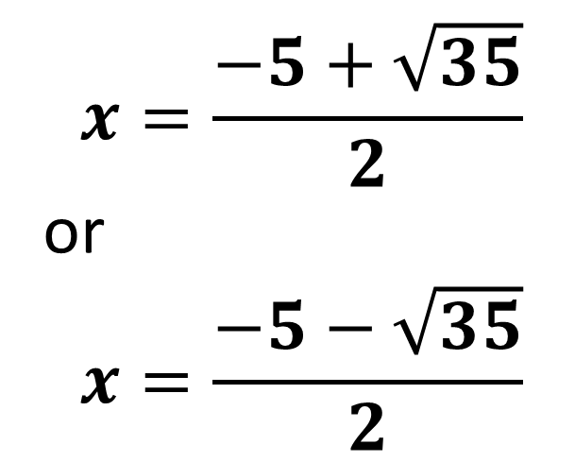
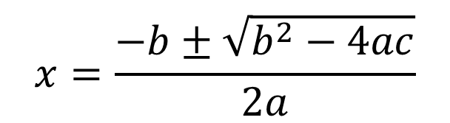
Solve the quadratic by using
the quadratic formula
$$x^{2}+5x− \frac{5}{2}=0$$
$$a=1, b=5, c=−\frac{5}{2}$$
$$x=\frac{−5+\sqrt{35}}{2}$$
or
$$x=\frac{−5−\sqrt{35}}{2}$$
$$x=\frac{−b±\sqrt{b^{2}−4ac}}{2a}$$
$$x=\frac{−5±\sqrt{25+10}}{2}$$

Slide 9
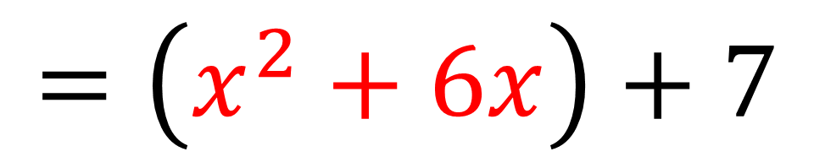
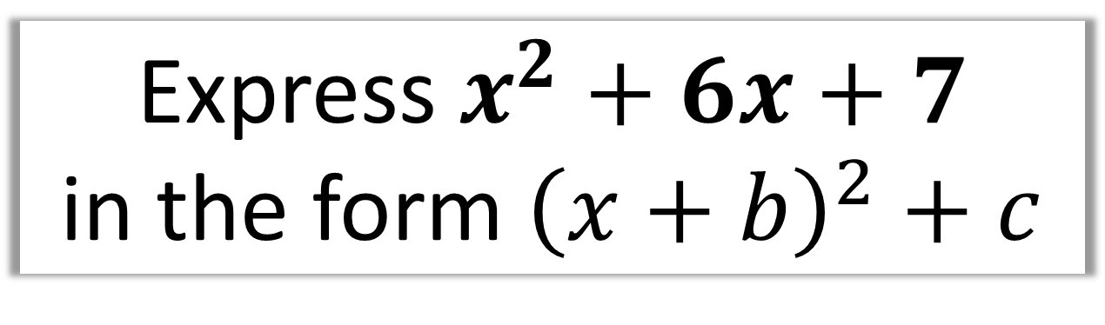
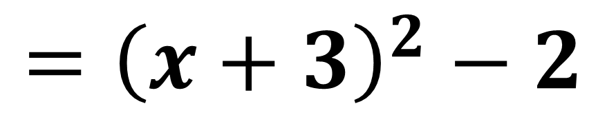
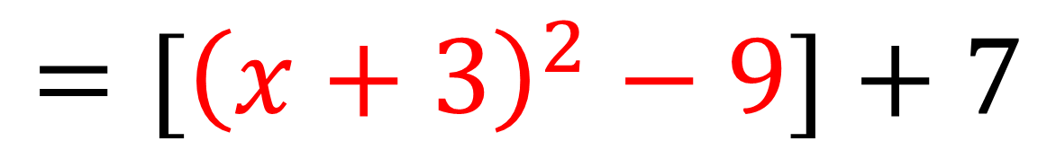
Express $x^{2}+6x+7$
in the form ${\left(x+b\right)}^{2}+c$
$$=\left(x^{2}+6x\right)+7$$
$$=[{\left(x+3\right)}^{2}−9]+7$$
$$={\left(x+3\right)}^{2}−2$$

Slide 10
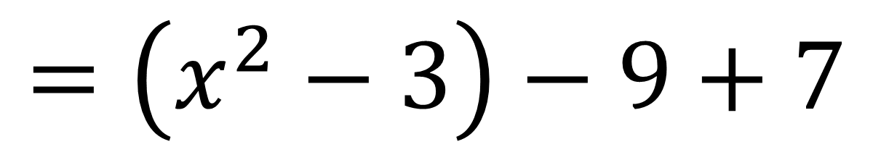
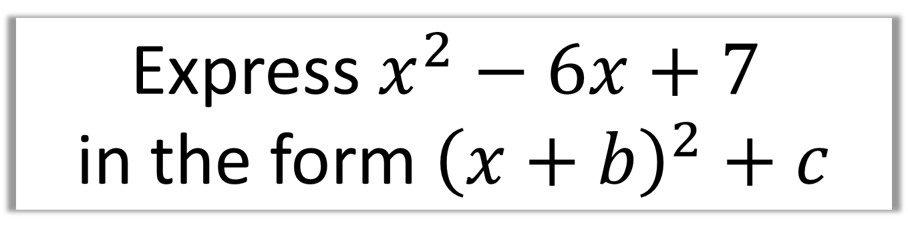
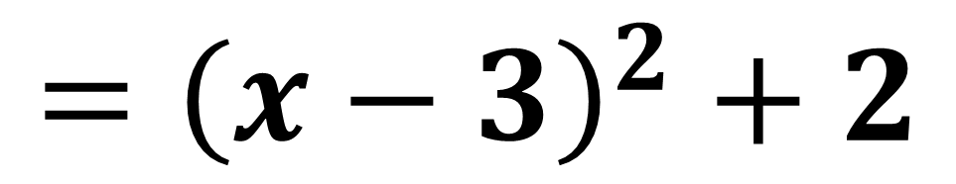
Express $x^{2}−6x+7$
in the form ${\left(x+b\right)}^{2}+c$
$$=\left(x^{2}−3\right)−9+7$$
$$={\left(x−3\right)}^{2}+2$$

Slide 11
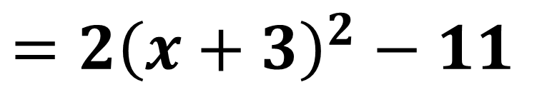
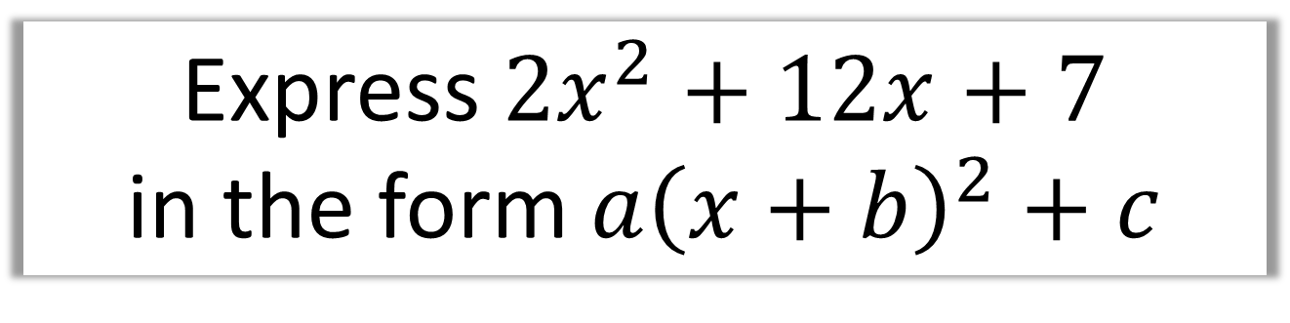
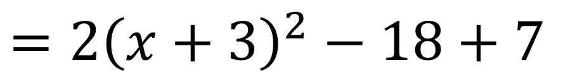
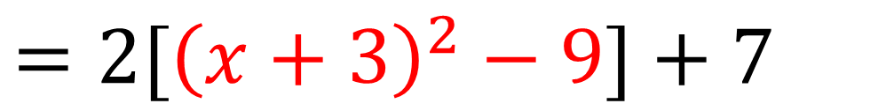
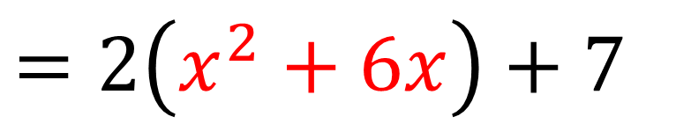
Express $2x^{2}+12x+7$
in the form $a{\left(x+b\right)}^{2}+c$
$$=2\left(x^{2}+6x\right)+7$$
$$=2[{\left(x+3\right)}^{2}−9]+7$$
$$=2{\left(x+3\right)}^{2}−18+7$$
$$=2{\left(x+3\right)}^{2}−11$$

Slide 12
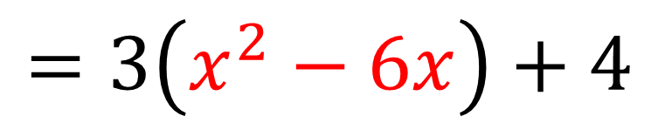
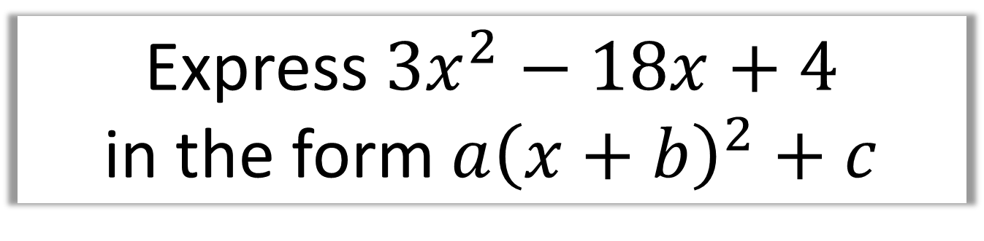
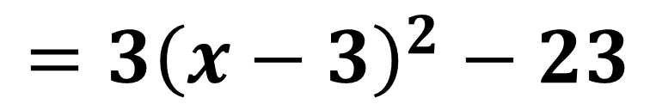
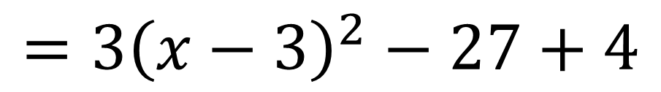
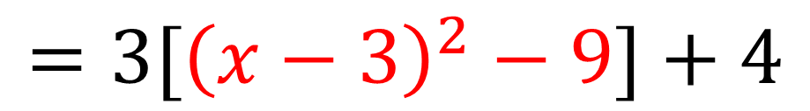
Express $3x^{2}−18x+4$
in the form $a{\left(x+b\right)}^{2}+c$
$$=3\left(x^{2}−6x\right)+4$$
$$=3[{\left(x−3\right)}^{2}−9]+4$$
$$=3{\left(x−3\right)}^{2}−27+4$$
$$=3{\left(x−3\right)}^{2}−23$$

Slide 13
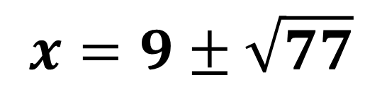
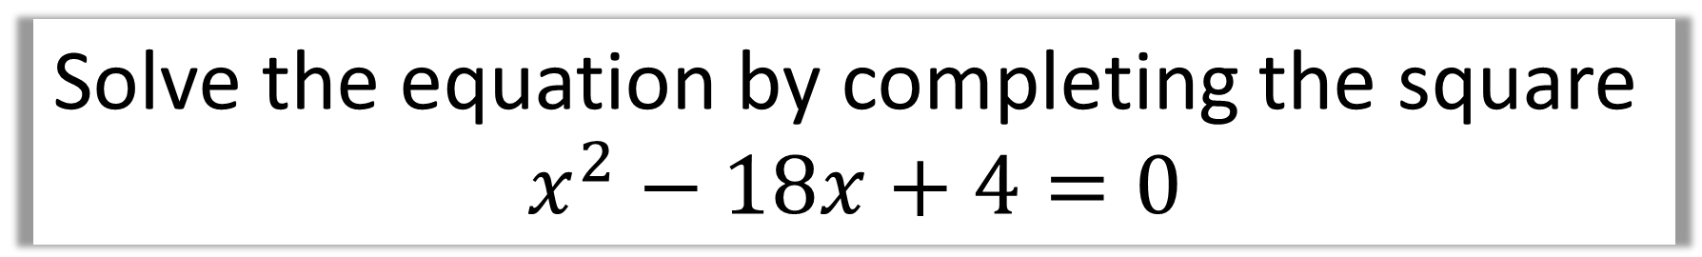
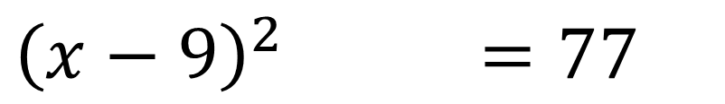
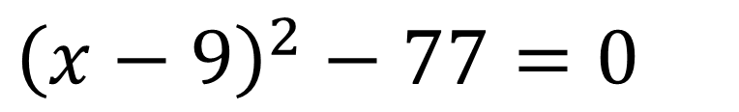
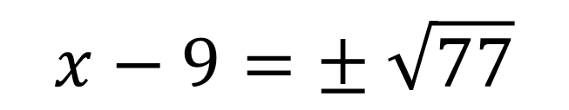
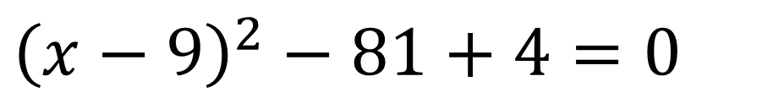
Solve the equation by completing the square
$$x^{2}−18x+4=0$$
$${\left(x−9\right)}^{2}−81+4=0$$
$${\left(x−9\right)}^{2}−77=0$$
$${\left(x−9\right)}^{2}−77=77$$
$$x−9=± \sqrt{77}$$
$$x=9±\sqrt{77}$$

