Slide 1
Differentiation
More Trig Functions
Chapter 9
(Part 6 of 10)

Slide 2
Differentiating other trigonometric functions.
If you have trigonometric functions
that are not sin or cos then
have a look in the formula booklet.

Slide 3
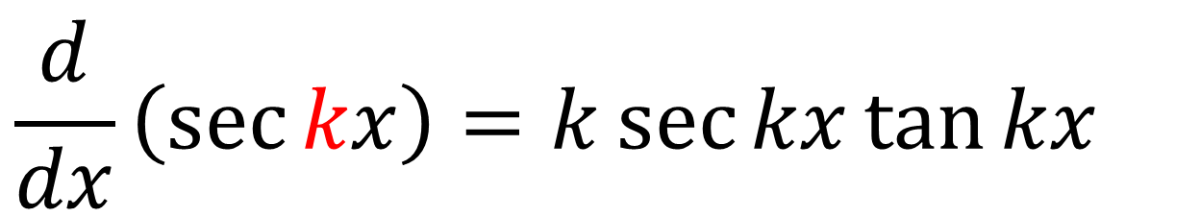
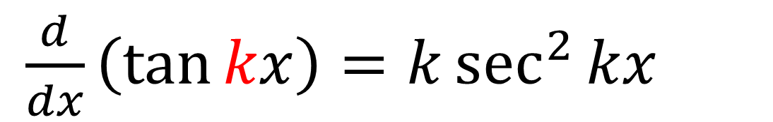
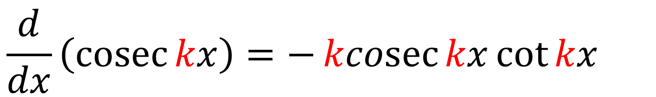
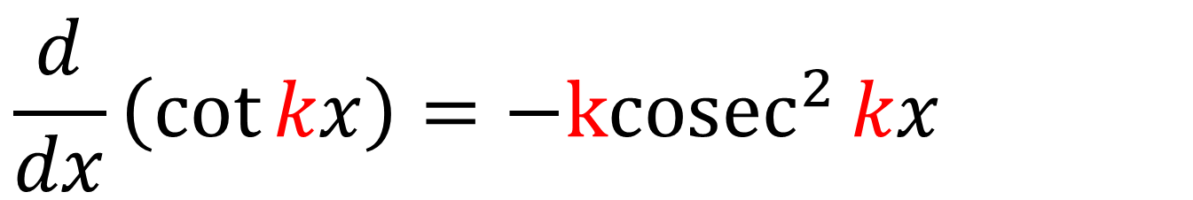
In the formula booklet:
$\frac{d}{dx}\left(\tan{kx}\right)=k\sec^{2}{kx}$
$$\frac{d}{dx}\left(\sec{kx}\right)=k\sec{kx}\tan{kx}$$
$$\frac{d}{dx}\left(\cot{kx}\right)={−kcosec}^{2}{kx}$$
$$\frac{d}{dx}\left(\operatorname{cosec}{kx}\right)=−\operatorname{kcosec}{kx}\cot{kx}$$

Slide 4
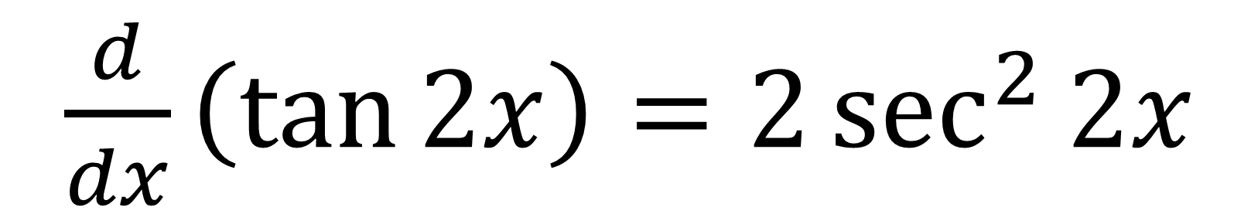
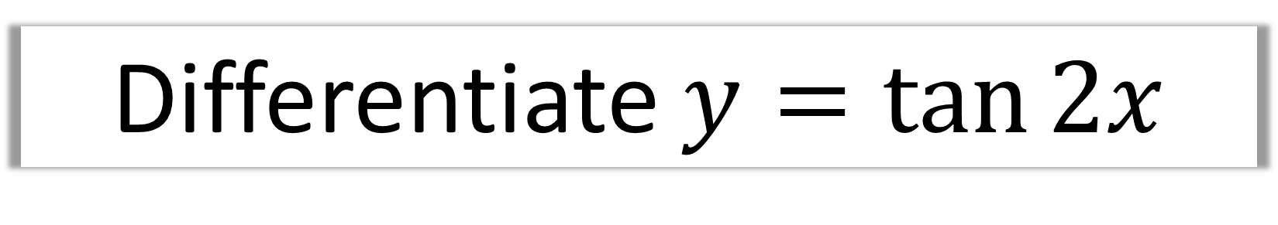
Differentiate $y=\tan{2x}$
$\frac{d}{dx}\left(\tan{2x}\right)=2\sec^{2}{2x}$

Slide 5
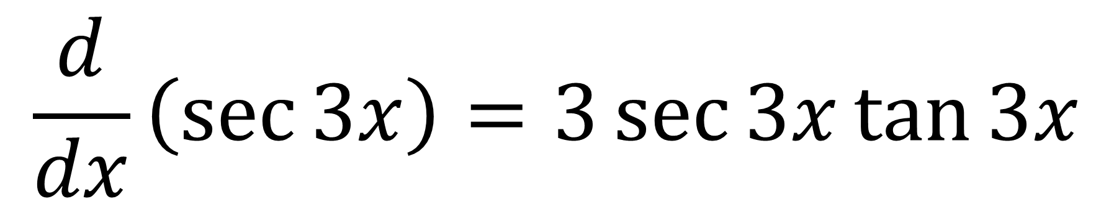
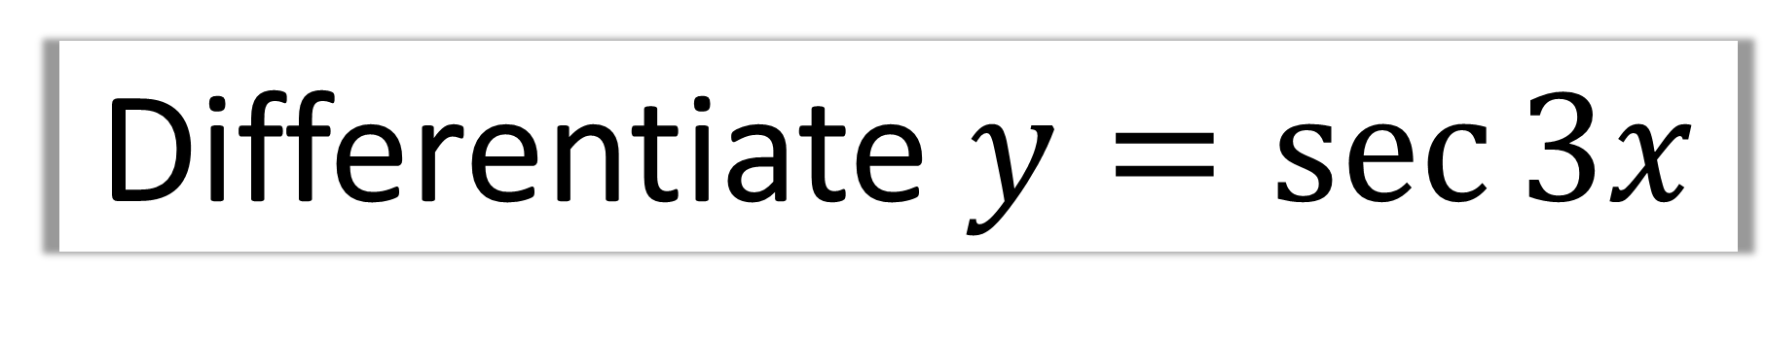
Differentiate $y=\sec{3x}$
$$\frac{d}{dx}\left(\sec{3x}\right)=3\sec{3x}\tan{3x}$$

Slide 6
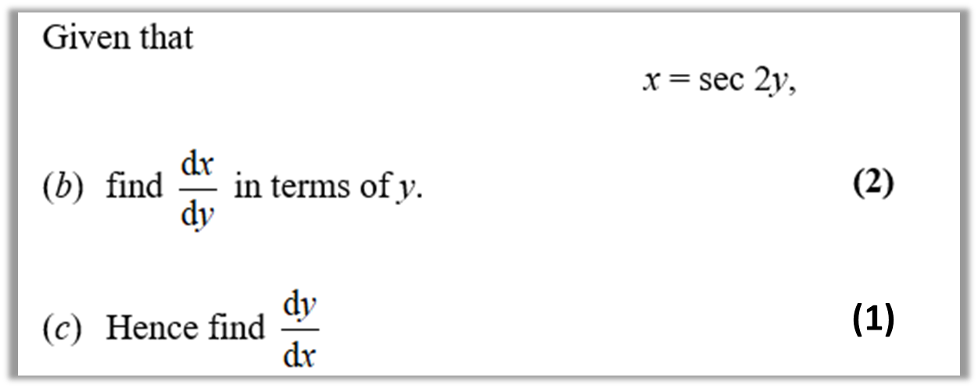
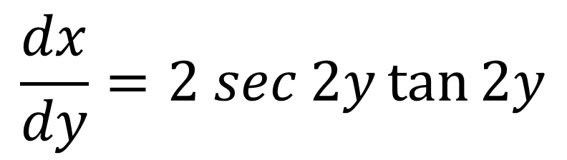
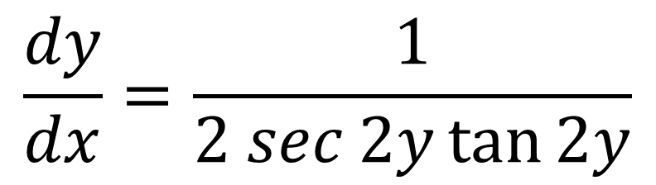
$$\frac{dx}{dy}=2 sec{2y}\tan{2y}$$
(b)
$$\frac{dy}{dx}=\frac{1}{2 sec{2y}\tan{2y}}$$
(c)

Slide 7
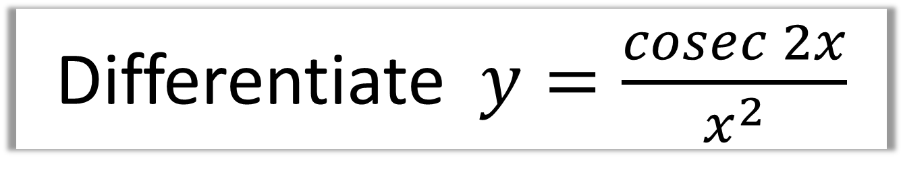
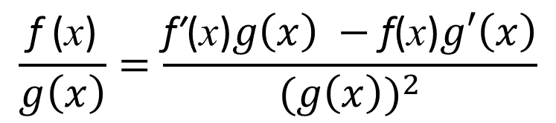
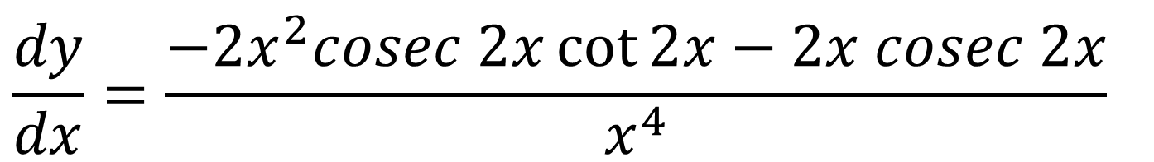


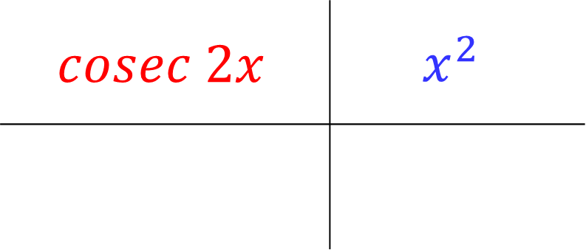
Differentiate $y=\frac{cosec 2x}{x^{2}}$
$$\frac{\text{f}\text{ (}\text{x}\text{)}}{g\left(x\right)}=\frac{\text{f}\text{′}\text{(}\text{x}\text{)}g\left(x\right) −\text{f}\text{(}\text{x}\text{)}g′\left(x\right)}{{(g\left(x\right))}^{2}}$$
$$cosec 2x$$ | $$x^{2}$$
$$−2cosec 2x\cot{2x}$$
$$2x$$
$$\frac{dy}{dx}=\frac{−2x^{2}cosec 2x\cot{2x}−2x cosec 2x}{x^{4}}$$

Slide 8
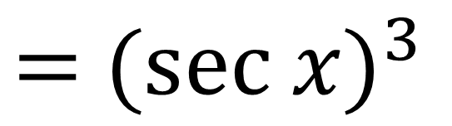
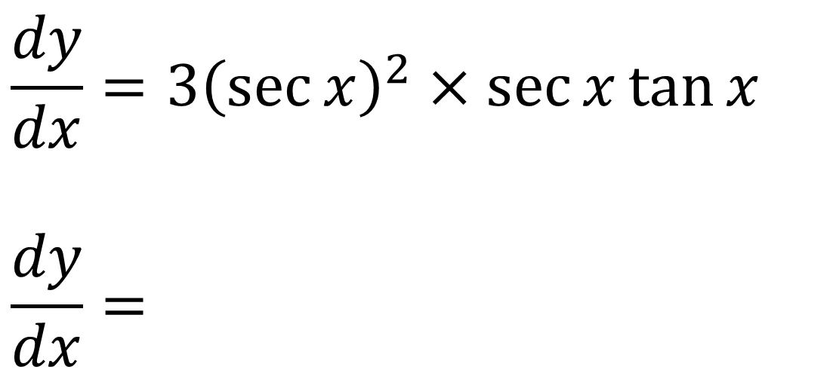
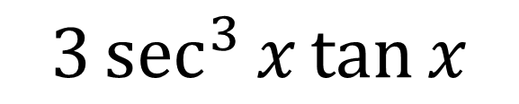
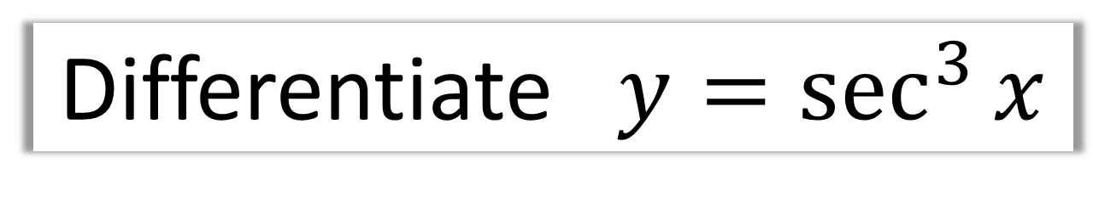
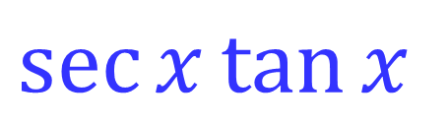

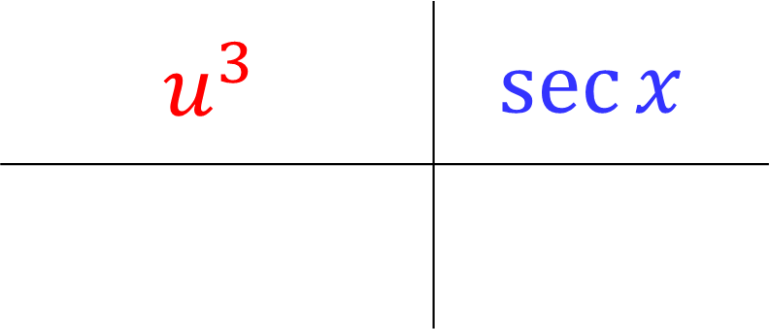
Differentiate $y=\sec^{3}{x}$
$=$ $({sec x)}^{3}$
$$u^{3}$$ | $$\sec{x}$$
$${3u}^{2}$$
$$\sec{x}\tan{x}$$
$$\frac{dy}{dx}=3{\left(\sec{x}\right)}^{2}×\sec{x}\tan{x}$$
$$\frac{dy}{dx}=$$
$$3\sec^{3}{x}\tan{x}$$

Slide 9
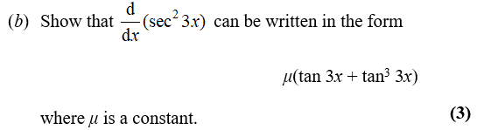
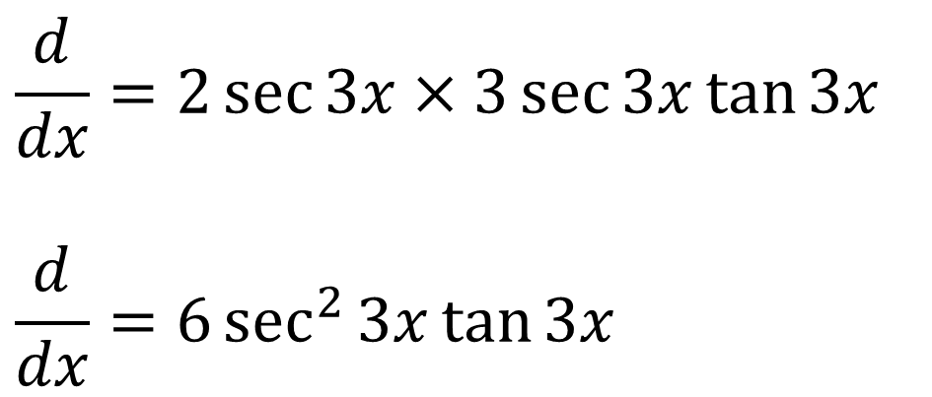
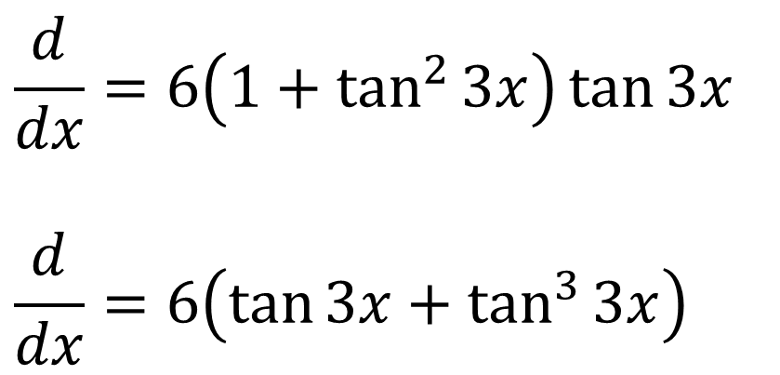
$$\frac{d}{dx}=2\sec{3x}×3\sec{3x}\tan{3x}$$
$$\frac{d}{dx}=6\sec^{2}{3x}\tan{3x}$$
$$\frac{d}{dx}=6\left(1+\tan^{2}{3x}\right)\tan{3x}$$
$$\frac{d}{dx}=6\left(\tan{3x}+\tan^{3}{3x}\right)$$

Slide 10
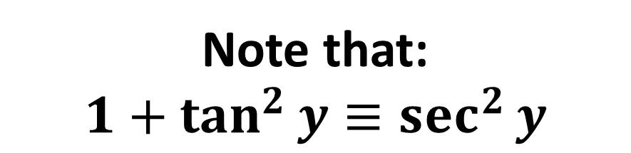
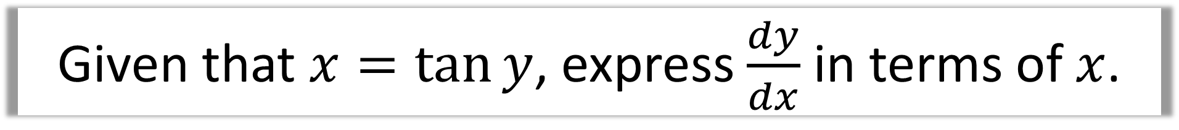
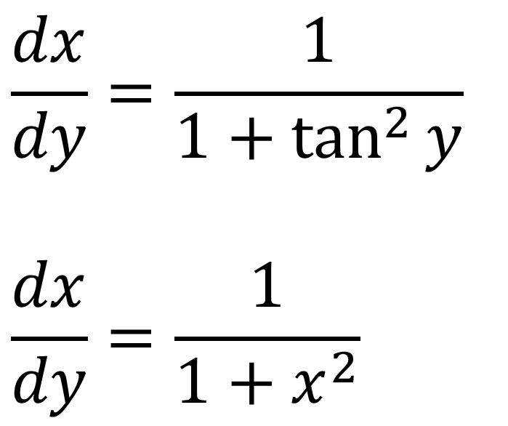
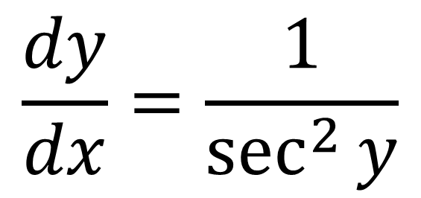
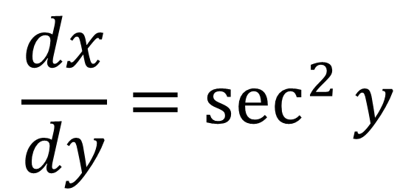
Given that $x=\tan{y}$, express $\frac{dy}{dx}$ in terms of $x$.
Note that:
$$1+\tan^{2}{y}≡\sec^{2}{y}$$
$$\frac{dx}{dy}=\sec^{2}{y}$$
$$\frac{dx}{dy}=\frac{1}{1+\tan^{2}{y}}$$
$$\frac{dx}{dy}=\frac{1}{1+x^{2}}$$
$$\frac{dy}{dx}=\frac{1}{\sec^{2}{y}}$$

Slide 11
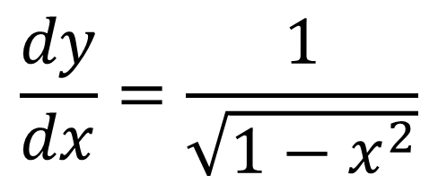
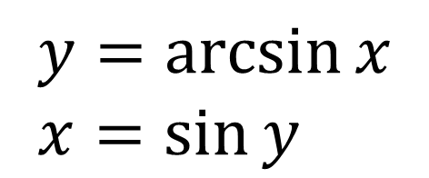
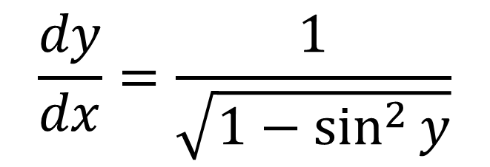
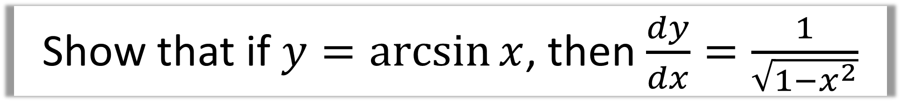
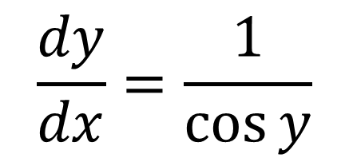
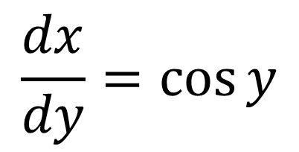
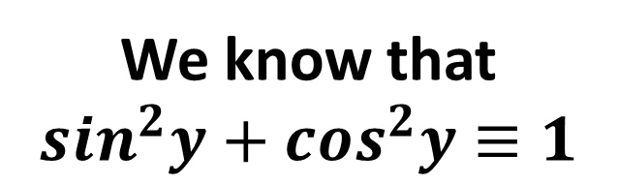
Show that if $y=\arcsin{x}$, then $\frac{dy}{dx}=\frac{1}{\sqrt{1−x^{2}}}$
$$y=\arcsin{x} \\ x=\sin{y}$$
We know that
$$sin^{2}y+cos^{2}y≡1$$
$$\frac{dy}{dx}=\frac{1}{\sqrt{1−\sin^{2}{y}}}$$
$$\frac{dx}{dy}=\cos{y}$$
$$\frac{dy}{dx}=\frac{1}{\cos{y}}$$
$$\frac{dy}{dx}=\frac{1}{\sqrt{1−x^{2}}}$$

