Slide 1
LO: Two Way Tables
and Probability

Slide 2
 | Drama | Action | Comedy | Total
Girls | 3 | 4 | 7 | 14
Boys | 1 | 8 | 2 | 11
Total | 4 | 12 | 9 | 25

Slide 3
30 Students were surveyed on
what type of film they preferred.
 | Drama | Action | Comedy | Total
Girls | 3 |  | 7 | 15
Boys | 1 | 8
Total |  |  |  | 30
5
6
15
4
13
13

Slide 4
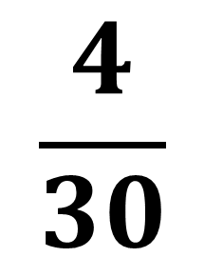
 | Drama | Action | Comedy | Total
Girls | 3 | 5 | 7 | 15
Boys | 1 | 8 | 6 | 15
Total | 4 | 13 | 13 | 30
Find the probability of the following events.
$$\frac{4}{30}$$
P(Drama) =

Slide 5
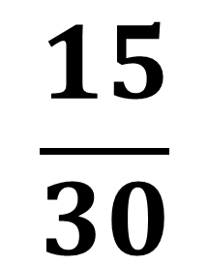
 | Drama | Action | Comedy | Total
Girls | 3 | 5 | 7 | 15
Boys | 1 | 8 | 6 | 15
Total | 4 | 13 | 13 | 30
Find the probability of the following events.
$$\frac{15}{30}$$
P(Boy) =

Slide 6
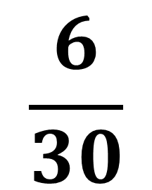
 | Drama | Action | Comedy | Total
Girls | 3 | 5 | 7 | 15
Boys | 1 | 8 | 6 | 15
Total | 4 | 13 | 13 | 30
Find the probability of the following events.
$$\frac{6}{30}$$
P(Boy and Comedy) =

Slide 7
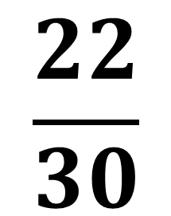
 | Drama | Action | Comedy | Total
Girls | 3 | 5 | 7 | 15
Boys | 1 | 8 | 6 | 15
Total | 4 | 13 | 13 | 30
Find the probability of the following events.
$$\frac{22}{30}$$
P(Boy or Comedy) =

Slide 8
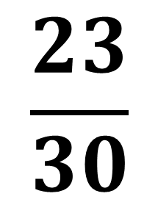
 | Drama | Action | Comedy | Total
Girls | 3 | 5 | 7 | 15
Boys | 1 | 8 | 6 | 15
Total | 4 | 13 | 13 | 30
Find the probability of the following events.
$$\frac{23}{30}$$
P(Girls or Action) =

