Slide 1
LO: Factorising
(With Powers)

Slide 2
Factorise
12x + 8 =
4(3x + 2)

Slide 3
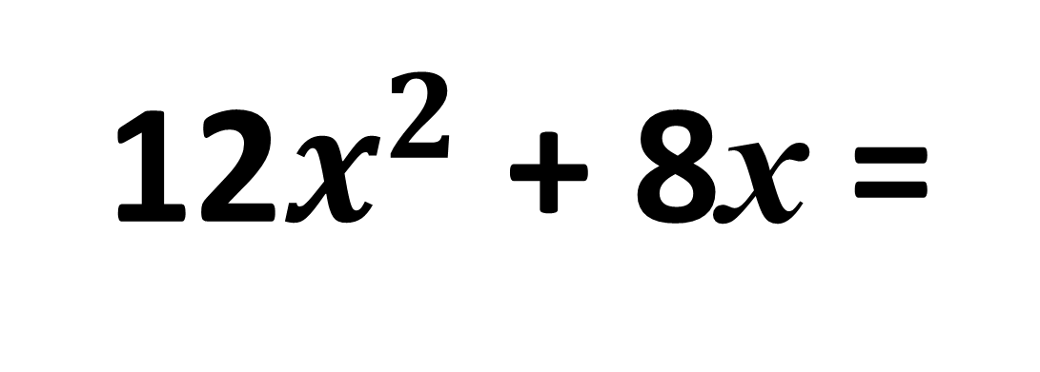
Factorise
12$x^{2}$ + 8x =
4x(3x + 2)

Slide 4
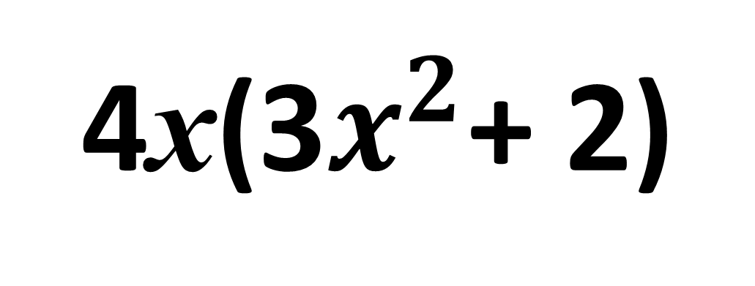
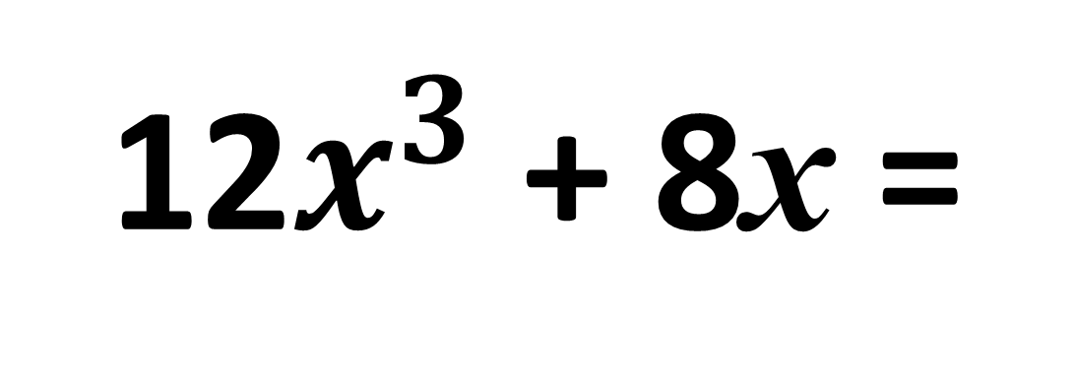
Factorise
12$x^{3}$ + 8x =
4x(3$x^{2}$+ 2)

Slide 5
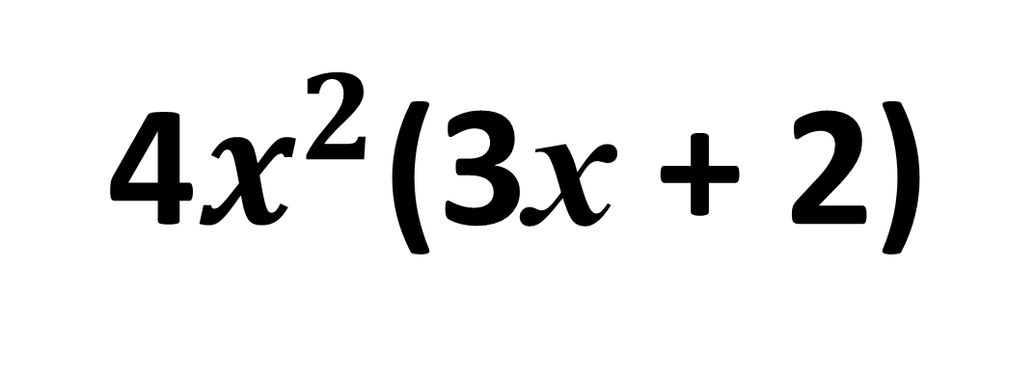
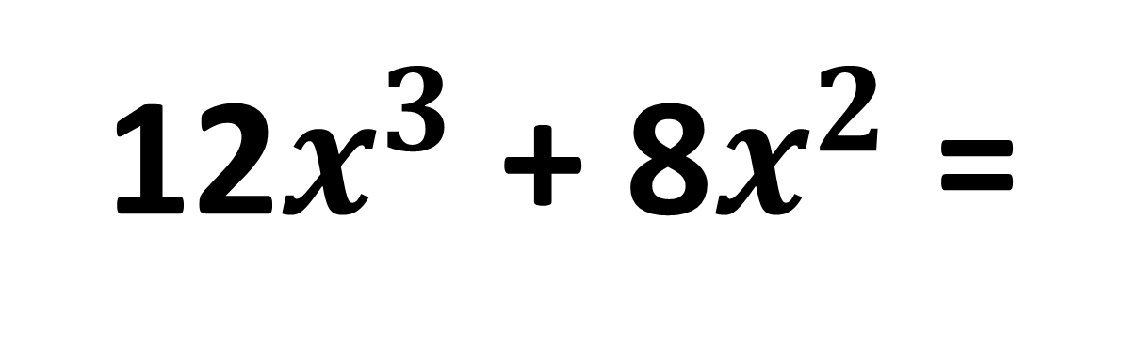
Factorise
12$x^{3}$ + 8$x^{2}$ =
4$x^{2}$(3x + 2)

Slide 6
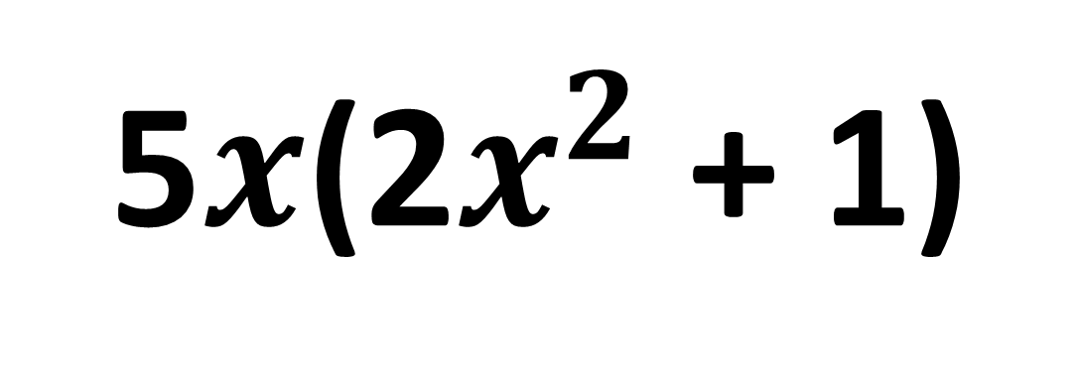
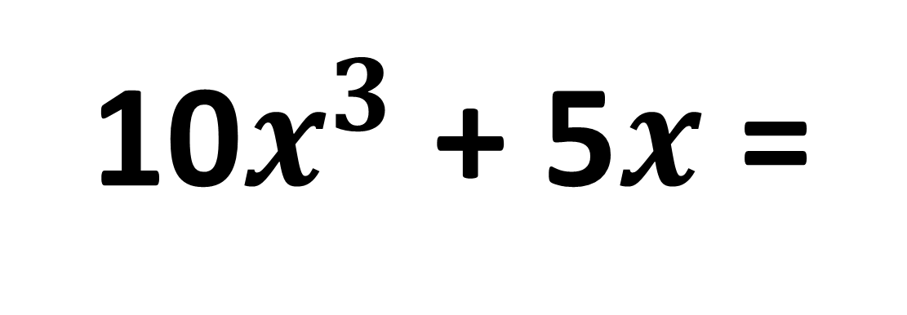
Factorise
10$x^{3}$ + 5$x$ =
5$x$(2$x^{2}$ + 1)

Slide 7
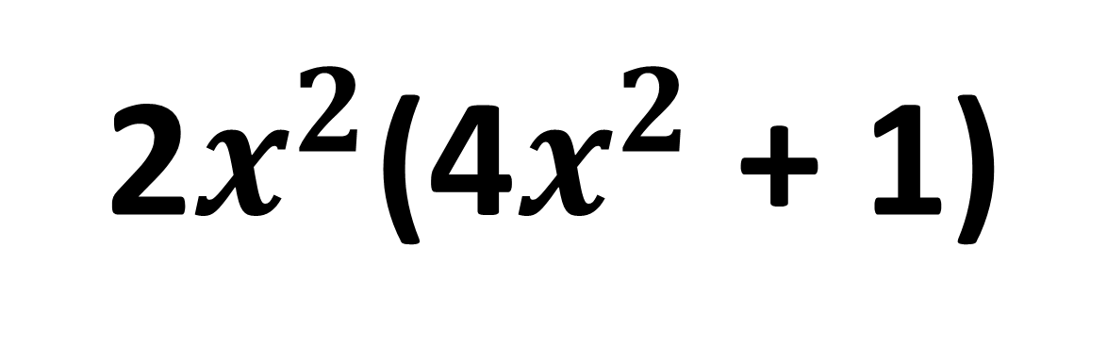
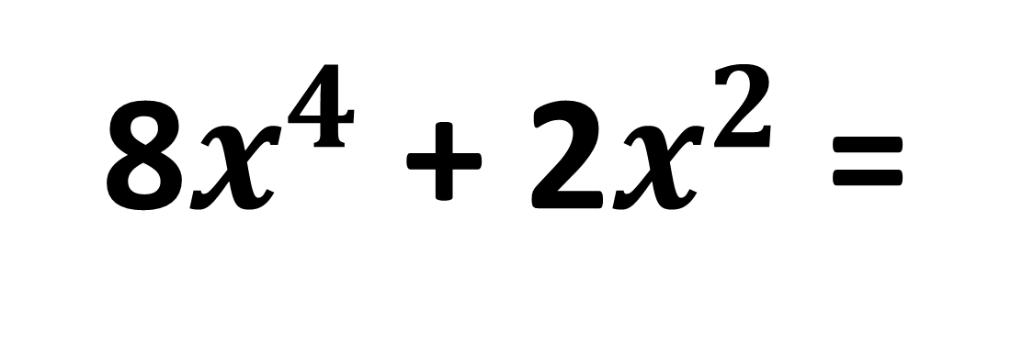
Factorise
8$x^{4}$ + 2$x^{2}$ =
2$x^{2}$(4$x^{2}$ + 1)

Slide 8
Does it Factorise?
3y + 4
NO

Slide 9
Does it Factorise?
3y + 4x
NO

Slide 10
Does it Factorise?
3xy + 4x
YES

Slide 11
Does it Factorise?
3xy + 4y
YES

Slide 12
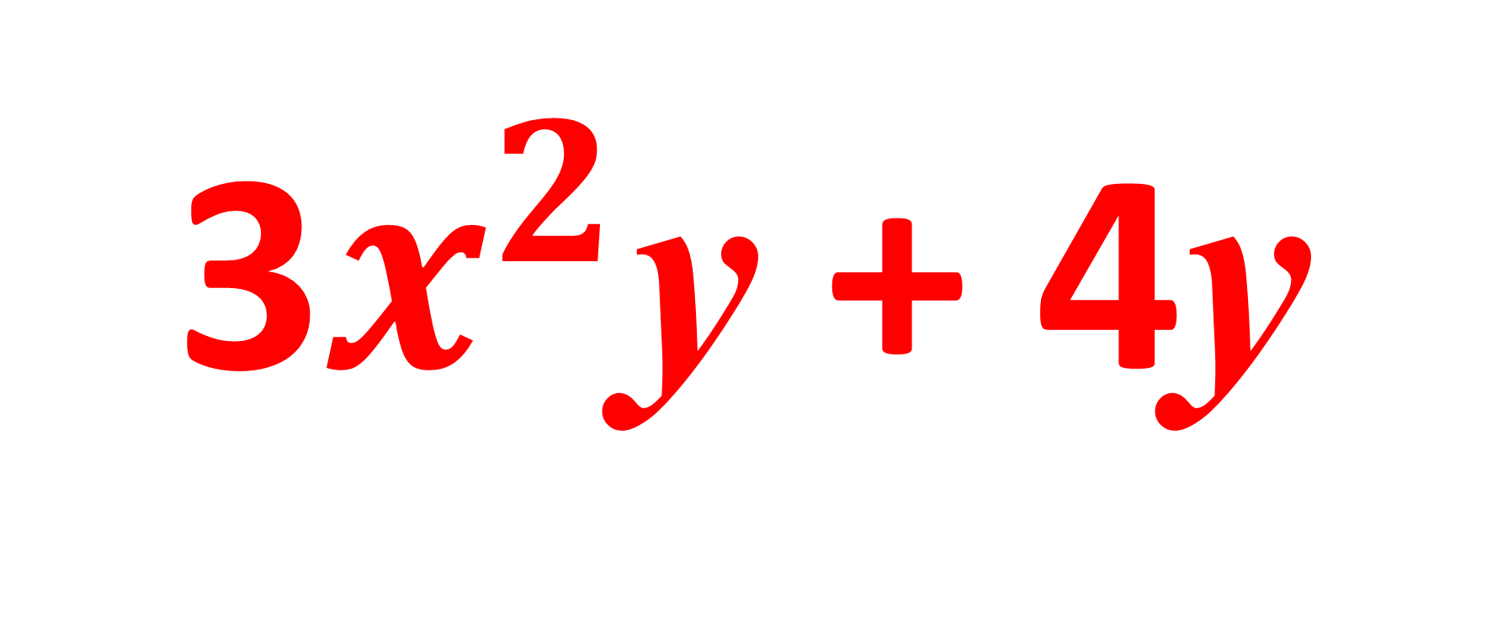
Does it Factorise?
3$x^{2}$y + 4y
YES

Slide 13
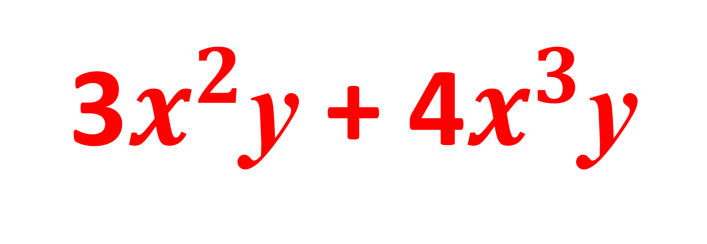
Does it Factorise?
3$x^{2}$y + 4$x^{3}$y
YES

Slide 14
Fully Factorised or Not?
6x² + 3x = 3x(2x + 1)
FULLY

Slide 15
Fully Factorised or Not?
8x² + 4x = 4(2x² + x)
NOT

Slide 16
Fully Factorised or Not?
4xy + 2x = 2x(2y + 1)
FULLY

Slide 17
Fully Factorised or Not?
x³y + x² = x(x²y + x)
NOT

Slide 18
A
Factorise
B
C
D

Slide 19
A
Factorise
B
C
D

Slide 20
A
Factorise
B
C
D

Slide 21
A
Factorise
B
C
D

Slide 22
A
Factorise
B
C
D

Slide 23
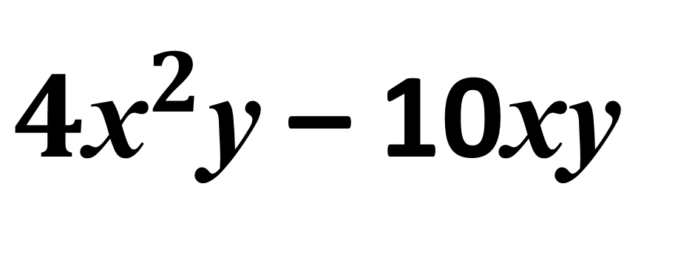
Factorise
$4{\text{x}}^{2}$y – 10xy
2xy(2x – 5)

Slide 24
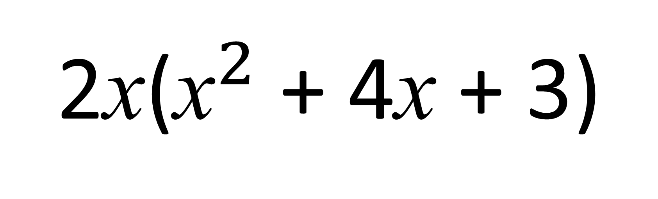
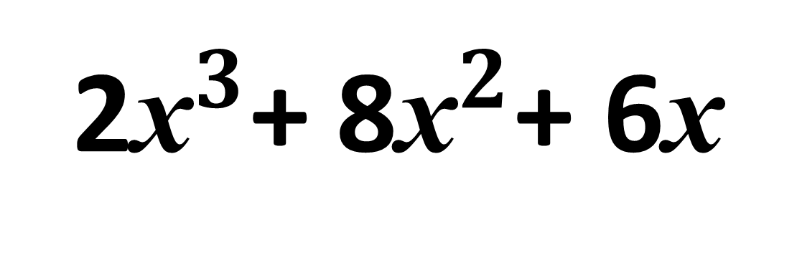
Factorise
2${\text{x}}^{3}$+ 8${\text{x}}^{2}$+ 6x
2x(${\text{x}}^{2}$ + 4x + 3)

Slide 25
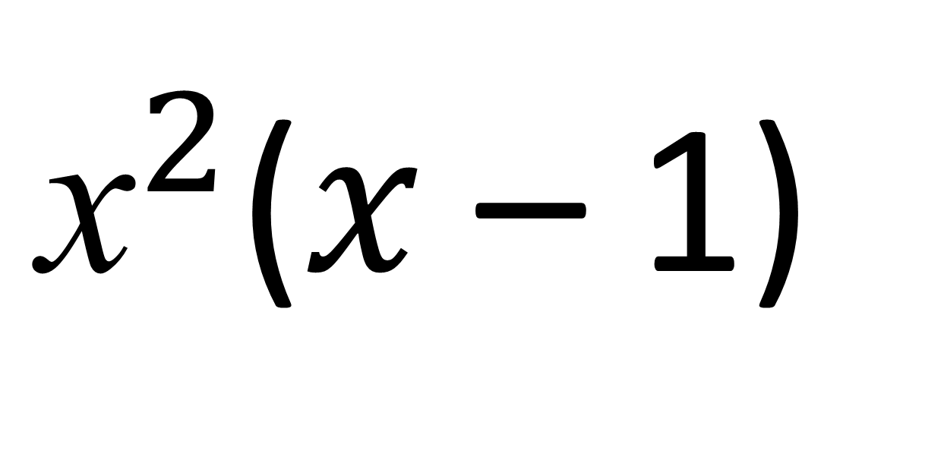
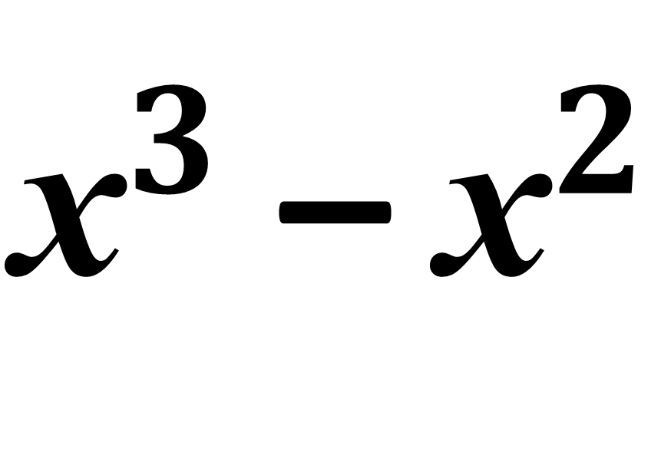
${\text{x}}^{3}$ – ${\text{x}}^{2}$
Factorise
${\text{x}}^{2}$($x$ – 1)

