Slide 1
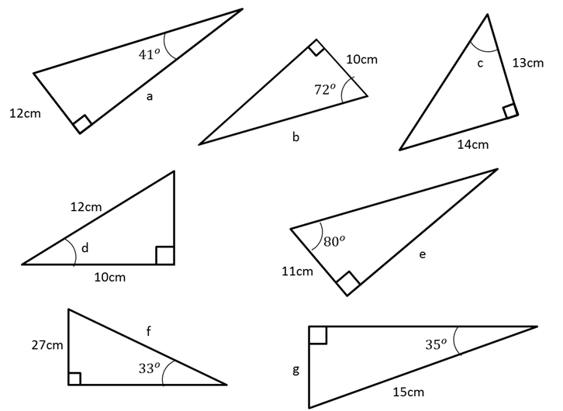

Slide 2
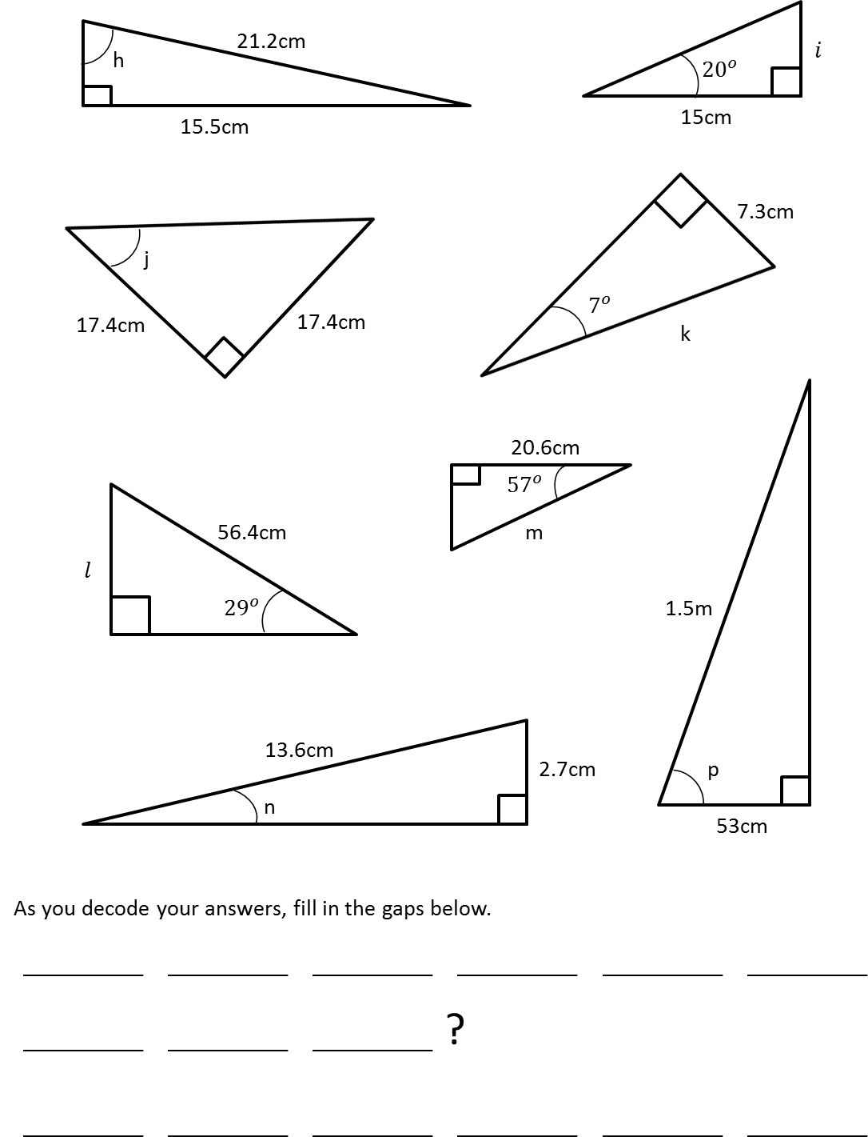

Slide 3
ANSWERS

Slide 4
12
tan (41)
a)
= 14
10
cos (72)
b)
= 32
14
13
c)
tan⁻¹
= 47
10
12
d)
cos⁻¹
= 34
e) 11 cos (30) = 62
27
sin (33)
f)
= 50
g) 15 sin (35) = 9

Slide 5
15.5
21.2
h)
sin⁻¹
= 47
i) 15 tan (30) = 5
17.4
17.4
j)
tan⁻¹
= 45
7.3
sin (7)
k)
= 60
20.6
cos (57)
l) 56.4 sin (29) = 27
m)
= 38
2.7
13.6
53
150
n)
sin⁻¹
= 11
p)
cos⁻¹
= 69

Slide 6
Why
did
the
obtuse
angle
go
to
the
beach
Because
it
was
over
90
degrees

