Slide 1
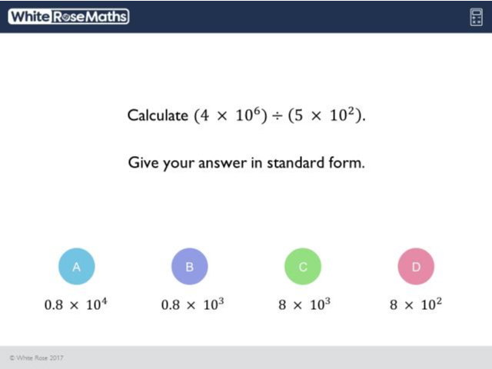
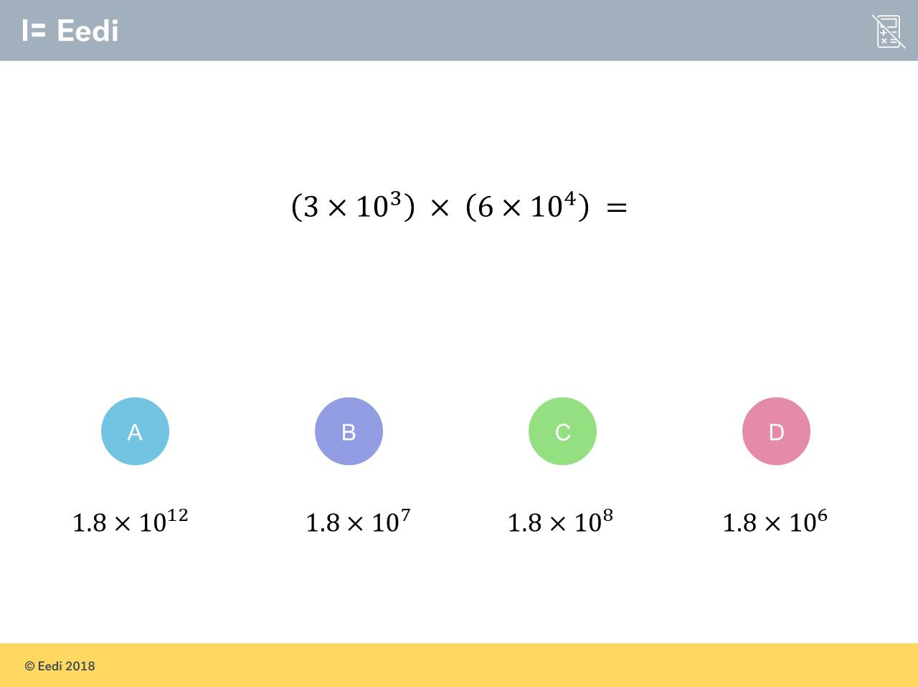
Worst answered question?
Most common wrong answer?

Slide 2
ANSWERS

Slide 3
Worst answered question?

Slide 4
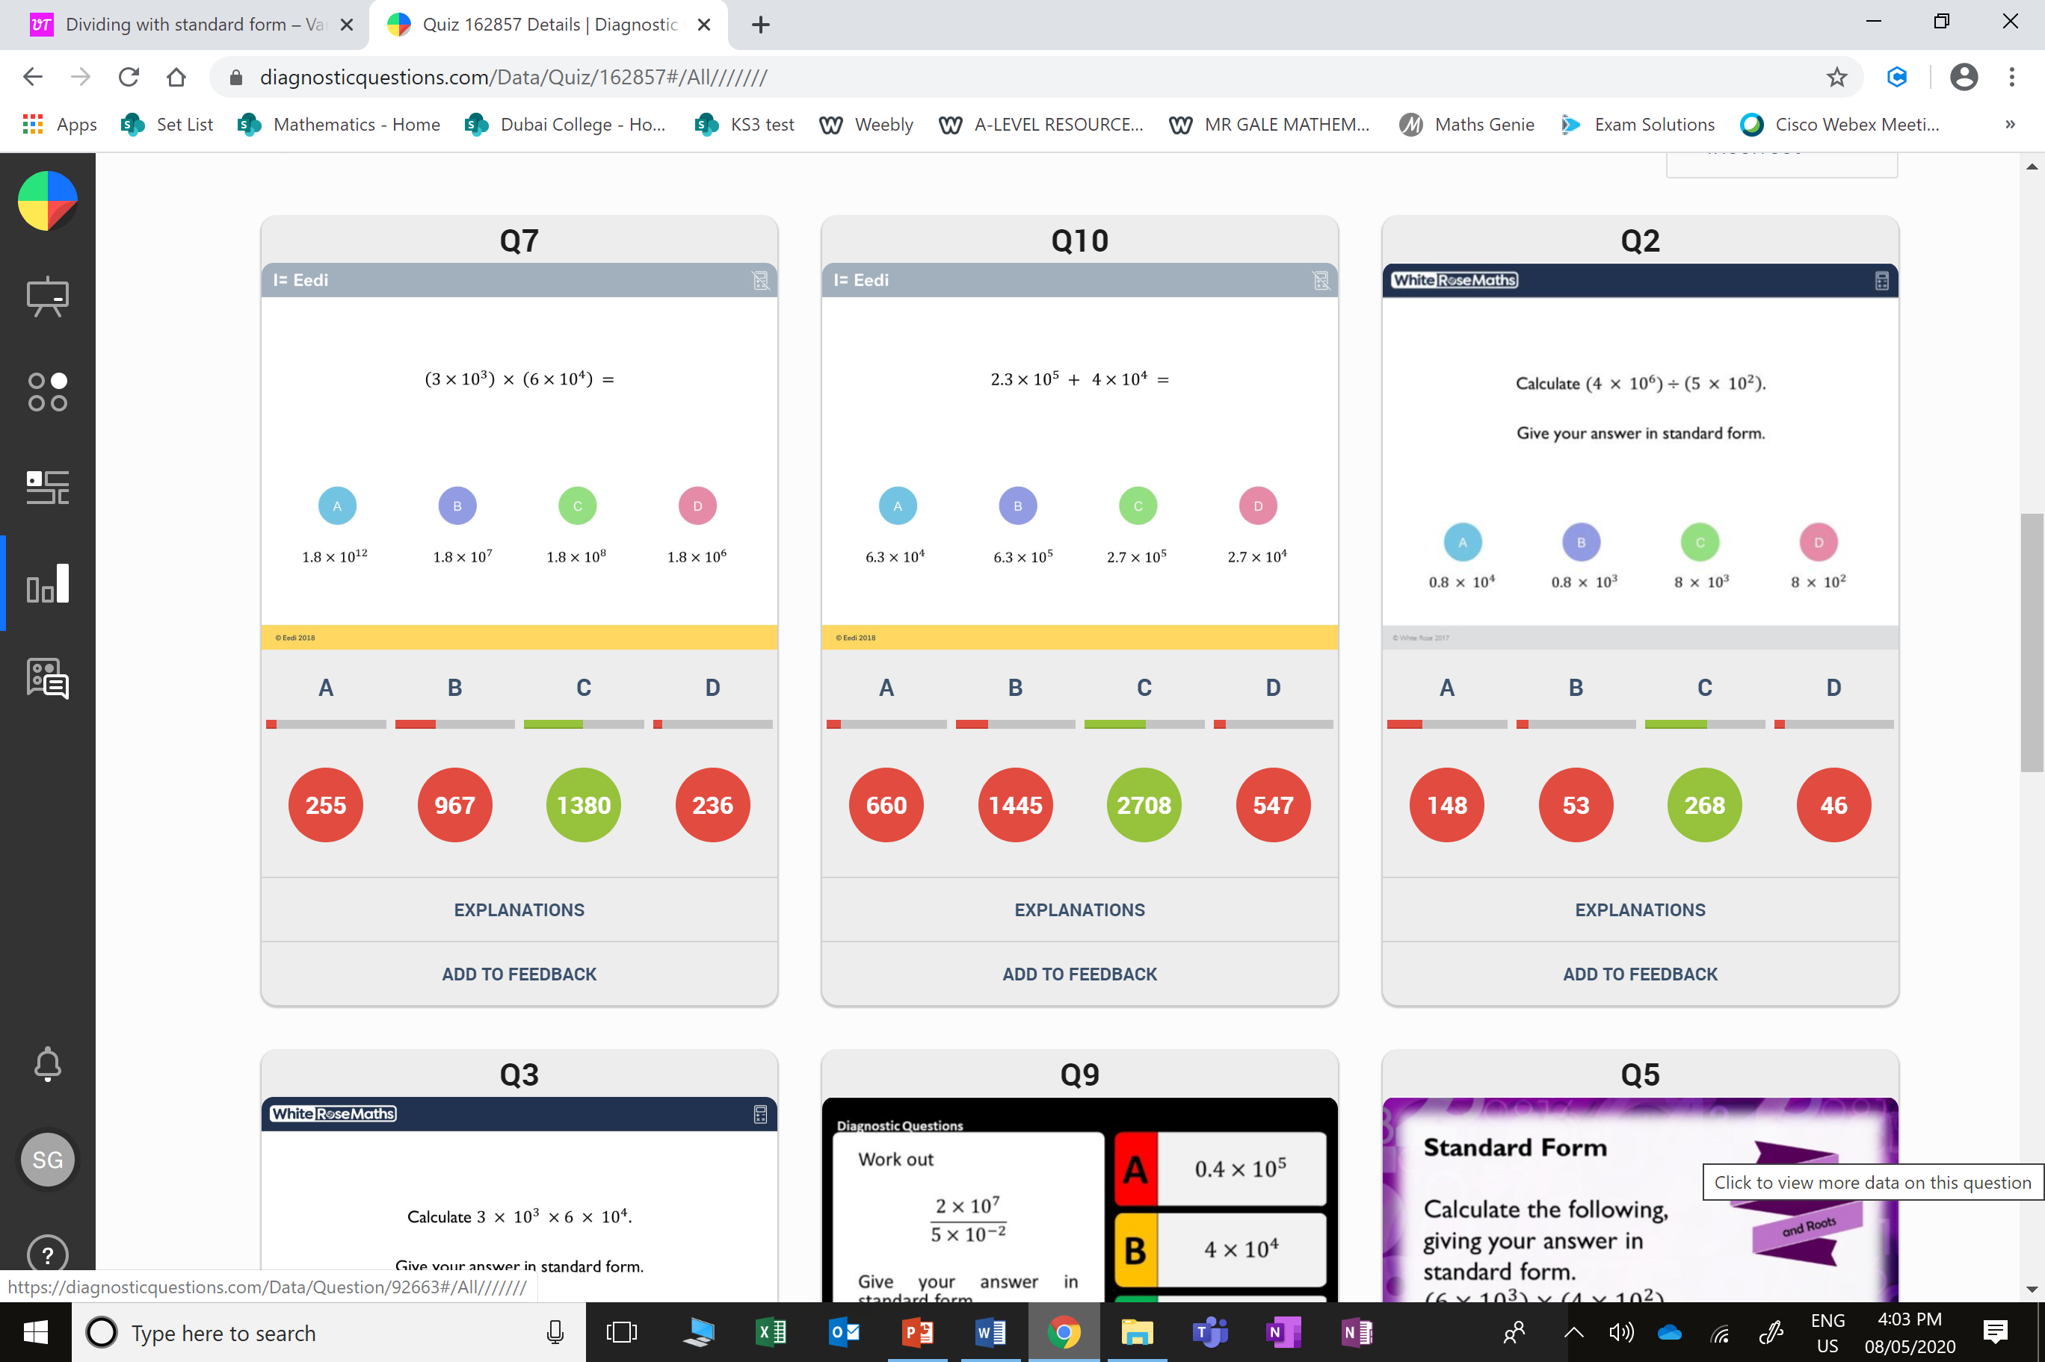
B
They forgot to increase the
power of 10’s.

Slide 5
A
They is right answer but it is not in correct standard form.

