Slide 1
LO: Squares, Cubes and Roots

Slide 2
What is the rule that gets you from
the input number to the output number?
Input | Output
1 | 1
3 | 9
4 | 16
9 | 81

Slide 3
What is the rule that gets you from
the input number to the output number?
Input | Output
25 | 5
49 | 7
64 | 8
100 | 10

Slide 4
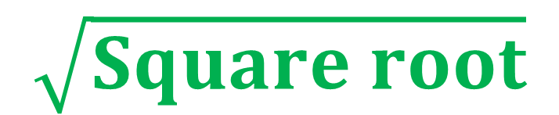
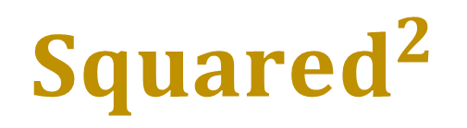
$${Squared}^{2}$$
8
64
$$\sqrt{Square root}$$

Slide 5

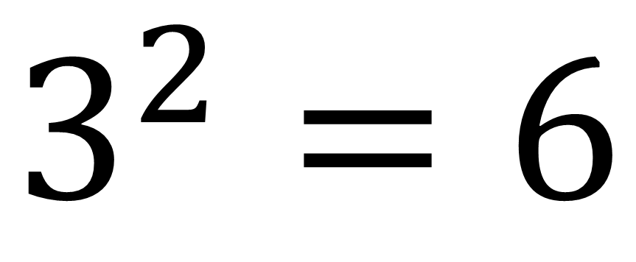
What have they done wrong?
$$3^{2}=6$$
Multiplied instead of squared.

Slide 6
3² + 6² =
45
(3 + 6)² =
81

Slide 7

Maths = Money
Click the sign above to watch the video.

Slide 8
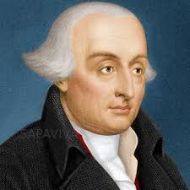
Joseph-Louis Lagrange
Born: Turin, Italy
Dates: 1736 – 1813
Interesting Facts: He made major contributions to the development of physics, mechanics, calculus, algebra, number theory, and group theory. He was largely
self-taught and did not obtain a university degree.
All whole numbers can be made from
the sum of squared numbers
and
using no more than four square numbers.

Slide 9
All whole numbers could be made from
the sum of squared numbers
and
using no more than four square numbers.
24 | = |  | + |  | + |  | +
16
4
4

Slide 10
Find up to 4 squares numbers that add up to the following numbers.
 |  | 29 | = |  | + |  | + |  | +
 |  | 52 | = |  | + |  | + |  | +
 |  | 107 | = |  | + |  | + |  | +
 |  | 91 | = |  | + |  | + |  | +
 |  | 157 | = |  | + |  | + |  | +
 |  | 141 | = |  | + |  | + |  | +
25 |  | 4
25 |  | 25 |  | 1 |  | 1
81 |  | 25 |  | 1
81 |  | 9 |  | 1
121 |  | 36
121 |  | 16 |  | 4

Slide 11
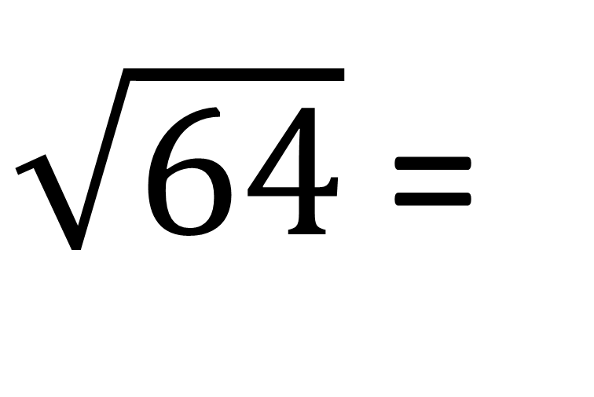
What is the
square root of 64?
$\sqrt{64}$ =
8

Slide 12
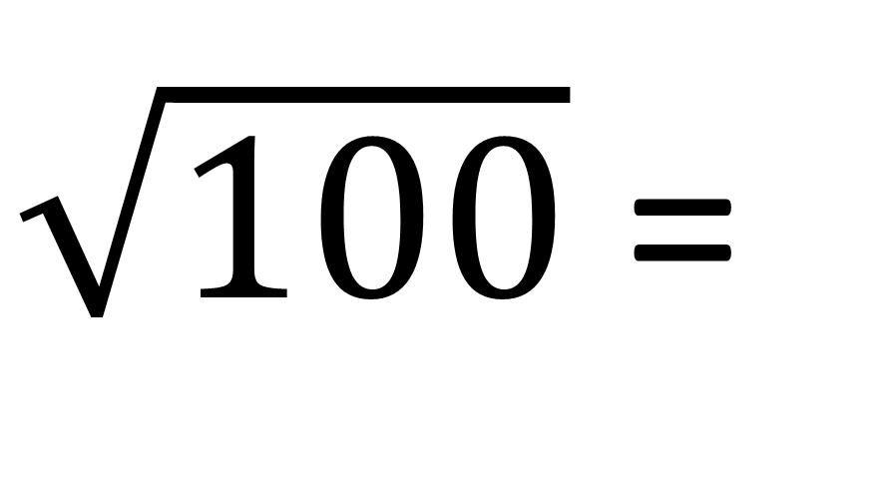
What is the
square root of 100?
$\sqrt{100}$ =
10

Slide 13
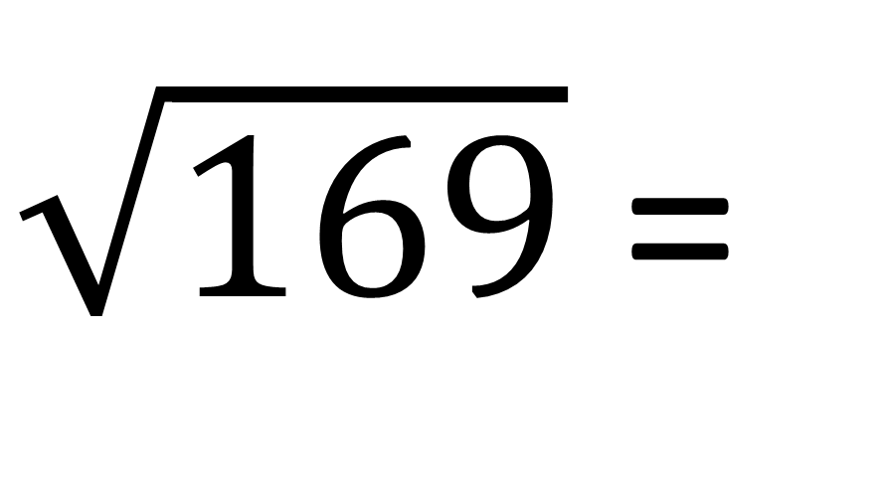
What is the
square root of 169?
$\sqrt{169}$ =
13

Slide 14
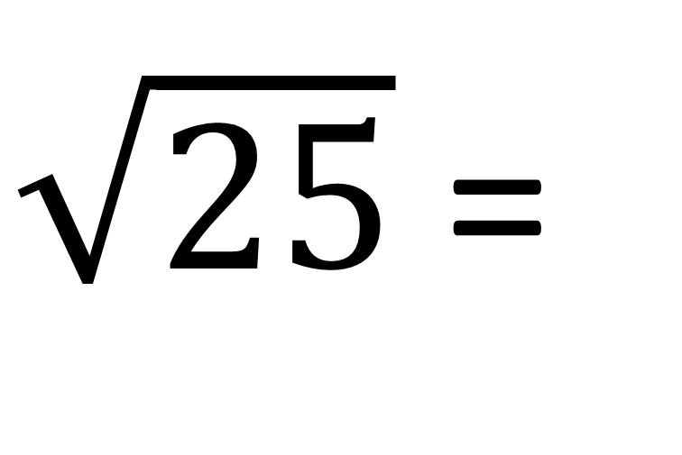
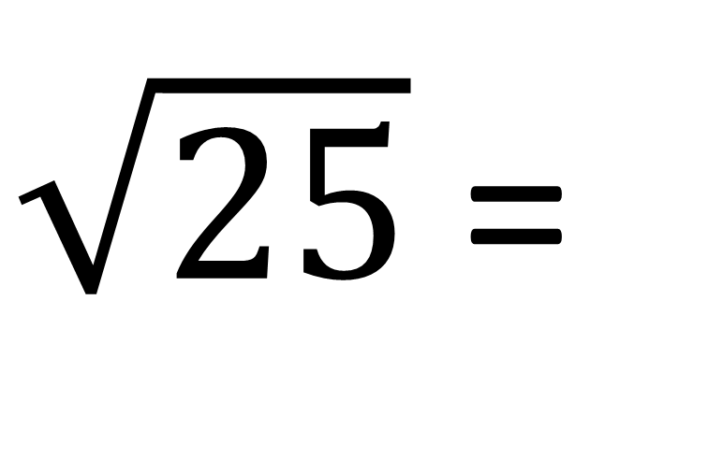
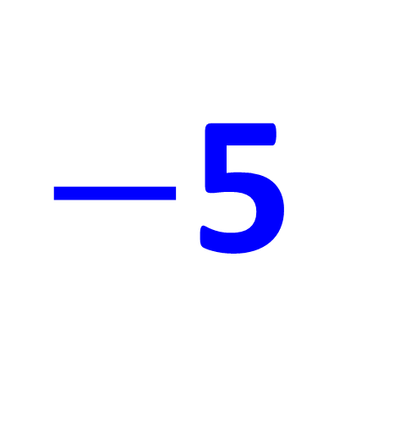
What are the two solutions for the square of 25?
$\sqrt{25}$ =
5
$\sqrt{25}$ =
$−$5

Slide 15
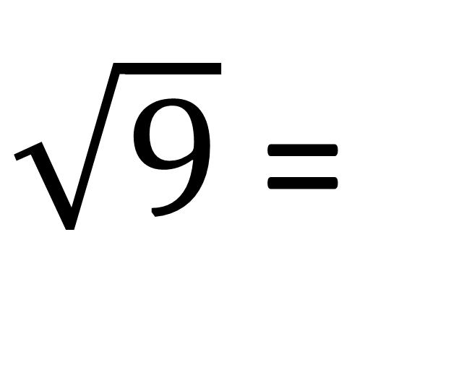
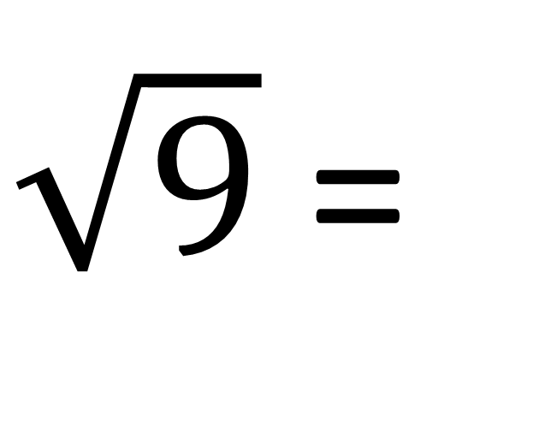
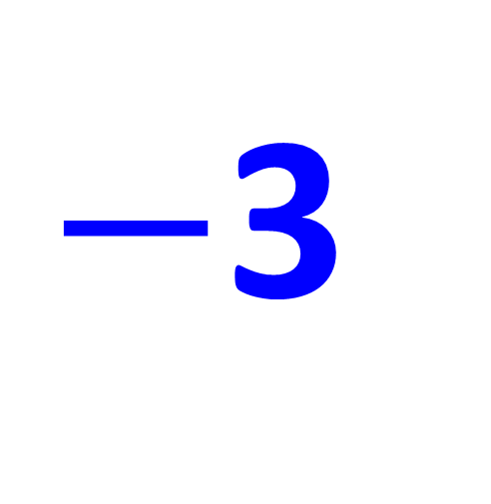
Every square root will produce two answers.
A positive and a negative
$\sqrt{9}$ =
3
$\sqrt{9}$ =
$−$3

Slide 16
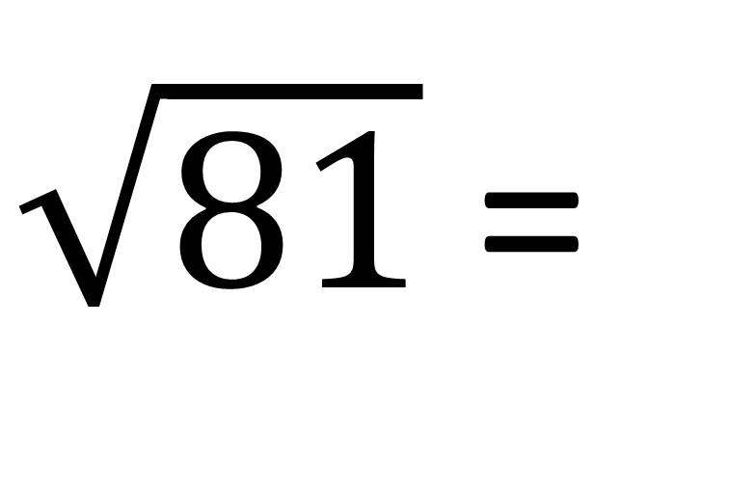
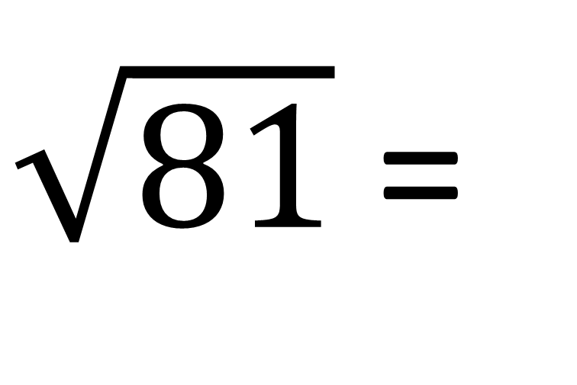
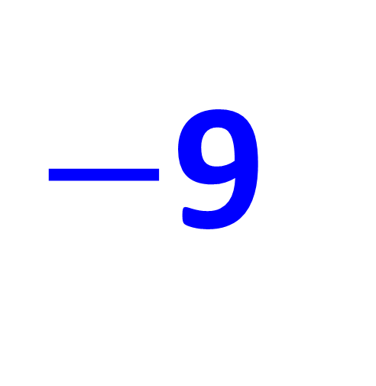
What are the two solutions for the square of 25?
$\sqrt{81}$ =
9
$\sqrt{81}$ =
$−$9

Slide 17
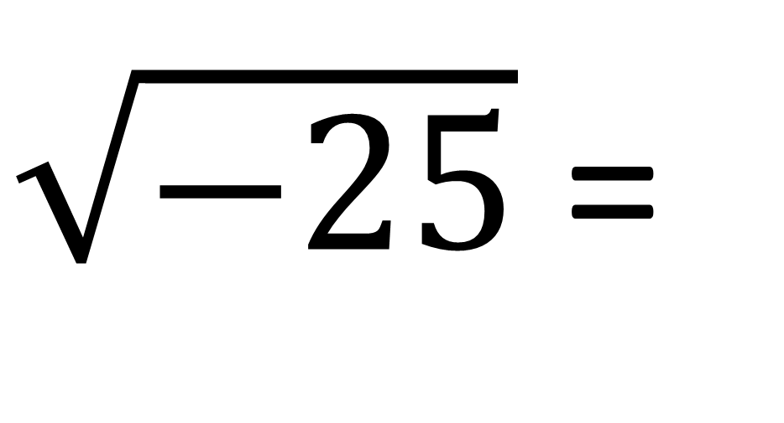
What is the square root of negative 25?
$\sqrt{−25}$ =
No solutions

Slide 18
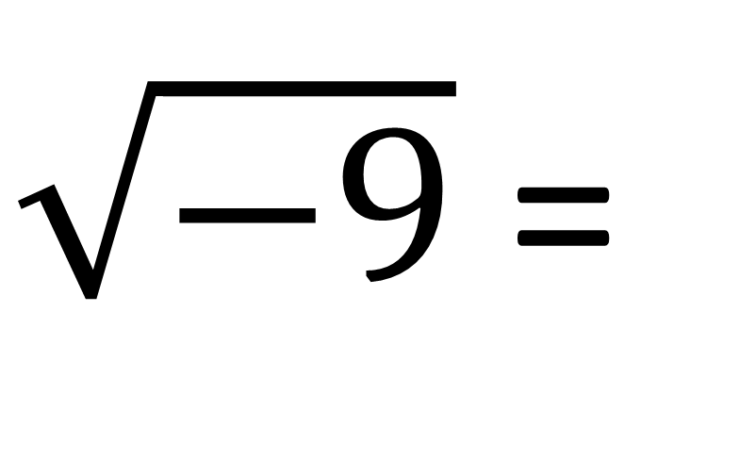
You cannot square root a negative number.
$\sqrt{−9}$ =
No solutions

Slide 19
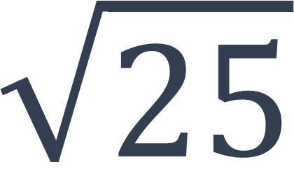
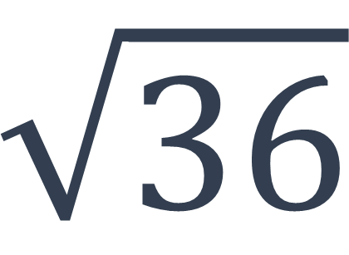
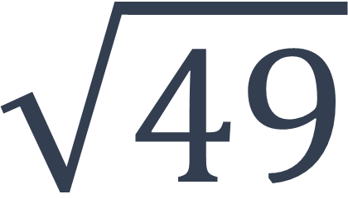
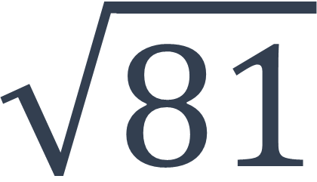
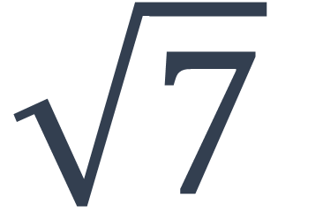
Which one of these is the odd one out?
$$\sqrt{36}$$
$$\sqrt{7}$$
$$\sqrt{25}$$
$$\sqrt{81}$$
$$\sqrt{49}$$

Slide 20
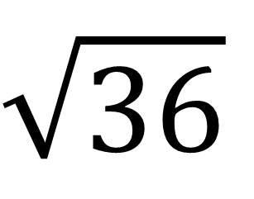
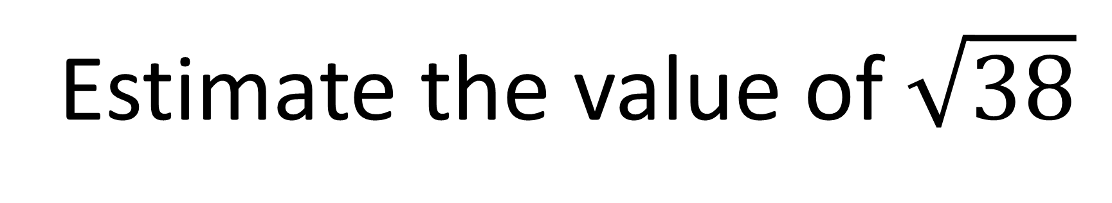
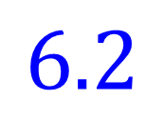
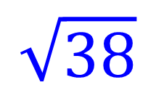
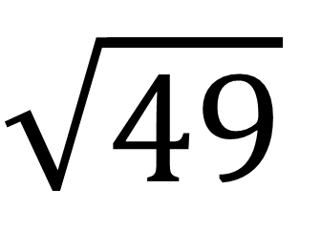
Estimate the value of $\sqrt{38}$
$$\sqrt{36}$$
$$\sqrt{49}$$
$$\sqrt{38}$$
6
$$6.2$$
7

Slide 21
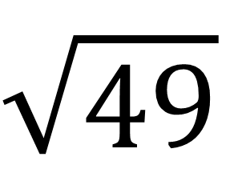
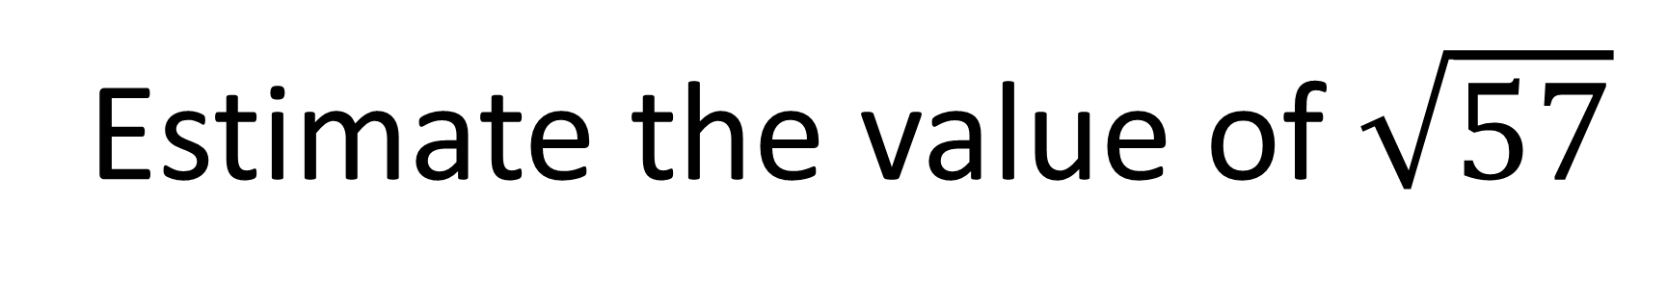
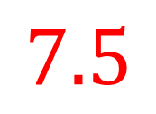
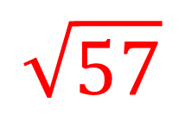
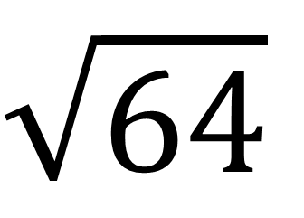
Estimate the value of $\sqrt{57}$
$$\sqrt{49}$$
$$\sqrt{64}$$
$$\sqrt{57}$$
7
$$7.5$$
8

Slide 22
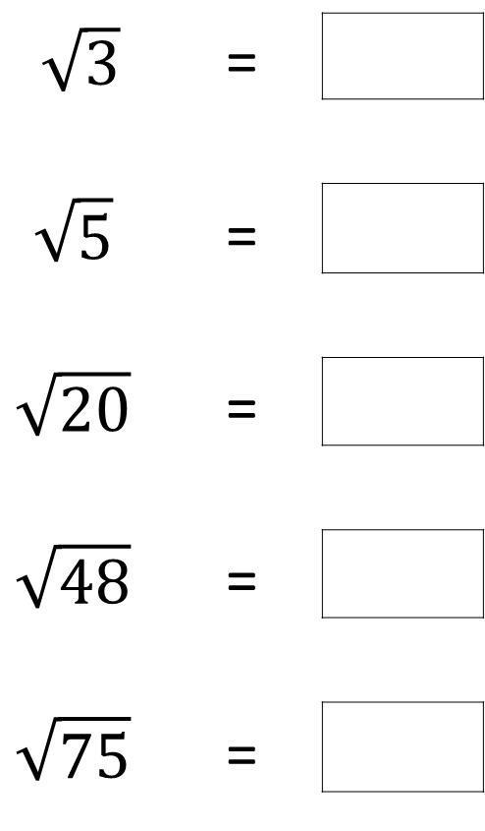
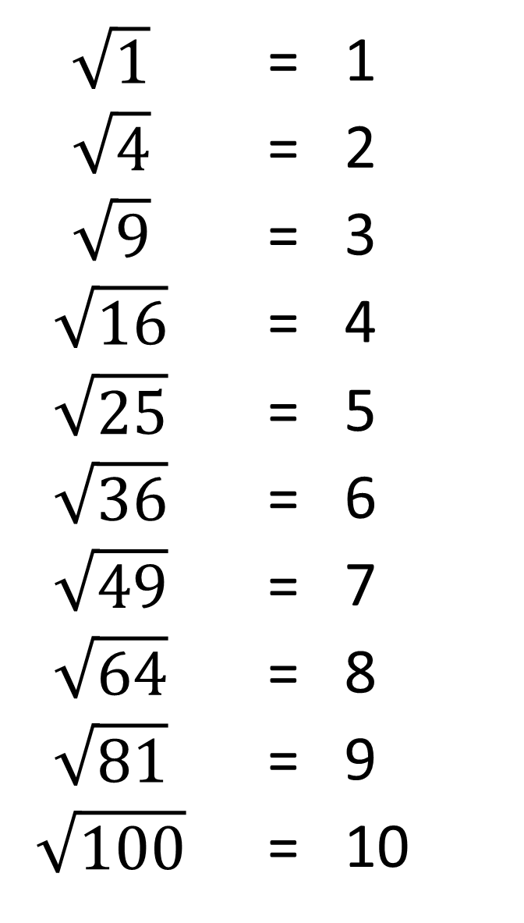
$\sqrt{1}$ | = | 1
$$\sqrt{4}$$ | = | 2
$$\sqrt{9}$$ | = | 3
$$\sqrt{16}$$ | = | 4
$$\sqrt{25}$$ | = | 5
$$\sqrt{36}$$ | = | 6
$$\sqrt{49}$$ | = | 7
$$\sqrt{64}$$ | = | 8
$$\sqrt{81}$$ | = | 9
$$\sqrt{100}$$ | = | 10
Estimate the following
square roots to 1dp
1.7
$\sqrt{3}$ | =
$$\sqrt{5}$$ | =
$$\sqrt{20}$$ | =
$$\sqrt{48}$$ | =
$$\sqrt{75}$$ | =
2.2
4.5
6.9
8.7

Slide 23
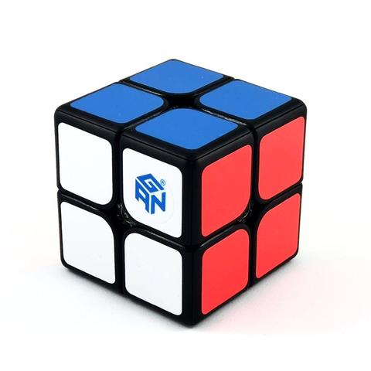
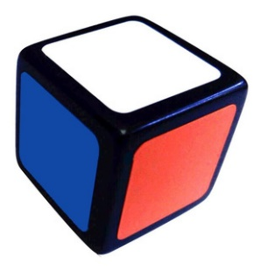
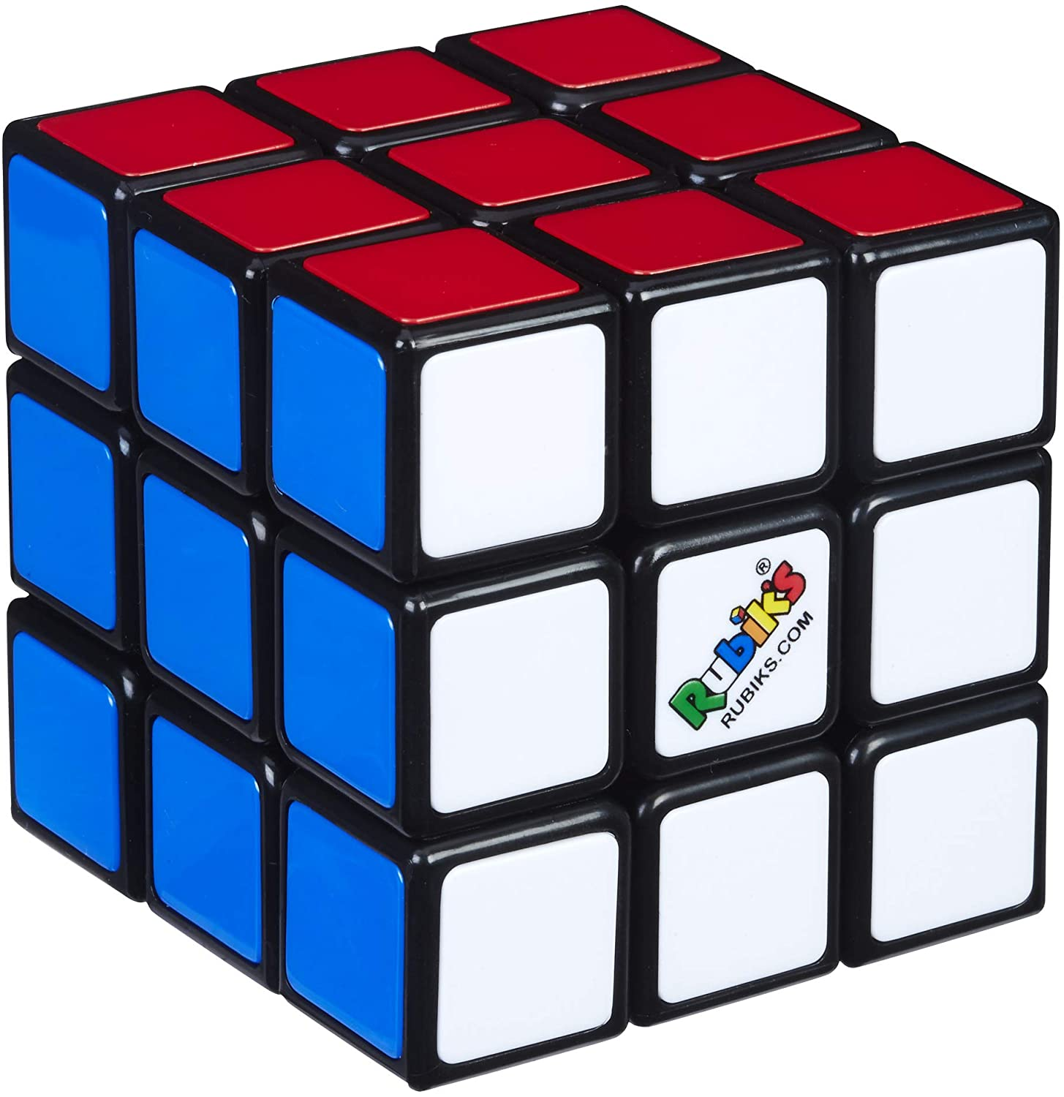
1 x 1 x 1
2 x 2 x 2
3 x 3 x 3
1
8
27

Slide 24

Which one is correct?
$$3^{3}$$
= 9
$$3^{3}$$
= 27

Slide 25
$${Cubes}^{3}$$
4
64
$$\sqrt[3]{64}$$

Slide 26
2³ + 5³ =
133
(2 + 5)³ =
343

Slide 27
$\sqrt[3]{64}$ =
4

Slide 28
$\sqrt[3]{8}$ =
2

Slide 29
Which is bigger?
$\sqrt[3]{27}$ or 2³

Slide 30
Which is bigger?
$\sqrt[3]{125}$ or 1³

Slide 31
$\sqrt[3]{−8}$ =
$−$2
because
$−$2 x $−$2 x $−$2 = $−$8

Slide 32
$\sqrt[3]{−27}$ =
$−$3

Slide 33
Write 27 as the product of primes.
27
3 x 3 x 3 = 27
3
9
$\sqrt[3]{27}$ =
3
3
3

Slide 34
Write 216 as the product of primes.
216
2 x 3 x 2 x 3 x 2 x 3 = 216
2
108
$\sqrt[3]{216}$ =
6
2
54
9
6
3
3
2
3

Slide 35
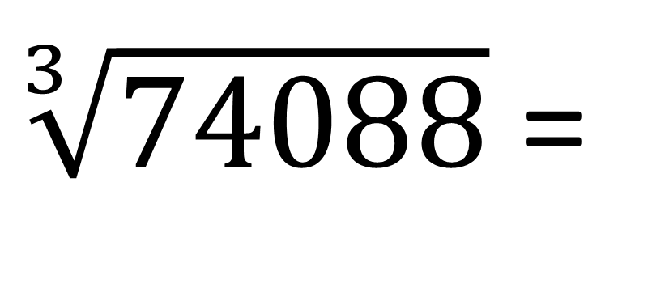
2 x 3 x 7 x 2 x 3 x 7 x 2 x 3 x 7 = 74088
$\sqrt[3]{74088}$ =
42

Slide 36
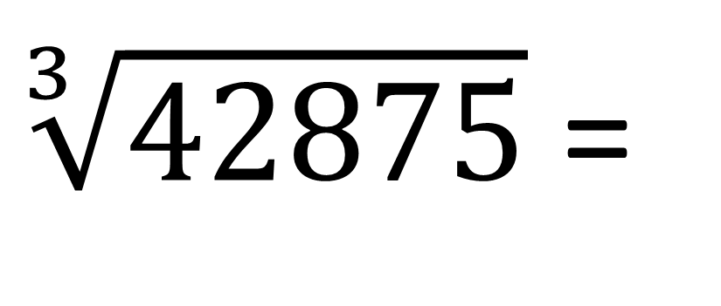
5 x 7 x 5 x 7 x 5 x 7 = 42875
$\sqrt[3]{42875}$ =
35

Slide 37
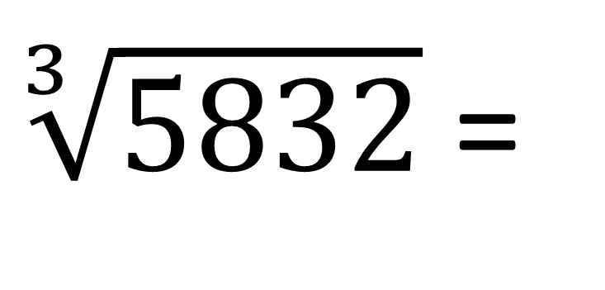
2 x 3 x 3 x 2 x 9 x 2 x 9 = 5832
$\sqrt[3]{5832}$ =
18

Slide 38
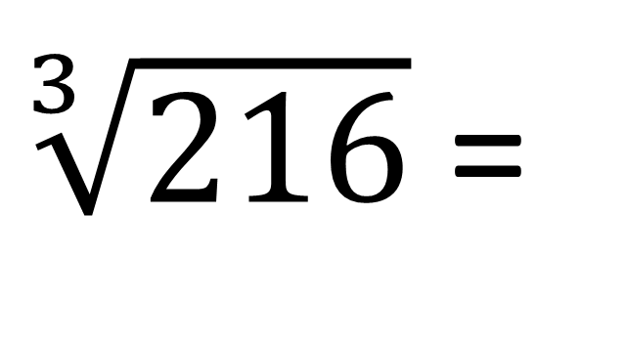
27 x 8 = 216
$\sqrt[3]{216}$ =
6

Slide 39
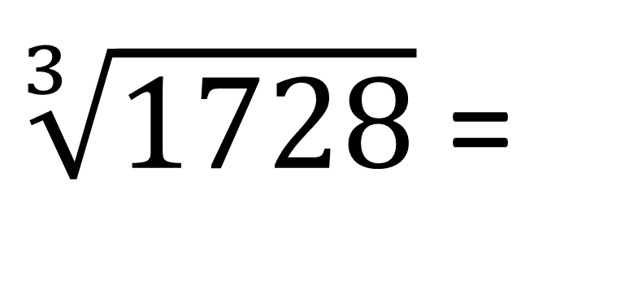
64 x 27 = 1728
$\sqrt[3]{1728}$ =
12

