Slide 1
Binomial Expansion
Partial Fractions
Chapter 4
(Part 3 of 4)

Slide 2

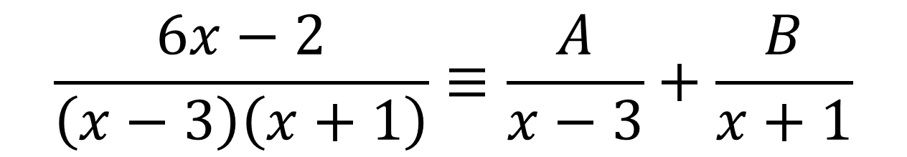
Binomial Expansion – Partial Fractions
Express $\frac{6x−2}{\left(x−3\right)\left(x+1\right)}$as a partial fraction
$$\frac{6x−2}{\left(x−3\right)\left(x+1\right)}≡\frac{A}{x−3}+\frac{B}{x+1}$$

Slide 3


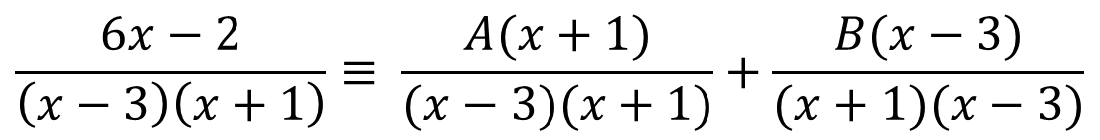


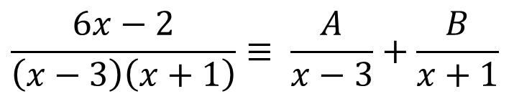



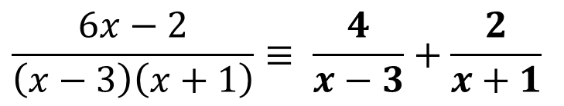

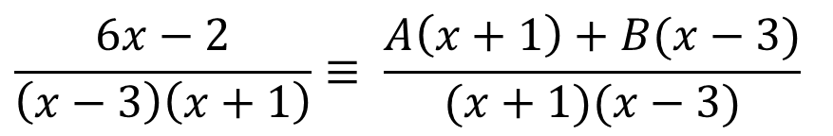


$$\frac{6x−2}{\left(x−3\right)\left(x+1\right)}≡ \frac{A}{x−3}+\frac{B}{x+1}$$
$$6x−2≡A\left(x+1\right)+B(x−3)$$
$$Let x=3$$
$$\frac{6x−2}{\left(x−3\right)\left(x+1\right)}≡ \frac{A(x+1)}{(x−3)(x+1)}+\frac{B(x−3)}{(x+1)(x−3)}$$
$$6(3)−2≡A\left(3+1\right)+B(3−3)$$
$$16≡4A$$
$$A≡4$$
$$\frac{6x−2}{\left(x−3\right)\left(x+1\right)}≡ \frac{A\left(x+1\right)+B(x−3)}{(x+1)(x−3)}$$
$$\frac{6x−2}{\left(x−3\right)\left(x+1\right)}≡ \frac{4}{x−3}+\frac{2}{x+1}$$
$$6x−2≡A\left(x+1\right)+B(x−3)$$
$$Let x=−1$$
$$6(−1)−2≡A\left(−1+1\right)+B(−1−3)$$
$$−8≡−4B$$
$$B≡2$$

Slide 4
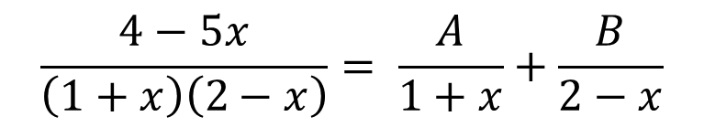
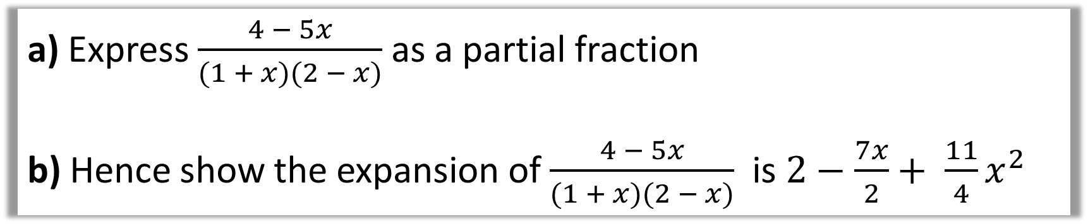
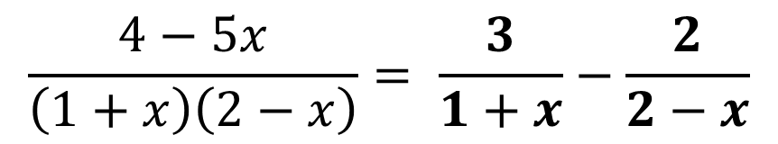








a) Express $\frac{4 − 5x}{(1 + x)(2 − x)}$ as a partial fraction
b) Hence show the expansion of $\frac{4 − 5x}{(1 + x)(2 − x)}$ is $2−\frac{7x}{2}+ \frac{11}{4}x^{2}$
a)
$$\frac{4−5x}{\left(1+x\right)\left(2−x\right)}= \frac{A}{1+x}+\frac{B}{2−x}$$
$$4−5x≡A\left(2−x\right)+B(1+x)$$
$$Let x=2$$
$$−6≡3B$$
$$4−5x≡A\left(2−x\right)+B(1+x)$$
$$A≡−2$$
$$Let x=−1$$
$$9≡3A$$
$$\frac{4−5x}{\left(1+x\right)\left(2−x\right)}= \frac{3}{1+x}−\frac{2}{2−x}$$
$$A≡3$$

Slide 5
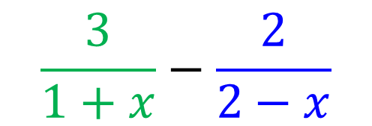
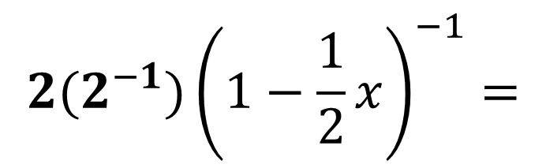
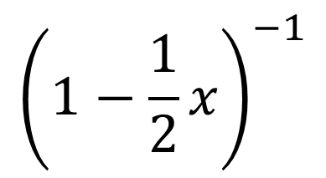
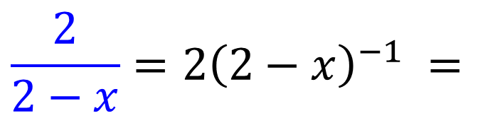
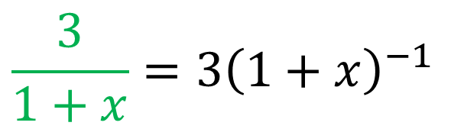
a) Express $\frac{4 − 5x}{(1 + x)(2 − x)}$ as a partial fraction
b) Hence show the expansion of $\frac{4 − 5x}{(1 + x)(2 − x)}$ is $2−\frac{7x}{2}+ \frac{11}{4}x^{2}$
$$\frac{3}{1+x}−\frac{2}{2−x}$$
b)
$${\frac{3}{1+x}=3\left(1+x\right)}^{−1}$$
$${2(2}^{−1}){\left(1−\frac{1}{2}x\right)}^{−1}=$$
$${\left(1−\frac{1}{2}x\right)}^{−1}$$
$${\frac{2}{2−x}=2\left(2−x\right)}^{−1} =$$

Slide 6
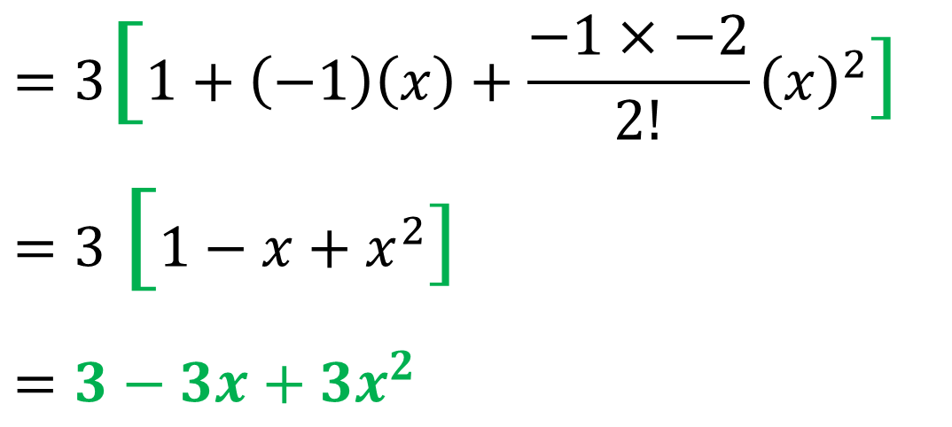
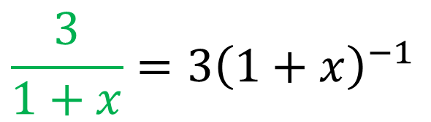
a) Express $\frac{4 − 5x}{(1 + x)(2 − x)}$ as a partial fraction
b) Hence show the expansion of $\frac{4 − 5x}{(1 + x)(2 − x)}$ is $2−\frac{7x}{2}+ \frac{11}{4}x^{2}$
$${\frac{3}{1+x}=3\left(1+x\right)}^{−1}$$
$$=3[1+\left(−1\right)\left(x\right)+\frac{−1×−2}{2!}{\left(x\right)}^{2}]$$
$$=3 [1−x+x^{2}]$$
$$=3−3x+3x^{2}$$
b)

Slide 7
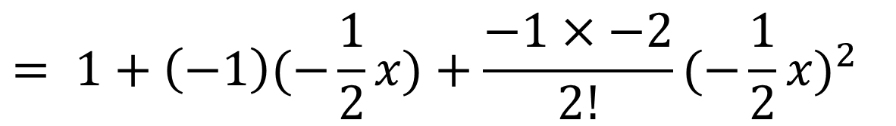
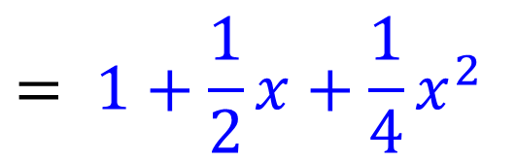
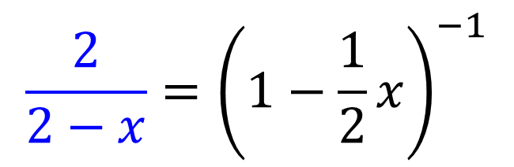
a) Express $\frac{4 − 5x}{(1 + x)(2 − x)}$ as a partial fraction
b) Hence show the expansion of $\frac{4 − 5x}{(1 + x)(2 − x)}$ is $2−\frac{7x}{2}+ \frac{11}{4}x^{2}$
$$\frac{2}{2−x}={\left(1−\frac{1}{2}x\right)}^{−1}$$
b)
$$= 1+\left(−1\right)(−\frac{1}{2}x)+\frac{−1×−2}{2!}{(−\frac{1}{2}x)}^{2}$$
$$= 1+\frac{1}{2}x+{\frac{1}{4}x}^{2}$$

Slide 8
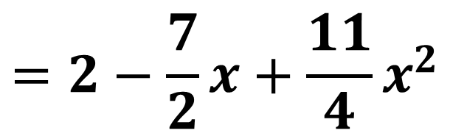
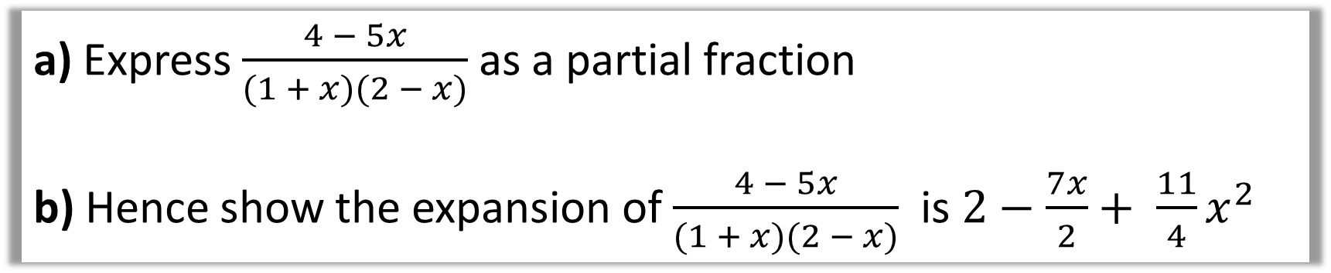
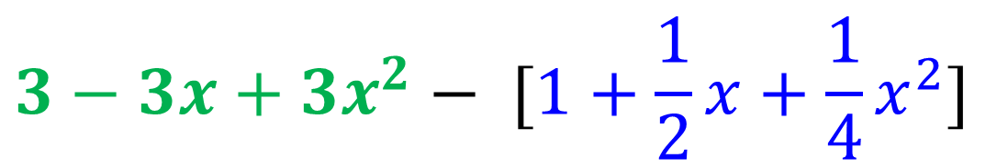
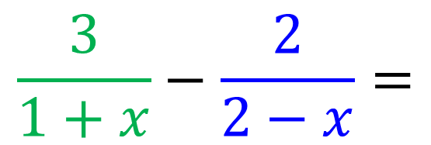
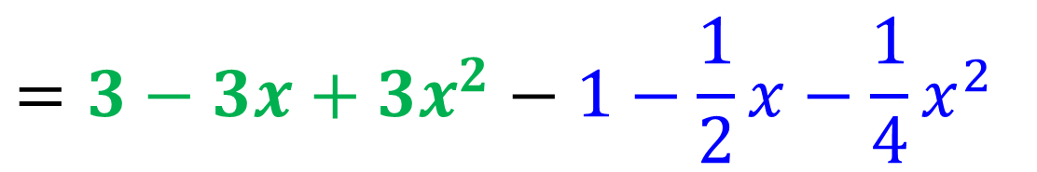
a) Express $\frac{4 − 5x}{(1 + x)(2 − x)}$ as a partial fraction
b) Hence show the expansion of $\frac{4 − 5x}{(1 + x)(2 − x)}$ is $2−\frac{7x}{2}+ \frac{11}{4}x^{2}$
$$\frac{3}{1+x}−\frac{2}{2−x}=$$
$$3−3x+3x^{2}− [1+\frac{1}{2}x+{\frac{1}{4}x}^{2}]$$
b)
$$=3−3x+3x^{2}−1−\frac{1}{2}x−{\frac{1}{4}x}^{2}$$
$$=2−\frac{7}{2}x+\frac{11}{4}x^{2}$$

Slide 9
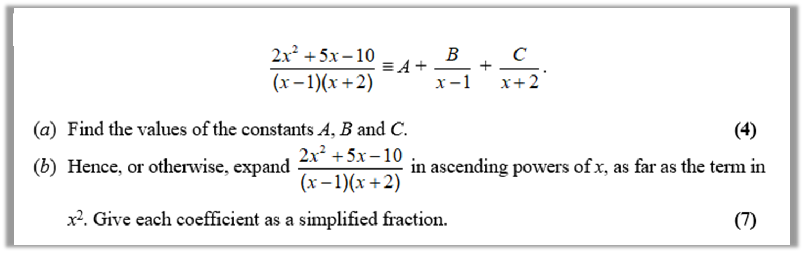
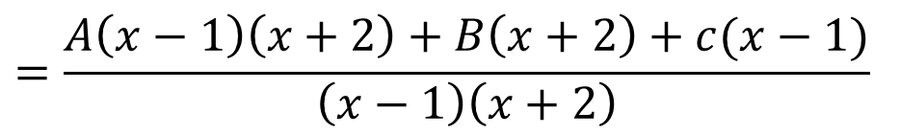




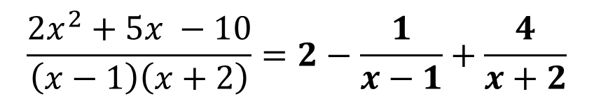
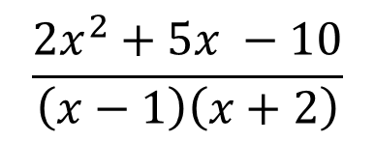



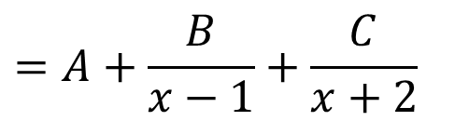


a)
$${2x}^{2}+5x −10=A\left(x−1\right)\left(x+2\right)+B\left(x+2\right)+C(x−1)$$
$$\frac{{2x}^{2}+5x −10}{\left(x−1\right)\left(x+2\right)}$$
$$Let x=1$$
$$−3≡3B$$
$$B≡−1$$
$$Let x=−2$$
$$−12≡−3B$$
$C≡4$
$$=A+\frac{B}{x−1}+\frac{C}{x+2}$$
$$Let x=0$$
$$−10≡−2A+2B −C$$
$A≡2$
$$=\frac{A\left(x−1\right)\left(x+2\right)+B\left(x+2\right)+c(x−1)}{\left(x−1\right)\left(x+2\right)}$$
$$\frac{{2x}^{2}+5x −10}{\left(x−1\right)\left(x+2\right)}=2−\frac{1}{x−1}+\frac{4}{x+2}$$

Slide 10
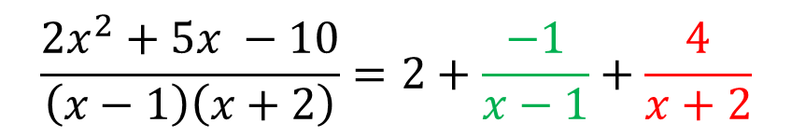



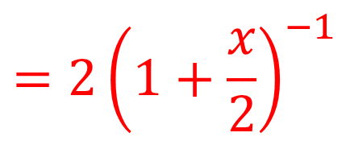
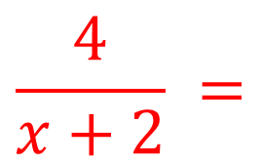
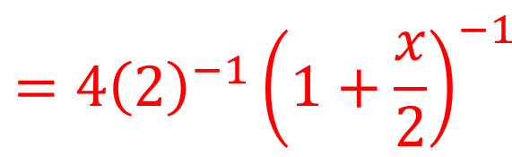
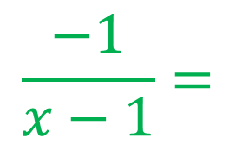

b)
$$\frac{{2x}^{2}+5x −10}{\left(x−1\right)\left(x+2\right)}=2+\frac{−1}{x−1}+\frac{4}{x+2}$$
$${\left(1+x\right)}^{n}=1+n\left(x\right)+\frac{n(n−1)}{1 \text{x} 2}{\left(x\right)}^{2}+\frac{n\left(n−1\right)…(n−r+1)}{1 \text{x} 2 \text{x} …\text{x} r}{\left(x\right)}^{2}$$
$$\frac{4}{x+2} =$$
$$\frac{−1}{x−1}=$$
$$4({2+x)}^{−1}$$
$${−1\left(−1+x\right)}^{−1}$$
$${=4{\left(2\right)}^{−1}\left(1+\frac{x}{2}\right)}^{−1}$$
$${{=−1\left(−1\right)}^{−1}\left(1−x\right)}^{−1}$$
$${=2\left(1+\frac{x}{2}\right)}^{−1}$$
$${=\left(1−x\right)}^{−1}$$

Slide 11

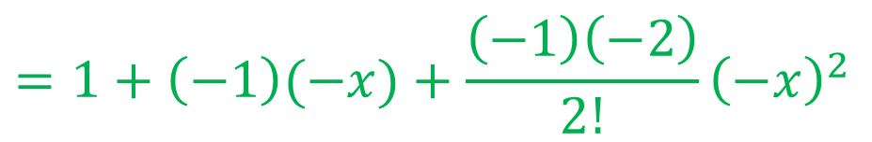
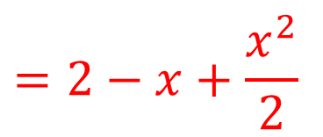
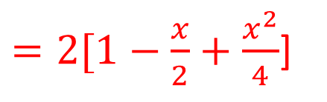
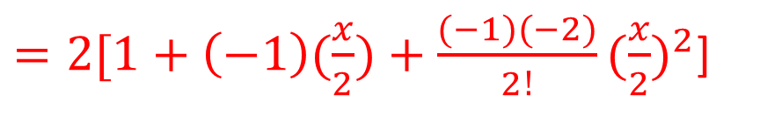
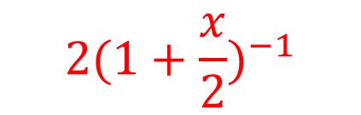

b)
$${2(1+\frac{x}{2})}^{−1}$$
$${\left(1+x\right)}^{n}=1+n\left(x\right)+\frac{n(n−1)}{1 \text{x} 2}{\left(x\right)}^{2}+\frac{n\left(n−1\right)…(n−r+1)}{1 \text{x} 2 \text{x} …\text{x} r}{\left(x\right)}^{2}$$
$=2[1+\left(−1\right)(\frac{x}{2})+\frac{(−1)(−2)}{2!}{(\frac{x}{2})}^{2}$]
$${\left(1−x\right)}^{−1}$$
$$=1+\left(−1\right)(−x)+\frac{\left(−1\right)\left(−2\right)}{2!}{\left(−x\right)}^{2}$$
$=2[1−\frac{x}{2}+\frac{x^{2}}{4}$]
$$=2−x+\frac{x^{2}}{2}$$
$$=1+x{ + x}^{2}$$

Slide 12
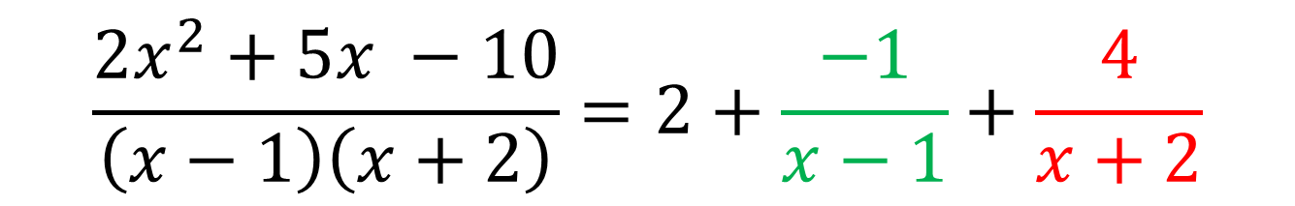
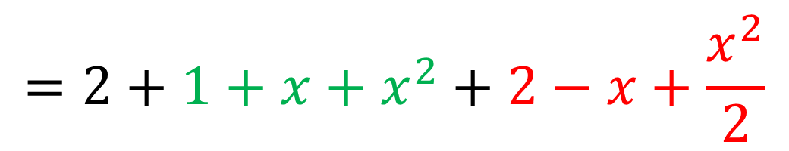
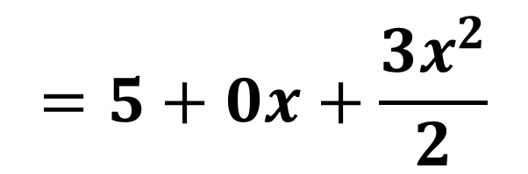
b)
$$\frac{{2x}^{2}+5x −10}{\left(x−1\right)\left(x+2\right)}=2+\frac{−1}{x−1}+\frac{4}{x+2}$$
$$=2+1+x{ + x}^{2}+2−x+\frac{x^{2}}{2}$$
$$=5+0x+\frac{{3x}^{2}}{2}$$

