Slide 1
Sketching Graphs
Quartic Graphs
Chapter 4
(Part 2 of 5)

Slide 2
Quartic Graphs
$$y={{{ax}^{4}+bx}^{3}+cx}^{2}+dx+e$$

Slide 3
Questions you should ask yourself
when sketching a quartic graph.
General Shape
Positive or negative gradient?
x Intercepts
Where does the graph cross the x axis?
y Intercept
What is the constant?

Slide 4
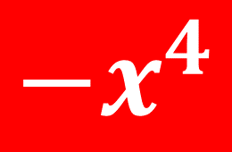
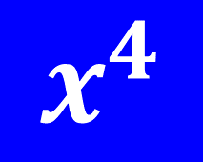
Which graph has a positive gradient?
Positive Gradient
Negative Gradient
$${−x}^{4}$$
$$x^{4}$$

Slide 5
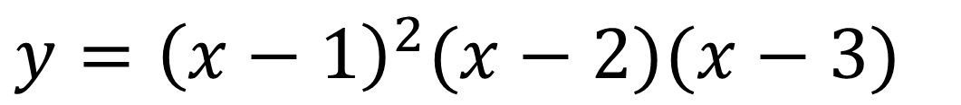
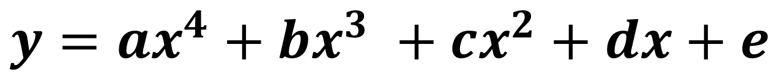
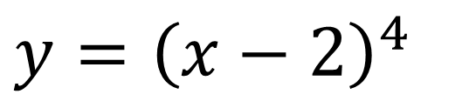
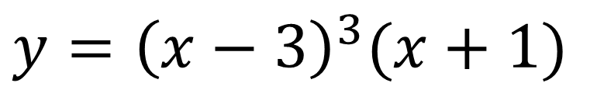
Possible Quartic Equations
$$y=ax^{4}+bx^{3} +cx^{2}+dx+e$$
$$y=(x+1)(x+2)(x−3)(x−4)$$
$$y={\left(x−1\right)}^{2}(x−2)(x−3)$$
$$y={\left(x−3\right)}^{3}(x+1)$$
$$y={\left(x−2\right)}^{4}$$

Slide 6
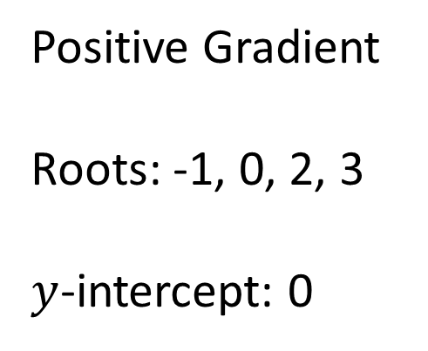
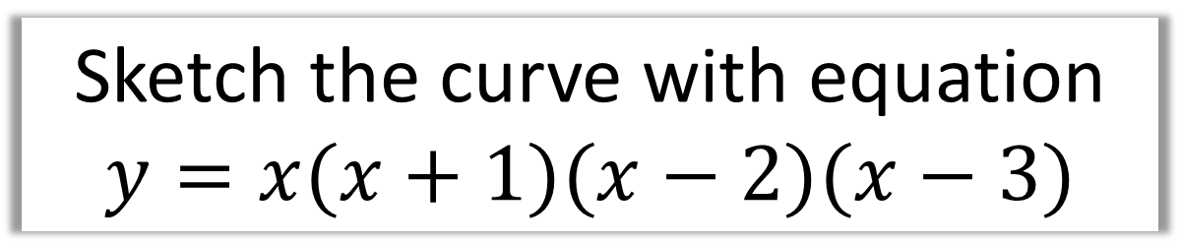


Sketch the curve with equation
$$y=x(x+1)(x−2)(x−3)$$
No Equal Roots
$$y$$
Positive Gradient
Roots: -1, 0, 2, 3
$y$-intercept: 0
$$x$$
-1
2
3

Slide 7

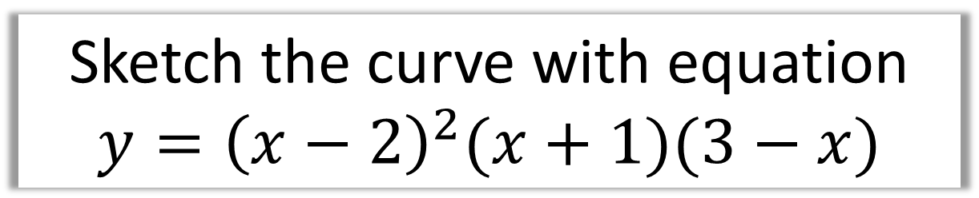
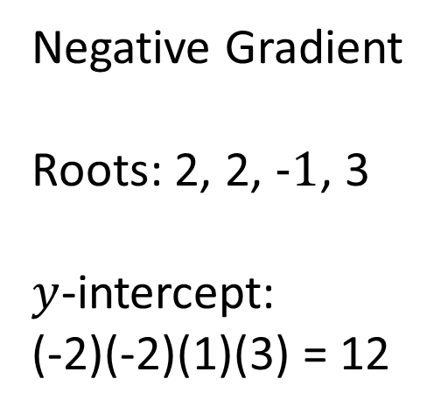

Sketch the curve with equation
$$y={\left(x−2\right)}^{2}(x+1)(3−x)$$
$$y$$
Two Equal Roots
Negative Gradient
Roots: 2, 2, $−1$, 3
$y$-intercept:
(-2)(-2)(1)(3) = 12
$$x$$
-1
2
3

Slide 8


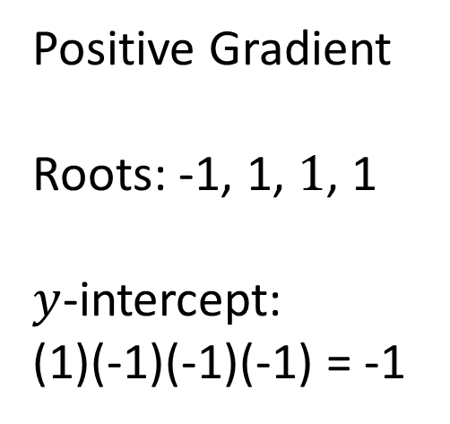

Sketch the curve with equation
$$y=\left(x+1\right){\left(x−1\right)}^{3}$$
$$y$$
Three Equal Roots
Positive Gradient
Roots: -1, 1, $1$, 1
$y$-intercept:
(1)(-1)(-1)(-1) = -1
$$x$$
-1
1
-1

Slide 9
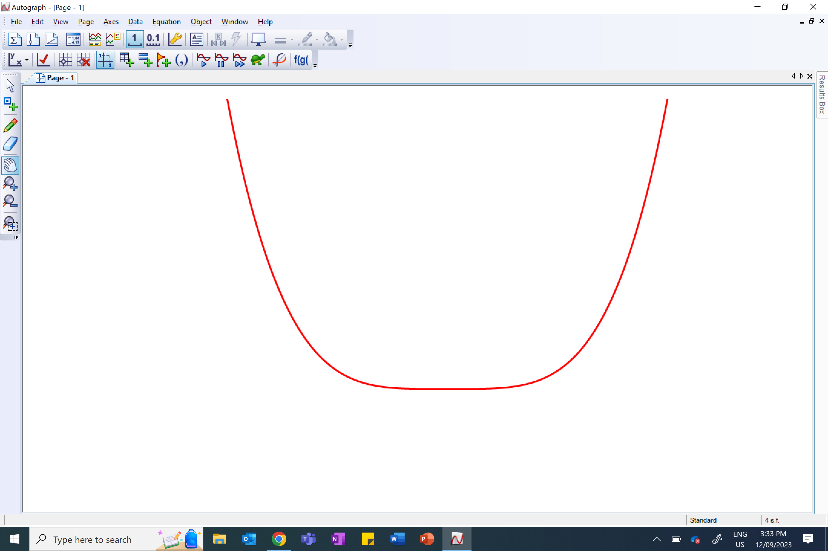



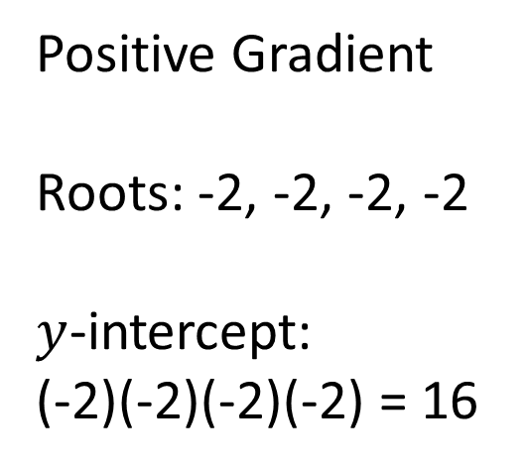
Sketch the curve with equation
$$y={\left(x−2\right)}^{4}$$
$$y$$
$$y$$
Four Equal Roots
Positive Gradient
Roots: -2, -2, -2, -2
$y$-intercept:
(-2)(-2)(-2)(-2) = 16
16
$$x$$
$$x$$
2

Slide 10



Sketch the curve with equation
$$y=x^{2}\left(x+1\right)\left(x−1\right)$$
$$y$$
$$x$$
-1
1

Slide 11



Sketch the curve with equation
$$y=−(x+1){\left(x−3\right)}^{3}$$
$$y$$
27
-1
3
$$x$$

