Slide 1
Vectors
Application to Mechanics
Chapter 12
(Part 6 of 6)

Slide 2
A vector has direction and magnitude.

Slide 3
A scalar is only a magnitude.

Slide 4
Speed
Vector or Scalar?
Scalar

Slide 5
Velocity
Vector or Scalar?
Vector

Slide 6
Acceleration
Vector or Scalar?
Vector

Slide 7
Mass
Vector or Scalar?
Scalar

Slide 8
Time
Vector or Scalar?
Scalar

Slide 9
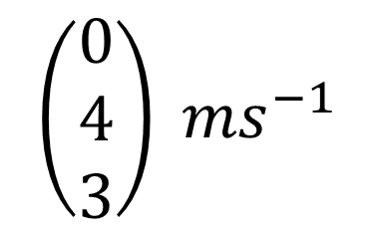
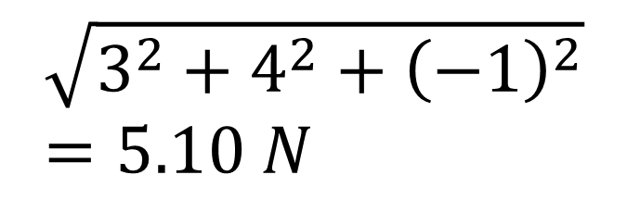
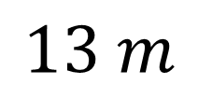
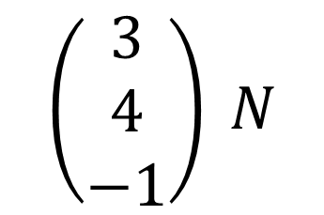
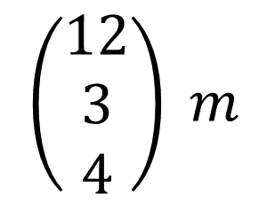
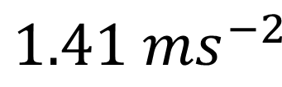
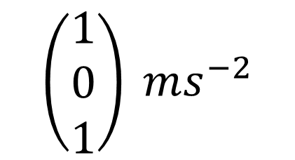
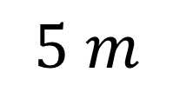
Vector
Scalar
$$\left(\begin{matrix}3 \\ 4 \\ −1\end{matrix}\right) N$$
Force
$$\sqrt{3^{2}+4^{2}+{\left(−1\right)}^{2}} \\ =5.10 N$$
$$\left(\begin{matrix}1 \\ 0 \\ 1\end{matrix}\right) ms^{−2}$$
Acceleration
$$1.41 ms^{−2}$$
$$\left(\begin{matrix}12 \\ 3 \\ 4\end{matrix}\right) m$$
Displacement
$$13 m$$
Distance
$$\left(\begin{matrix}0 \\ 4 \\ 3\end{matrix}\right) ms^{−1}$$
Velocity
$$5 m$$
Speed

Slide 10
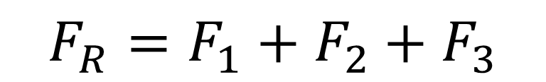
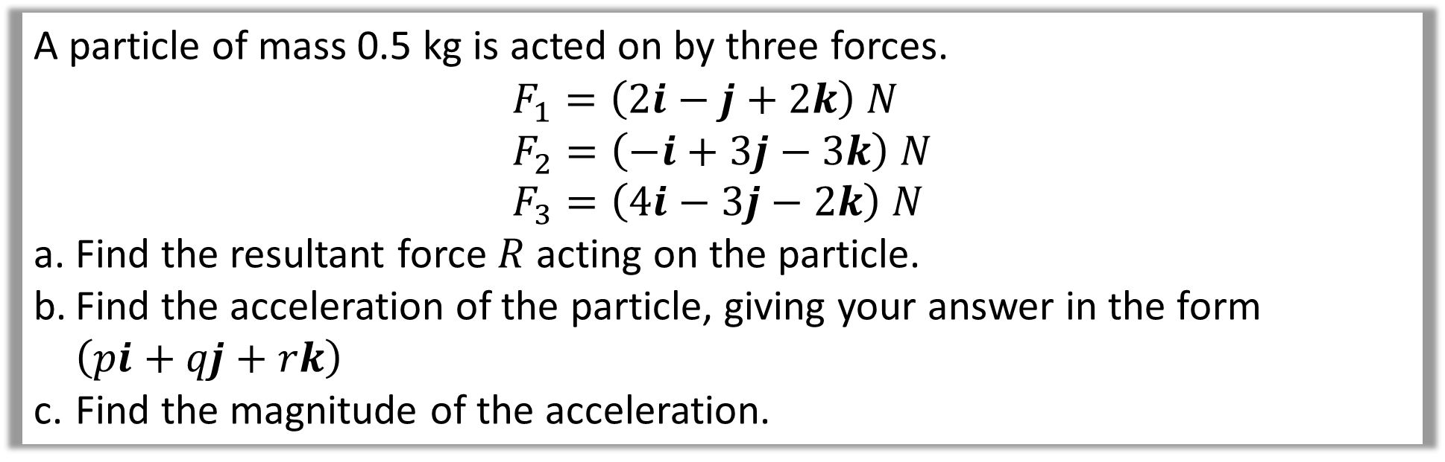
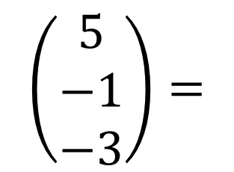
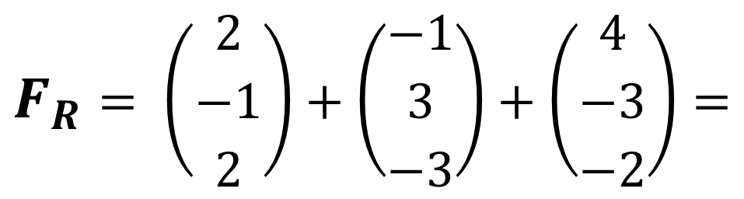
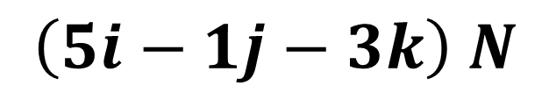
A particle of mass 0.5 kg is acted on by three forces.
$$F_{1}=\left(2i−j+2k\right) N \\ F_{2}=\left(−i+3j−3k\right) N \\ F_{3}=\left(4i−3j−2k\right) N$$
Find the resultant force $R$ acting on the particle.
Find the acceleration of the particle, giving your answer in the form $\left(pi+qj+rk\right)$
Find the magnitude of the acceleration.
a)
$${F_{R}=F}_{1}+F_{2}+F_{3}$$
$$F_{R}= \left(\begin{matrix}2 \\ −1 \\ 2\end{matrix}\right)+\left(\begin{matrix}−1 \\ 3 \\ −3\end{matrix}\right)+\left(\begin{matrix}4 \\ −3 \\ −2\end{matrix}\right)=$$
$$\left(\begin{matrix}5 \\ −1 \\ −3\end{matrix}\right)=$$
$$\left(5i−1j−3k\right) N$$

Slide 11
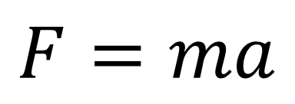
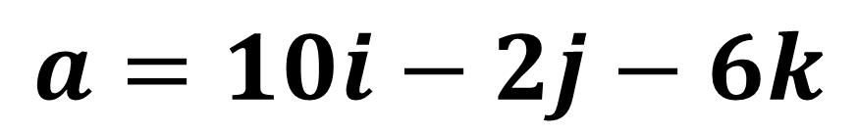
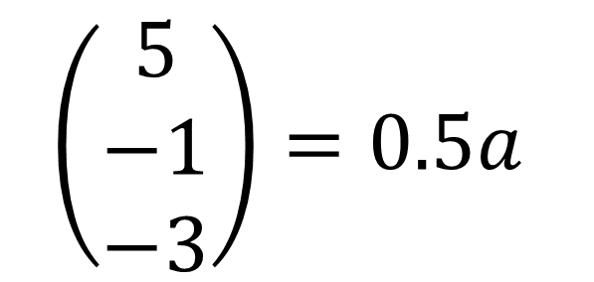
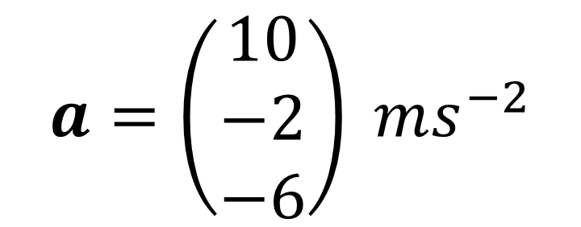
A particle of mass 0.5 kg is acted on by three forces.
$$F_{1}=\left(2i−j+2k\right) N \\ F_{2}=\left(−i+3j−3k\right) N \\ F_{3}=\left(4i−3j−2k\right) N$$
Find the resultant force $R$ acting on the particle.
Find the acceleration of the particle, giving your answer in the form $\left(pi+qj+rk\right)$
Find the magnitude of the acceleration.
$$\left(\begin{matrix}5 \\ −1 \\ −3\end{matrix}\right)=0.5a$$
$$a=\left(\begin{matrix}10 \\ −2 \\ −6\end{matrix}\right) ms^{−2}$$
b)
$$F=ma$$
$$a=10i−2j−6k$$

Slide 12
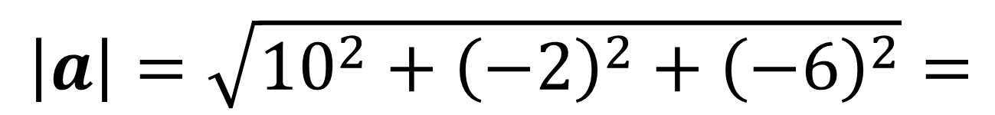
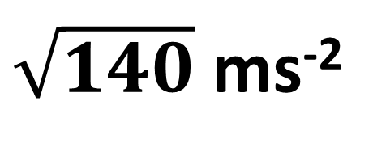
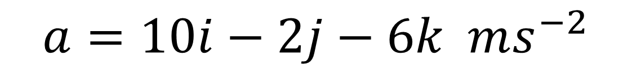
A particle of mass 0.5 kg is acted on by three forces.
$$F_{1}=\left(2i−j+2k\right) N \\ F_{2}=\left(−i+3j−3k\right) N \\ F_{3}=\left(4i−3j−2k\right) N$$
Find the resultant force $R$ acting on the particle.
Find the acceleration of the particle, giving your answer in the form $\left(pi+qj+rk\right)$
Find the magnitude of the acceleration.
c)
$$a=10i−2j−6k ms^{−2}$$
$\left|a\right|=\sqrt{{10}^{2}+{\left(−2\right)}^{2}+{\left(−6\right)}^{2}}=$
$\sqrt{140}$ ms⁻²

