Slide 1
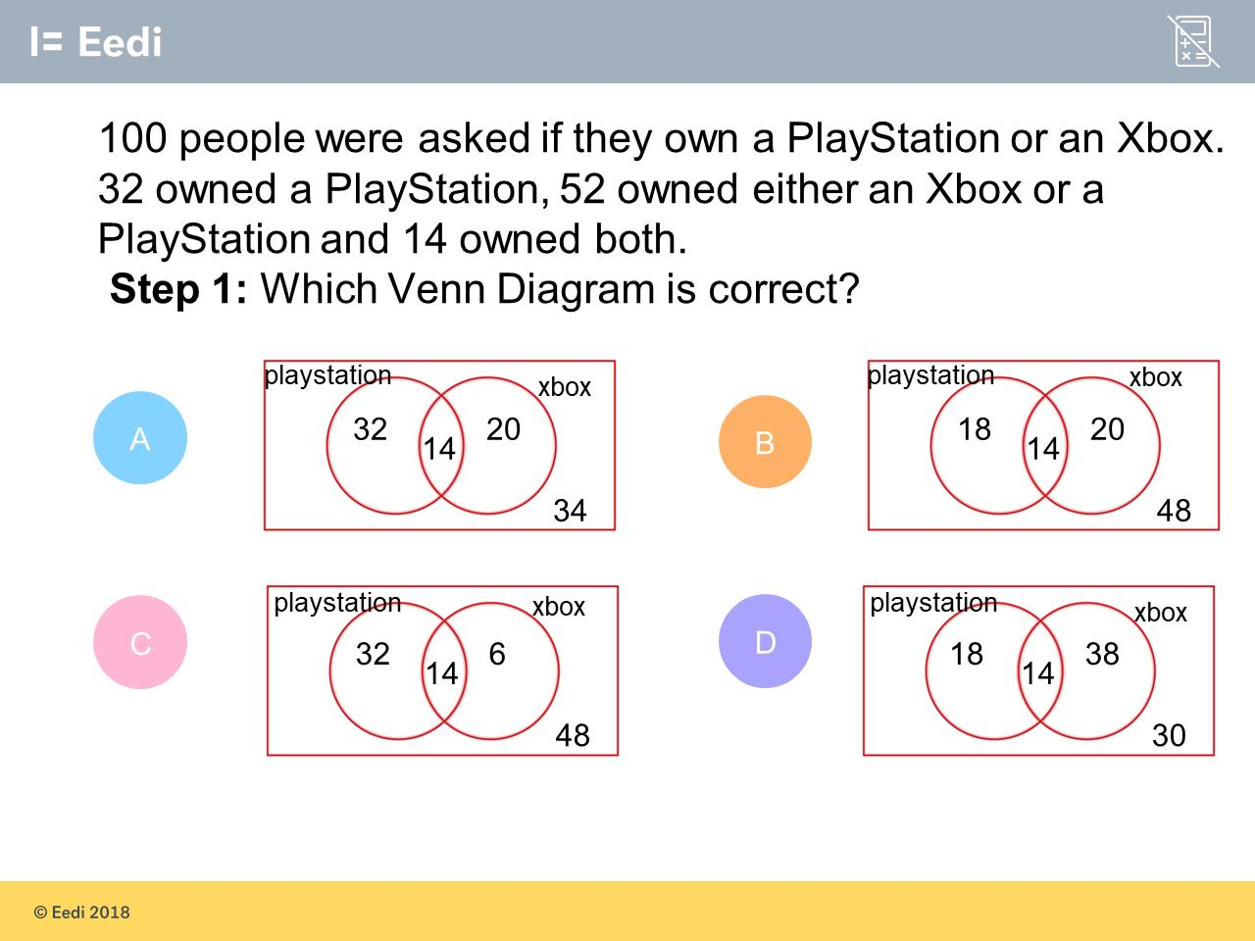
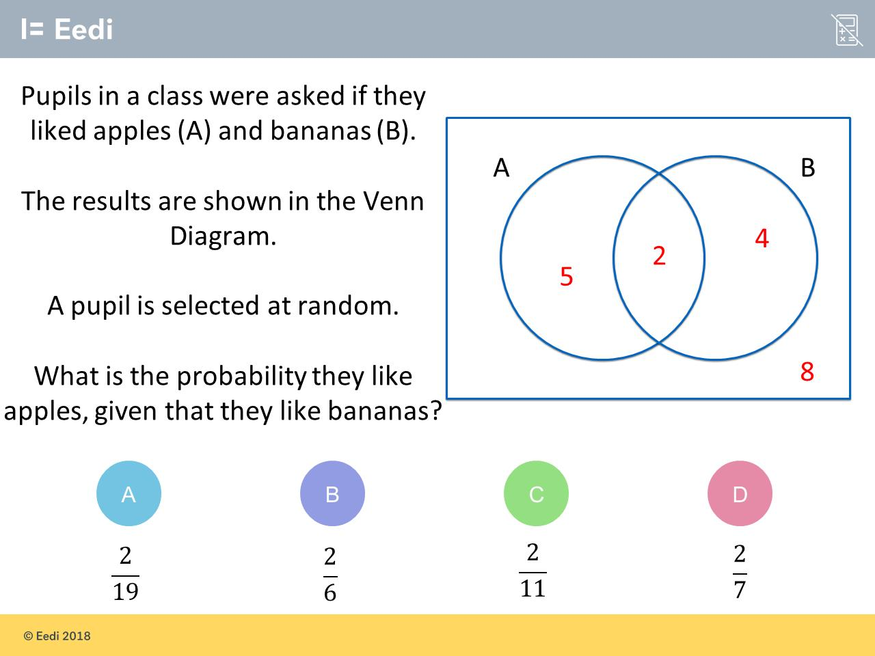
Worst answered question?
Most common wrong answer?

Slide 2
ANSWERS

Slide 3
Worst answered question?

Slide 4
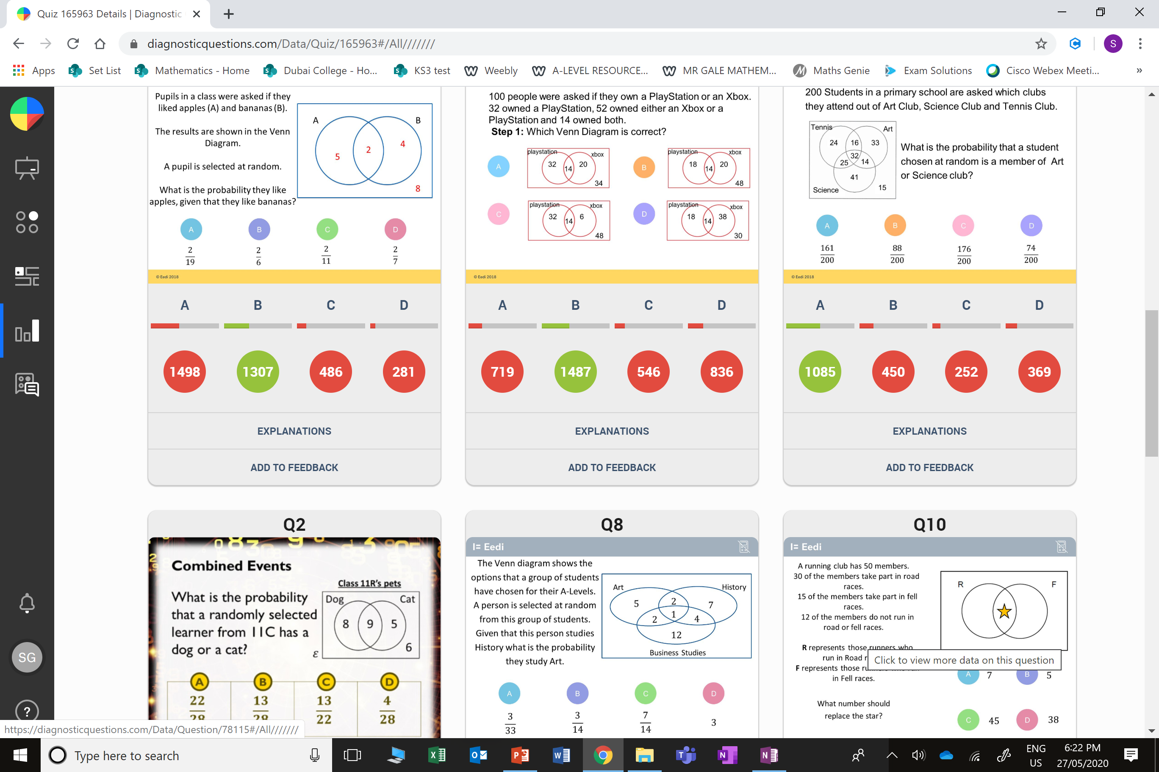
A
The student has given the probability that they like both.

Slide 5
D
The student has not subtracted 18 from 38 for the people who own just an xbox.

