Slide 1

Intermediate Challenge 5
GOLD

Slide 2
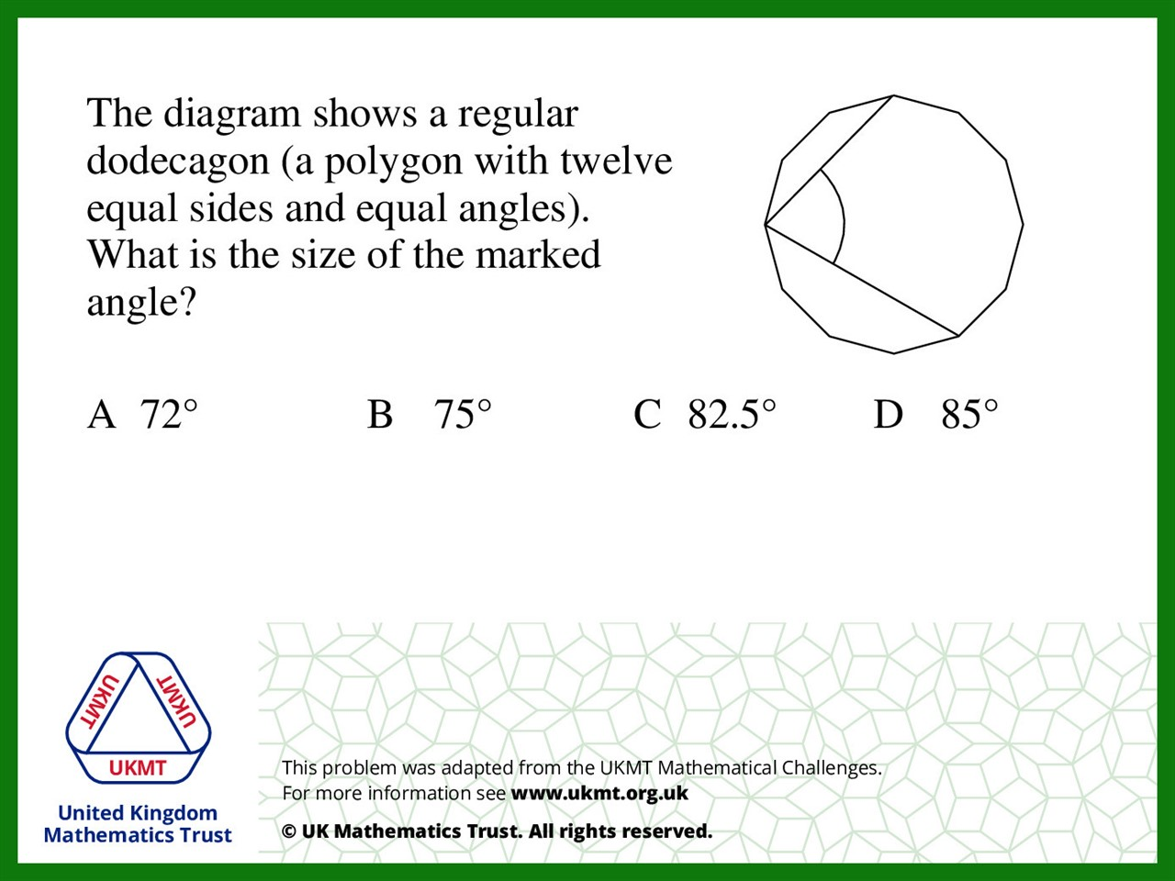
Q1.
180 ÷ 12 = 15˚
15˚per one section
Therefore 5 sections = 15 x 5 = 75˚

Slide 3
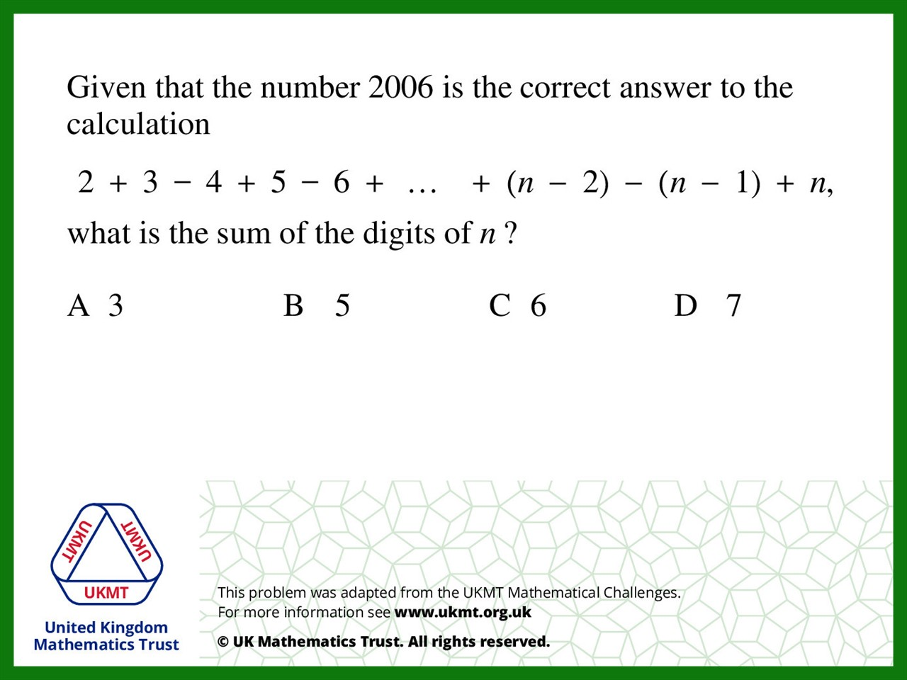
Q2.

Slide 4
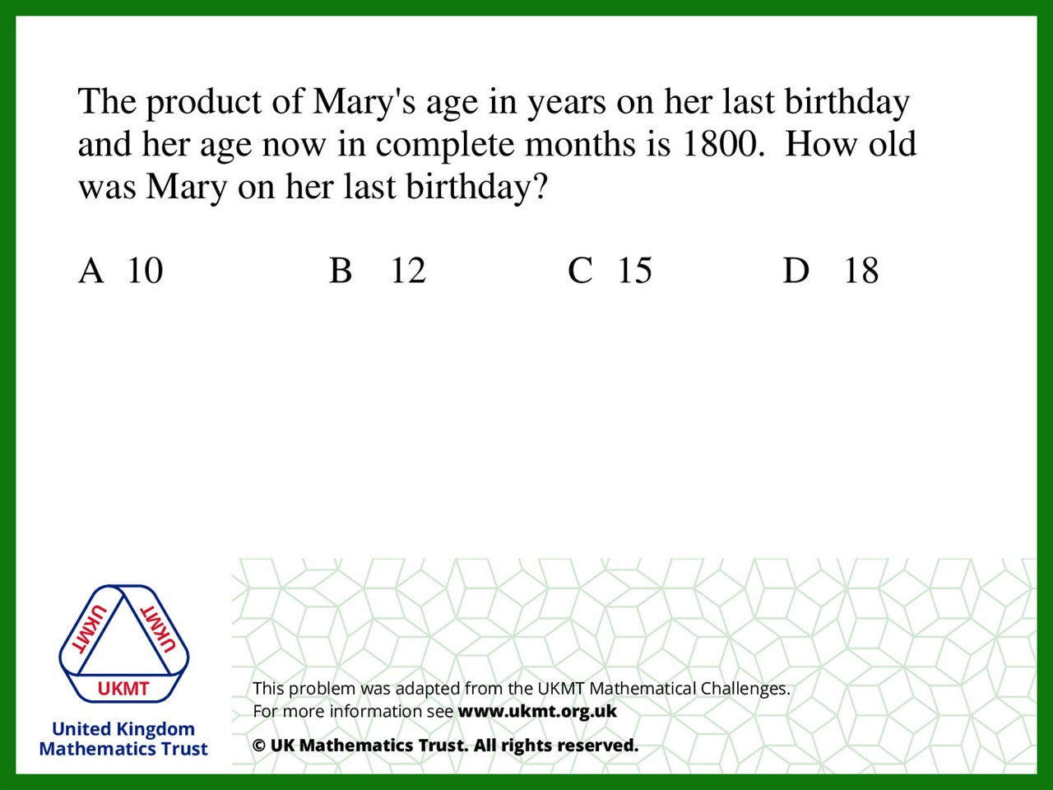
Q3.
1800 ÷ 12 = 150
The product of Mary's age on her last birthday
and her age now must be 150.
The product of 12 times 12 is closest to 150.

Slide 5
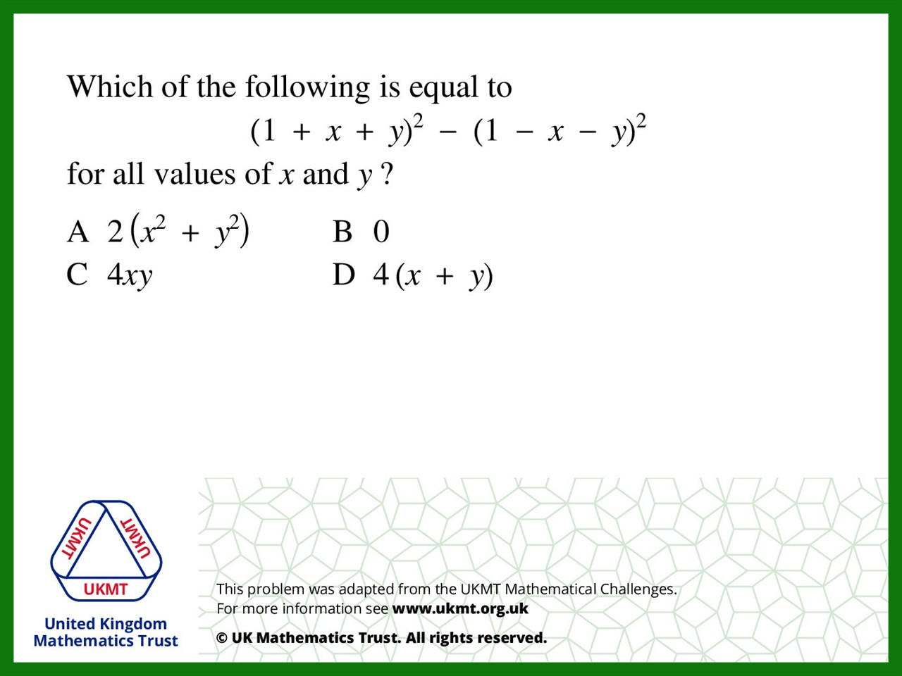
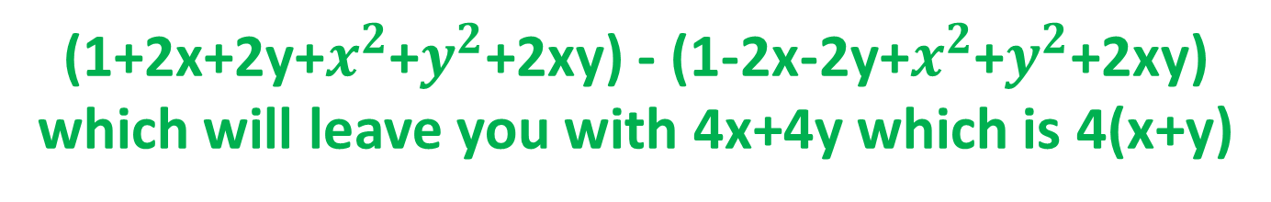
Q4.
(1+2x+2y+$x^{2}$+$y^{2}$+2xy) - (1-2x-2y+$x^{2}$+$y^{2}$+2xy)
which will leave you with 4x+4y which is 4(x+y)

Slide 6
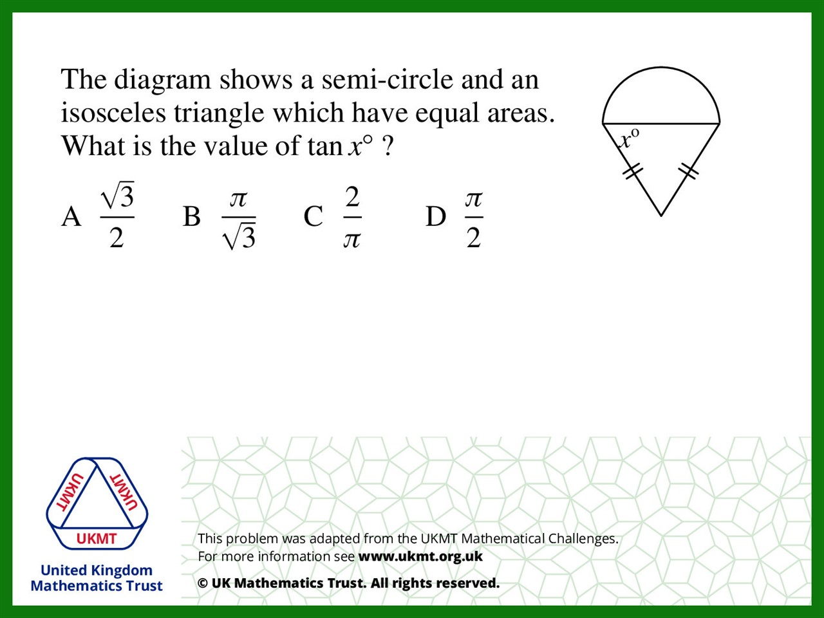

Q5.
Let radius = r and height = h
tan x = h/r
area of semi-circle = ½ $π^{2}$
area of triangle = ½ x 2r x h = rh
rh = ½$π^{2}$
so $\frac{h}{r}=\frac{π}{2}$

