Slide 1
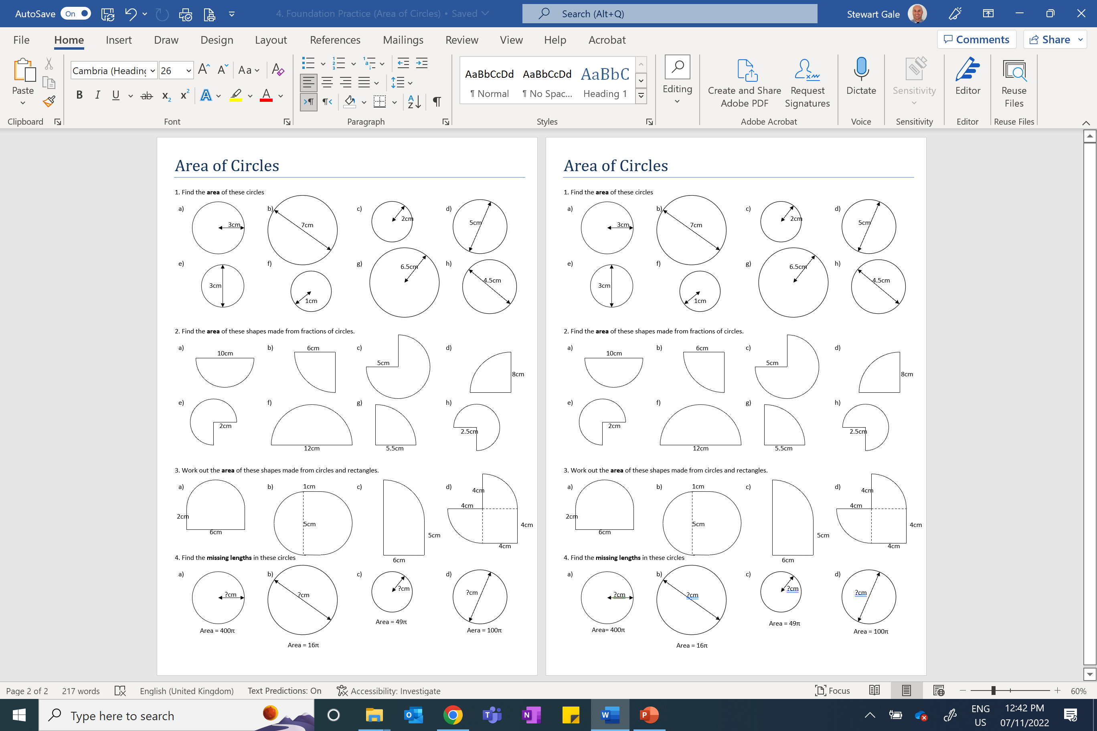

Slide 3
ANSWERS

Slide 4








a) ${Area=π3}^{2}=9π$
d) ${Area= π2.5}^{2}=6.25π$
g) ${Area= π6.5}^{2}=42.25π$
b) ${Area=π3.5}^{2}=12.25π$
e) ${Area= π1.5}^{2}=2.25π$
h) ${Area= π2.25}^{2}=5.0625π$
c) ${Area=π2}^{2}=4π$
f) ${Area= π1}^{2}=π$

Slide 5








a) ${Area=\frac{1}{2}π5}^{2}=12.5π$
d) ${Area=\frac{1}{4}π8}^{2}=16π$
g) ${Area=\frac{1}{4}π5.5}^{2}=7.5625π$
b) ${Area=\frac{1}{4}π6}^{2}=9π$
e) ${Area=\frac{3}{4}π2}^{2}=3π$
h) ${Area=\frac{3}{4}π2.5}^{2}=4.6875π$
c) ${Area=\frac{3}{4}π5}^{2}=18.75π$
f) ${Area=\frac{1}{2}π6}^{2}=18π$

Slide 6














$$SemiCircle=14.1$$
$$Rectangle=12$$
$$SemiCircle=9.8$$
$$QuaterCircle=12.6$$
$$QuaterCircle=28.3$$
$$Total=26.1{cm}^{2}$$
$$SemiCircle=9.8$$
$$QuaterCircle=12.6$$
$$Rectangle=5$$
$$Rectangle=30$$
$$Rectangle=16$$
$$Total=24.6{cm}^{2}$$
$$Total=58.3{cm}^{2}$$
$$Total=41.2{cm}^{2}$$

Slide 7

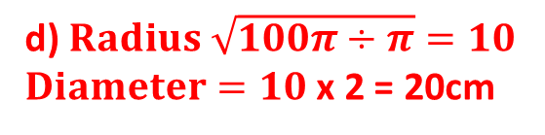

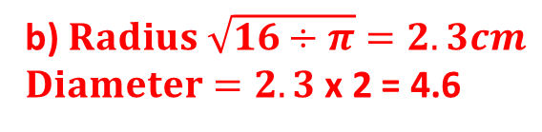
a) $Radius \sqrt{400÷π}=11.3cm$
c) $Radius \sqrt{49π÷π}=7cm$
b) $Radius \sqrt{16÷π}=2.3cm$
$Diameter=2.3$ x 2 = 4.6
d) $Radius \sqrt{100π÷π}=10$
$Diameter=10$ x 2 = 20cm

