Slide 1
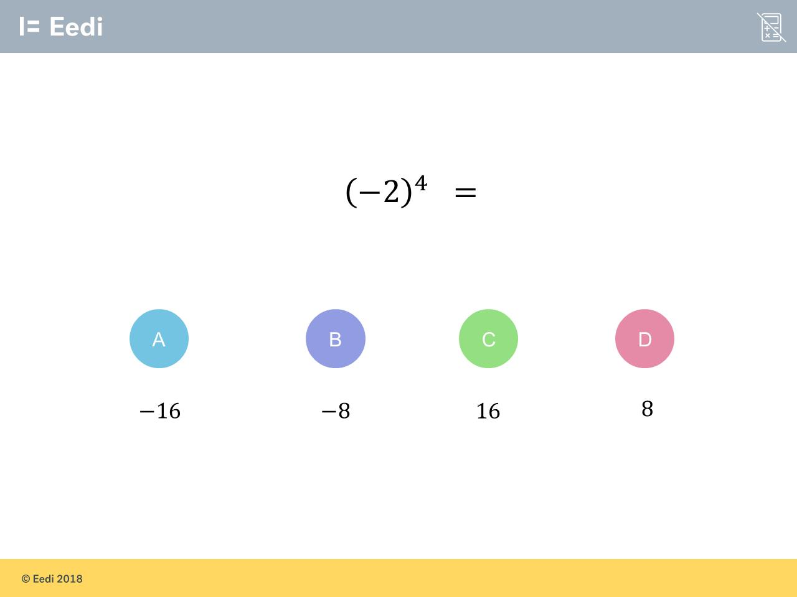
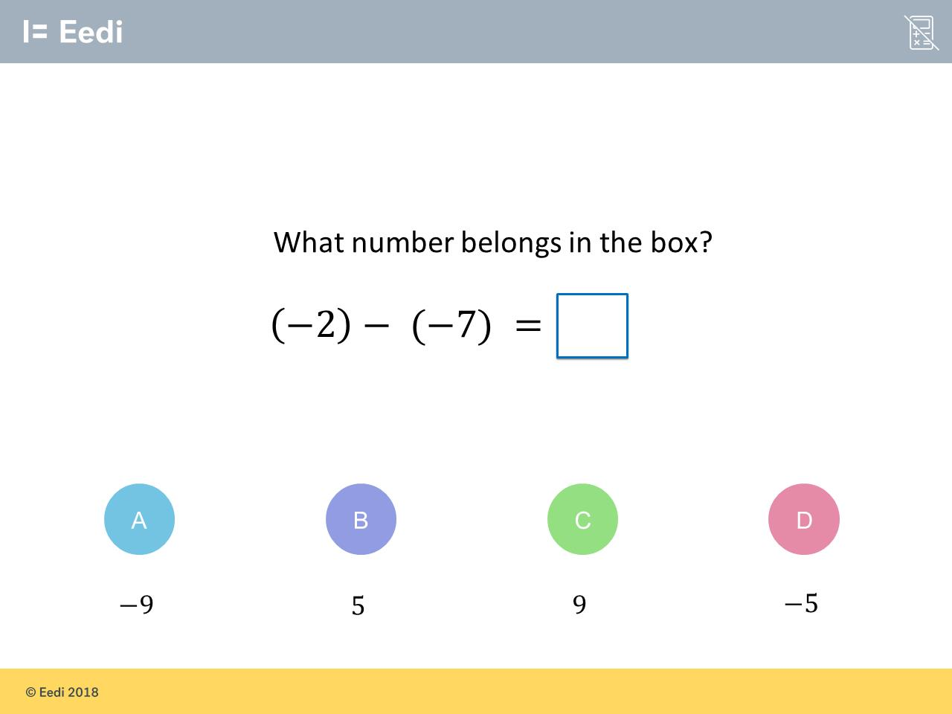
Worst answered question?
Most common wrong answer?

Slide 2
ANSWERS

Slide 3
Worst answered question?

Slide 4

A
They keep the negative.

Slide 5
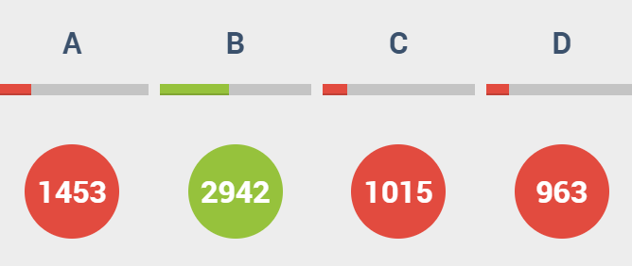
A
They did not change the
two negative
into a positive.

