Slide 1

Diagnostic Assessment .Delta 2
Unit 8
OR and AND Rules
Mutually Exclusive Events
Venn Diagrams
Relative Frequency
Sample Space
Two Way Tables
Tree Diagrams

Slide 2
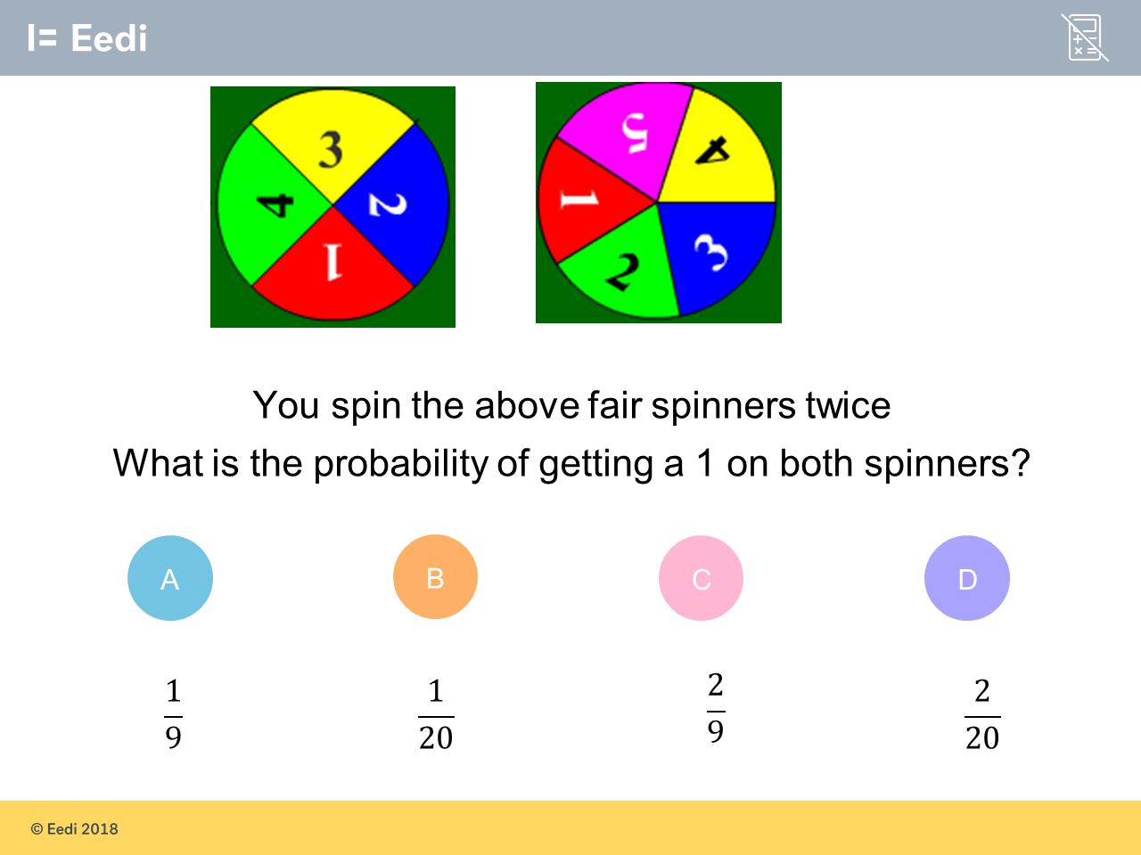
Question 1 – OR and AND Rules

Slide 3
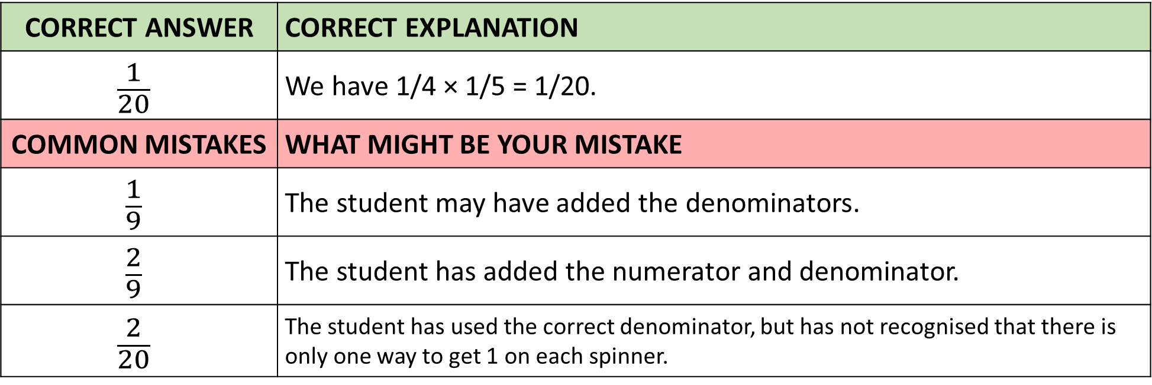
Answer 1 – OR and AND Rules
CORRECT ANSWER | CORRECT EXPLANATION
$$\frac{1}{20}$$ | We have 1/4 × 1/5 = 1/20.
COMMON MISTAKES | WHAT MIGHT BE YOUR MISTAKE
$$\frac{1}{9}$$ | The student may have added the denominators.
$$\frac{2}{9}$$ | The student has added the numerator and denominator.
$$\frac{2}{20}$$ | The student has used the correct denominator, but has not recognised that there is only one way to get 1 on each spinner.

Slide 4
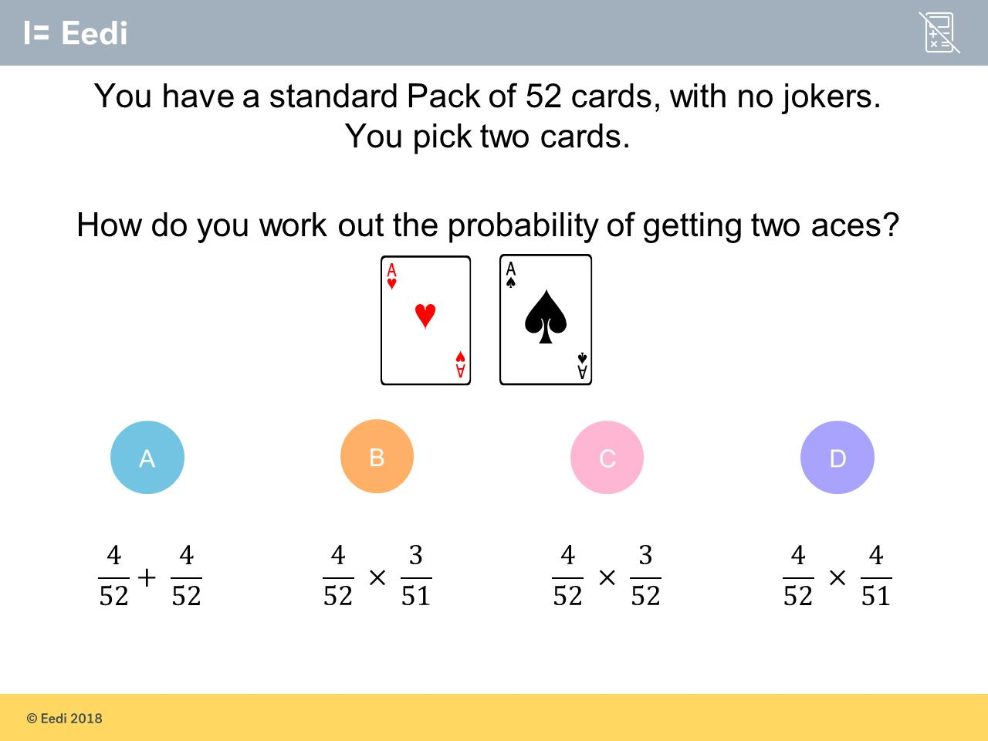
Question 2 – OR and AND Rules

Slide 5
Answer 2 – OR and AND Rules
CORRECT ANSWER | CORRECT EXPLANATION
B | There are 4 aces, so the probability of getting the first ace is 4/52. As there are now 3 aces and 51 cards, the next probability is 3/51. Multiplying the two together gives the full probability.
COMMON MISTAKES | WHAT MIGHT BE YOUR MISTAKE
A | The student has attempted to add, rather than multiplying.
B | The student has not adjusted the second denominator.
C | The student has not adjusted the second numerator.

Slide 6
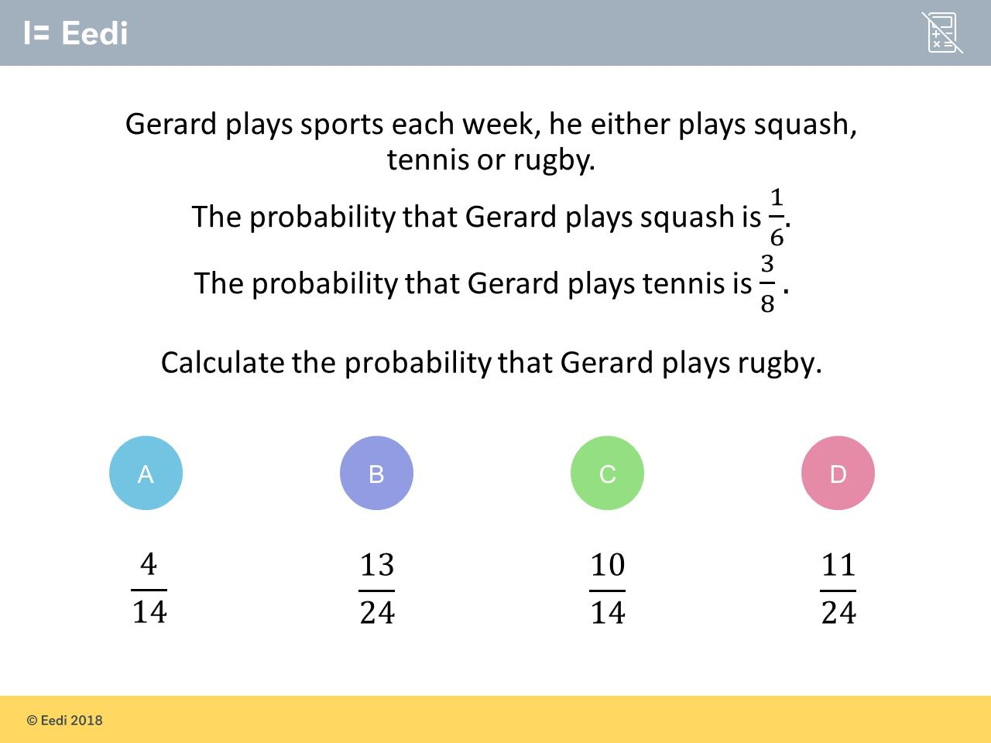
Question 3 – OR and AND Rules

Slide 7
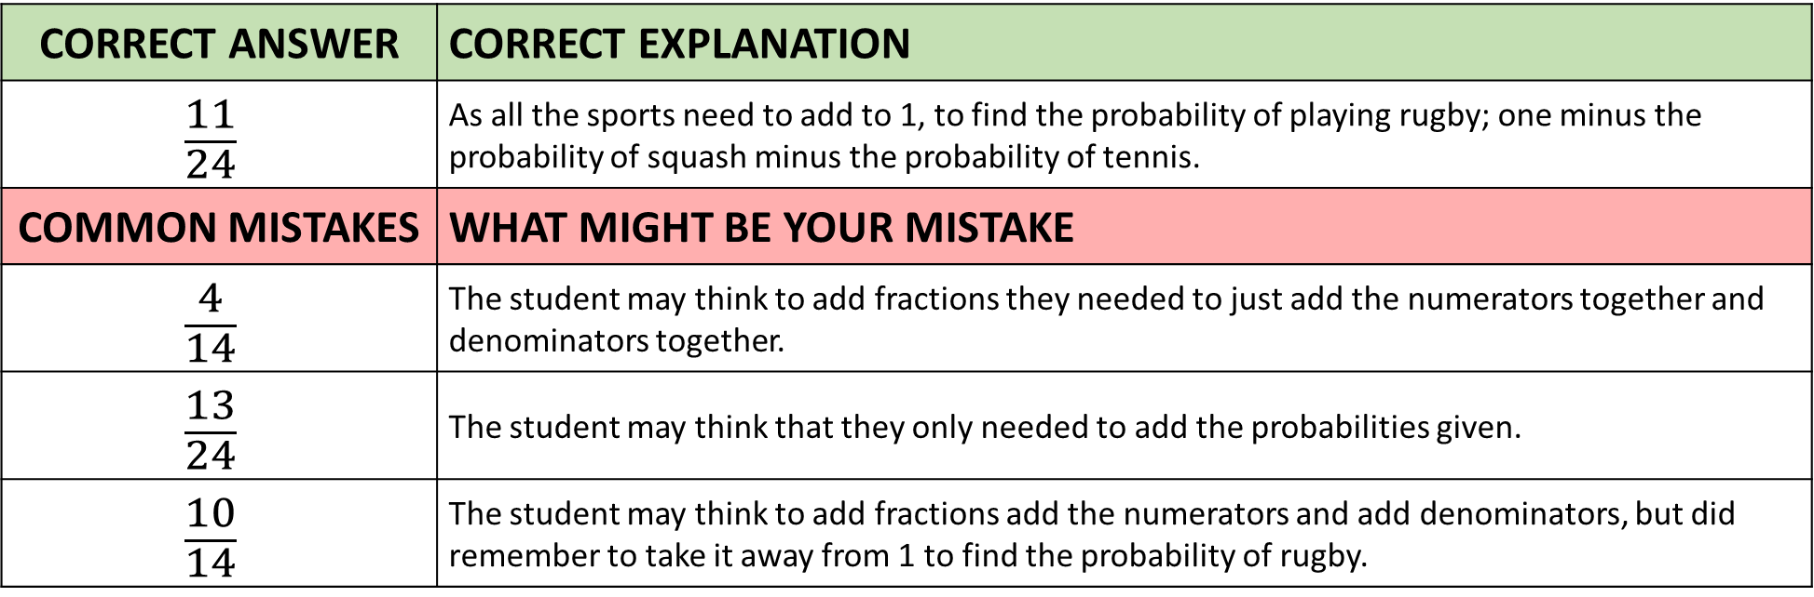
Answer 3 – OR and AND Rules
CORRECT ANSWER | CORRECT EXPLANATION
$$\frac{11}{24}$$ | As all the sports need to add to 1, to find the probability of playing rugby; one minus the probability of squash minus the probability of tennis.
COMMON MISTAKES | WHAT MIGHT BE YOUR MISTAKE
$$\frac{4}{14}$$ | The student may think to add fractions they needed to just add the numerators together and denominators together.
$$\frac{13}{24}$$ | The student may think that they only needed to add the probabilities given.
$$\frac{10}{14}$$ | The student may think to add fractions add the numerators and add denominators, but did remember to take it away from 1 to find the probability of rugby.

Slide 8
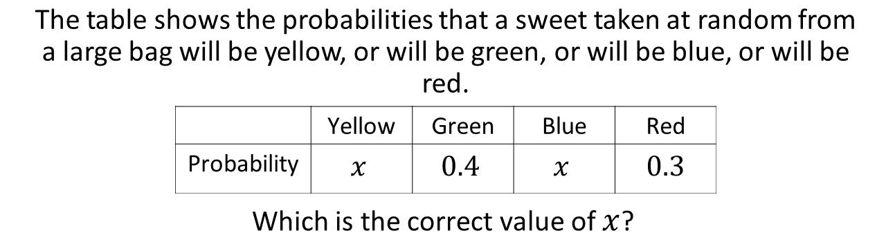
Question 4 – OR and AND Rules

Slide 9
Answer 4 – OR and AND Rules
CORRECT ANSWER | CORRECT EXPLANATION
0.15 | As the answer to the first step is 0.3, the 0.3 is for yellow and blue. So in algebra that would be 𝑥 + 𝑥 =2𝑥 and 2𝑥 = 0.3, and so divide by 2 to get 𝑥.
COMMON MISTAKES | WHAT MIGHT BE YOUR MISTAKE
0.3 | The student may have not realised there were two 𝑥's so needed to divide by 2.
0.7 | The student added the probabilities together.
0.9 | The student miscalculated by not taking into account the brackets (BIDMAS).

Slide 10
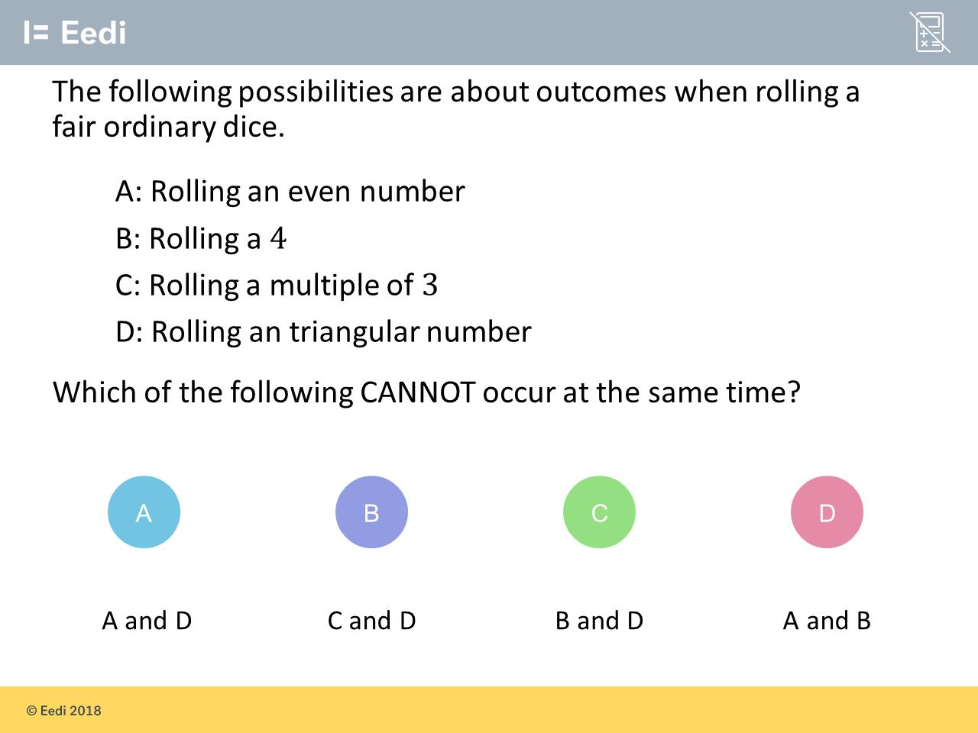
Question 5 – Mutually Exclusive Events

Slide 11
Answer 5 – Mutually Exclusive Events
CORRECT ANSWER | CORRECT EXPLANATION
C | 4 is not a triangular number (1, 3, 6...) so both a 4 and a triangular number cannot occur at the same time.
COMMON MISTAKES | WHAT MIGHT BE YOUR MISTAKE
A | The student may think that the triangular numbers are all odd.
B | The student may think that 6 isn't a triangular number.
D | The student may think 4 is an odd number rather than an even.

Slide 12
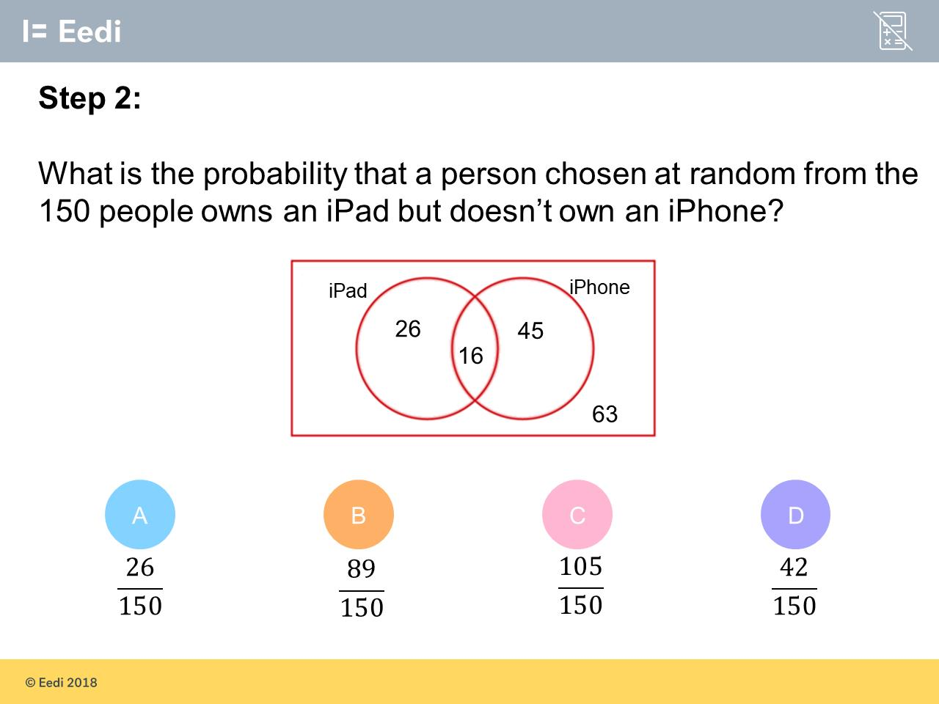
Question 6 – Venn Diagrams

Slide 13
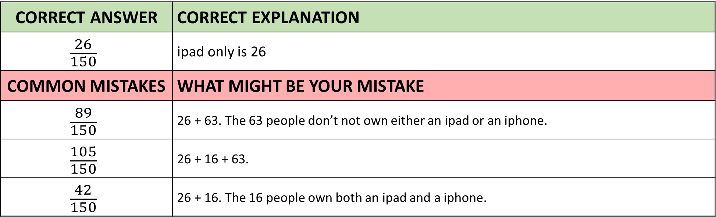
Answer 6 – Venn Diagrams
CORRECT ANSWER | CORRECT EXPLANATION
$$\frac{26}{150}$$ | ipad only is 26
COMMON MISTAKES | WHAT MIGHT BE YOUR MISTAKE
$$\frac{89}{150}$$ | 26 + 63. The 63 people don’t not own either an ipad or an iphone.
$$\frac{105}{150}$$ | 26 + 16 + 63.
$$\frac{42}{150}$$ | 26 + 16. The 16 people own both an ipad and a iphone.

Slide 14
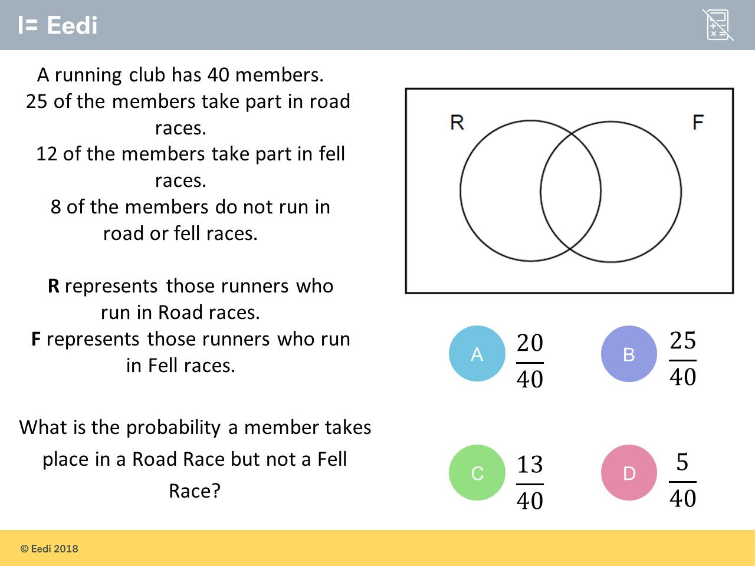
Question 7 –Venn Diagrams

Slide 15
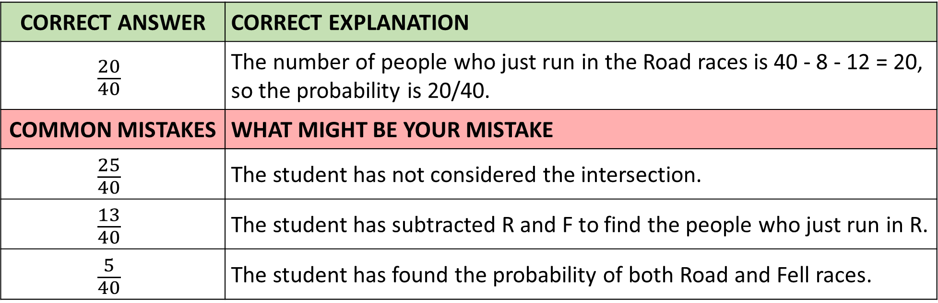
Answer 7 – Venn Diagrams
CORRECT ANSWER | CORRECT EXPLANATION
$$\frac{20}{40}$$ | The number of people who just run in the Road races is 40 - 8 - 12 = 20, so the probability is 20/40.
COMMON MISTAKES | WHAT MIGHT BE YOUR MISTAKE
$$\frac{25}{40}$$ | The student has not considered the intersection.
$$\frac{13}{40}$$ | The student has subtracted R and F to find the people who just run in R.
$$\frac{5}{40}$$ | The student has found the probability of both Road and Fell races.

Slide 16
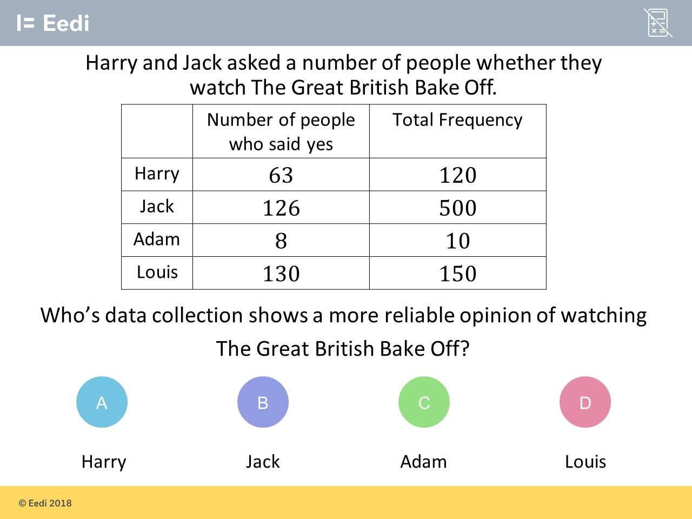
Question 8 – Relative Frequency

Slide 17
Answer 8 – Relative Frequency
CORRECT ANSWER | CORRECT EXPLANATION
Jack | As Jack asked the most people (total frequency), regardless if they watched it or not it is the most reliable.
COMMON MISTAKES | WHAT MIGHT BE YOUR MISTAKE
Harry | The student may think roughly half of the people asked watched it and so half didn't then it could be reliable.
Adam | The student may think that as Adam as the highest percentage of people who said yes then it's the same as being reliable.
Louis | The student may think that as the most people said yes then it is the most reliable.

Slide 18
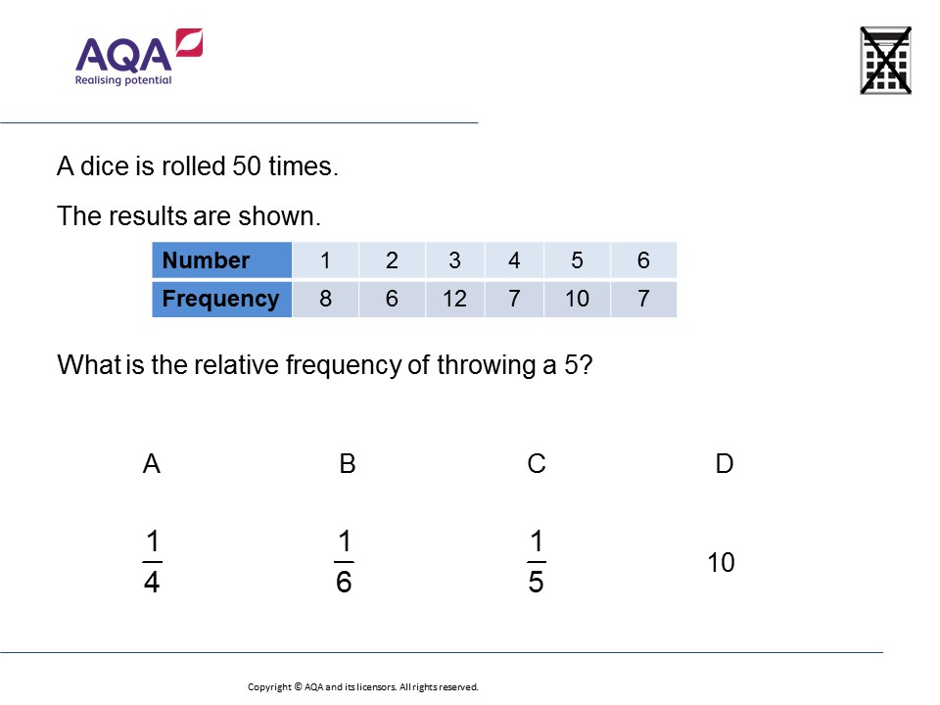
Question 9 – Relative Frequency

Slide 19
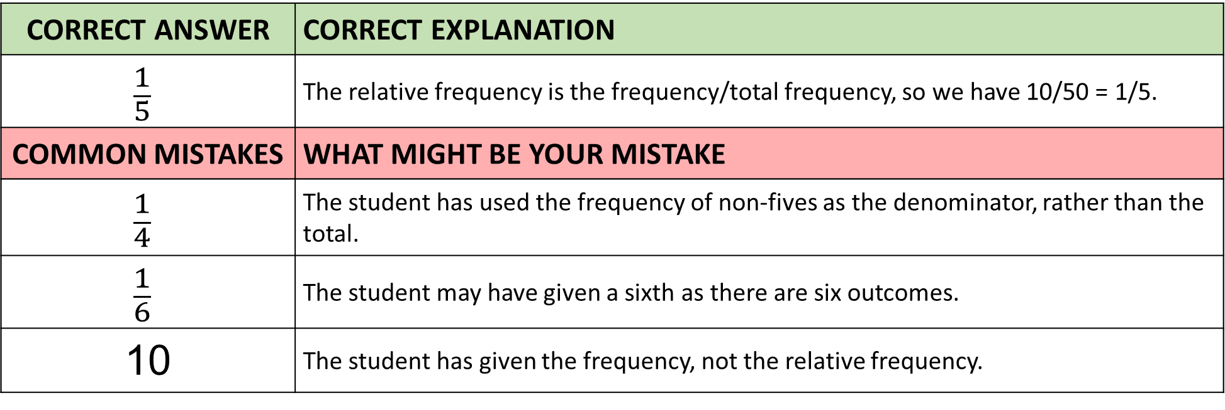
Answer 9 – Relative Frequency
CORRECT ANSWER | CORRECT EXPLANATION
$$\frac{1}{5}$$ | The relative frequency is the frequency/total frequency, so we have 10/50 = 1/5.
COMMON MISTAKES | WHAT MIGHT BE YOUR MISTAKE
$$\frac{1}{4}$$ | The student has used the frequency of non-fives as the denominator, rather than the total.
$$\frac{1}{6}$$ | The student may have given a sixth as there are six outcomes.
10 | The student has given the frequency, not the relative frequency.

Slide 20
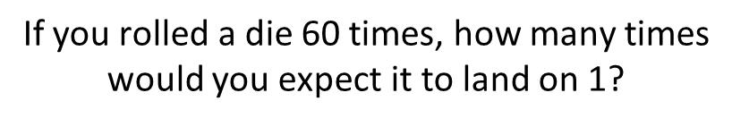
Question 10 – Estimating Outcomes

Slide 21
Answer 10 – Estimating Outcomes
CORRECT ANSWER | CORRECT EXPLANATION
10 | Probability of rolling a 1 is 1/6 therefore 1/6 of 60 = 10.
COMMON MISTAKES | WHAT MIGHT BE YOUR MISTAKE
30 | The students though is 50% of getting a 1.
1 | The student wrote the number of 1 you would except from
60 | The student has given the frequency, not the relative frequency.

Slide 22
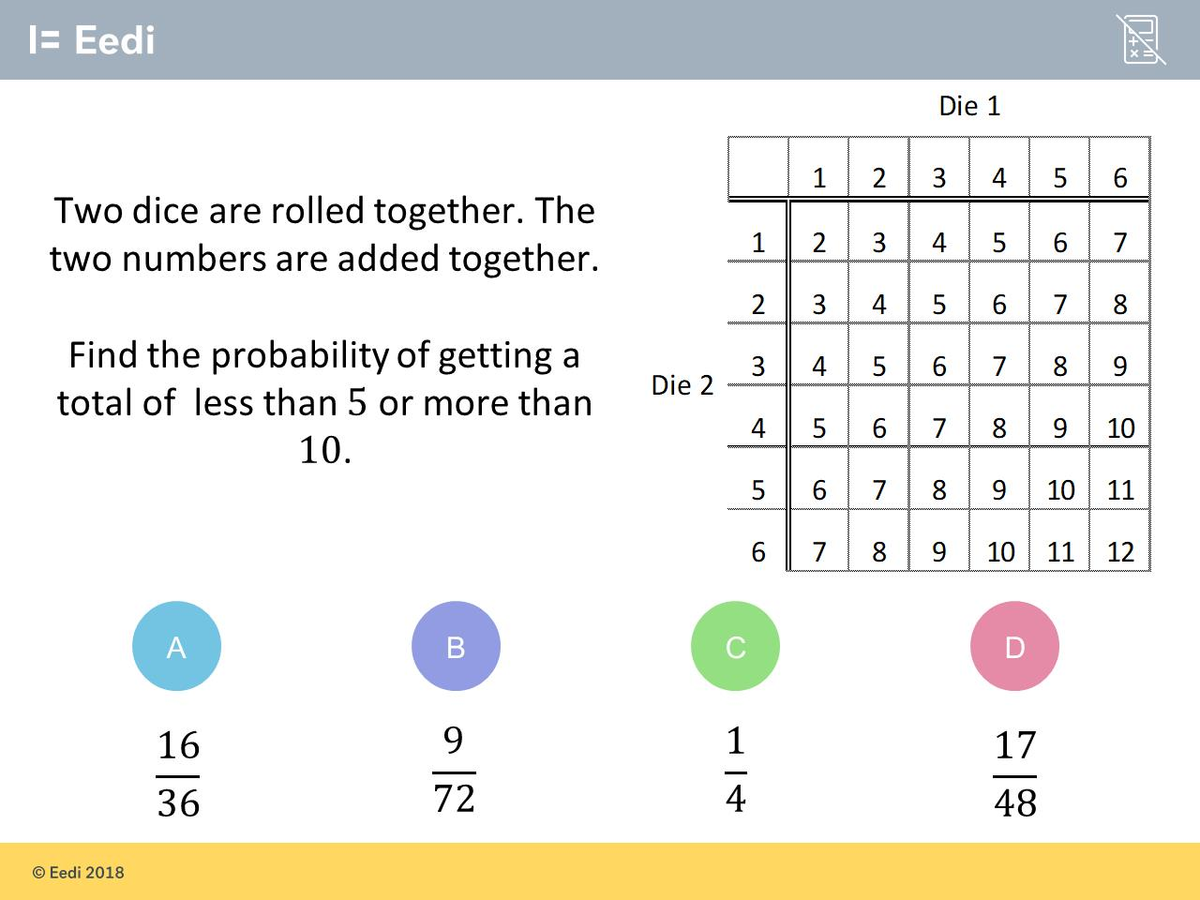
Question 11 – Sample Space

Slide 23
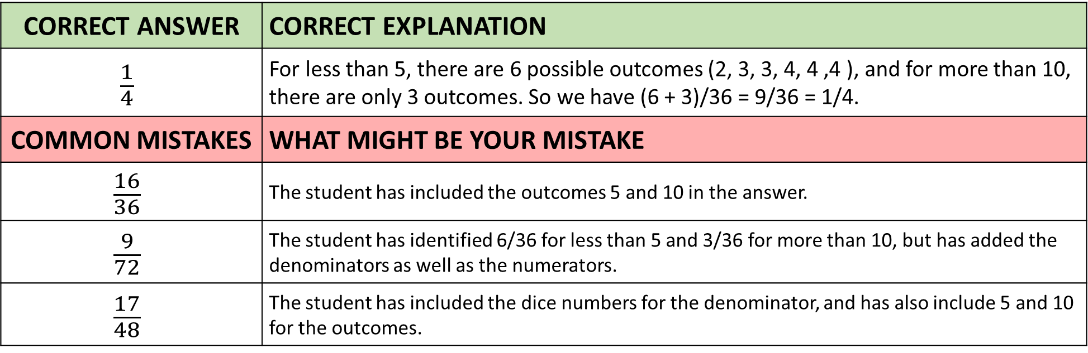
Answer 11 – Sample Space
CORRECT ANSWER | CORRECT EXPLANATION
$$\frac{1}{4}$$ | For less than 5, there are 6 possible outcomes (2, 3, 3, 4, 4 ,4 ), and for more than 10, there are only 3 outcomes. So we have (6 + 3)/36 = 9/36 = 1/4.
COMMON MISTAKES | WHAT MIGHT BE YOUR MISTAKE
$$\frac{16}{36}$$ | The student has included the outcomes 5 and 10 in the answer.
$$\frac{9}{72}$$ | The student has identified 6/36 for less than 5 and 3/36 for more than 10, but has added the denominators as well as the numerators.
$$\frac{17}{48}$$ | The student has included the dice numbers for the denominator, and has also include 5 and 10 for the outcomes.

Slide 24
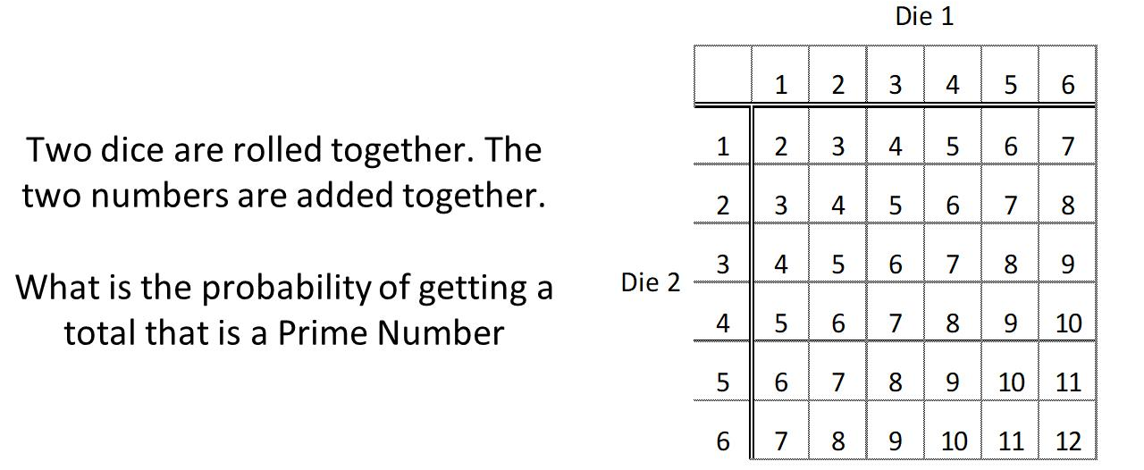
Question 12 – Sample Space

Slide 25
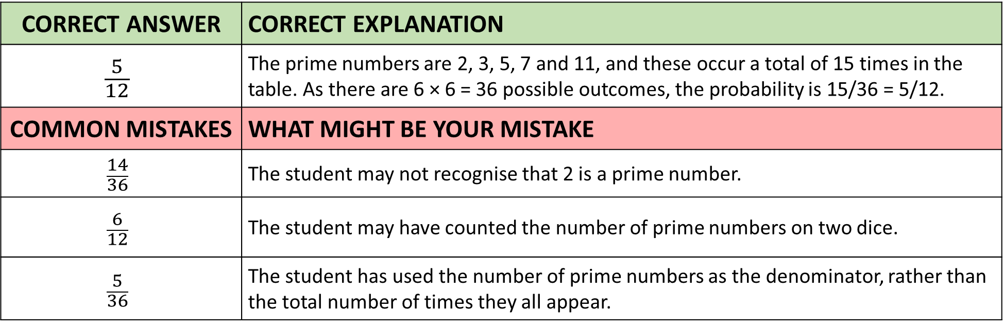
Answer 12 – Sample Space
CORRECT ANSWER | CORRECT EXPLANATION
$$\frac{5}{12}$$ | The prime numbers are 2, 3, 5, 7 and 11, and these occur a total of 15 times in the table. As there are 6 × 6 = 36 possible outcomes, the probability is 15/36 = 5/12.
COMMON MISTAKES | WHAT MIGHT BE YOUR MISTAKE
$$\frac{14}{36}$$ | The student may not recognise that 2 is a prime number.
$$\frac{6}{12}$$ | The student may have counted the number of prime numbers on two dice.
$$\frac{5}{36}$$ | The student has used the number of prime numbers as the denominator, rather than the total number of times they all appear.

Slide 26
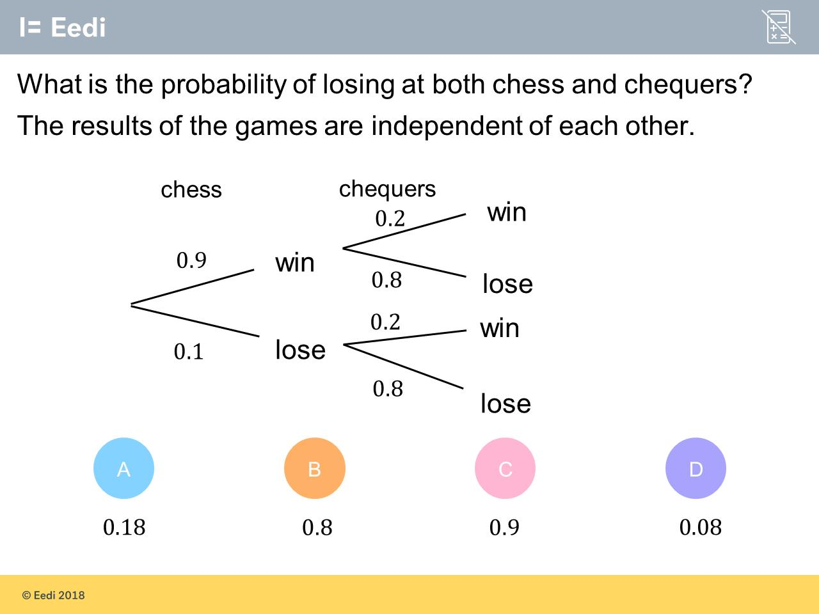
Question 13 – Tree Diagrams

Slide 27
Answer 13 – Tree Diagrams
CORRECT ANSWER | CORRECT EXPLANATION
0.08 | The bottom line is the probability that they lose both, so the answer is 0.1 X 0.8 = 0.08.
COMMON MISTAKES | WHAT MIGHT BE YOUR MISTAKE
0.18 | The student has found the probability of winning both.
0.8 | The student may believe that we only need the probability of the second loss.
0.9 | The student has added the probabilities, instead of multiplying.

Slide 28
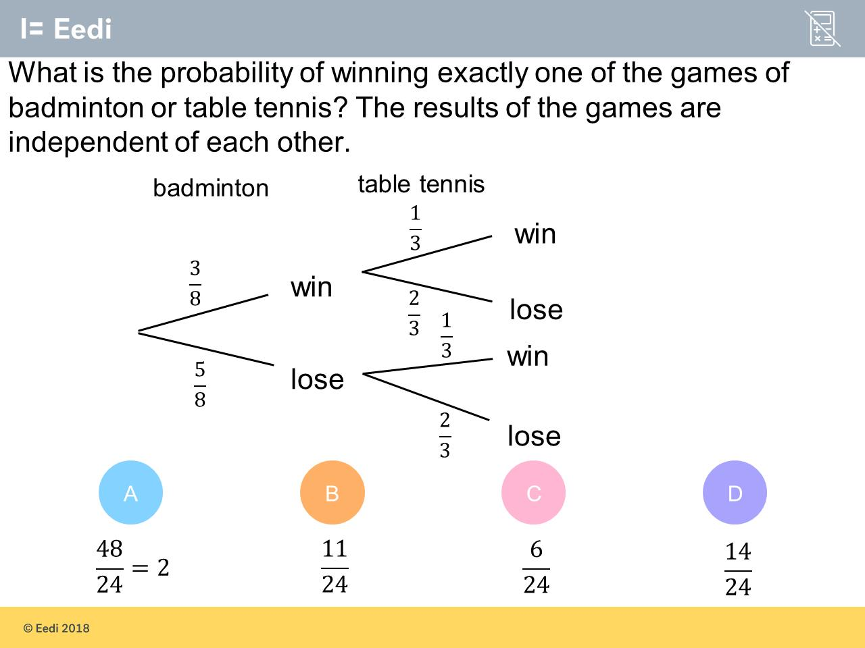
Question 14 – Tree Diagrams

Slide 29
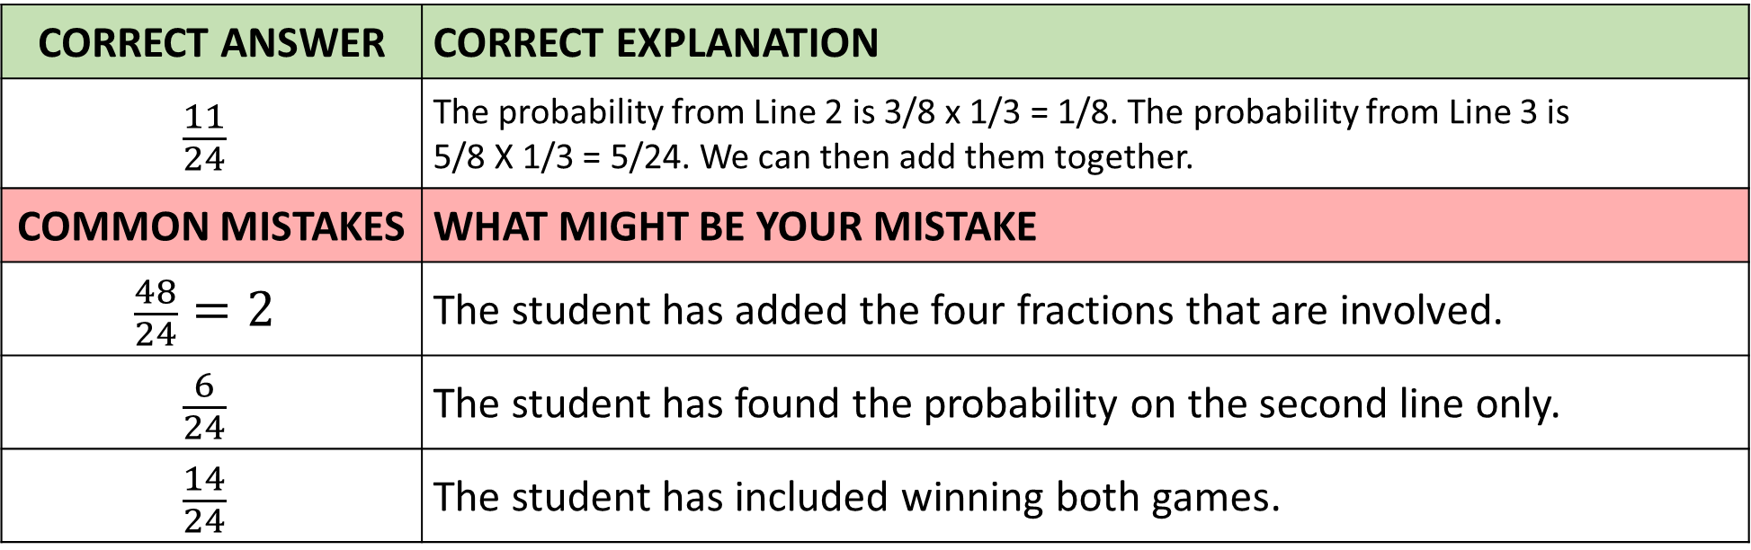
Answer 14 – Tree Diagrams
CORRECT ANSWER | CORRECT EXPLANATION
$$\frac{11}{24}$$ | The probability from Line 2 is 3/8 x 1/3 = 1/8. The probability from Line 3 is 5/8 X 1/3 = 5/24. We can then add them together.
COMMON MISTAKES | WHAT MIGHT BE YOUR MISTAKE
$$\frac{48}{24}=2$$ | The student has added the four fractions that are involved.
$$\frac{6}{24}$$ | The student has found the probability on the second line only.
$$\frac{14}{24}$$ | The student has included winning both games.

Slide 30
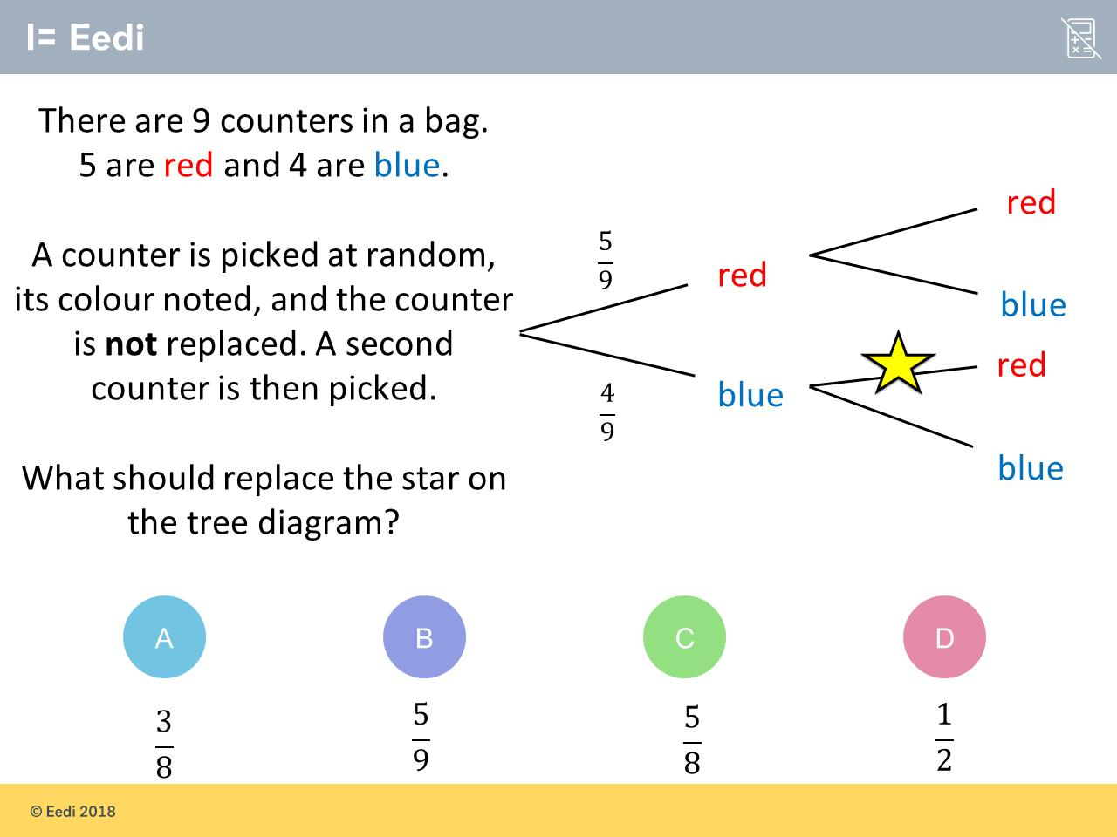
Question 15 – Tree Diagrams

Slide 31
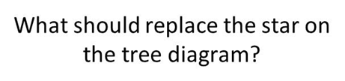
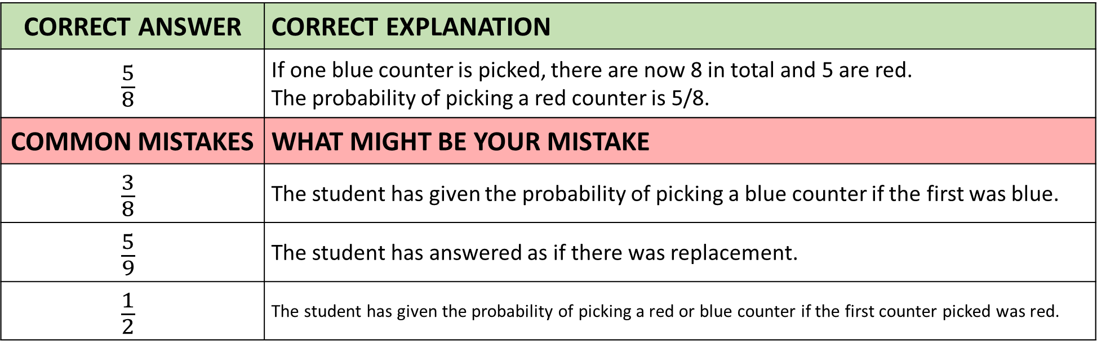
Answer 15 – Tree Diagrams
CORRECT ANSWER | CORRECT EXPLANATION
$$\frac{5}{8}$$ | If one blue counter is picked, there are now 8 in total and 5 are red. The probability of picking a red counter is 5/8.
COMMON MISTAKES | WHAT MIGHT BE YOUR MISTAKE
$$\frac{3}{8}$$ | The student has given the probability of picking a blue counter if the first was blue.
$$\frac{5}{9}$$ | The student has answered as if there was replacement.
$$\frac{1}{2}$$ | The student has given the probability of picking a red or blue counter if the first counter picked was red.

Slide 32
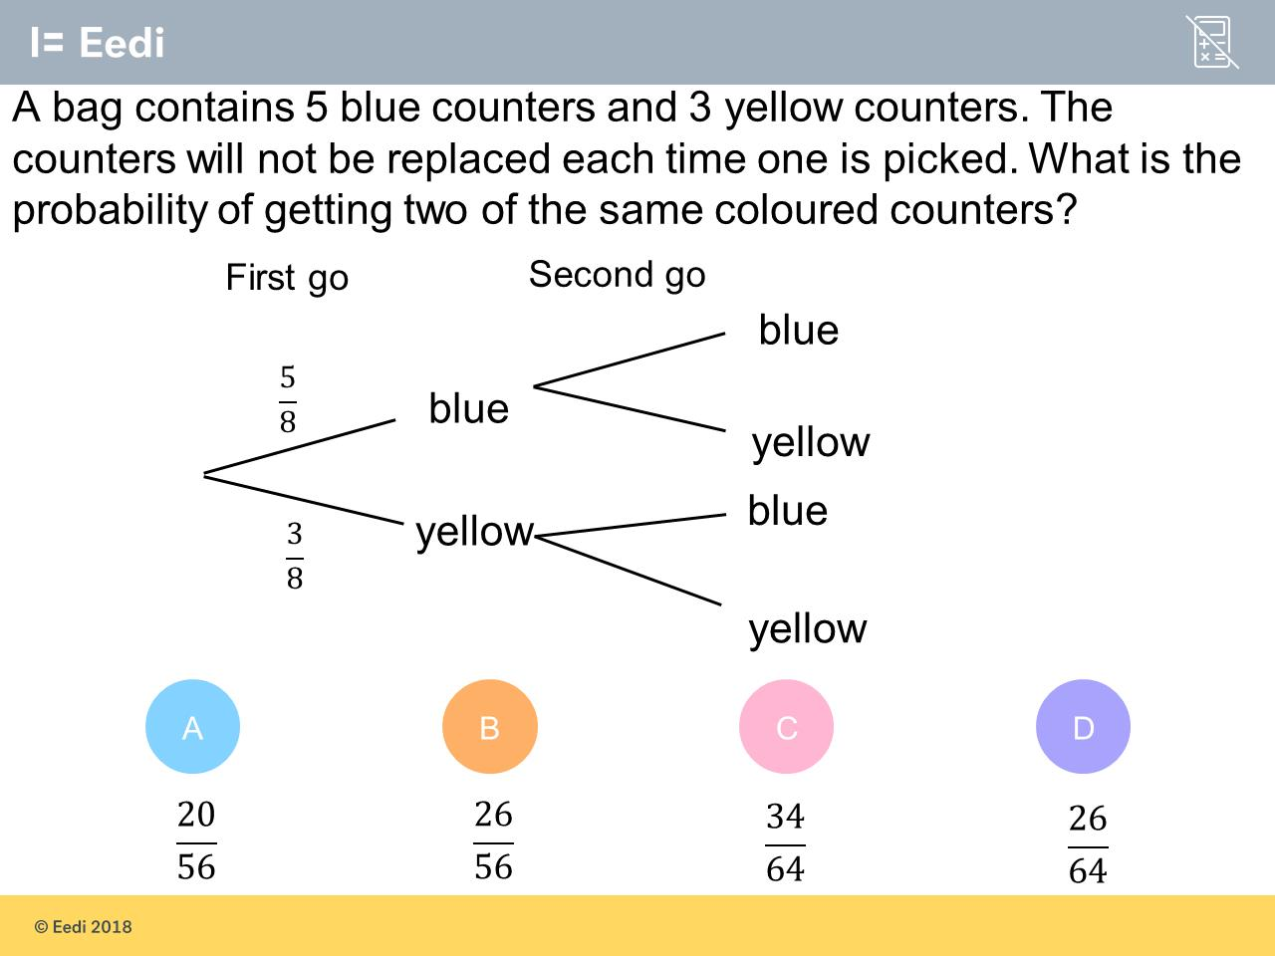
Question 16 – Tree Diagrams

Slide 33
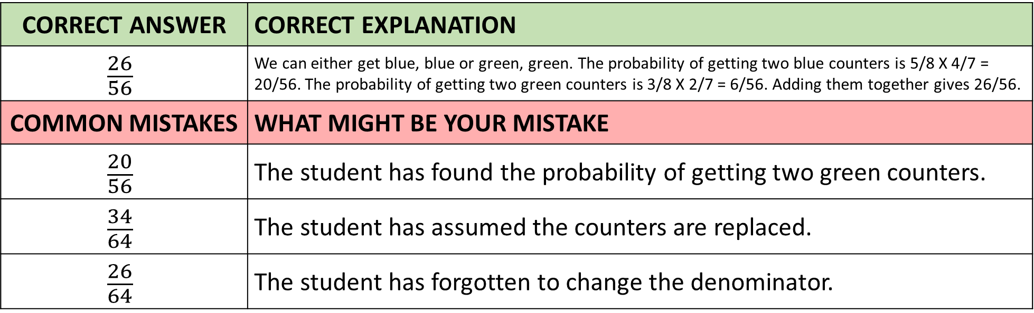
Answer 16 – Tree Diagrams
CORRECT ANSWER | CORRECT EXPLANATION
$$\frac{26}{56}$$ | We can either get blue, blue or green, green. The probability of getting two blue counters is 5/8 X 4/7 = 20/56. The probability of getting two green counters is 3/8 X 2/7 = 6/56. Adding them together gives 26/56.
COMMON MISTAKES | WHAT MIGHT BE YOUR MISTAKE
$$\frac{20}{56}$$ | The student has found the probability of getting two green counters.
$$\frac{34}{64}$$ | The student has assumed the counters are replaced.
$$\frac{26}{64}$$ | The student has forgotten to change the denominator.

