Slide 1
LO: Relative
Frequency

Slide 2
What is theoretical
probability?
What is experimental probability?

Slide 3
Theoretical or Experimental
The probability of getting three heads in a row.
Theoretical

Slide 4
Theoretical or Experimental
The probability of it raining tomorrow.
Experimental

Slide 5
Theoretical or Experimental
The probability of
the next car being red.
Experimental

Slide 6
Theoretical or Experimental
The probability of rolling consecutive sixes.
Theoretical

Slide 7

The dice is biased.
What is the probability
of rolling a 5?

Slide 8
Roll the dice and record the
Relative Frequency
of each number.

Slide 9






Number | Frequency | Relative Frequency
1
2
3
4
5
6
12
3
5
7
5
18
$$\frac{12}{50}$$
$$\frac{3}{50}$$
$$\frac{5}{50}$$
$$\frac{7}{50}$$
$$\frac{5}{50}$$
$$\frac{18}{50}$$

Slide 10
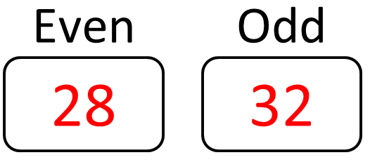
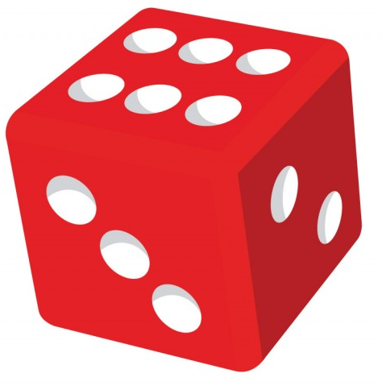
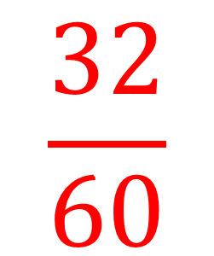
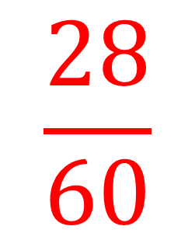
A dice is rolled 60 times.
Do you think this is a fair dice?
$$\frac{28}{60}$$
$$\frac{32}{60}$$

Slide 11
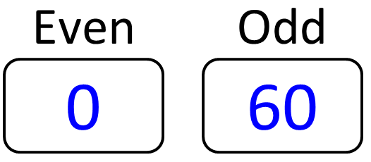
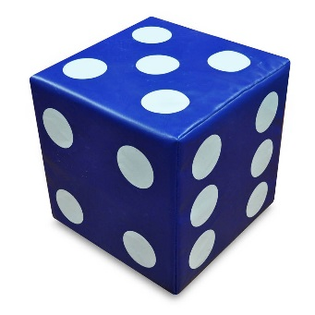
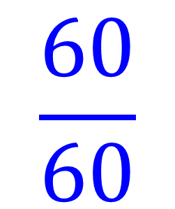
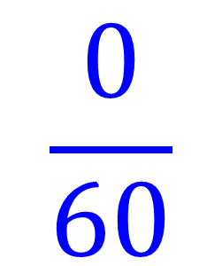
A dice is rolled 60 times.
Do you think this is a fair dice?
$$\frac{0}{60}$$
$$\frac{60}{60}$$

Slide 12
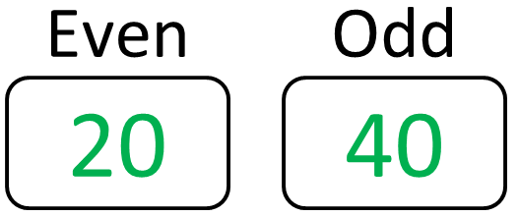
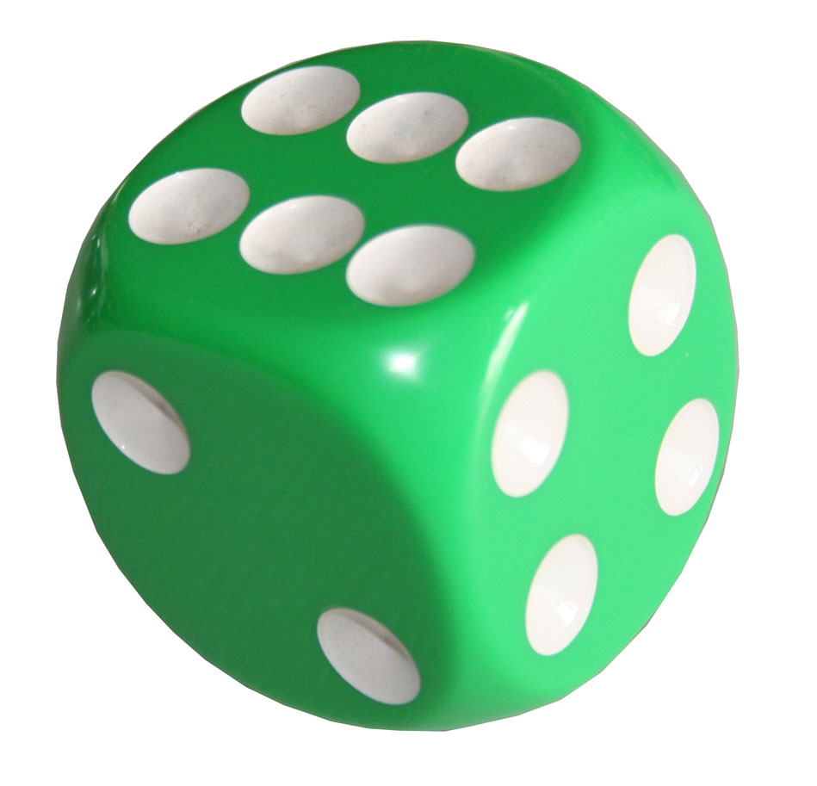
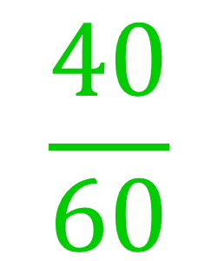
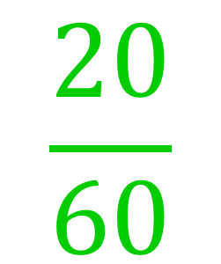
A dice is rolled 60 times.
Do you think this is a fair dice?
$$\frac{20}{60}$$
$$\frac{40}{60}$$

Slide 13
Relative Frequency is
a probability from an experiment.

