Slide 1

Intermediate Challenge 4
SILVER

Slide 2
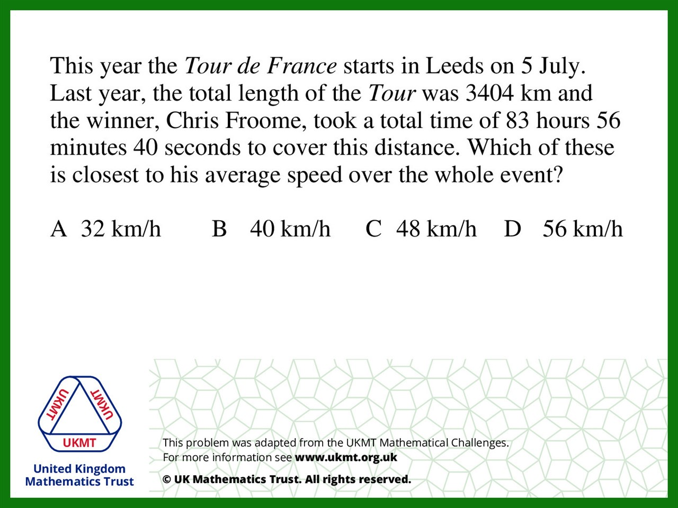
Q1.
3404 ÷ 84 is approximately 3400 ÷85 = 40

Slide 3
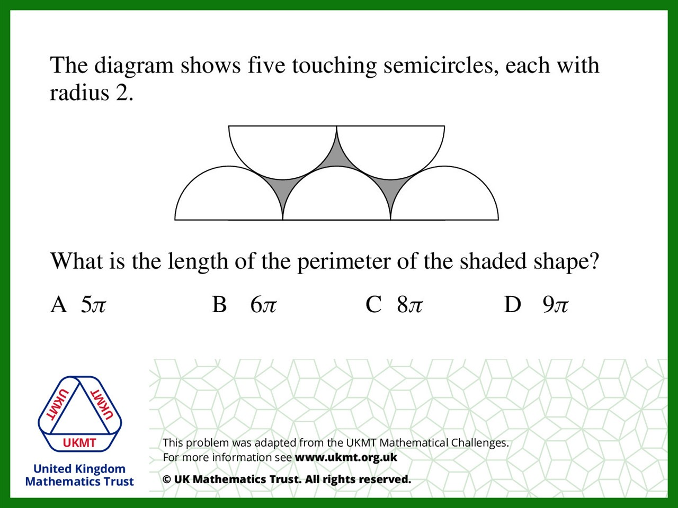
Q2.
Perimeter = One and half circumferences
= 1.5 x 2πr = 3π(2) = 6π

Slide 4
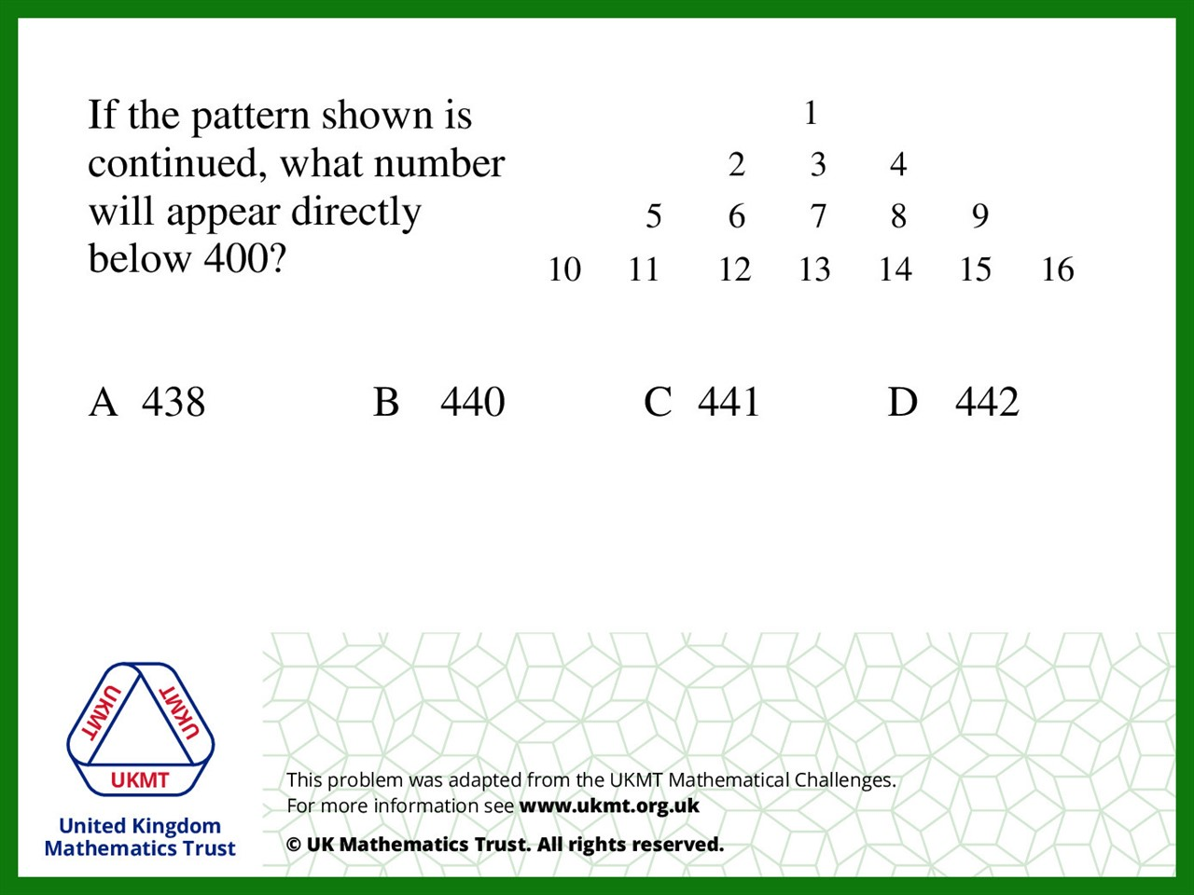
Q3.
Square numbers on right diagonal.
The square number below 400 is 441.
441 – 1 = 440.

Slide 5
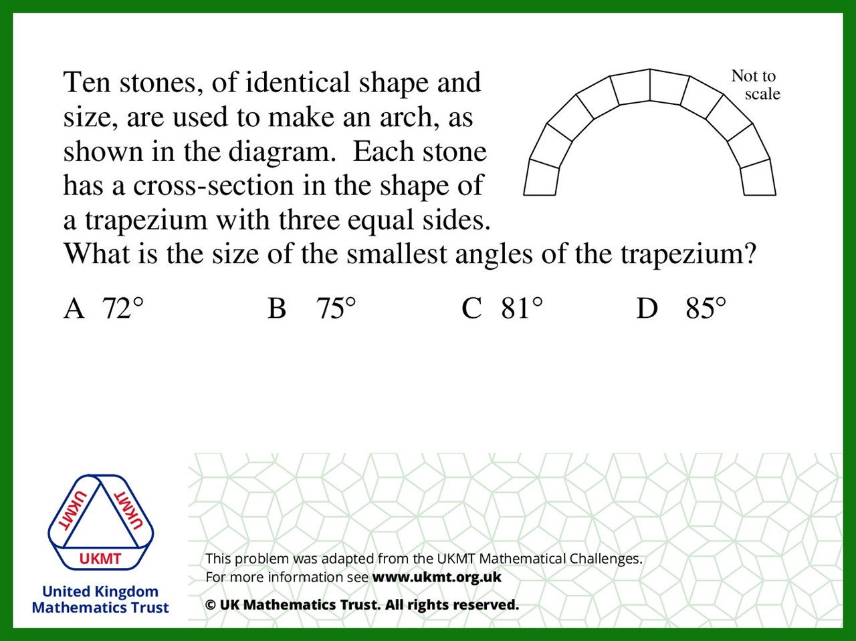
Q4.
If you extend the equal sides of the trapezium
to the centre you get an isosceles triangles
with the centre angle 180 ÷ 10 = 18.
(180 – 18) ÷ 2 = 81

Slide 6
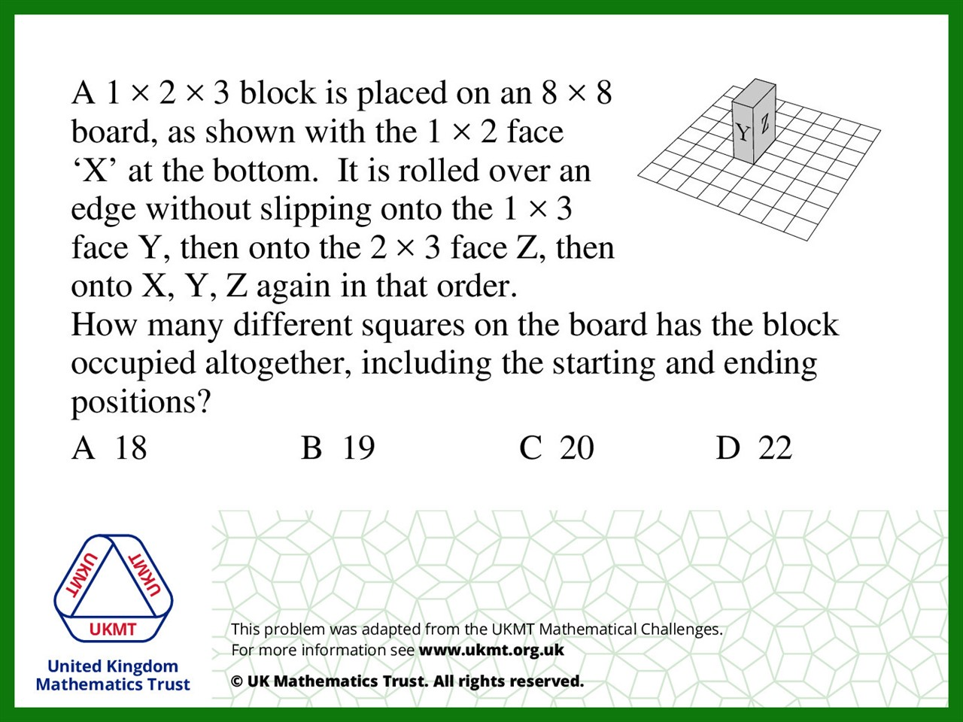
Q5.
2 + 3 + 6 + 2 + 2 + 4 = 19

