Slide 1
LO: Powers of 10

Slide 2







$${10}^{−2}$$
$${10}^{−1}$$
$${10}^{1}$$
$${10}^{2}$$
$${10}^{3}$$
$$\frac{1}{100}$$
$$\frac{1}{10}$$
10
100
1000

Slide 3
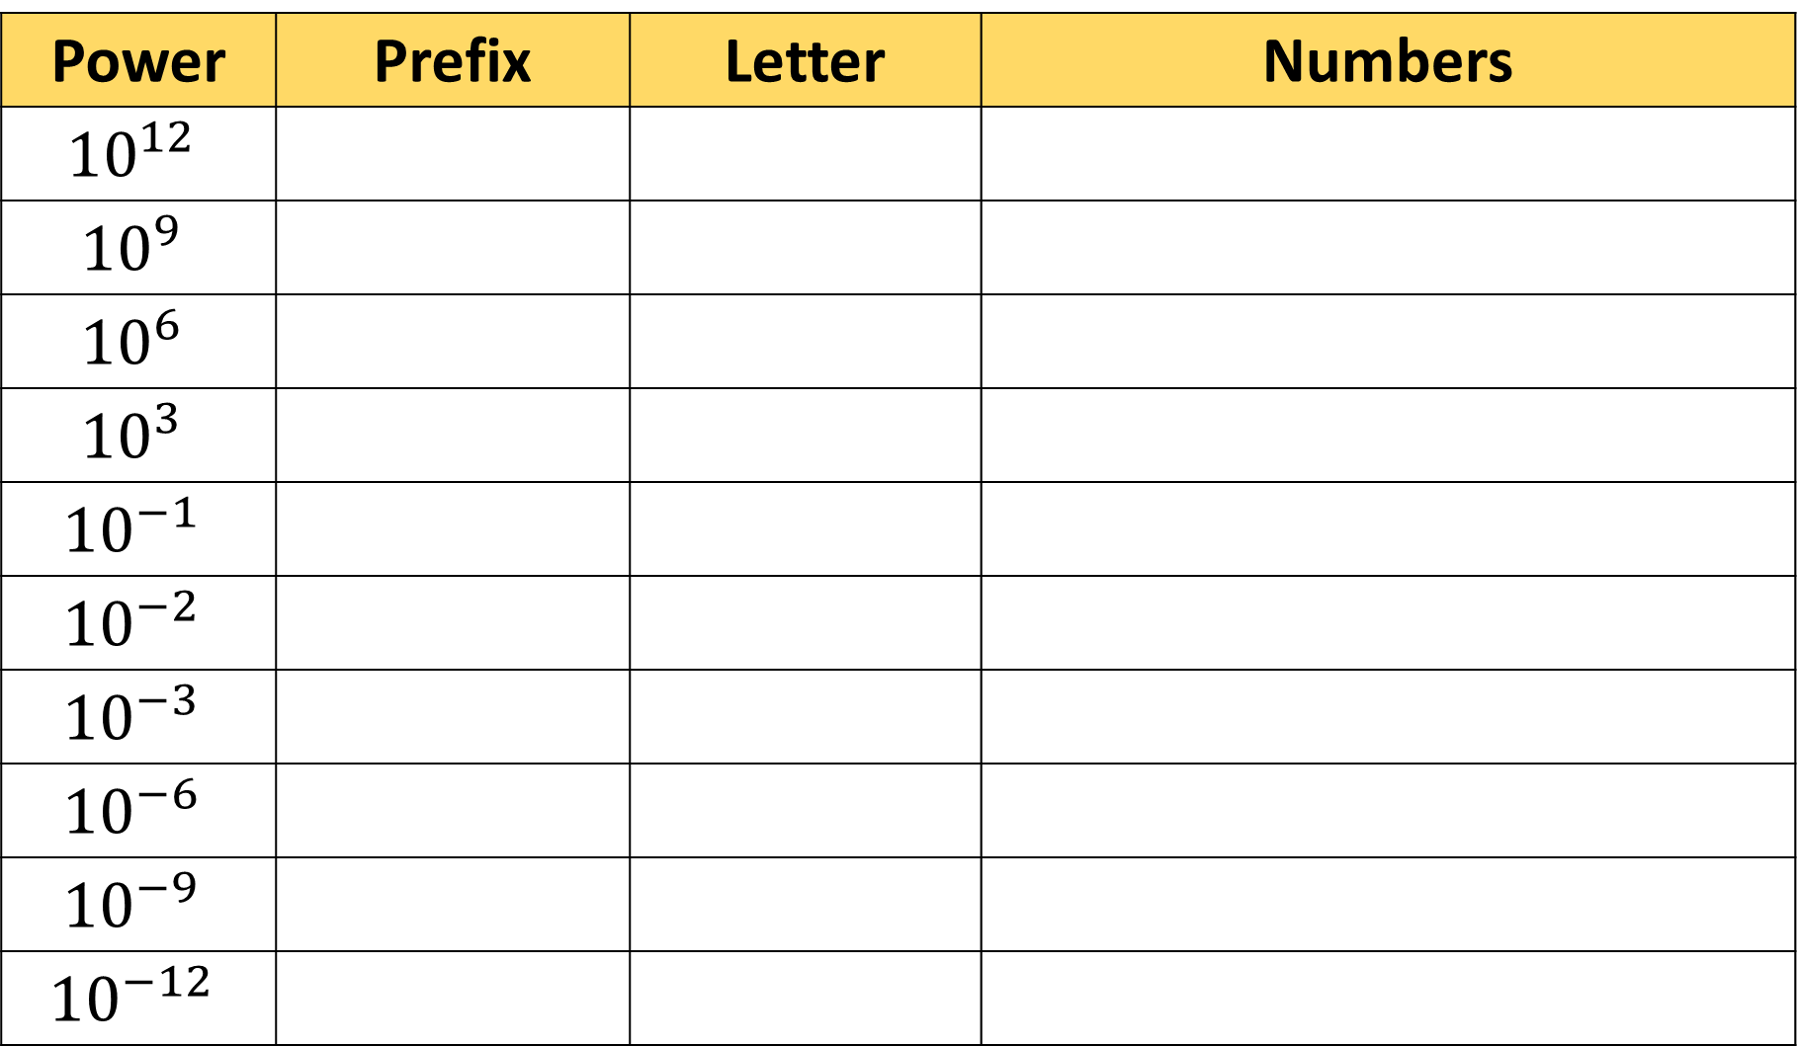
Power | Prefix | Letter | Numbers
$${10}^{12}$$
$${10}^{9}$$
$${10}^{6}$$
$${10}^{3}$$
$${10}^{−1}$$
$${10}^{−2}$$
$${10}^{−3}$$
$${10}^{−6}$$
$${10}^{−9}$$
$${10}^{−12}$$
Tera
T
1,000,000,000,000
Giga
G
1,000,000,000
Mega
M
1,000,000
Kilo
k
1,000
Deci
d
0.1
Centi
c
0.01
Milli
m
0.001
Micro
μ
0.000001
Nano
n
0.000000001
Pico
p
0.000000000001

Slide 4
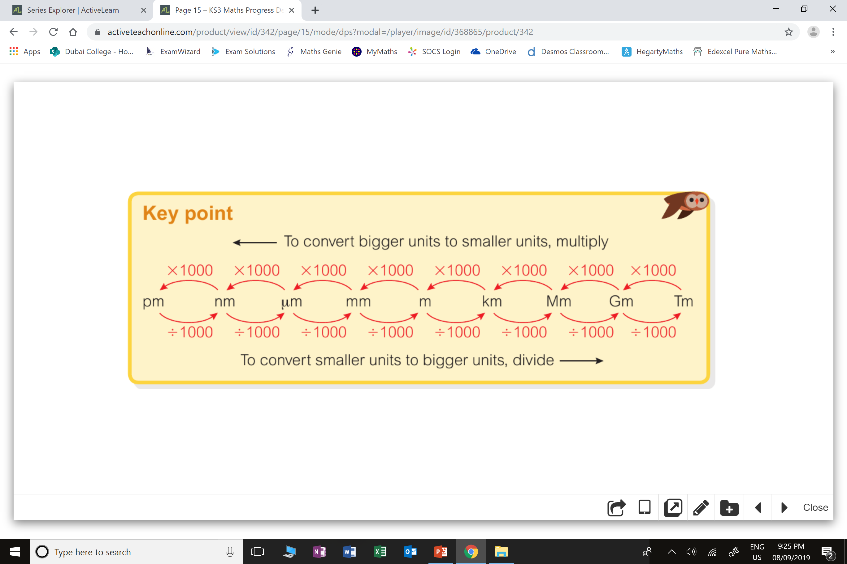
The most common place
you will find these prefixes
is with measurements.

Slide 5

Click on the sign for the 1 million pound question!

Slide 6
4.2 x 100 =
420

Slide 7
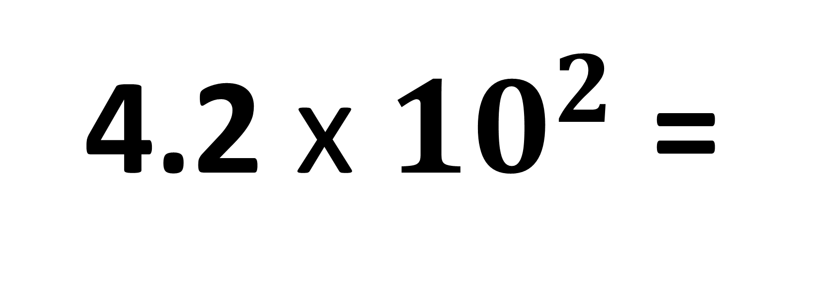
4.2 x ${10}^{2}$ =
420

Slide 8
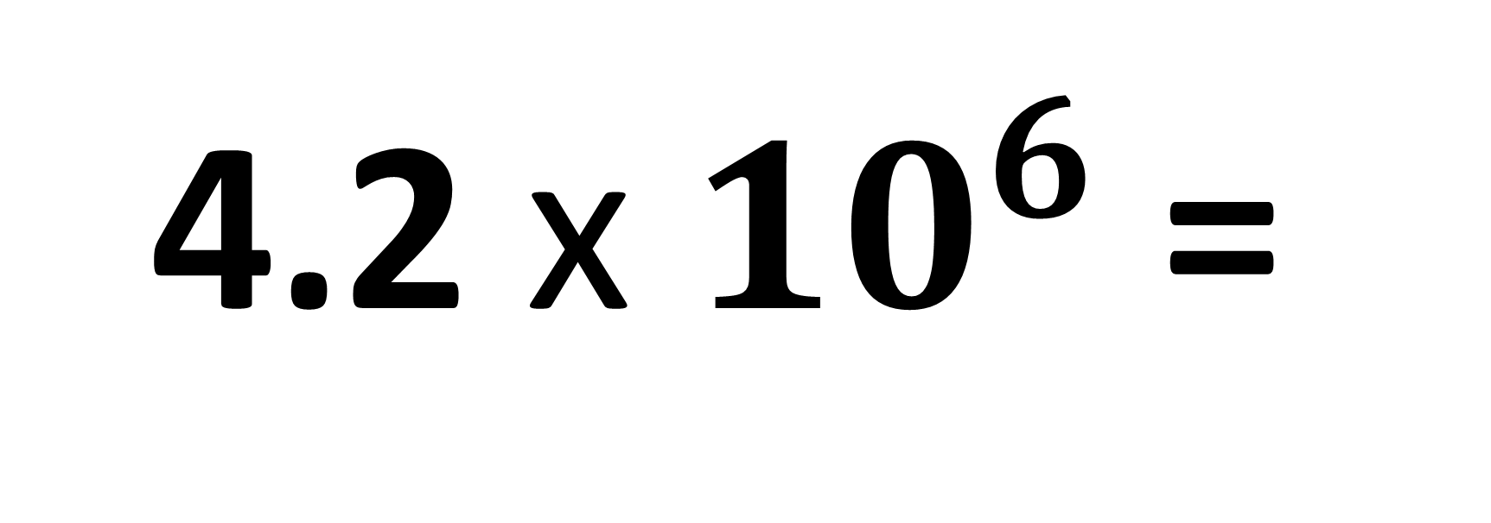
4.2 x ${10}^{6}$ =
4 200 000

Slide 9
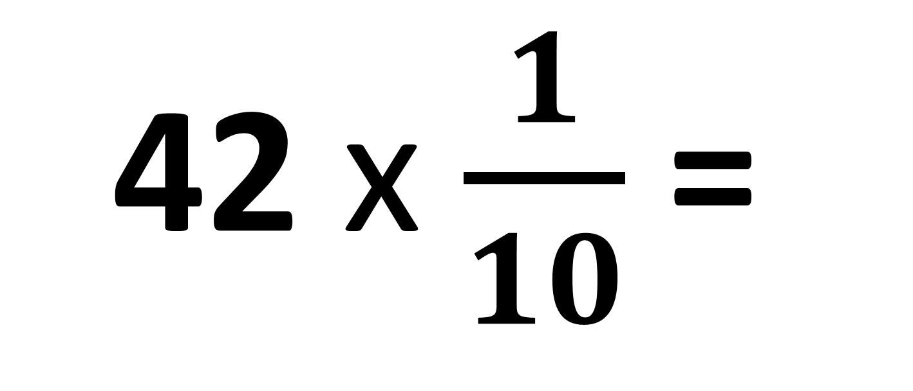
42 x $\frac{1}{10}$ =
4.2

Slide 10
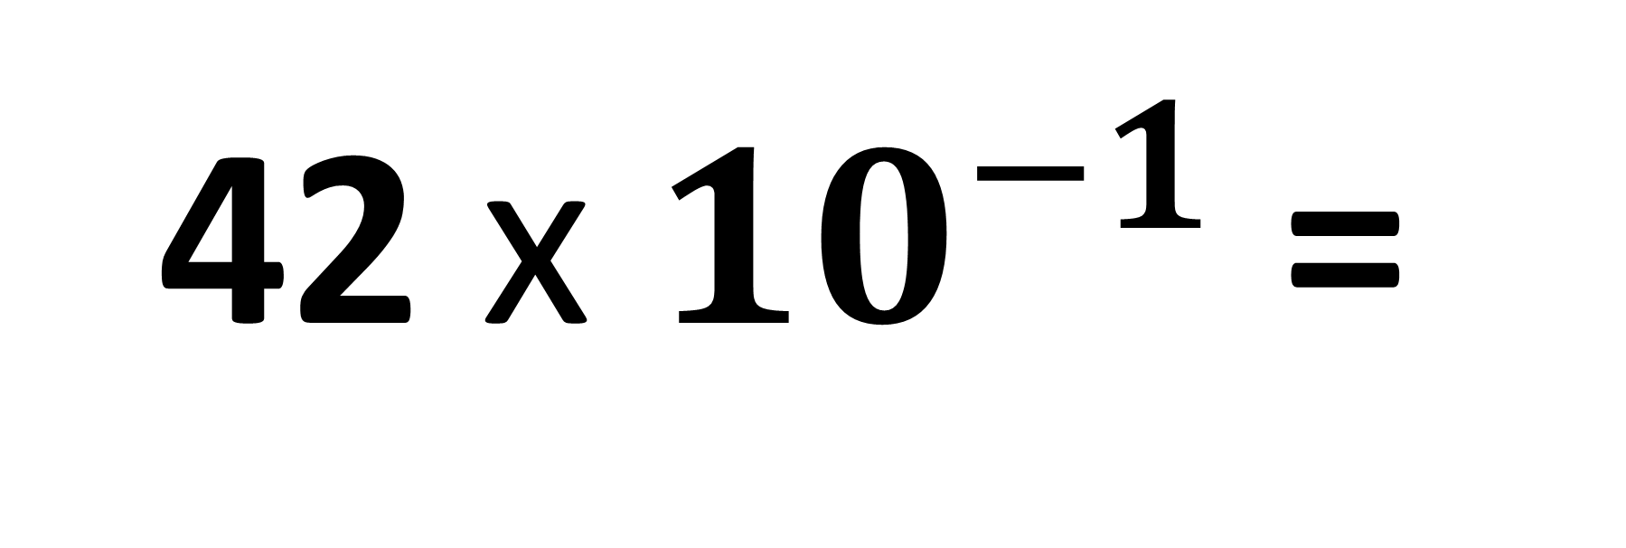
42 x ${10}^{−1}$=
4.2

Slide 11
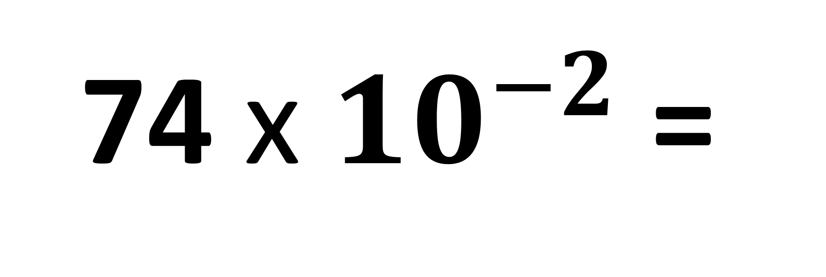
74 x ${10}^{−2}$=
0.74

Slide 12
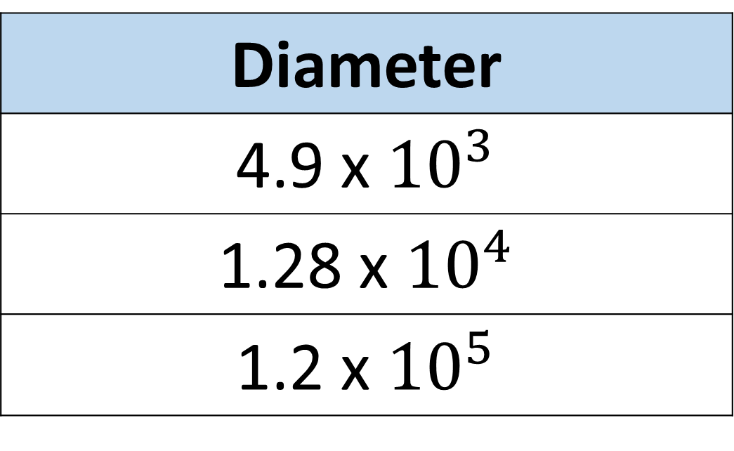
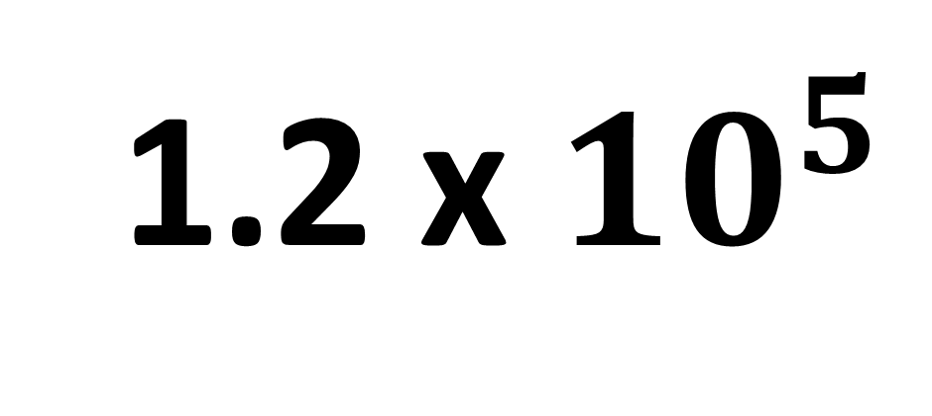
Diameter
4.9 x ${10}^{3}$
1.28 x ${10}^{4}$
1.2 x ${10}^{5}$
Which diameter has the biggest value?
1.2 x ${10}^{5}$

