Slide 1
Sketching Graphs
Reciprocal
Chapter 4
(Part 3 of 5)

Slide 2

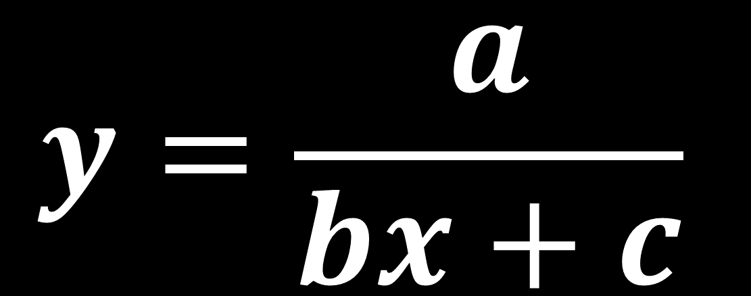
Reciprocal Graphs
$$y=\frac{a}{bx+c}$$
where $a$, $b$ and $c$ are integers.

Slide 3
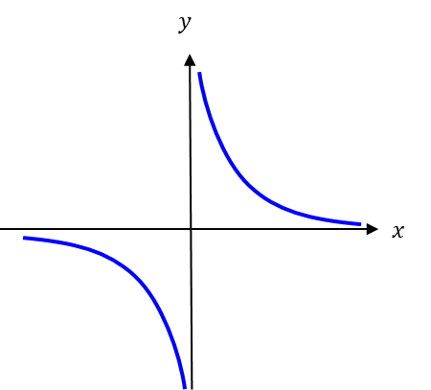
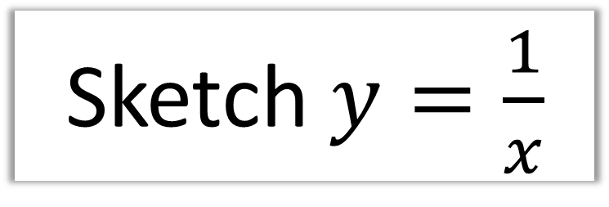
Sketch $y=\frac{1}{x}$

Slide 4

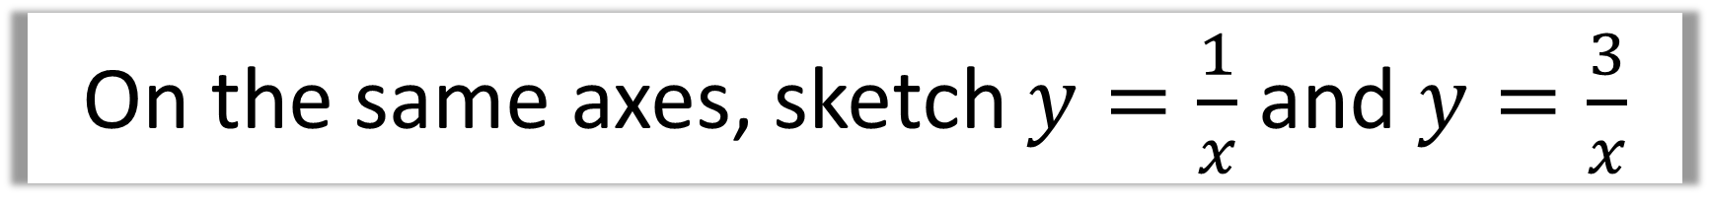
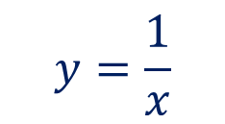
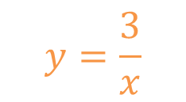

On the same axes, sketch $y=\frac{1}{x}$ and $y=\frac{3}{x}$
$$y$$
$$y=\frac{3}{x}$$
$$y=\frac{1}{x}$$
$$x$$

Slide 5
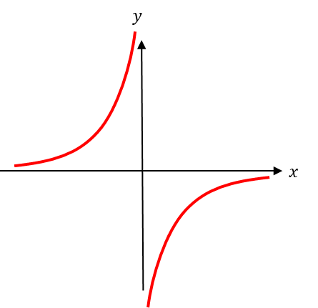
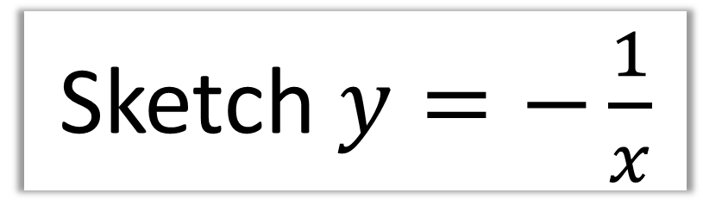
Sketch $y=−\frac{1}{x}$

Slide 6

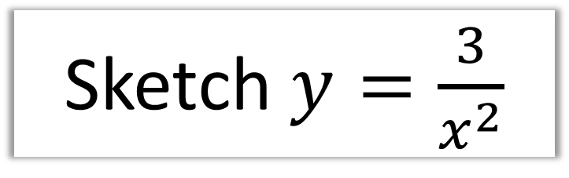

Sketch $y=\frac{3}{x^{2}}$
Hint: Note that anything squared will always be positive.
$$y$$
$$x$$

Slide 7

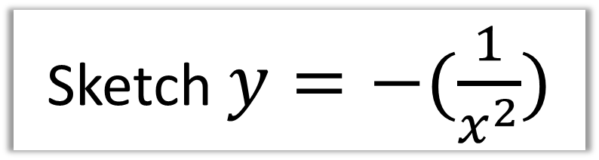

Sketch $y=−(\frac{1}{x^{2}})$
$$y$$
$$x$$

Slide 8
Asymptotes
An asymptote is a line which
the graph approaches
but never reaches.

Slide 9



Reciprocal Graphs - Asymptotes
$$y$$
$$x$$
Notice the distance between this line and the $x$-axis gradually decreases as the lines go off towards infinity.

Slide 10
State the equation of the asymptotes
y = 0
x = 0

Slide 11



State the equation of the asymptotes
$$y$$
y = 0
$$3$$
$$x$$
x = 3

