Slide 1
LO: Solving Equations
(Involving Fractions)

Slide 2
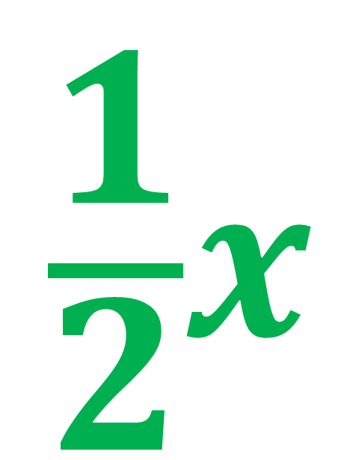

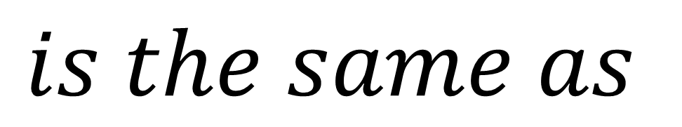
True or False?
$$\frac{1}{2}x$$
$$\frac{x}{2}$$
$$is the same as$$
True

Slide 3
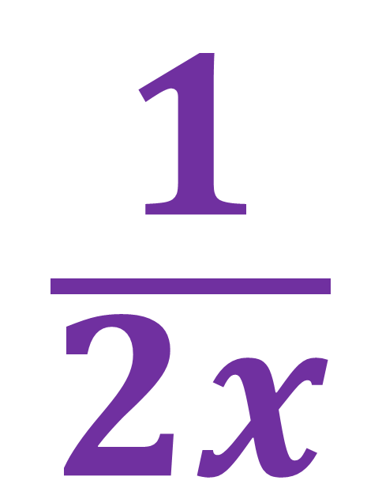

True or False?
$$\frac{1}{2x}$$
$$\frac{x}{2}$$
$$is the same as$$
False

Slide 4
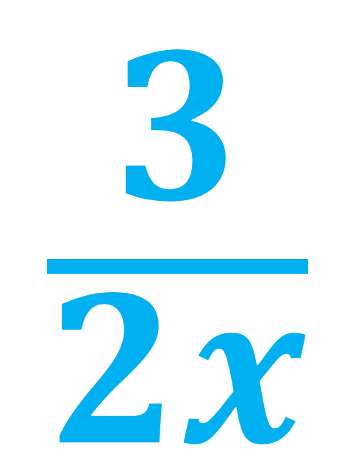
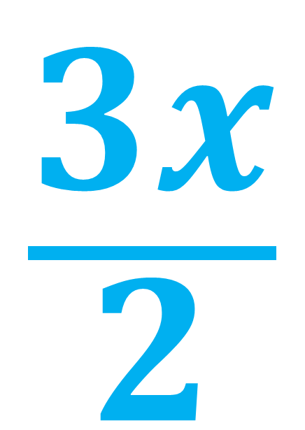
True or False?
$$\frac{3x}{2}$$
$$\frac{3}{2x}$$
$$is the same as$$
False

Slide 5
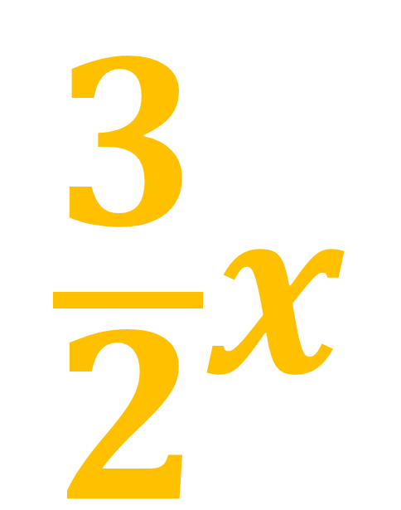
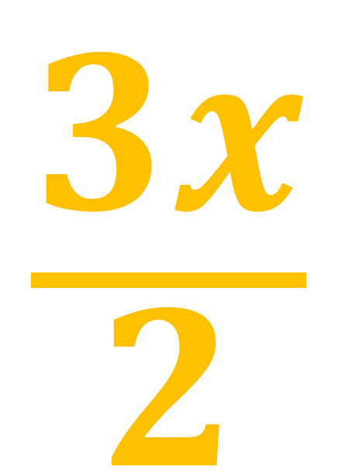
True or False?
$$\frac{3x}{2}$$
$$\frac{3}{2}x$$
$$is the same as$$
True

Slide 6
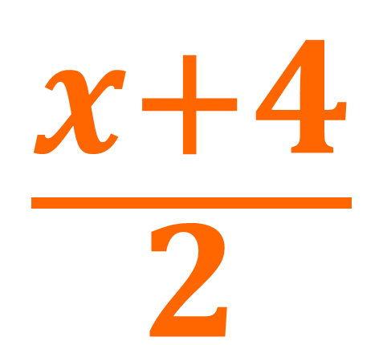
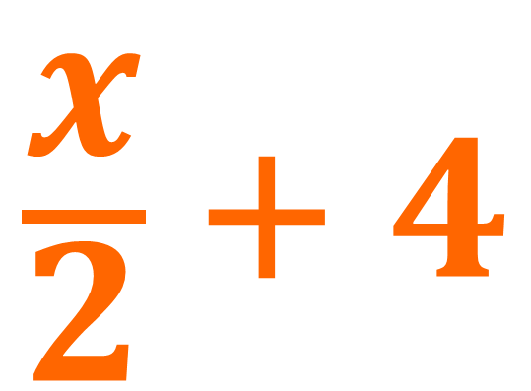
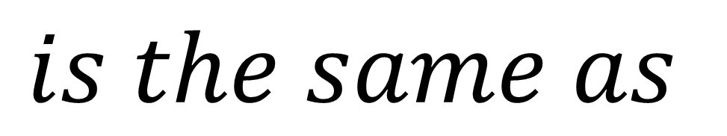
True or False?
$$\frac{x}{2} + 4$$
$$\frac{x+4}{2}$$
$$is the same as$$
False

Slide 7
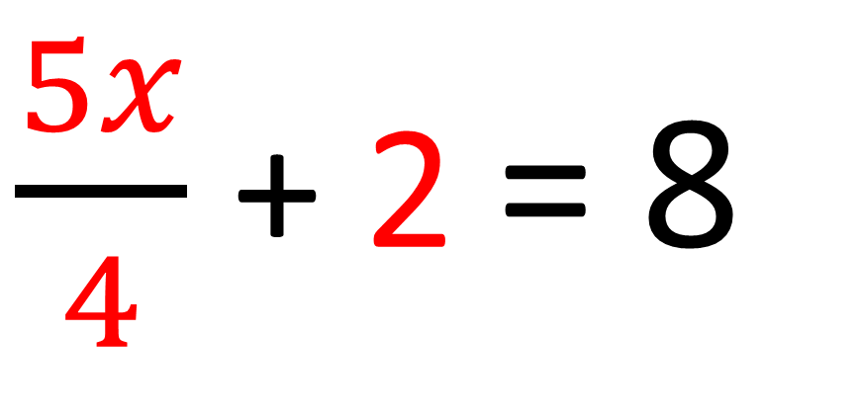
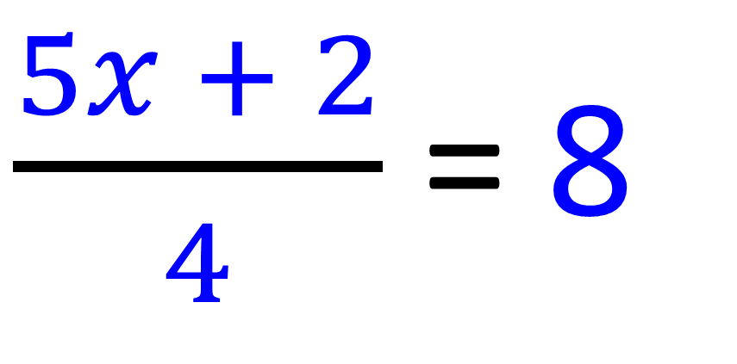
Are these two equations
the same?
$\frac{5x}{4}$ + 2 = 8
$\frac{5x + 2}{4}$ = 8
NO

Slide 8
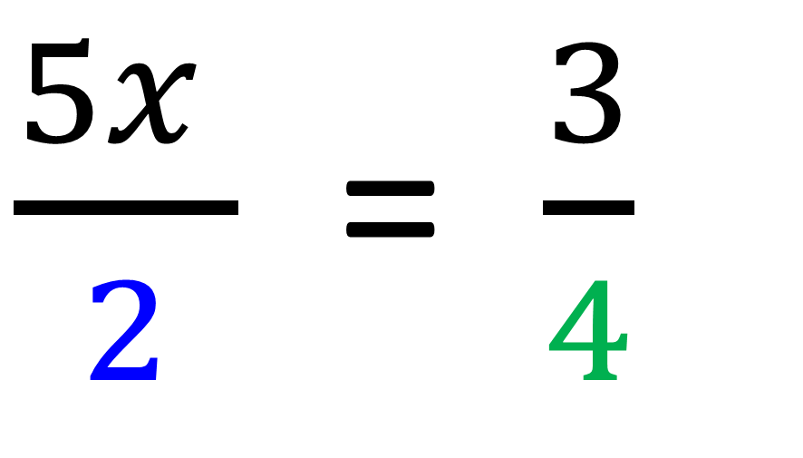
The key to solving equations
with fractions is to
cross multiplication when possible.
$\frac{5x }{2}$ = $\frac{3}{4}$

Slide 9
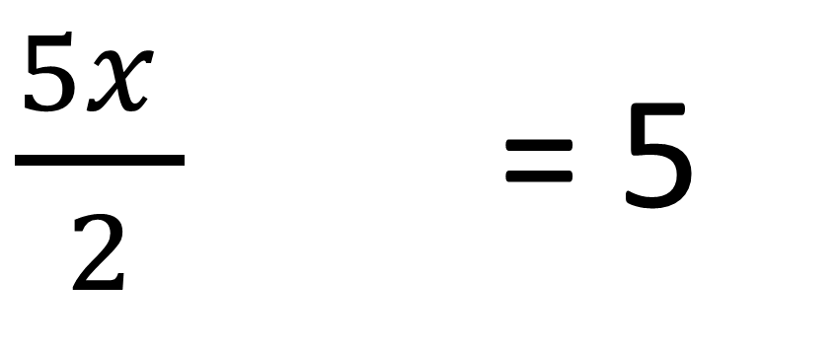
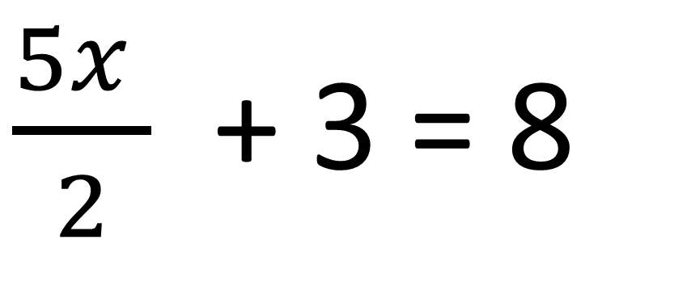
Before you can cross multiply
you need to deal with any
addition or subtraction terms first.
$\frac{5x }{2}$ + 3 = 8
$\frac{5x }{2}$ + 3 = 5

Slide 10
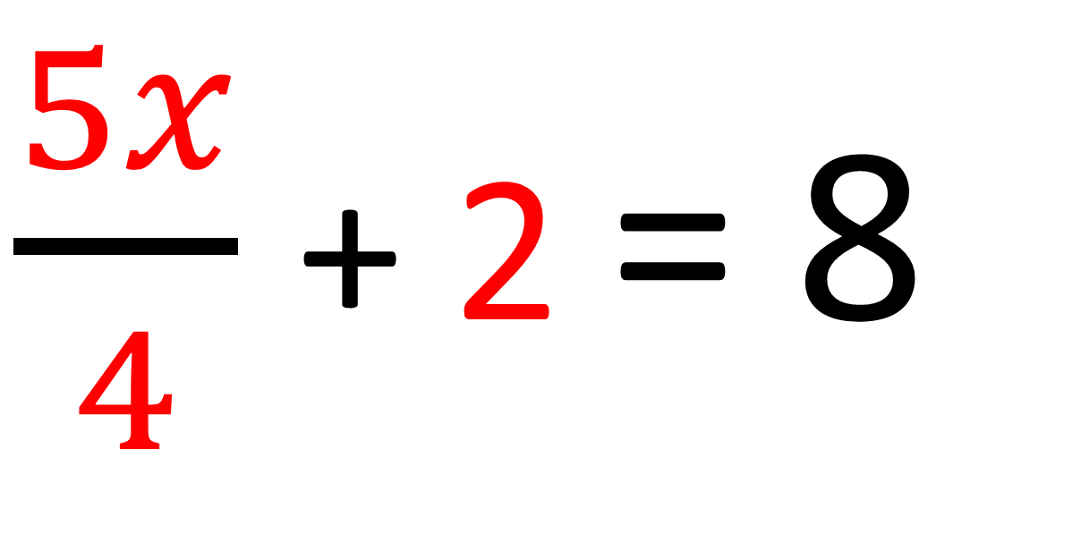
$\frac{5x}{4}$ + 2 = 8
Is the 4 ready for cross multiplying?
No

Slide 11
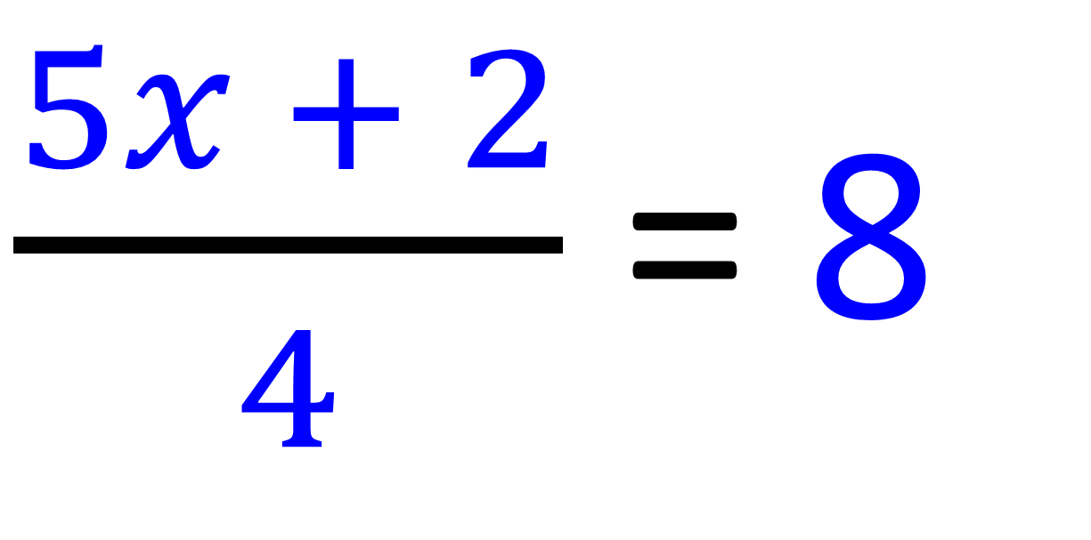
$\frac{5x + 2}{4}$ = 8
Is the 4 ready for cross multiplying?
Yes

Slide 12
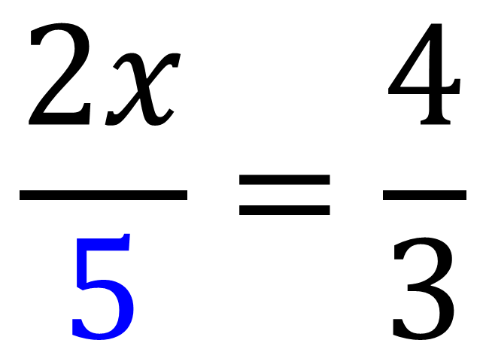
$$\frac{2x}{5}=\frac{4}{3}$$
Is the 5 ready for cross multiplying?
Yes

Slide 13
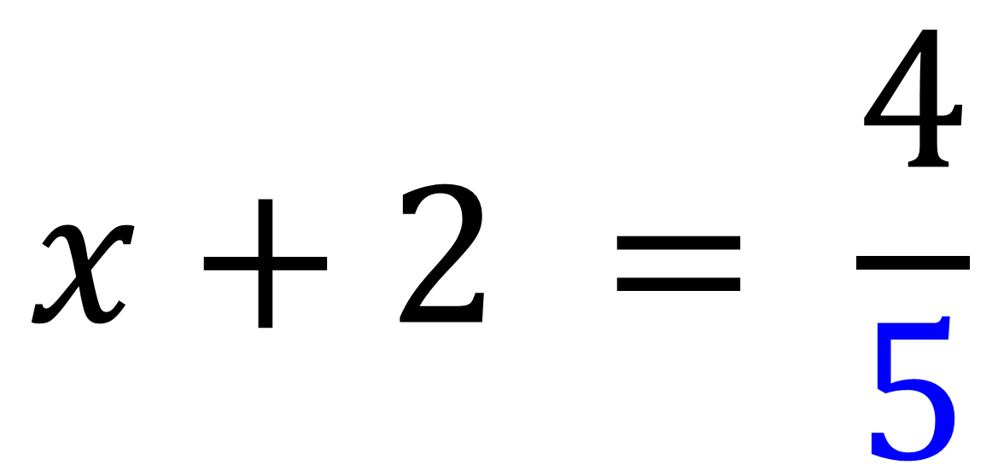
$$x+2 = \frac{4}{5}$$
Is the 5 ready for cross multiplying?
Yes

Slide 14
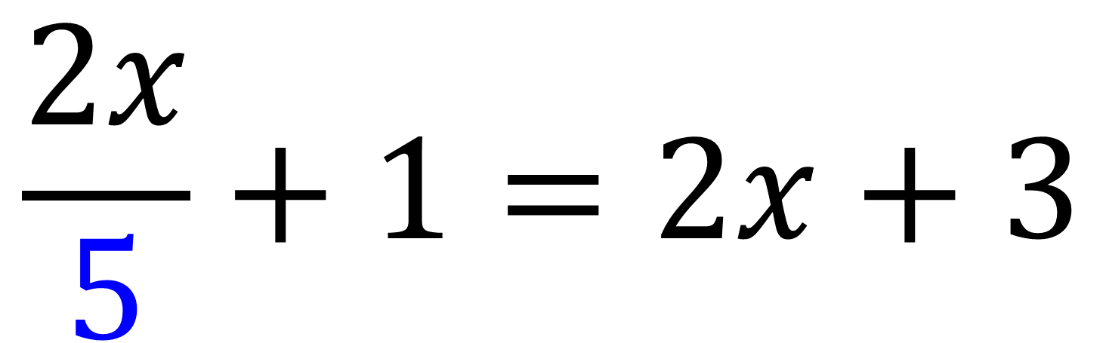
$$\frac{2x}{5}+1=2x+3$$
Is the 5 ready for cross multiplying?
No

Slide 15
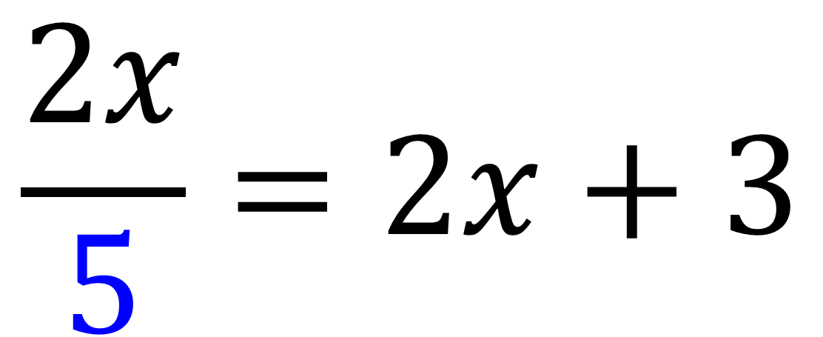
$$\frac{2x}{5}=2x+3$$
Is the 5 ready for cross multiplying?
Yes

Slide 16
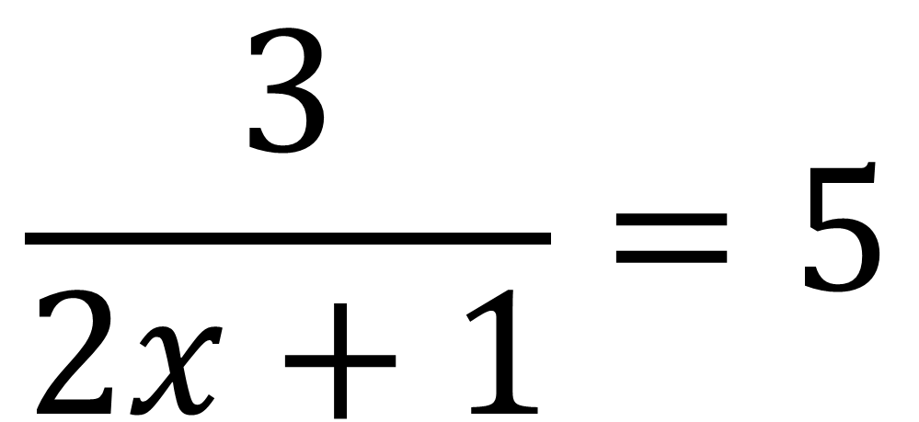
$$\frac{3}{2x+1}=5$$
Is the 2x + 1 ready for cross multiplying?
Yes

Slide 17
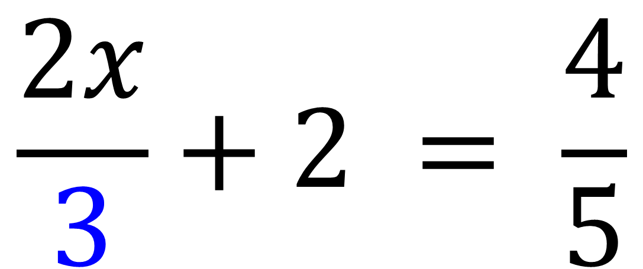
$$\frac{2x}{3}+2 = \frac{4}{5}$$
Is the 3 ready for cross multiplying?
No

Slide 18
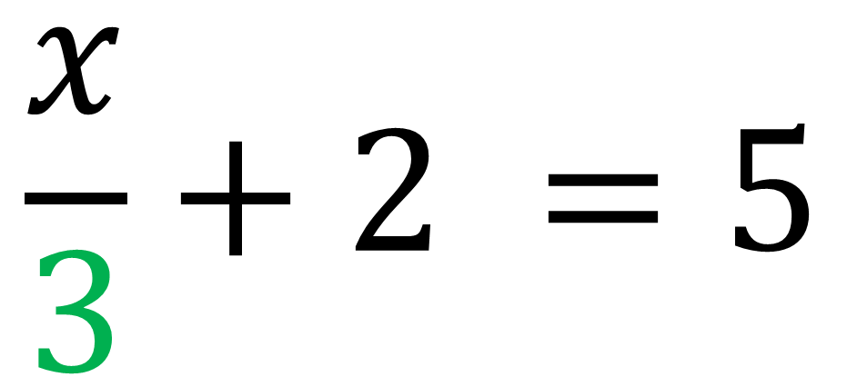
$$\frac{x}{3}+2 =5$$
Is the 3 ready for cross multiplying?
No

Slide 19
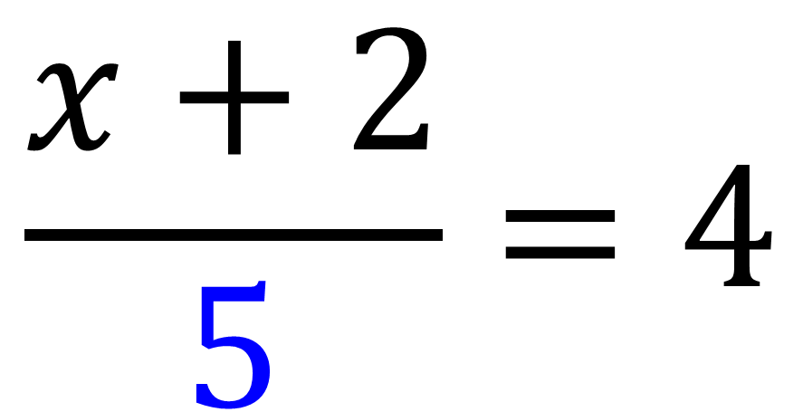
$$\frac{x+2}{5}=4$$
Is the 5 ready for cross multiplying?
Yes

Slide 20
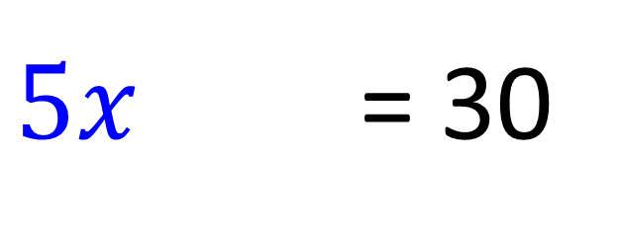
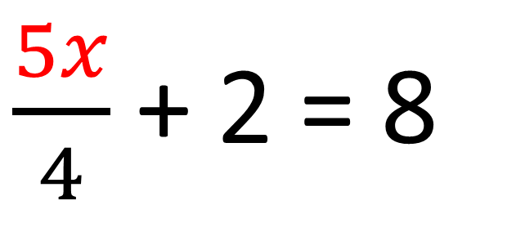
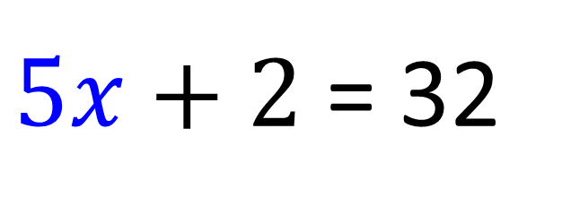
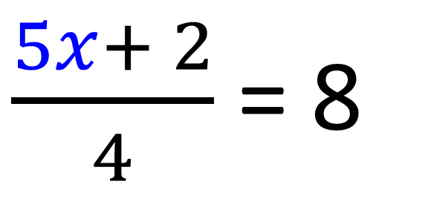
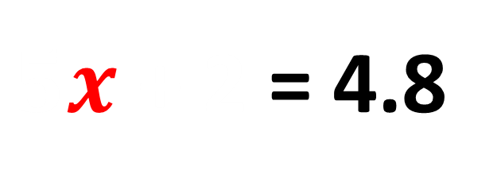
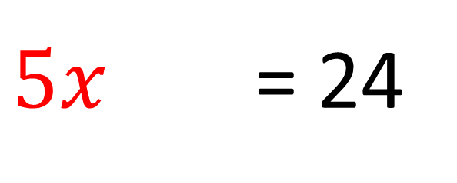
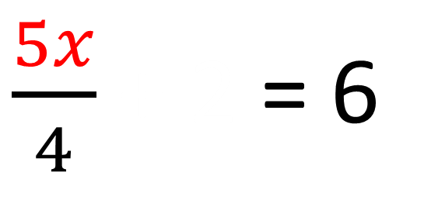
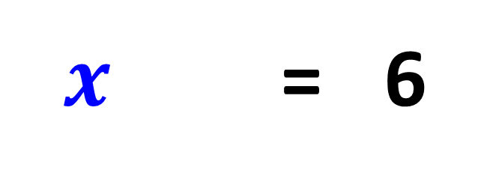
$\frac{5x}{4}$ + 2 = 8
$\frac{5x+ 2}{4}$ = 8
$\frac{5x}{4}$ + 2 = 6
$5x+2$ = 32
$5x$ + 2 = 24
$5x+2$ = 30
$5x$ + 2 = 4.8
$5x+2$ = 36

Slide 21
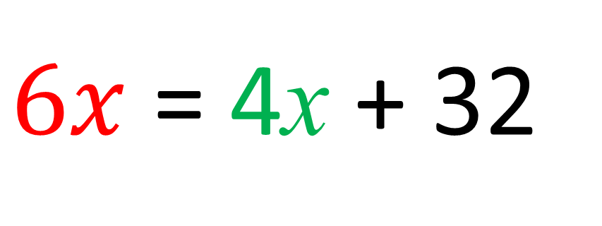
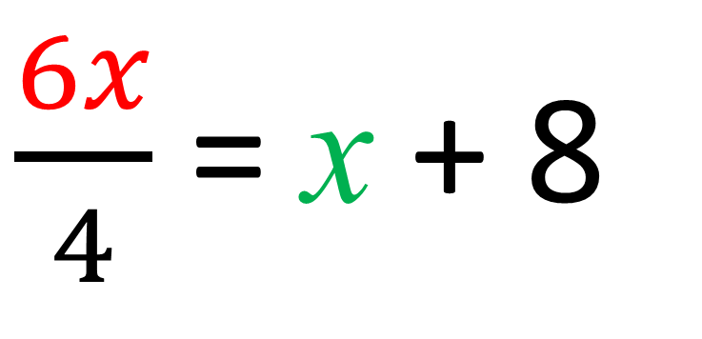
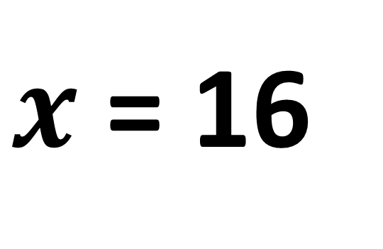
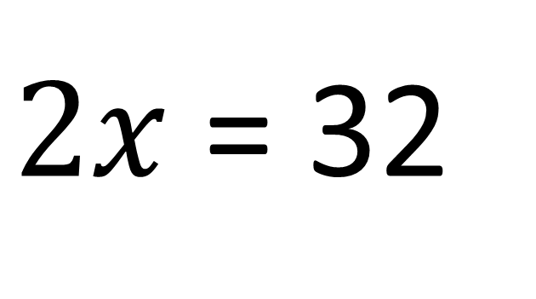
$\frac{6x}{4}$ = x + 8
$6x$ = 4x + 32
$2x$ = 32
$x$ = 16

Slide 22
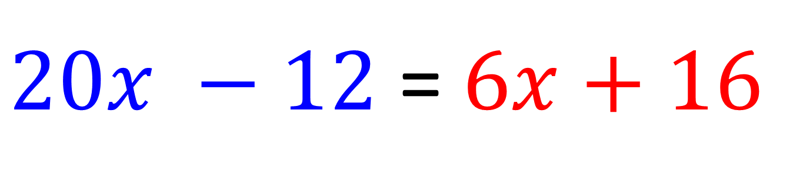
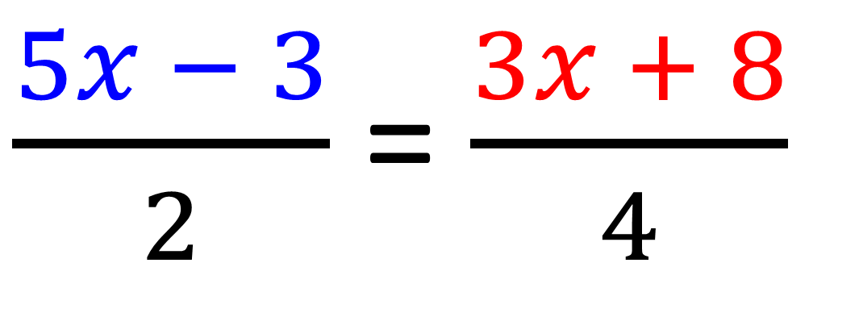
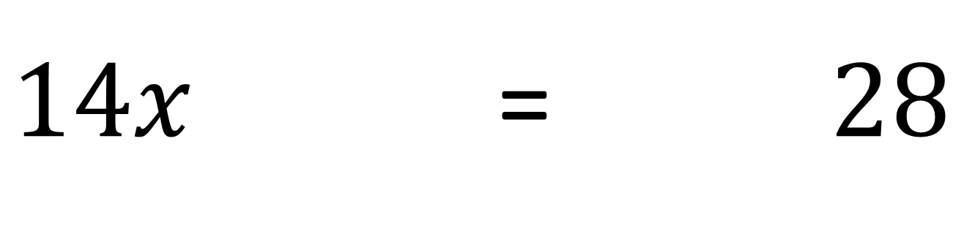
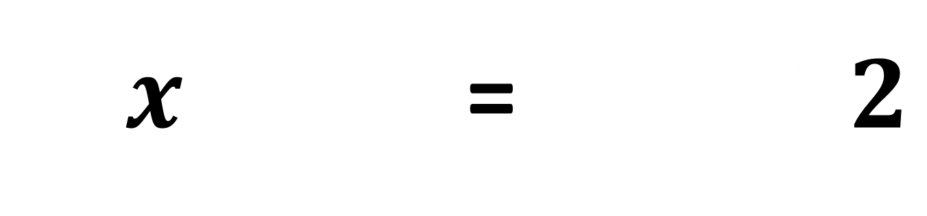
$\frac{5x − 3}{2}$ = $\frac{3x + 8}{4}$
$20x −12$ = $6x+16$
$14x −12$ = $6x+28$
$14x − 12$= $6x 22$

Slide 23
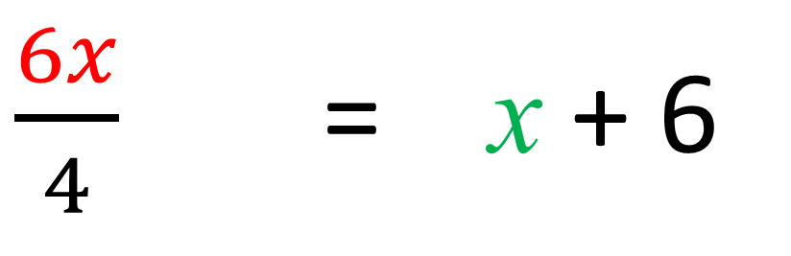
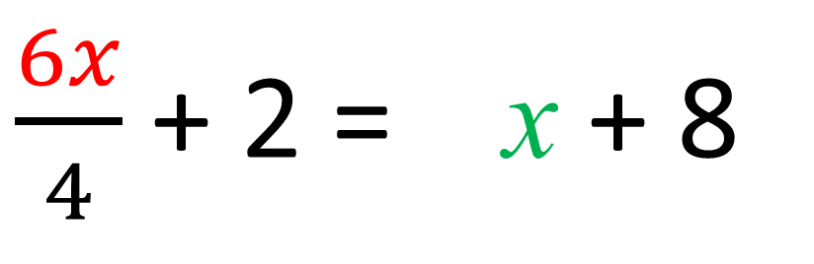
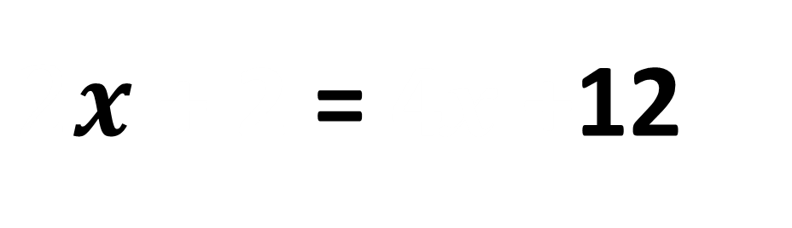
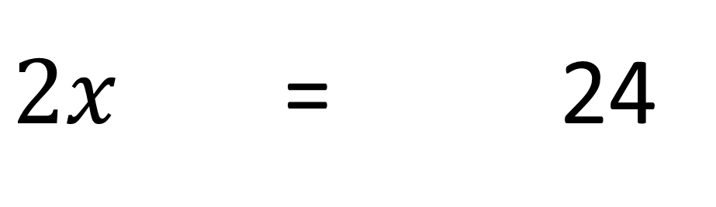
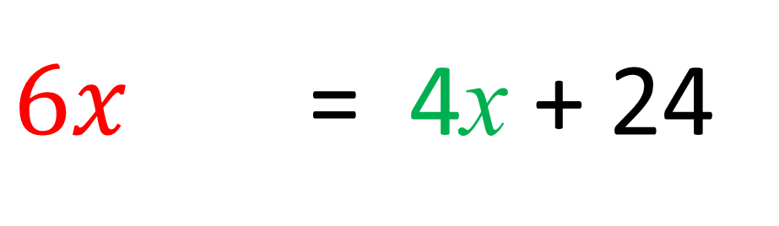
$\frac{6x}{4}$ + 2 = x + 8
$\frac{6x}{4}$ + 2 = x + 6
$6x$ + 2 = 4x + 24
$2x$ + 2 = 4x + 24
$2x$ + 2 = 4x +12

Slide 24
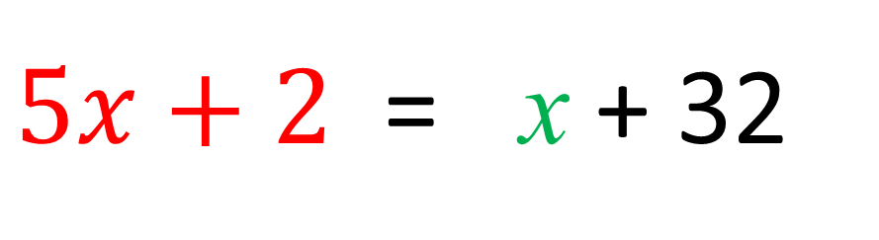
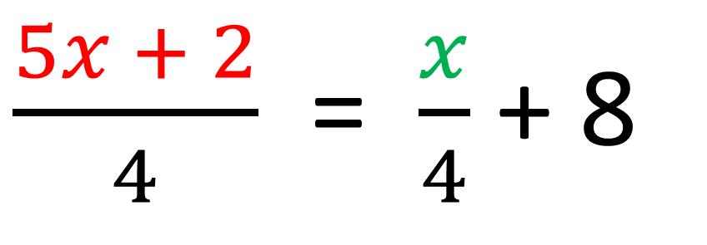
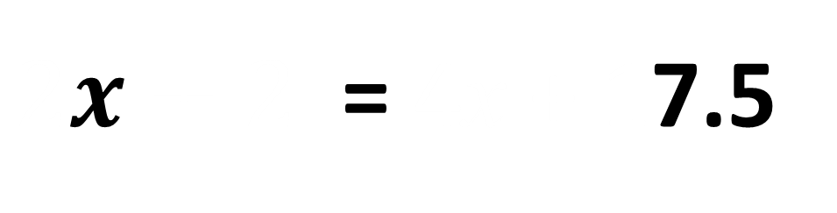
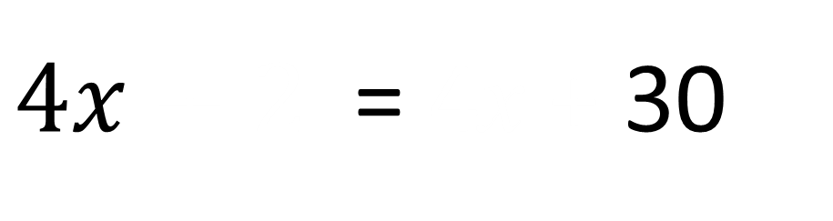

$\frac{5x + 2}{4}$ = $\frac{x}{4}$ + 8
$5x+2$ = 4x + 32
$4x+2$ = 4x + 32
$4x+2$ = 4x + 30
$2x+2$ = 4x + 17.5

