Slide 1
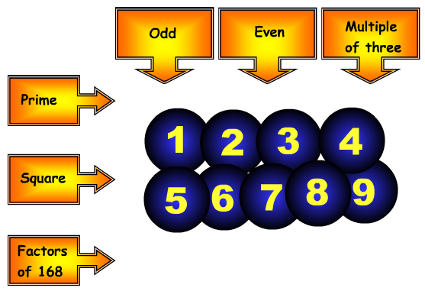
5
2
3
1
4
9
7
8
6
Sort the digits 1, 2, 3, 4, 5, 6, 7, 8, 9 into the grid so that they obey the row and column headings.
Notes:
Show this alternative factor tree for 36.
The prime factor decomposition is the same.

Slide 2
LO: HCF and LCM
by Listing

Slide 3
HCF
Highest Common Factors
LCM
Lowest Common Multiple

Slide 4
What are the factors of 24?
1
24
2
12
3
8
4
6

Slide 5
What are the factors of 36?
1
36
2
18
3
12
4
9
6

Slide 6
What is the
Highest Common Factor
of 24 and 36?
1
36
1
24
12
2
18
2
12
3
12
3
8
4
9
4
6
6

Slide 7
What are the multiplies of 6?
6
12
18
24
30

Slide 8
What are the multiplies of 8?
8
16
24
32
40

Slide 9
What is the
Lowest Common Multiple
of 6 and 8?
6
12
18
24
30
8
16
24
32
40
24

Slide 10
Be careful there are many common multiples
but you will be asked for the Lowest.
Multiples of 6
12
60
6
18
54
66
102…
8
16
24
48
72
96
24
32
40
48
56
64
72
80
88
96
104 …
Multiples of 8
30
42
78
90
36
84

