Slide 1
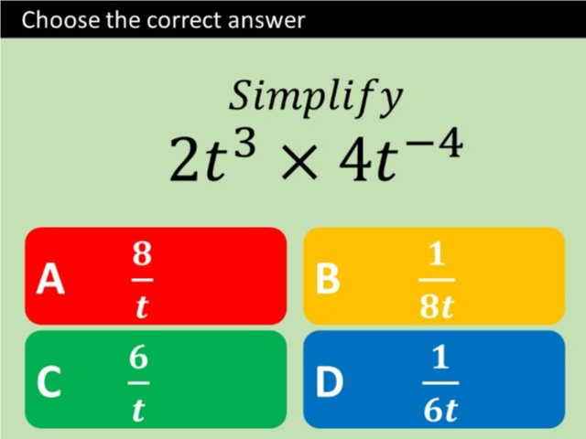
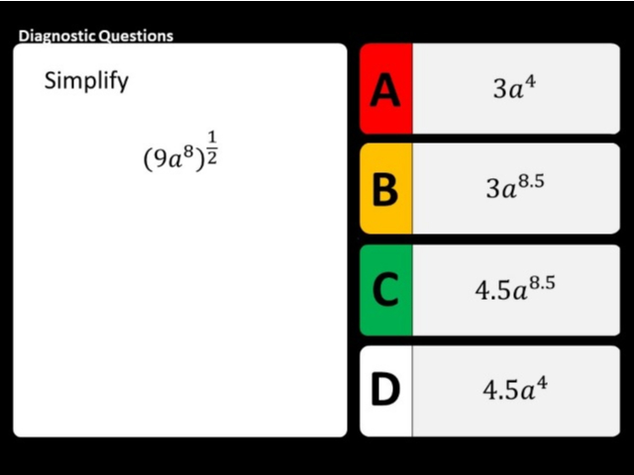
Worst answered question?
Most common wrong answer?

Slide 2
ANSWERS

Slide 3
Worst answered question?

Slide 4
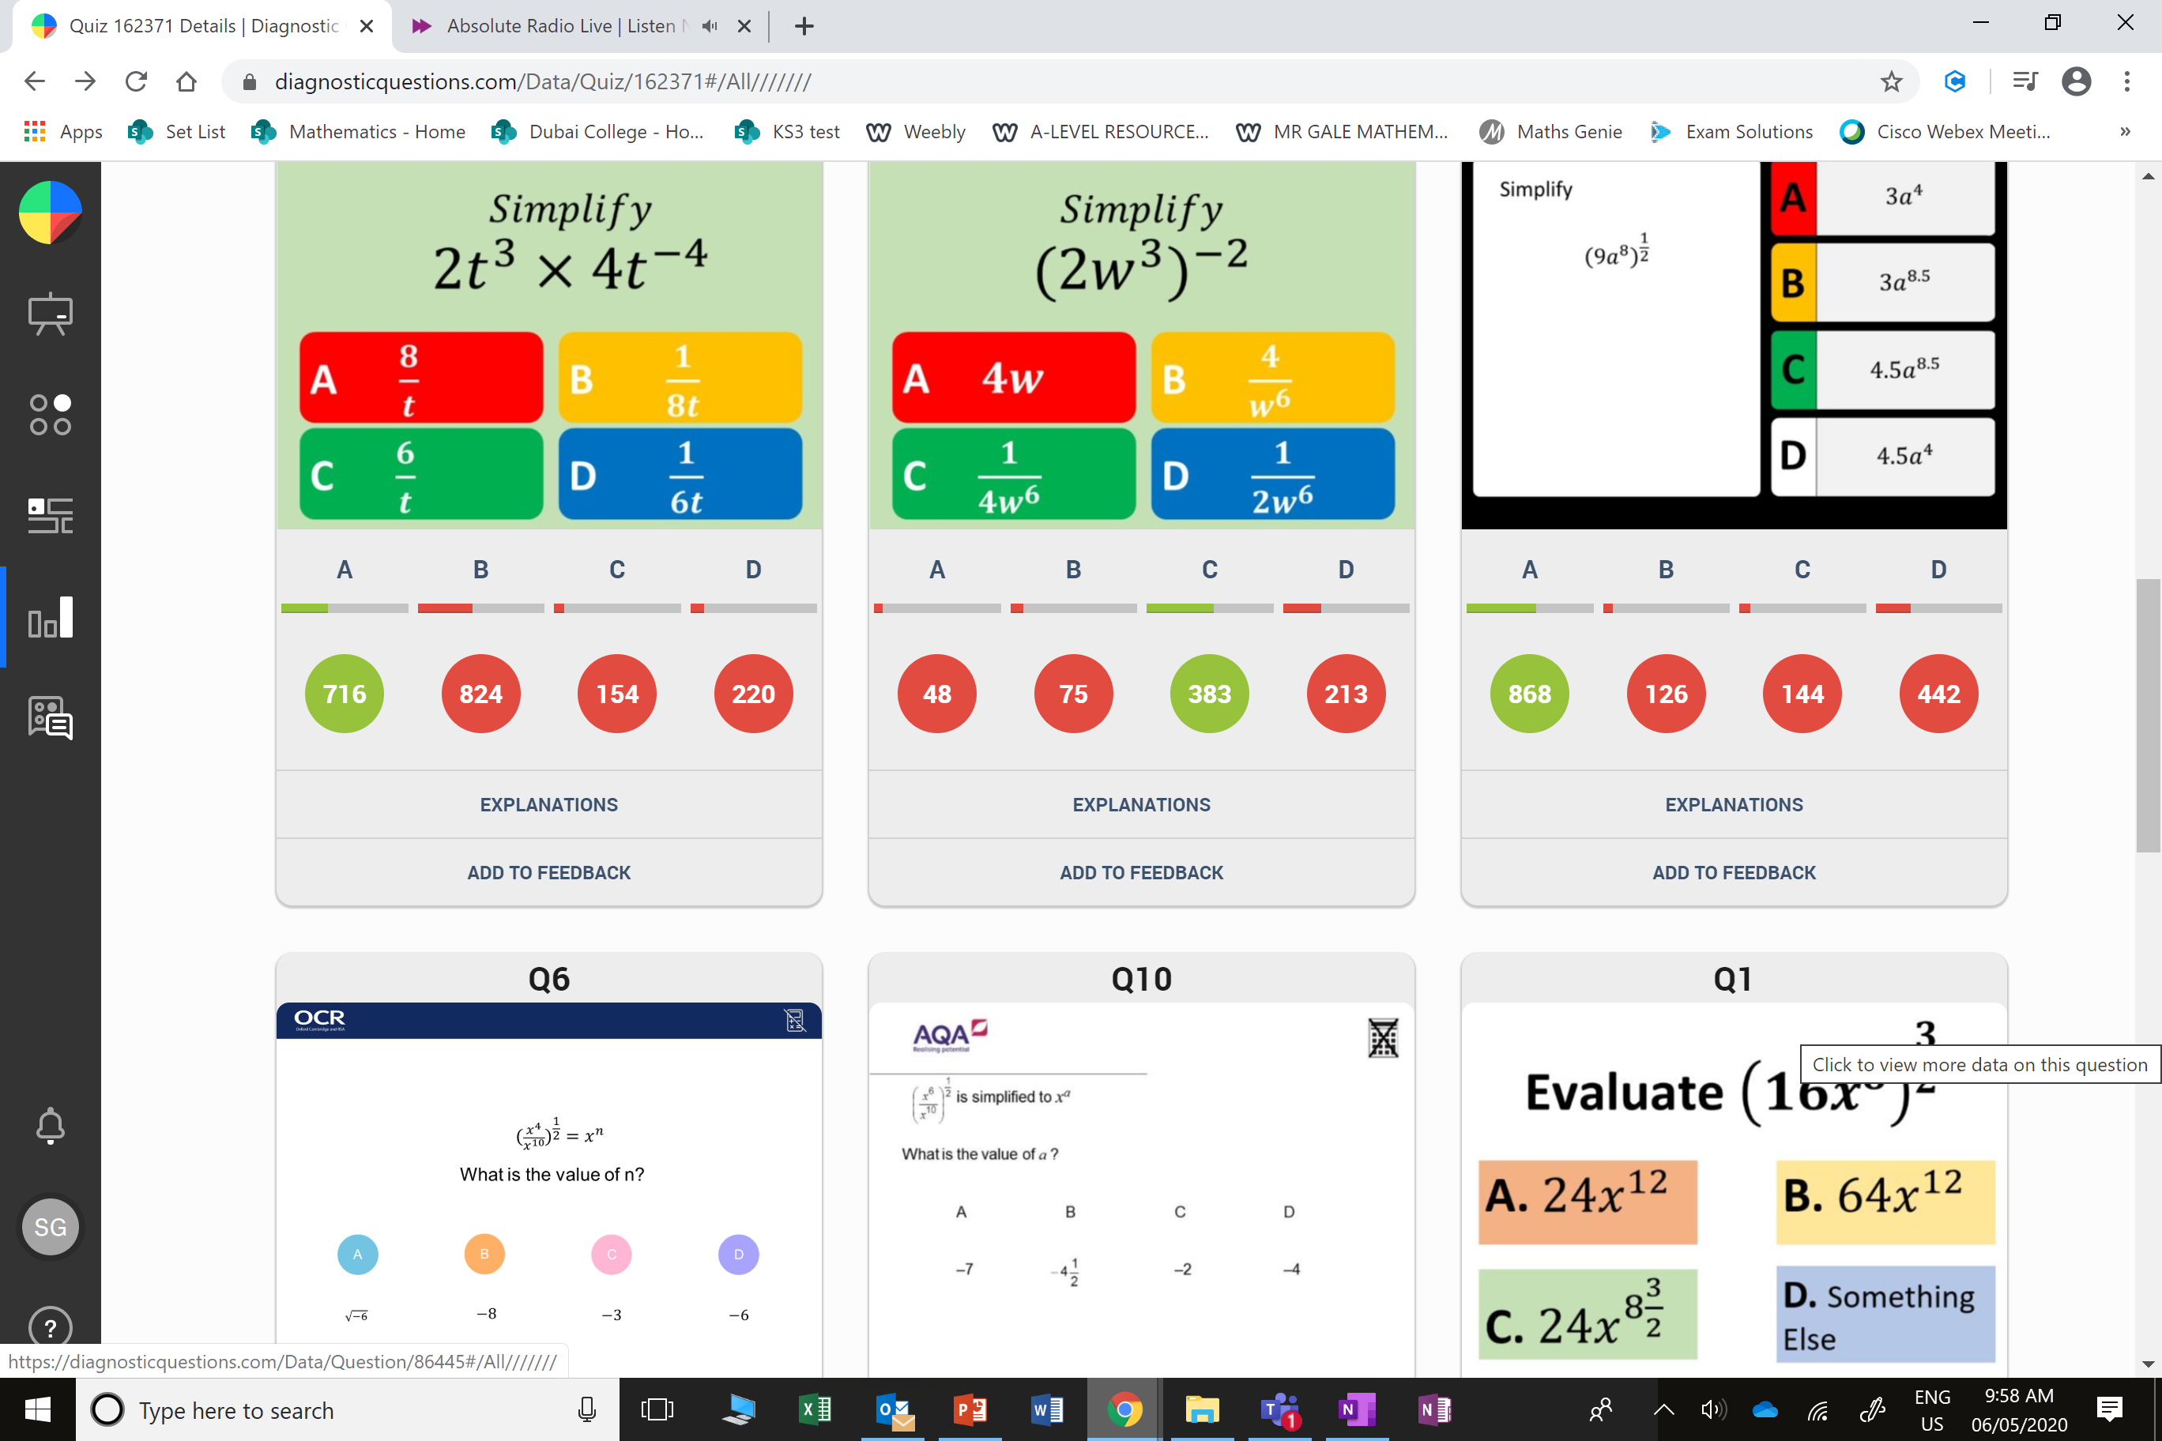
B
The did 8⁻¹ instead when they should not have.

Slide 5
D
The half the 9 instead of taking the square root.

