Slide 1
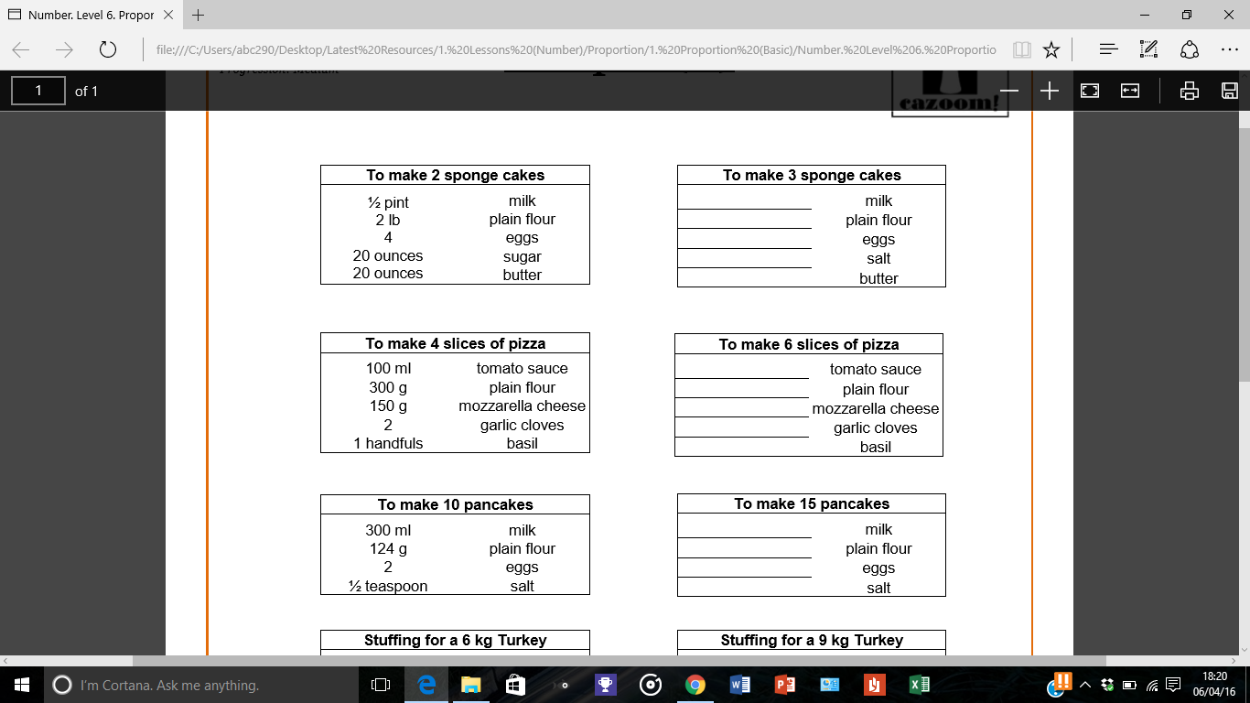
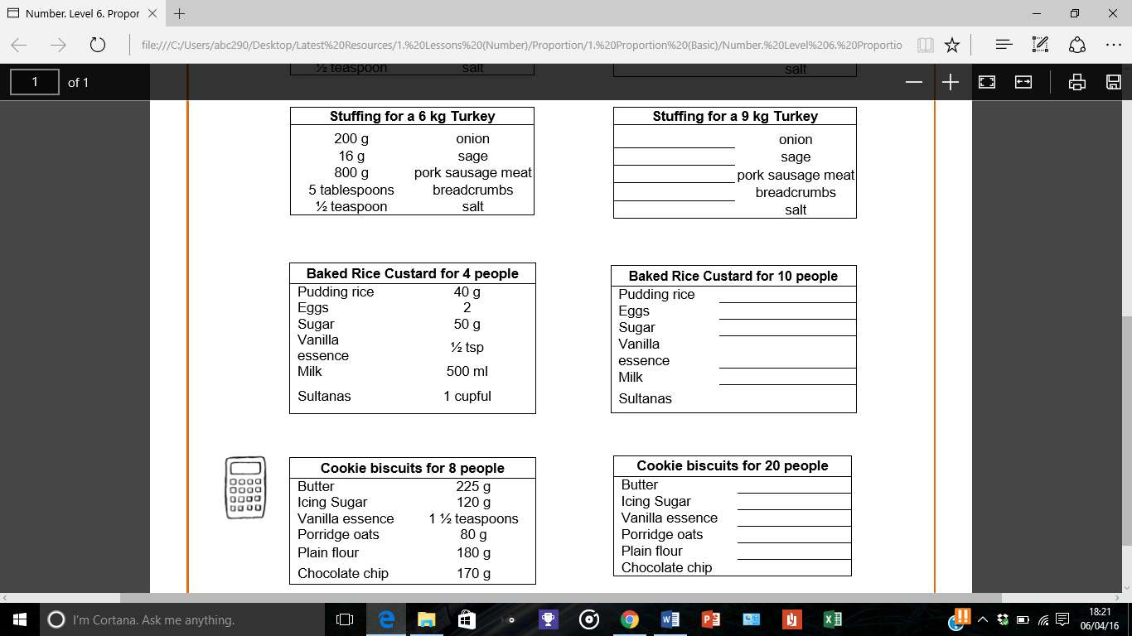

Slide 2
ANSWERS

Slide 3
3/4
3
6
30
30
150
450
225
3
1.5
450
186
3
3/4

Slide 4
300
24
1200
7.5
3/4
100
5
125
1.25
1250
2.5
562.5
300
3.75
200
450
425

