Slide 1
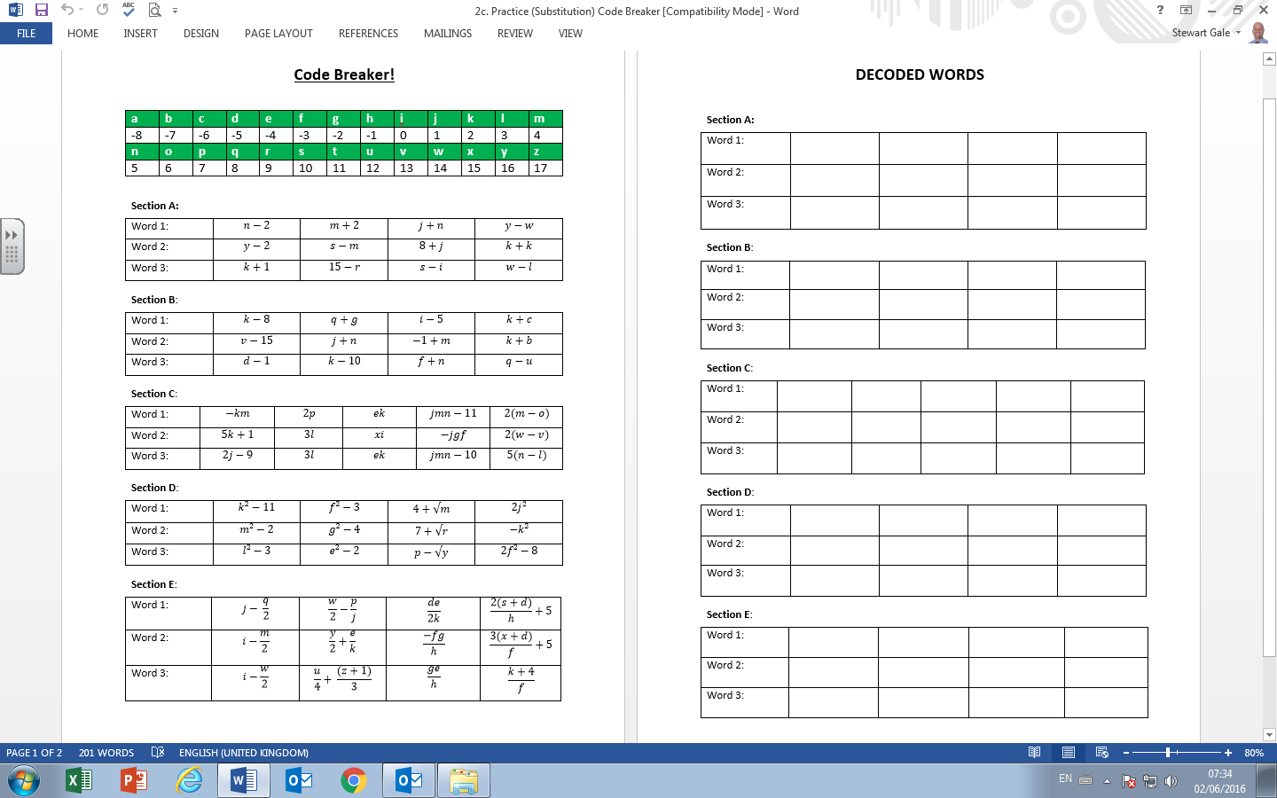
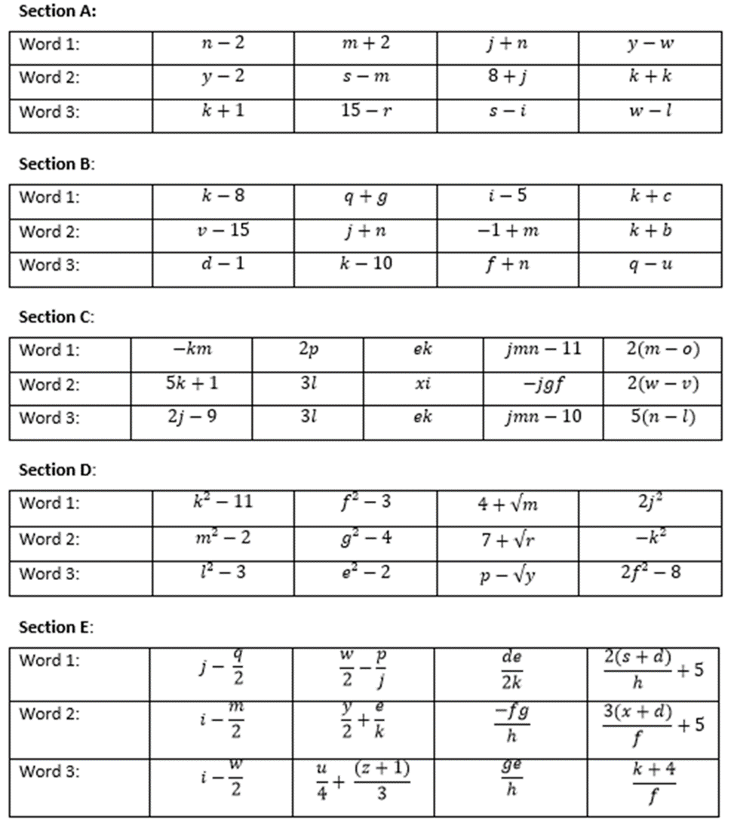
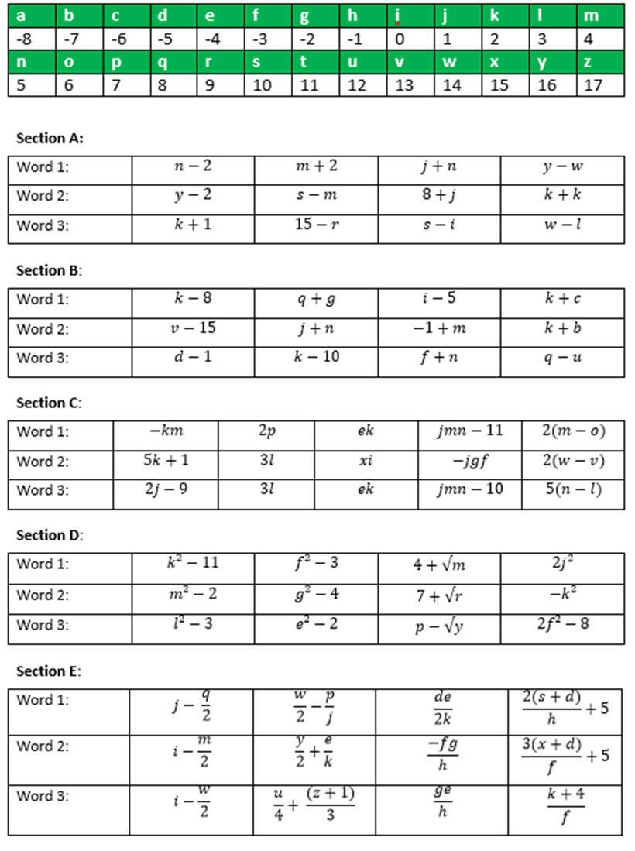

Slide 2
ANSWERS

Slide 3
3 L
6 O
6 O
2 K
14 W
6 O
9 R
4 M
3 L
6 O
10 S
11 T

Slide 4
-6 C
6 O
-5 D
-4 E
-2 G
6 O
3 L
-3 F
-6 C
-8 A
2 K
-4 E

Slide 5
-8 A
14 W
-8 A
9 R
-4 E
11 T
9 R
0 I
-6 C
2 K
-7 B
9 R
-8 A
10 S
10 S

Slide 6
-7 B
6 O
6 O
2 K
14 W
0 I
10 S
-4 E
6 O
14 W
3 L
10 S

Slide 7
-3 F
0 I
5 N
-5 D
-2 G
6 O
6 O
-5 D
-7 B
9 R
-8 A
-2 G

