Slide 1

Junior Challenge 1
Silver

Slide 2
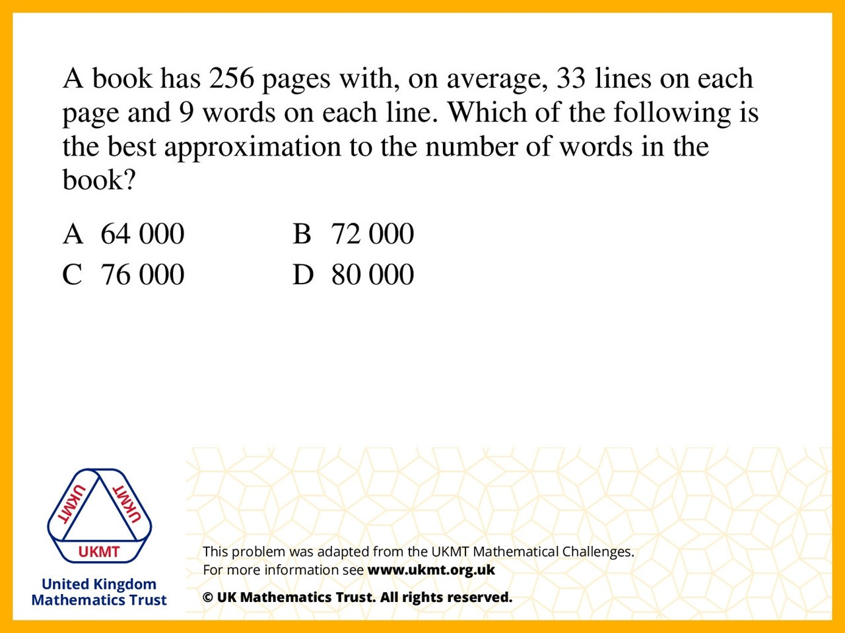
Q1.
256 x 33 = 8448
8448 x 9 = 76032 and then rounded it.

Slide 3
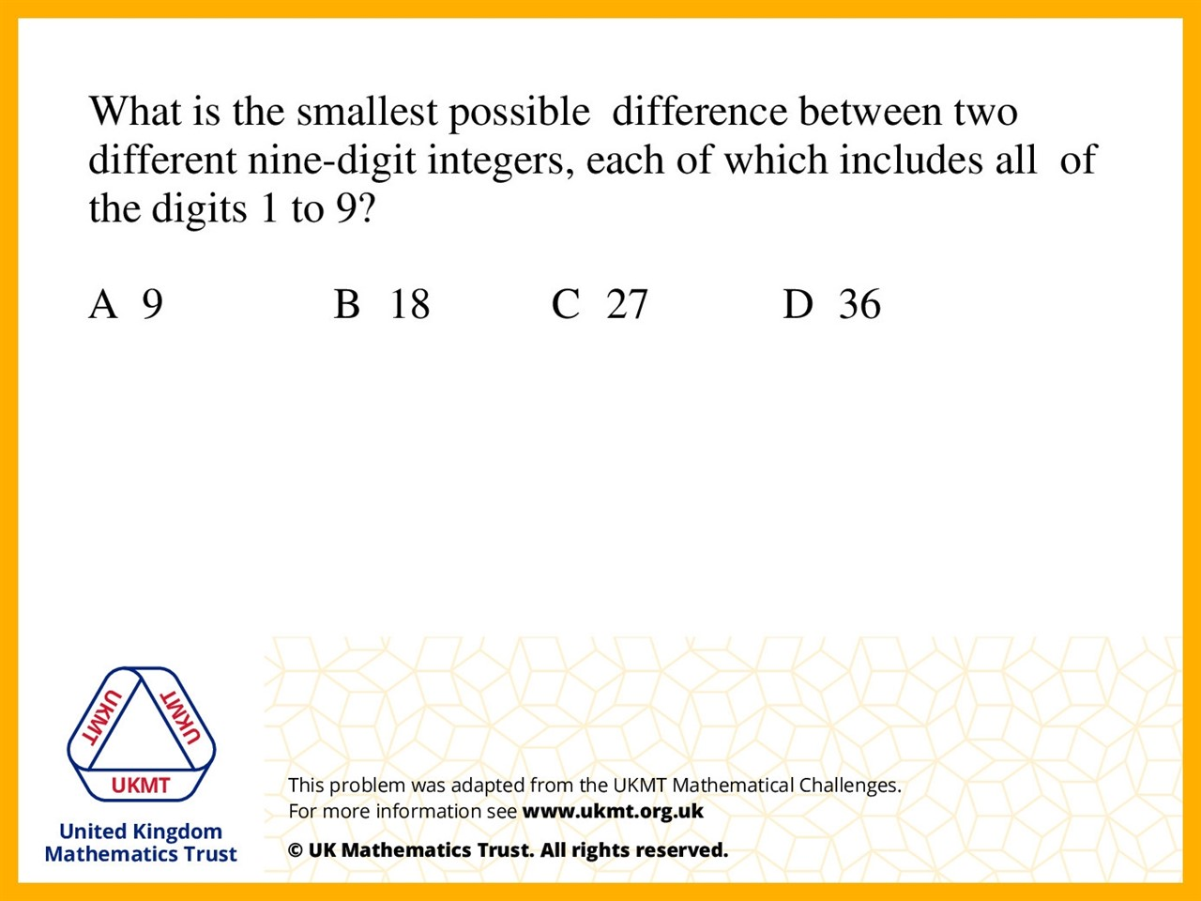
Q2.
The closest numbers are
987654321 and 987654312,
and the difference between them is 9.

Slide 4
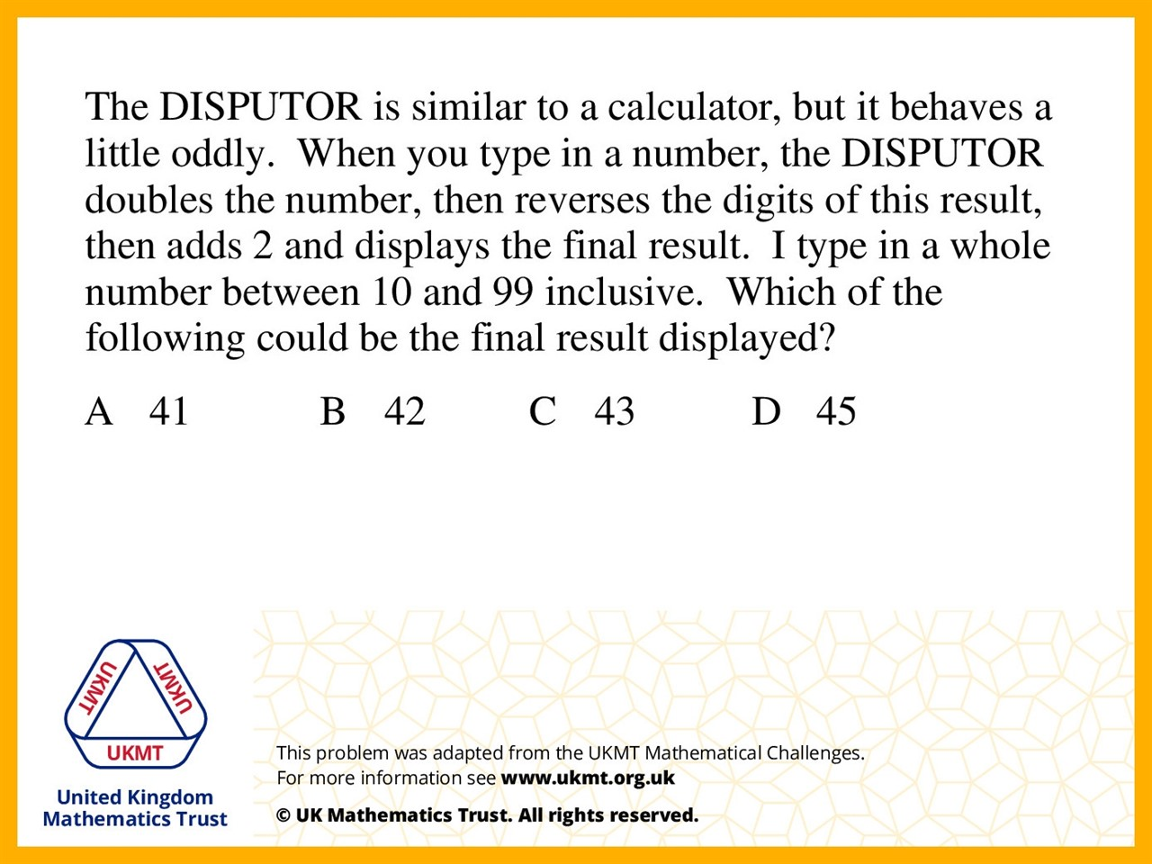
Q3.
Work backwards and take 2 away from 45 to get 43.
Then reversed the digits and halved the answer.

Slide 5
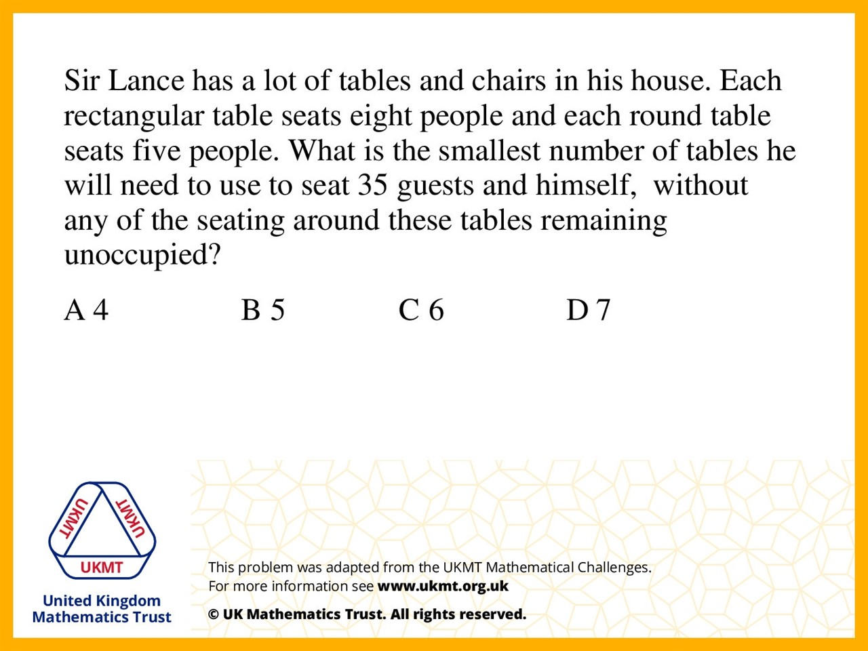
Q4.
6 tables work because you can have 2 tables of 8
and 4 tables of 5 and you would get exactly 36.

Slide 6
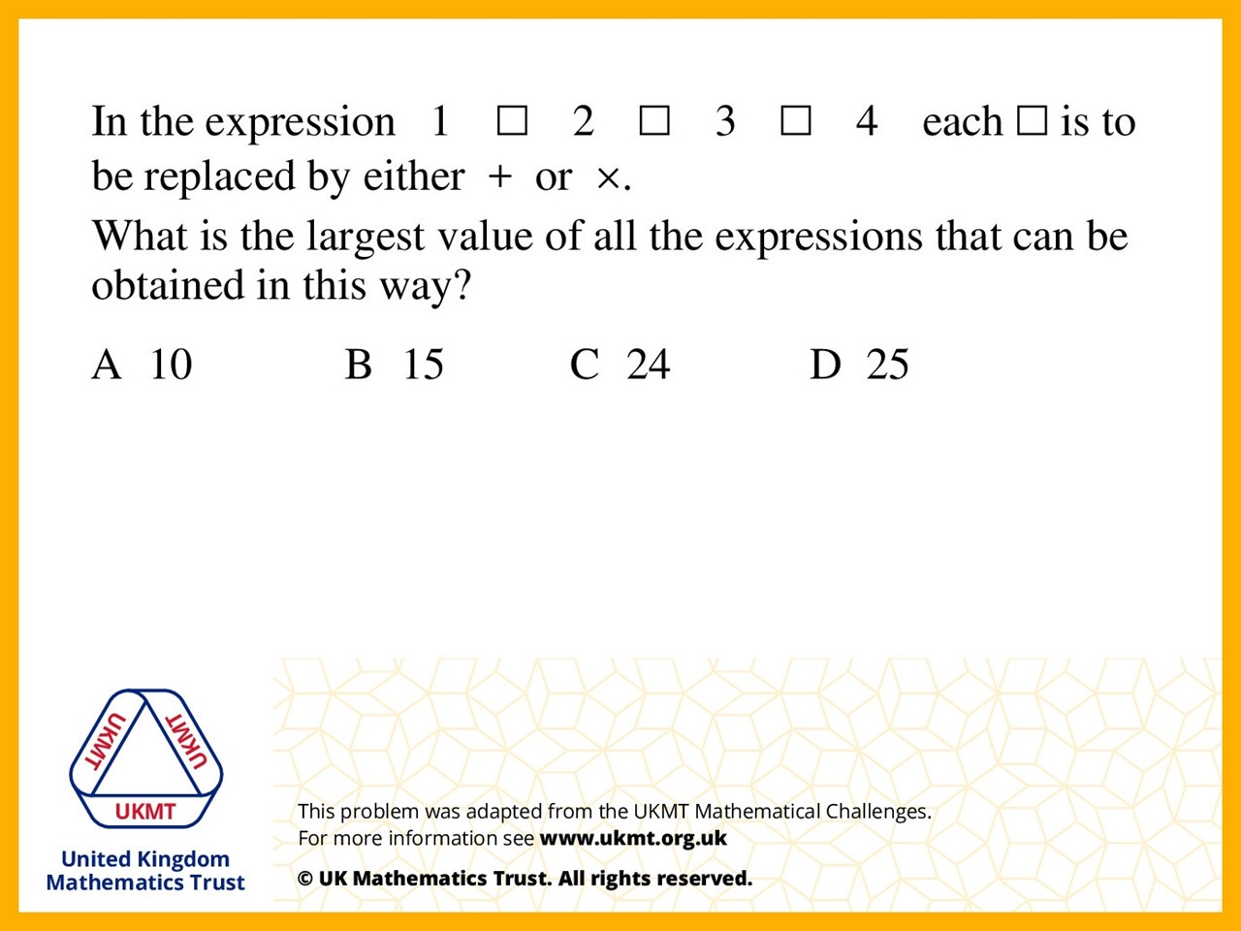
Q5.
1 + 2 x 3 x 4 is 25 because with BIDMAS you do the multiplying before addtion.

