Slide 1
LO: Similar Shapes
(Overlapping)

Slide 2
How many triangles can you see?
B
Two
(Similar Triangles)
A
C
E
D

Slide 3
B
B
B
A
C
E
D
E
D
A
C

Slide 4
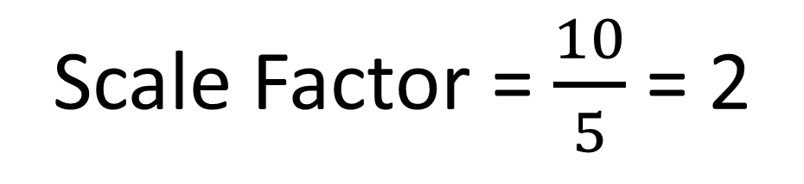
What is the length of BD?
B
B
9 cm
B
A
C
5 cm
9 cm
E
D
E
D
A
C
10 cm
5 cm
10 cm
Scale Factor = $\frac{10}{5}$ = 2
BD = 2 x 9 = 18cm

Slide 5
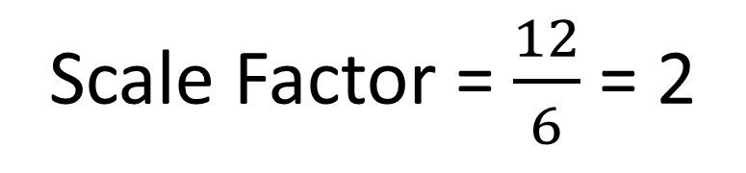
What is the length of CD?
B
B
8 cm
16 cm
B
A
C
6 cm
8 cm
E
D
E
D
A
C
12 cm
12 cm
6 cm
BD = 2 x 8 = 16cm
Scale Factor = $\frac{12}{6}$ = 2
CD = 16 – 8 = 8cm

Slide 6
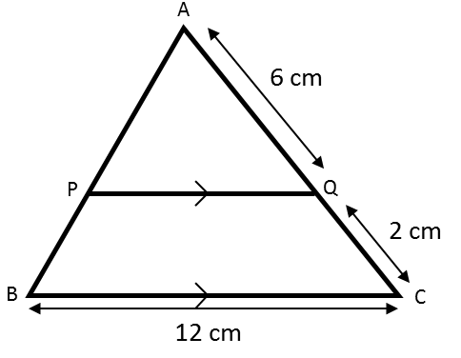
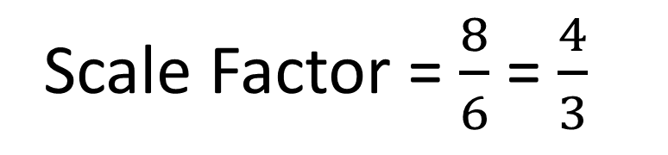

What is the length of PQ?
A
8 cm
A
6 cm
B
C
12 cm
P
Q
Scale Factor = $\frac{8}{6}$ = $\frac{4}{3}$
PQ = 12 ÷ $\frac{4}{3}$ = 9cm

Slide 7
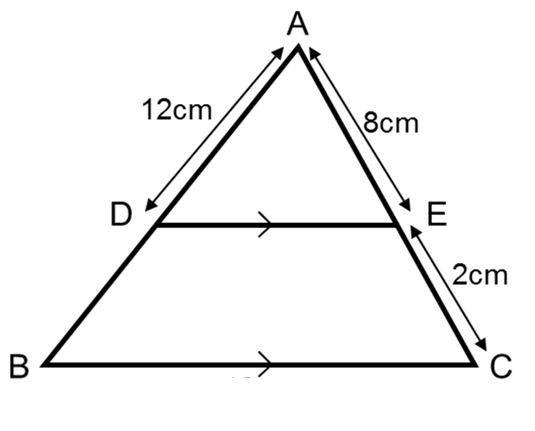

What is the length of DB?
A
10 cm
A
15 cm
12 cm
8 cm
B
C
D
E
AD = 1.25 x 12 = 15cm
Scale Factor = $\frac{10}{8}$ = 1.25
DB = 15 – 12 = 3cm

Slide 8
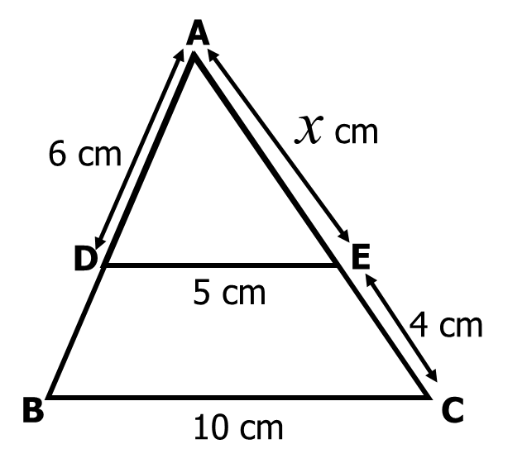
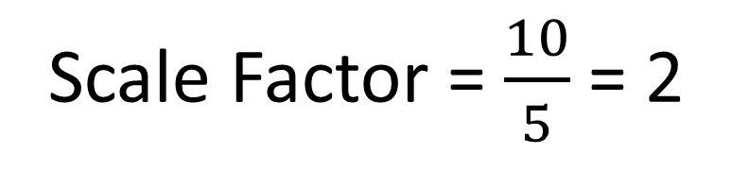
What is the length of AE?
A
A
x + 4 cm
x cm
B
c
D
E
10 cm
5 cm
2x = x + 4
Scale Factor = $\frac{10}{5}$ = 2
x = 4

Slide 9
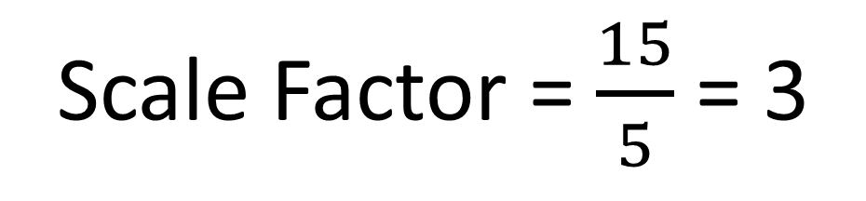
What is the length of BC?
B
B
x
B
x + 6
A
C
x
5 cm
6 cm
E
D
E
D
A
C
15 cm
5 cm
15 cm
x + 6 = 3x
Scale Factor = $\frac{15}{5}$ = 3
6 = 2x
3 = x

