Slide 1

Intermediate Challenge 5
SILVER

Slide 2
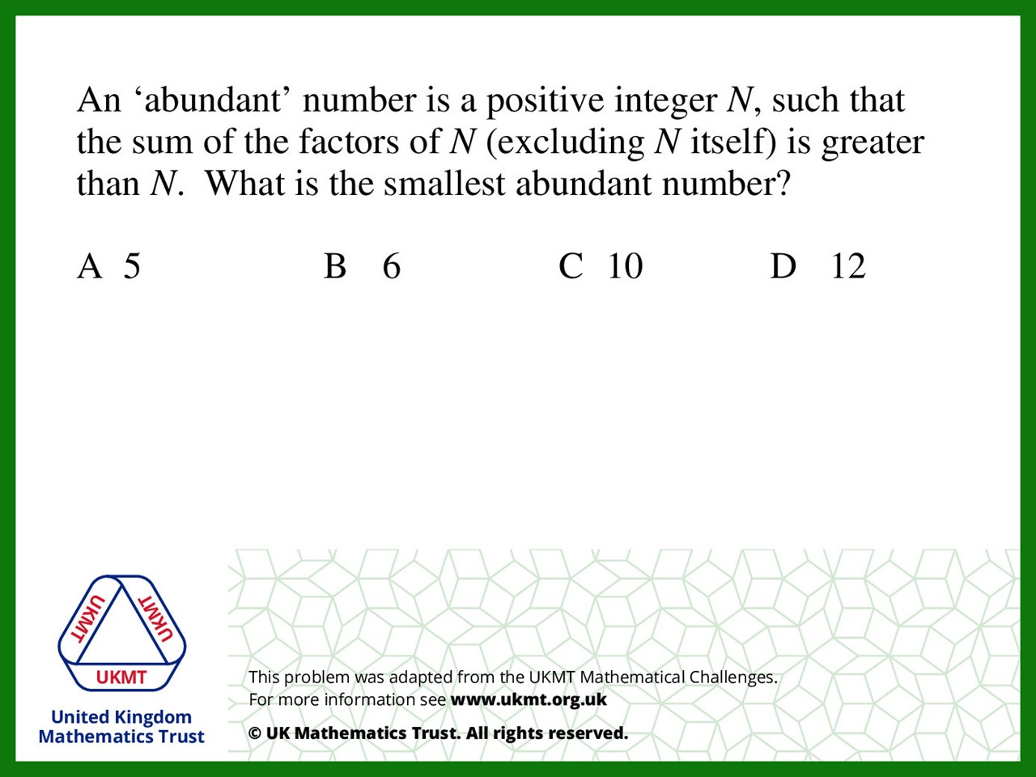
Q1.
A = 1
B = 1 + 2 + 3 = 6
C = 1 + 2 + 5 = 8
D = 1 + 2 + 3 + 4 + 6 = 16

Slide 3
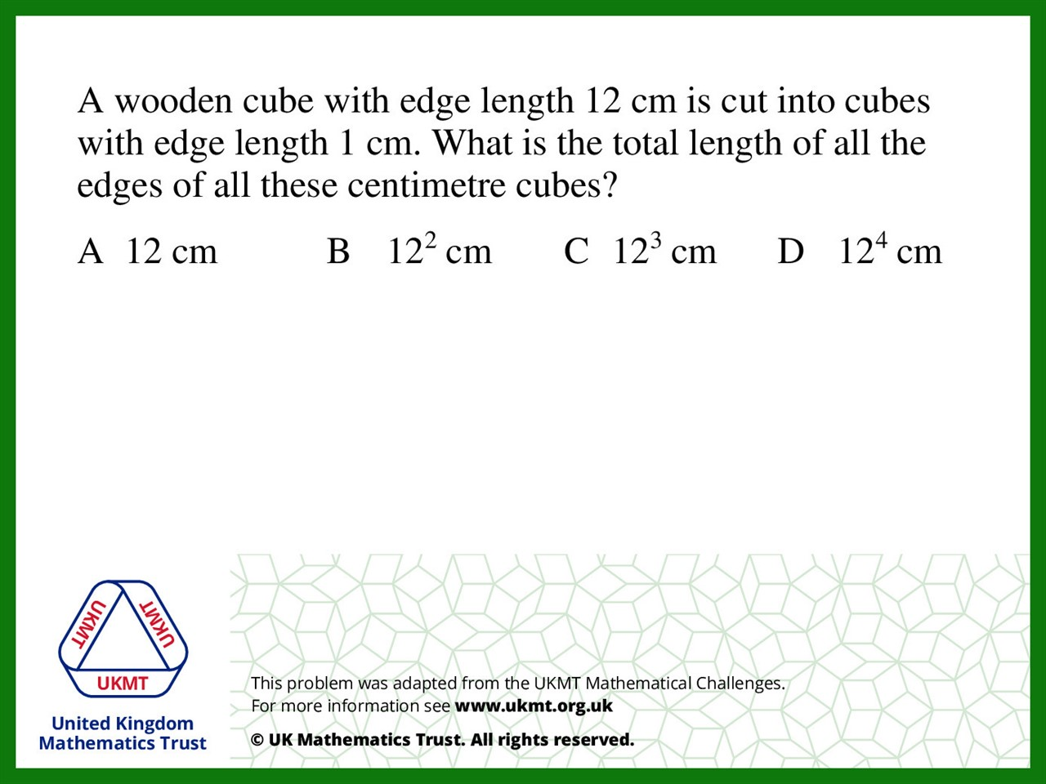
Q2.
12 (each cube has 12 edges)
x 12 (12 cubes wide)
x 12 (12 cubes deep)
x 12 (12 cubes high)

Slide 4
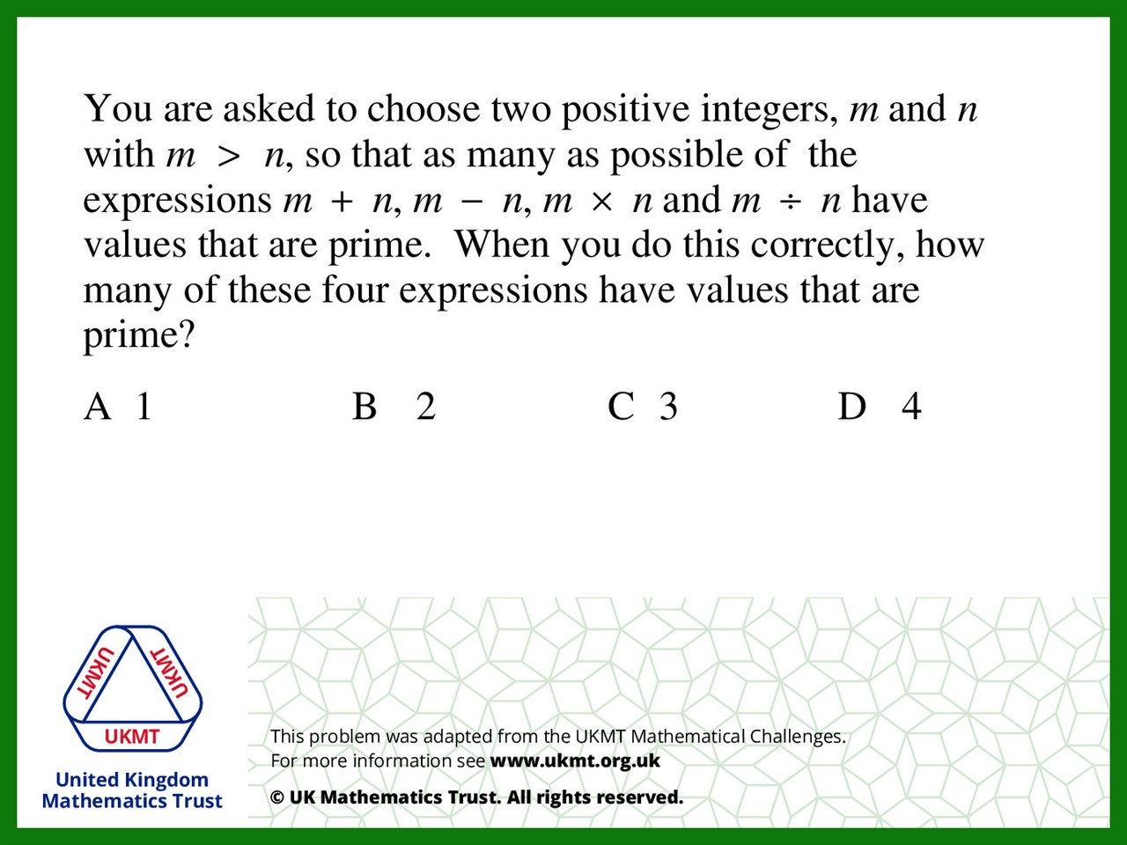
Q3.
m = 2 n = 1
2 + 1 = 3
2 – 1 = 1
2 x 1 = 2
2 ÷ 1 = 2

Slide 5
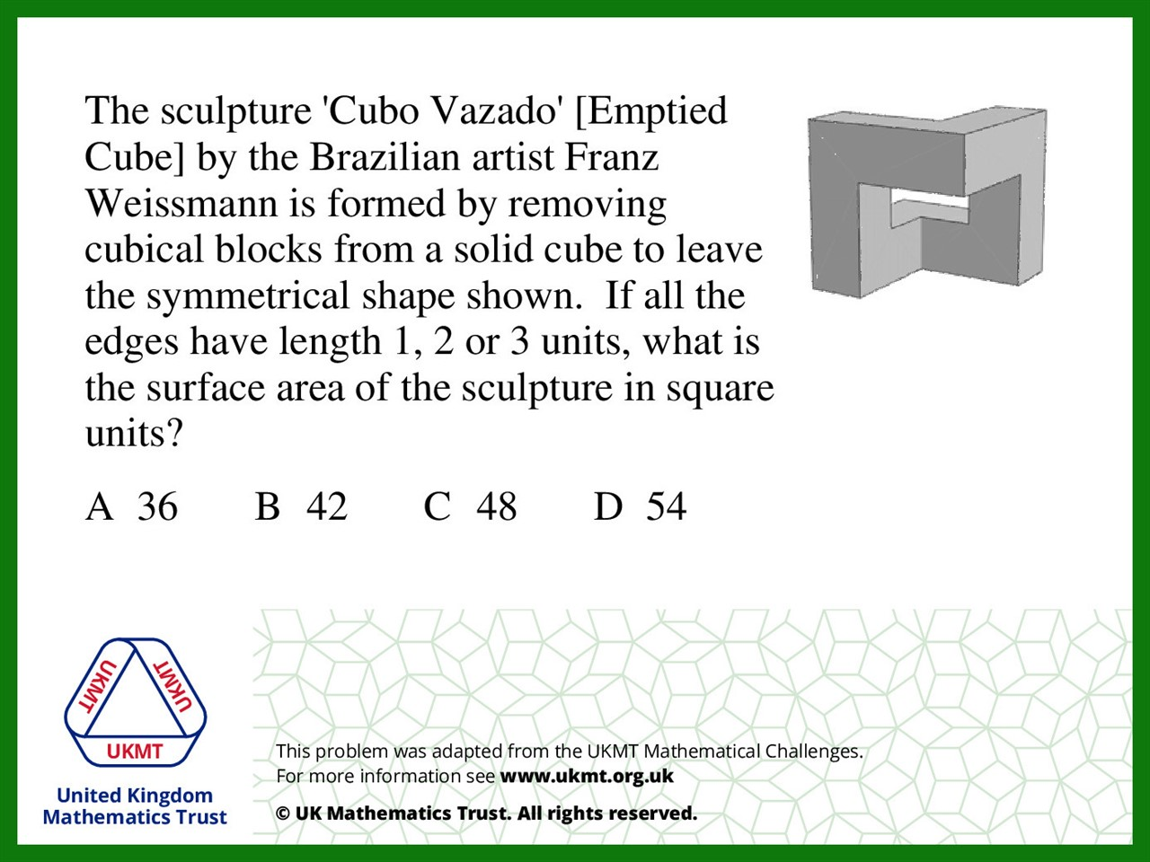
Q4.
There are 8 sides and each surface's area is 6

Slide 6
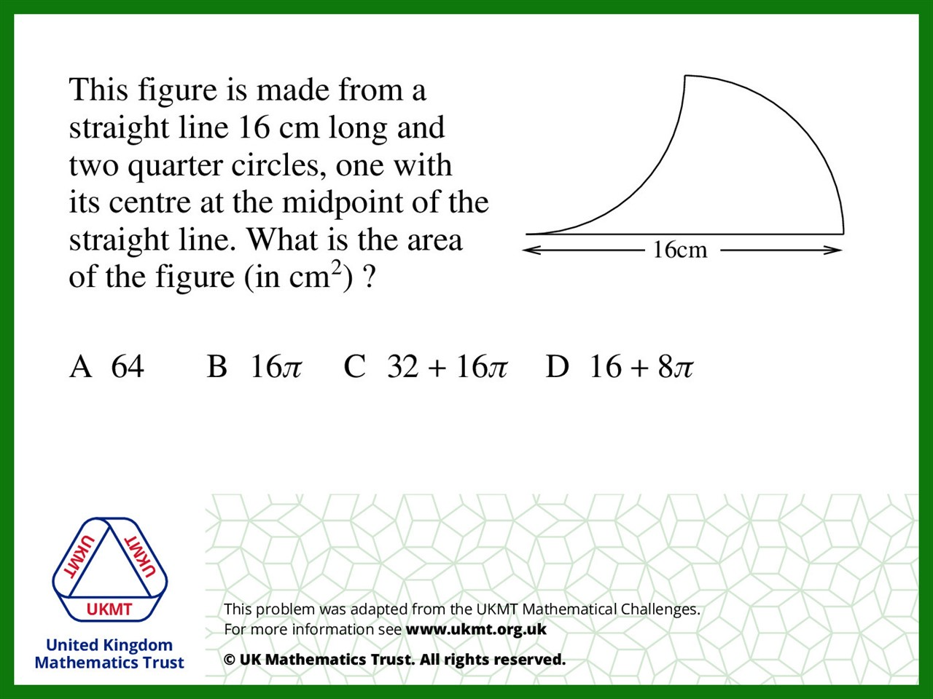
Q5.
Area of ¼ Circle = 16π
Square – ¼ Circle = 64 - 16π Total Area = 64 – 16π + 16π

