Slide 1
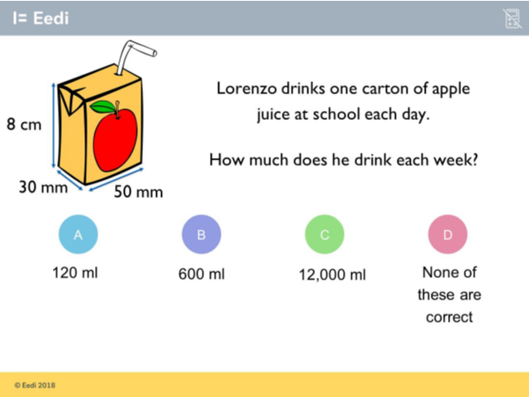
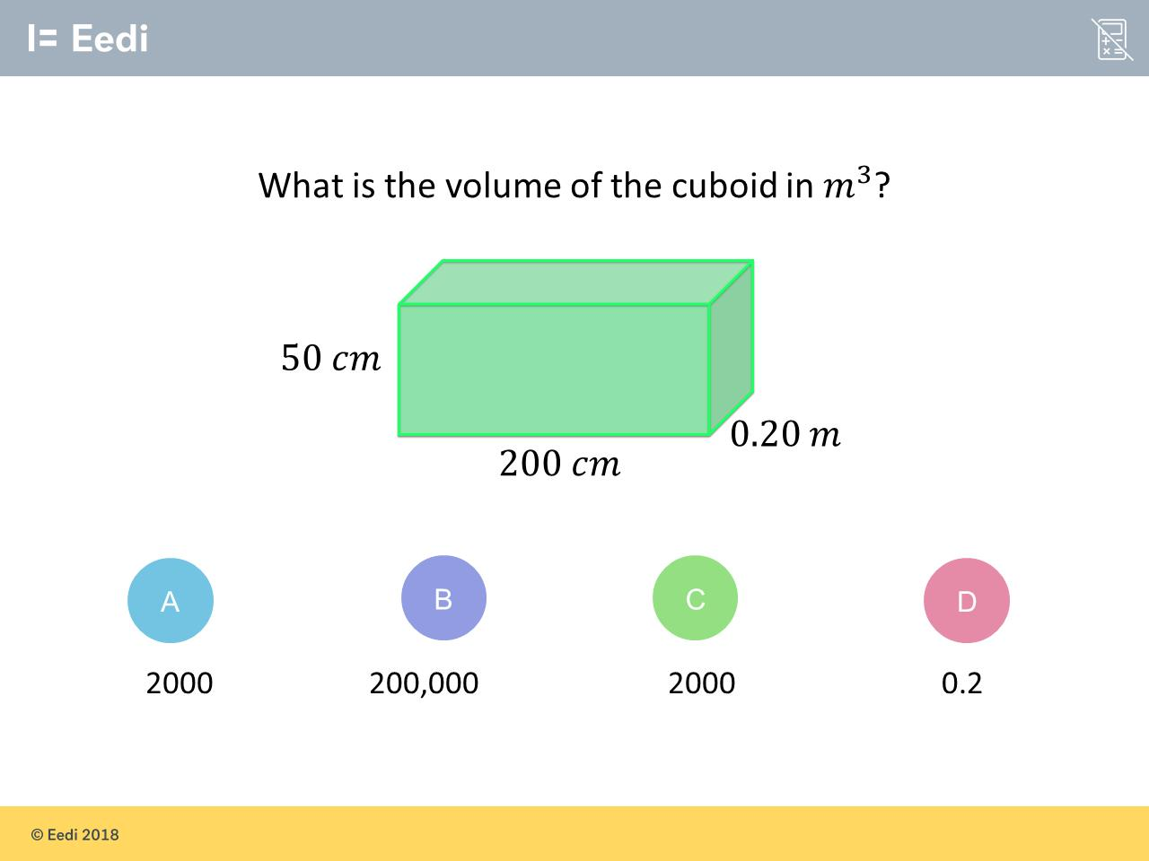
Worst answered question?
Most common wrong answer?

Slide 2
ANSWERS

Slide 3
Worst answered question?

Slide 4
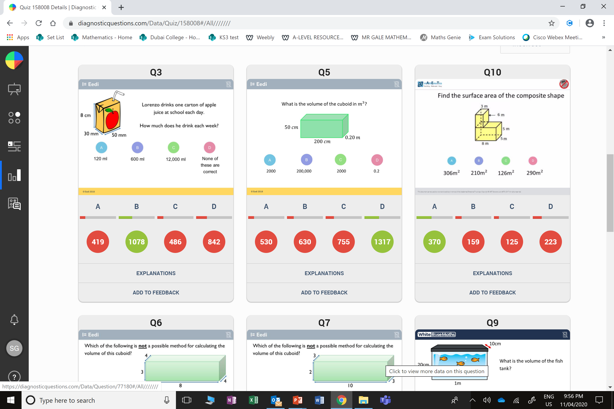
D
The student may have miscalculated. They may have forgotten to convert the units, or only found the volume per day.

Slide 5
C
The student may have converted the units incorrectly.

