Slide 1
Forces and Motions
Pulleys – Two Vertical
Chapter 10
(Part 6 of 9)

Slide 2
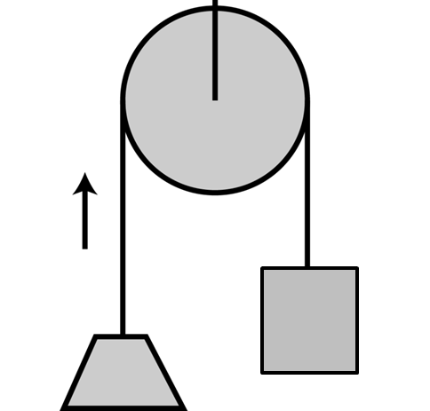
Pulleys
Pulley questions you will assume that particles are connected by a light inextensible string, which passes over a smooth pulley.

Slide 3
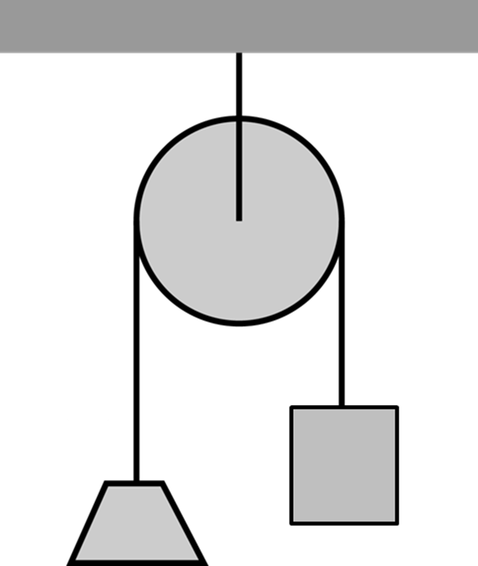
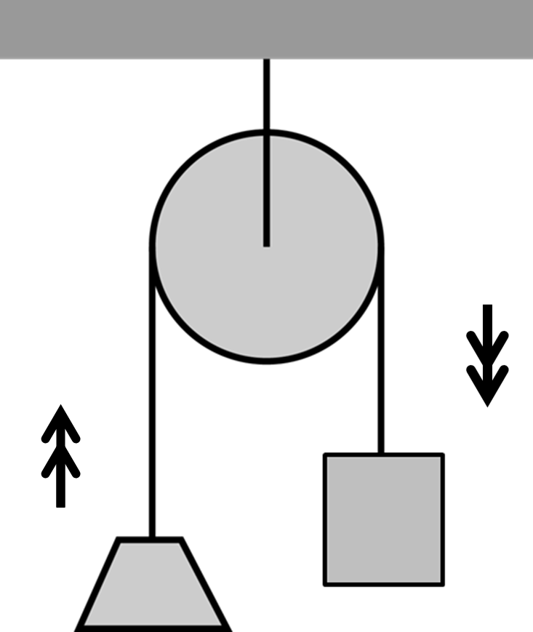
The acceleration and tension will be the same
on both sides, in opposite directions.
T
T
3kg
2kg
3g
2g

Slide 4


Write an F = ma equation for each particle.
T
T
2kg
3kg
T
2g
3g
T
3kg
F = ma
T – 2g = 2a
F = ma
3g – T = 3a
2kg
3g
2g

Slide 5
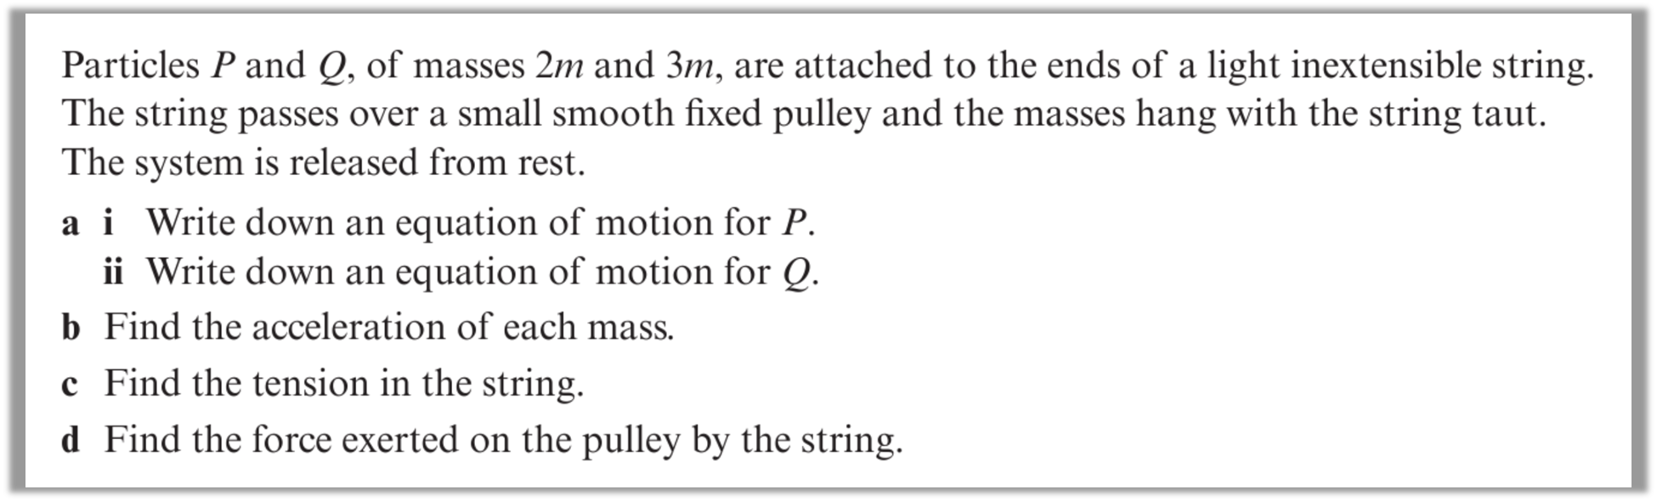
Question A

Slide 6
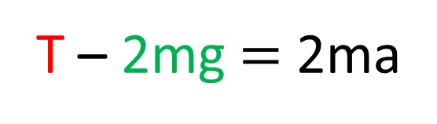
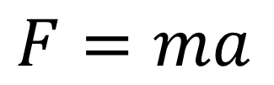
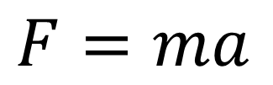
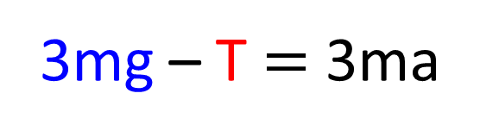
a.
T
T
2m
3m
2mg
3mg
$F=ma$
$F=ma$
T – 2mg $=$ 2ma
3mg – T $=$ 3ma

Slide 7
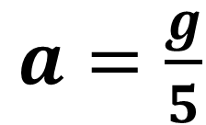
b.
T
T
3mg – T = 3ma
2m
3m
3mg – (2ma – 2mg) = 3ma
2mg
3mg
3mg – 2ma + 2mg = 3ma
T – 2mg = 2ma
3mg – T = 3ma
mg = 5ma
T = 2ma – 2mg
g = 5a
$a=\frac{g}{5}$

Slide 8
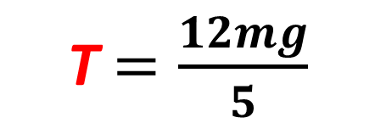

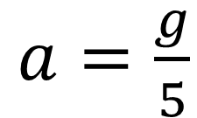
c.
T
T
T = 2ma + 2mg
2m
3m
T = 2m$\frac{g}{5}$ + 2mg
2mg
3mg
T $=\frac{12mg}{5}$
T – 2mg = 2ma
3mg – T = 3ma
$a=\frac{g}{5}$

Slide 9
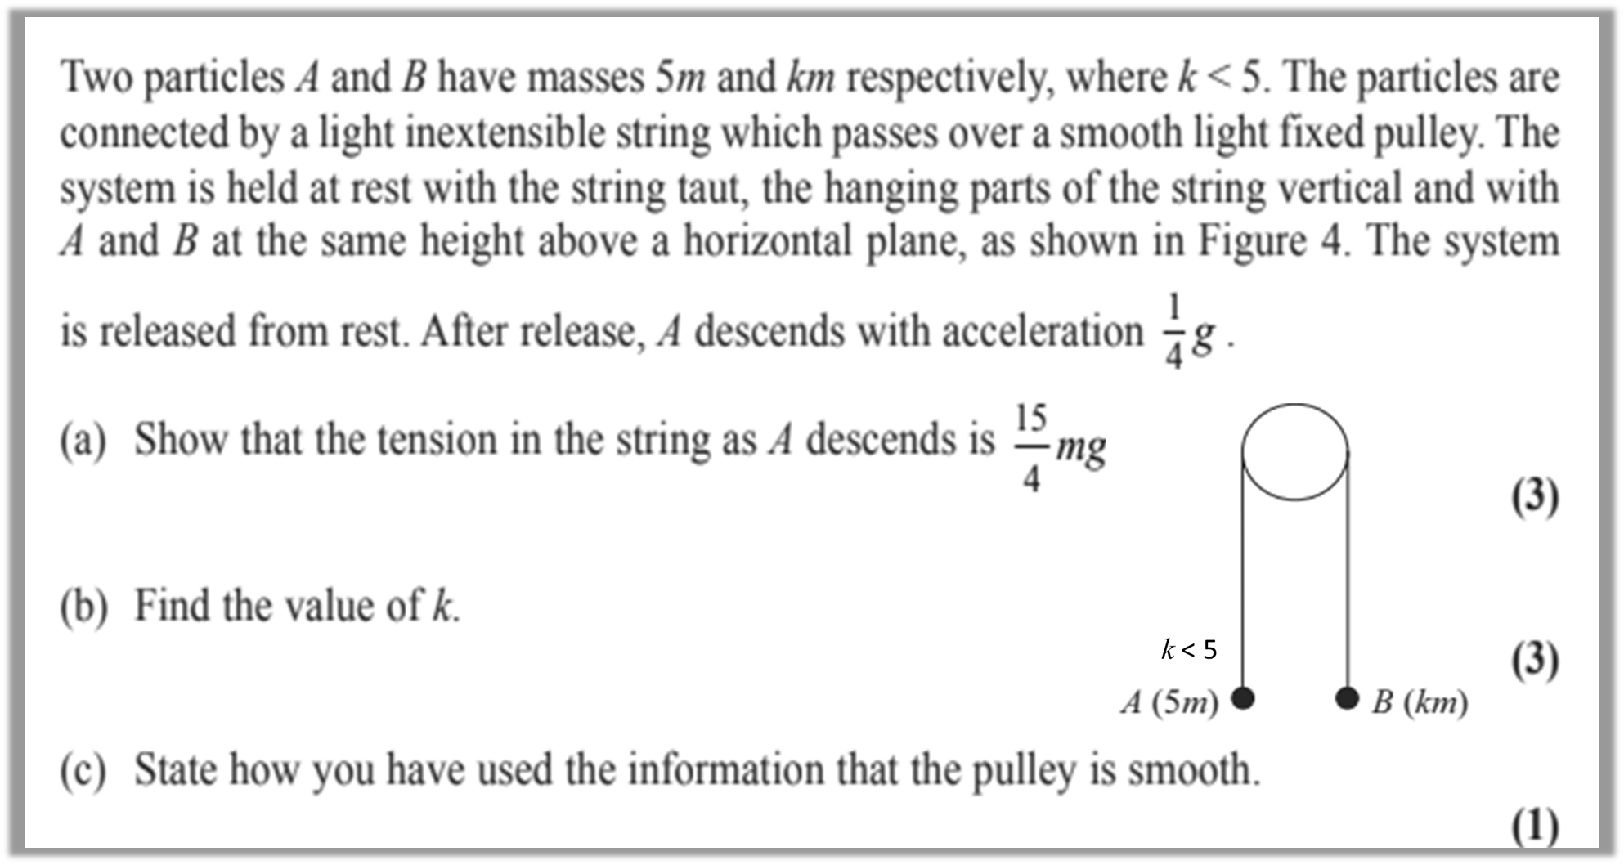
Question B

Slide 10
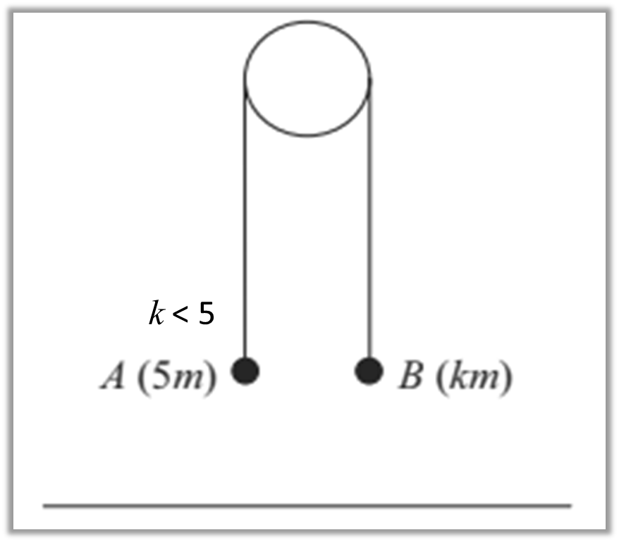
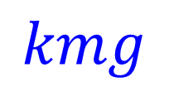
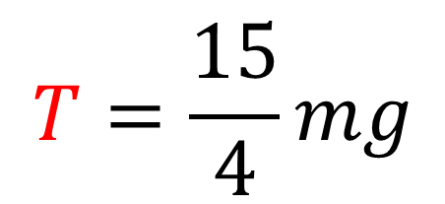
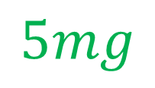
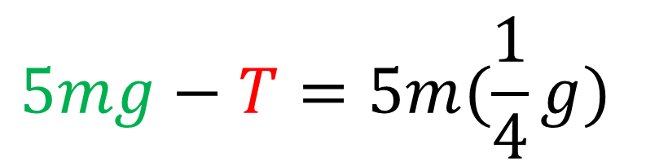

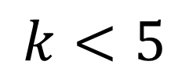

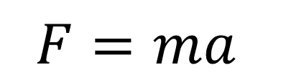
a.
$$k<5$$
$$F=ma$$
$$5mg−T=5m(\frac{1}{4}g)$$
$$T$$
$$T$$
$$T=\frac{15}{4}mg$$
$$5mg$$
$$kmg$$

Slide 11

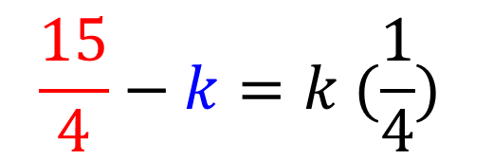
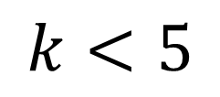
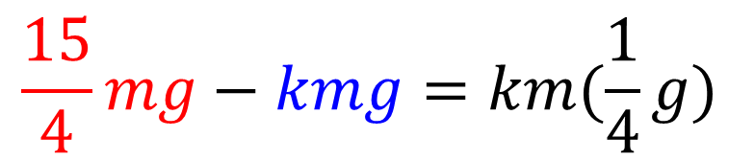
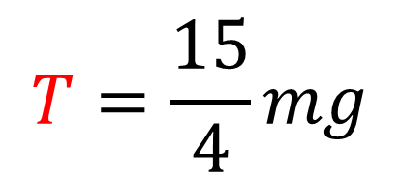
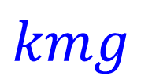

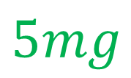

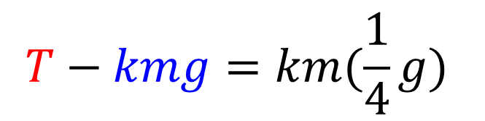

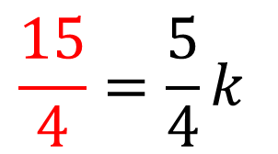
b.
$$k<5$$
$$F=ma$$
$$T−kmg=km(\frac{1}{4}g)$$
$$T=\frac{15}{4}mg$$
$$\frac{15}{4}mg−kmg=km(\frac{1}{4}g)$$
$$\frac{15}{4}−k=k (\frac{1}{4})$$
$$T$$
$$T$$
$$\frac{15}{4}=\frac{5}{4}k$$
$$5mg$$
$$kmg$$
$$3=k$$

Slide 12
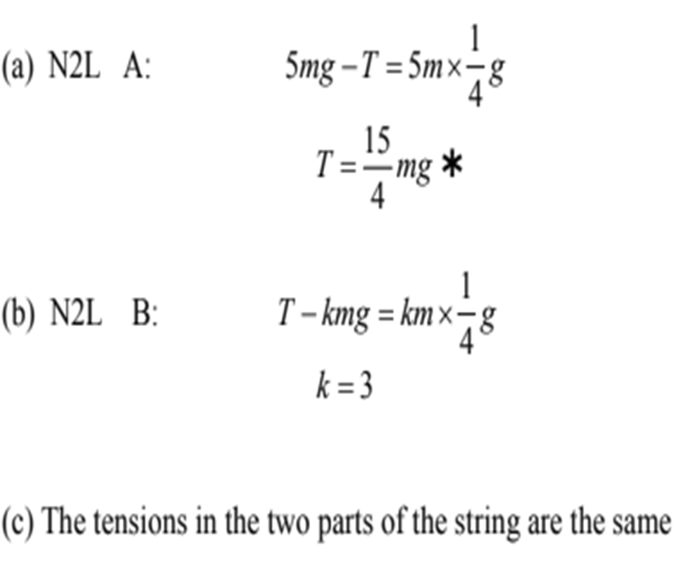
c.

Slide 13
Force Exerted on a Pulley
Sometimes you will be asked to find the force
exerted on the pulley
and in which direction.

Slide 14
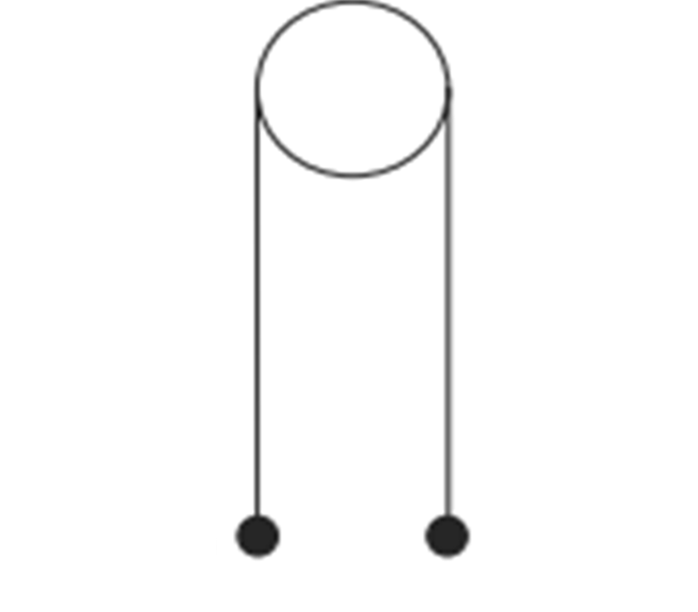

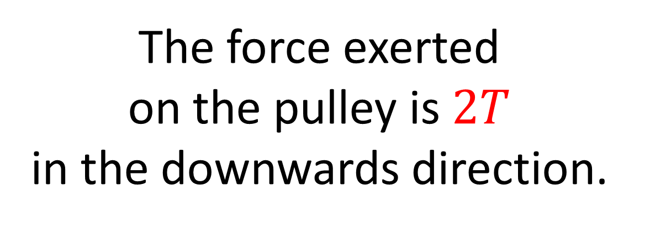
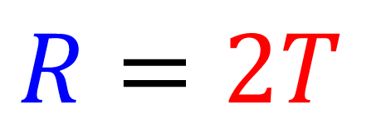


Find the for force exerted on the pulley
and in which direction.
$$R$$
$$R=2T$$
The force exerted
on the pulley is $2T$
in the downwards direction.
$$T$$
$$T$$

Slide 15
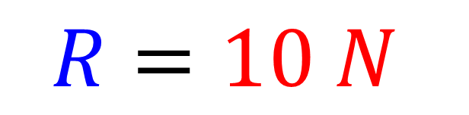

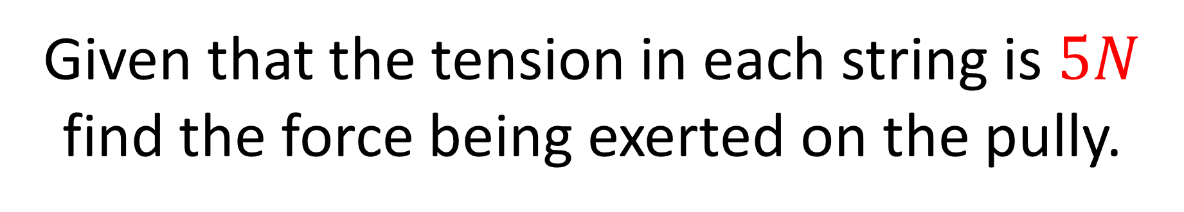



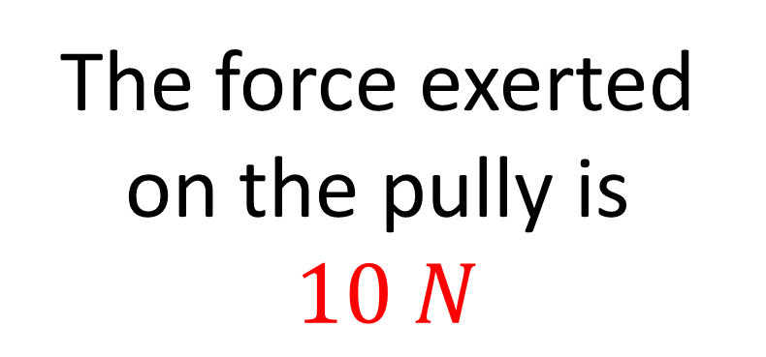
Given that the tension in each string is $5N$ find the force being exerted on the pully.
$$R$$
$$R=2T$$
$$R=10 N$$
The force exerted
on the pully is
$10 N$
$$T$$
$$T$$

