Slide 1
Parametric Equations
Introduction
Chapter 8
(Part 1 of 3)

Slide 2
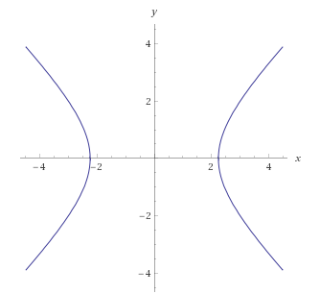
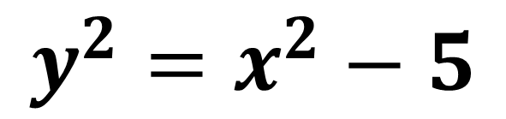

Cartesian Equations
Cartesian equations have two variables $x$ and $y.$
These two variables are connected by a single equation.
$$y^{2}=x^{2}−5$$

Slide 3
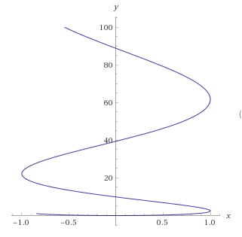
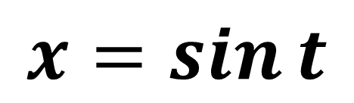
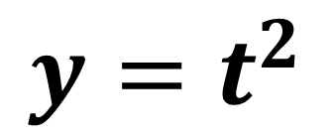

Parametric Equations
Parametric equations have two variables $x$ and $y$.
These two variables are calculated by separate equations.
$$x=\sin{t}$$
$$y=t^{2}$$

Slide 4
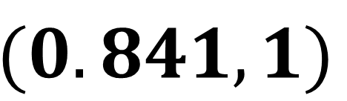
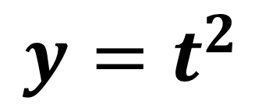
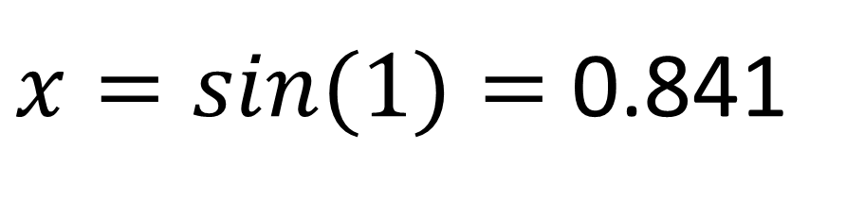

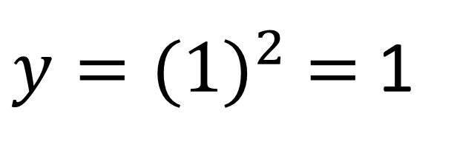

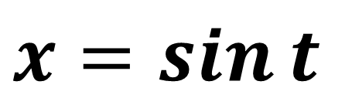
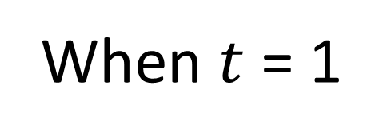
Finding a co-ordinate. You need a $t$ value.
$$y=t^{2}$$
$y={(1)}^{2}$ $=$ 1
$$x=\sin{t}$$
$x=\sin{(1)}=$ 0.841
When $t$ = 1
$$(0.841,1)$$
$t$ = 1

Slide 5
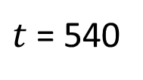
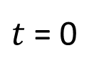
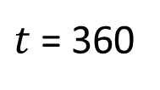
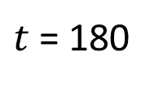
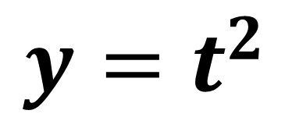
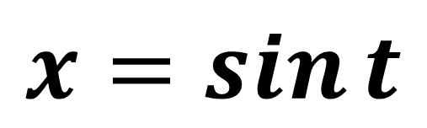
$$x=\sin{t}$$
$$y=t^{2}$$
$t$ = 540
$t$ = 360
$t$ = 180
$t$ = 0

Slide 6
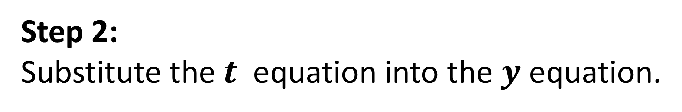
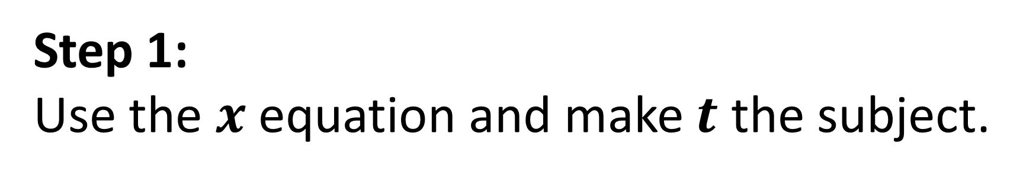
Converting Parametric to Cartesian
Step 1:
Use the $x$ equation and make $t$ the subject.
Step 2:
Substitute the $t$ equation into the $y$ equation.

Slide 7
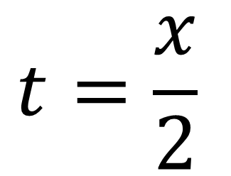
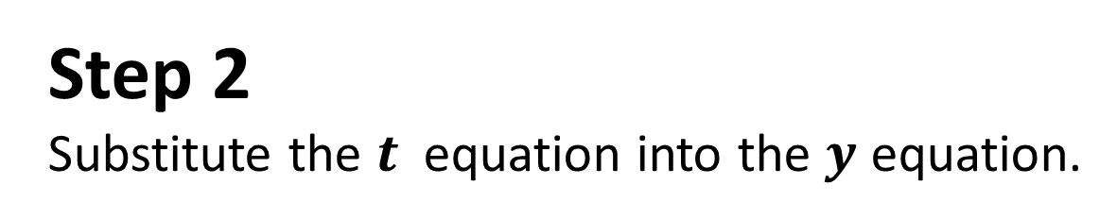
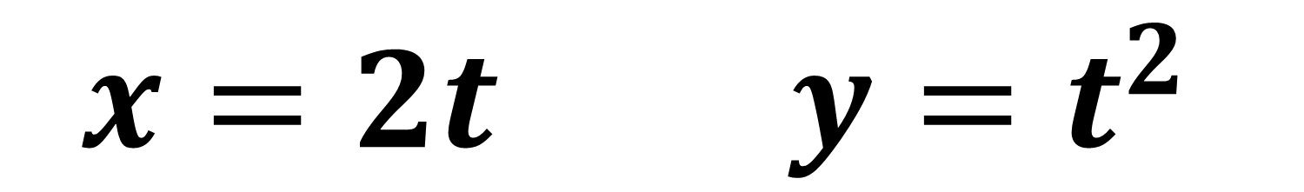
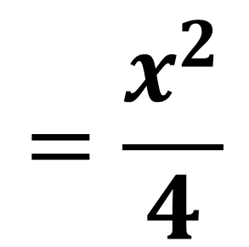
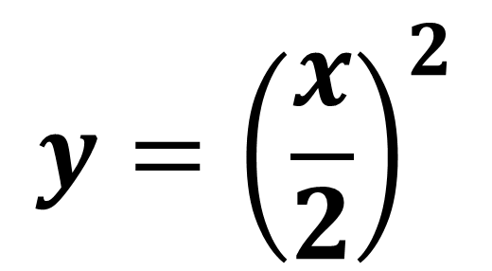
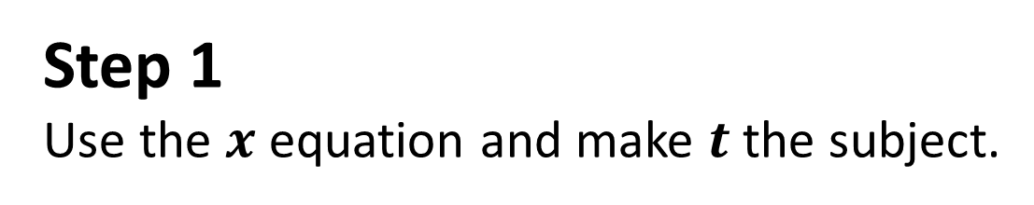
$$x=2t y=t^{2}$$
Step 1
Use the $x$ equation and make $t$ the subject.
$$t=\frac{x}{2}$$
Step 2
Substitute the $t$ equation into the $y$ equation.
$$y={\left(\frac{x}{2}\right)}^{2}$$
$$=\frac{x^{2}}{4}$$

Slide 8
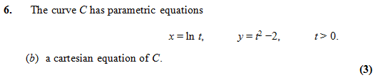
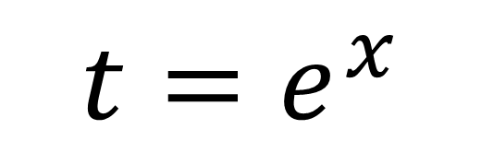

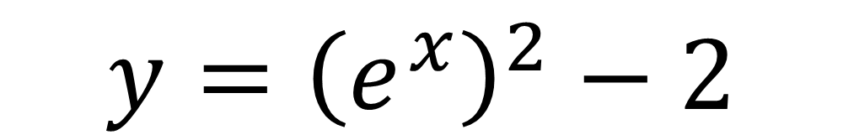
$$t=e^{x}$$
$$y={\left(e^{x}\right)}^{2}−2$$
$$y=e^{2x}−2$$

Slide 9
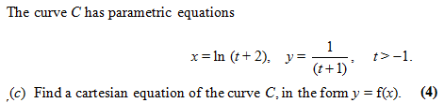
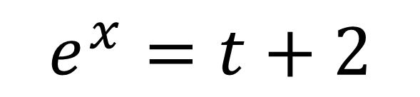
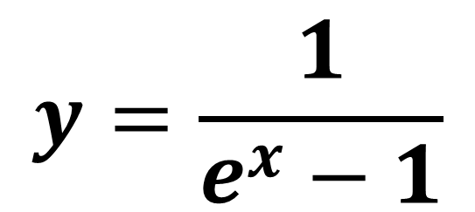
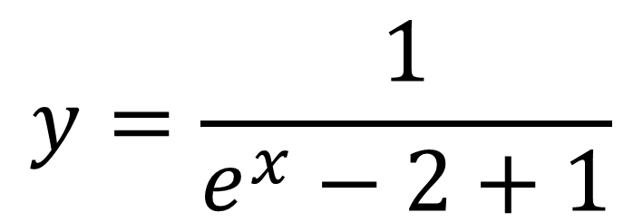
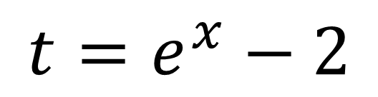
$$y=\frac{1}{e^{x}−2+1}$$
$$e^{x}=t+2$$
$${t=e}^{x}−2$$
$$y=\frac{1}{e^{x}−1}$$

Slide 10
Domain and Range
of Parametric Equations
A common strategy for domain/range questions
is to consider what happens at the boundary values then consider if any minimum or maximum values happen in between them.
A sketch of the graph may help with this.

Slide 11
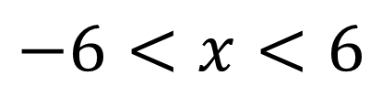
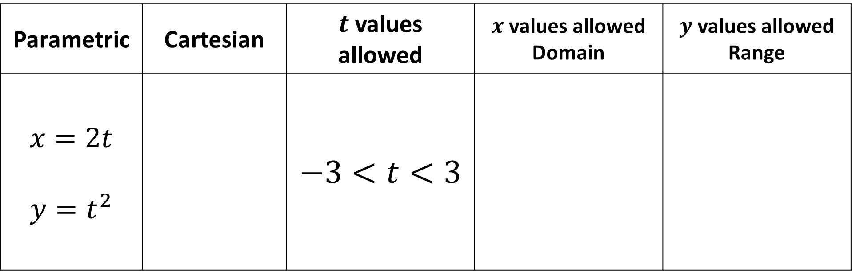

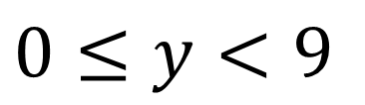
Domain and Range
Parametric | Cartesian | $t$ values allowed | $x$ values allowed Domain | $y$ values allowed Range
$$x=2t$$ $$y=t^{2}$$ |  | $$−3<t<3$$
$$y=\frac{x^{2}}{4}$$
$$−6<x<6$$
$$0≤y<9$$

Slide 12

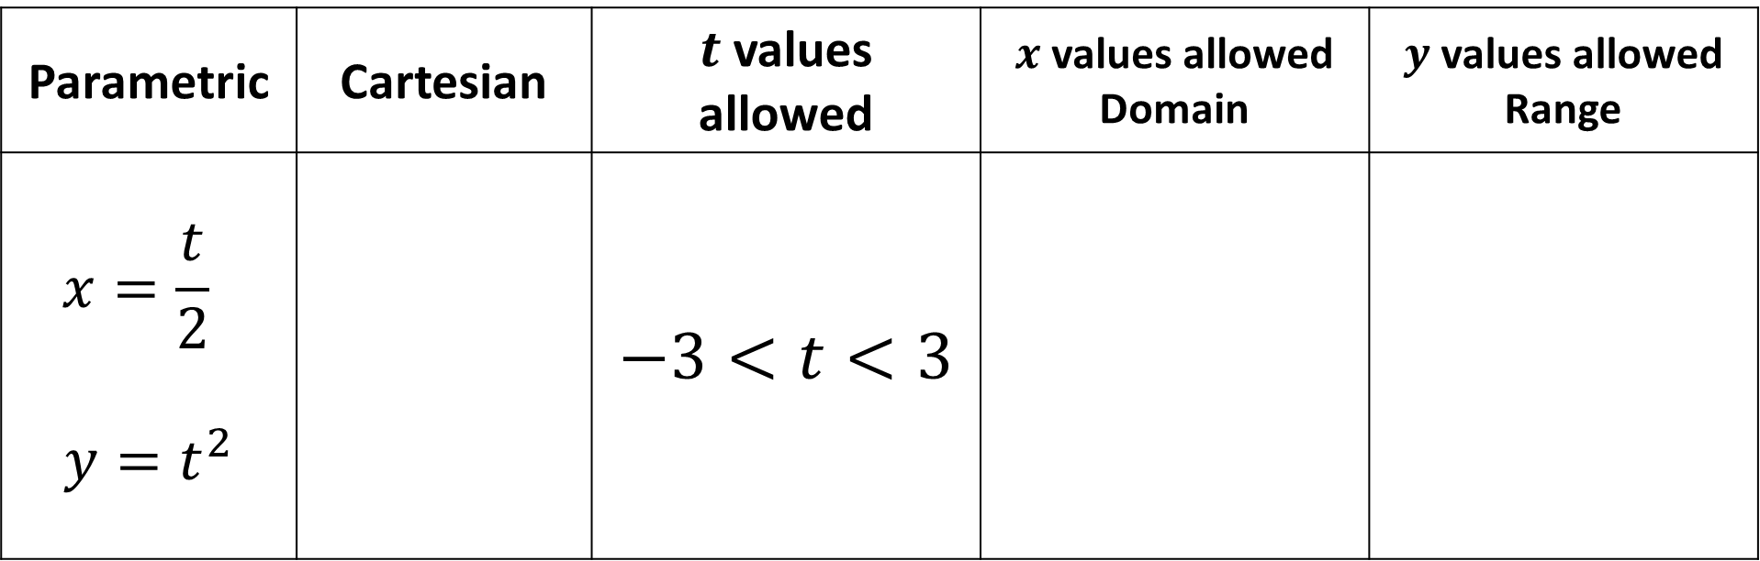

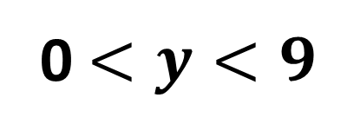
Domain and Range
Parametric | Cartesian | $t$ values allowed | $x$ values allowed Domain | $y$ values allowed Range
$$x=\frac{t}{2}$$ $$y=t^{2}$$ |  | $$−3<t<3$$
$$y={4x}^{2}$$
$$\frac{−3}{2}<x<\frac{3}{2}$$
0 $<y<9$

Slide 13



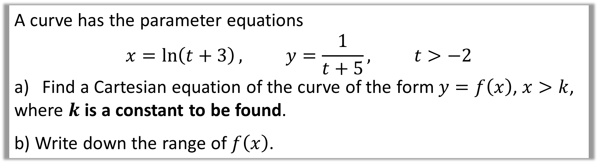

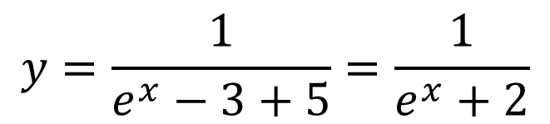
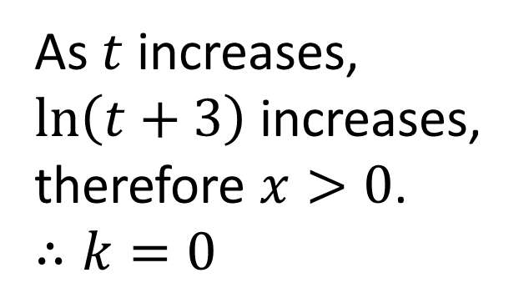

A curve has the parameter equations
$$x=\ln\left(t+3\right), y=\frac{1}{t+5}, t>−2$$
Find a Cartesian equation of the curve of the form $y=f\left(x\right)$, $x>k$,
where $k$ is a constant to be found.
b) Write down the range of $f\left(x\right)$.
a)
When $t=−2$,
$$x=\ln\left(t+3\right)$$
$$x=\ln\left(−2+3\right)=0$$
$$e^{x}=t+3$$
As $t$ increases,
$\ln\left(t+3\right)$ increases,
therefore $x>0$.
$∴k=0$
$$e^{x}−3=t$$
$$y=\frac{1}{e^{x}−3+5}=\frac{1}{e^{x}+2}$$

Slide 14
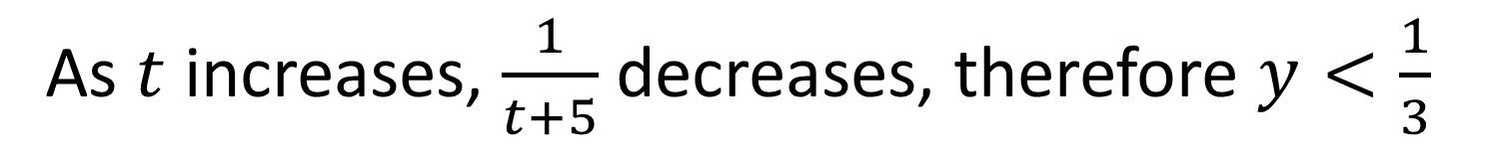
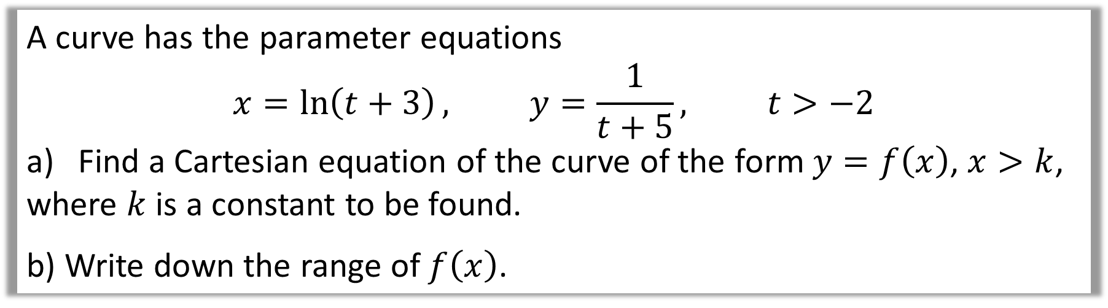
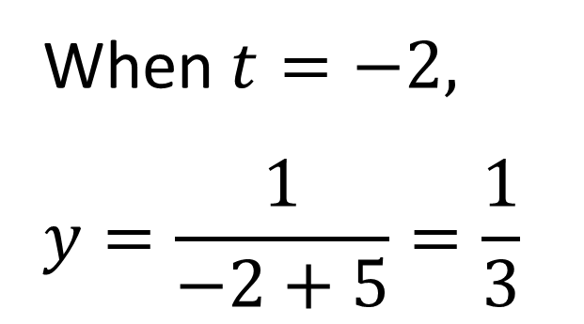
A curve has the parameter equations
$$x=\ln\left(t+3\right), y=\frac{1}{t+5}, t>−2$$
Find a Cartesian equation of the curve of the form $y=f\left(x\right)$, $x>k$,
where $k$ is a constant to be found.
b) Write down the range of $f\left(x\right)$.
b)
When $t=−2,$
$$y=\frac{1}{−2+5}=\frac{1}{3}$$
As $t$ increases, $\frac{1}{t+5}$ decreases, therefore $y<\frac{1}{3}$

