Slide 1

Intermediate Challenge 5
BRONZE

Slide 2
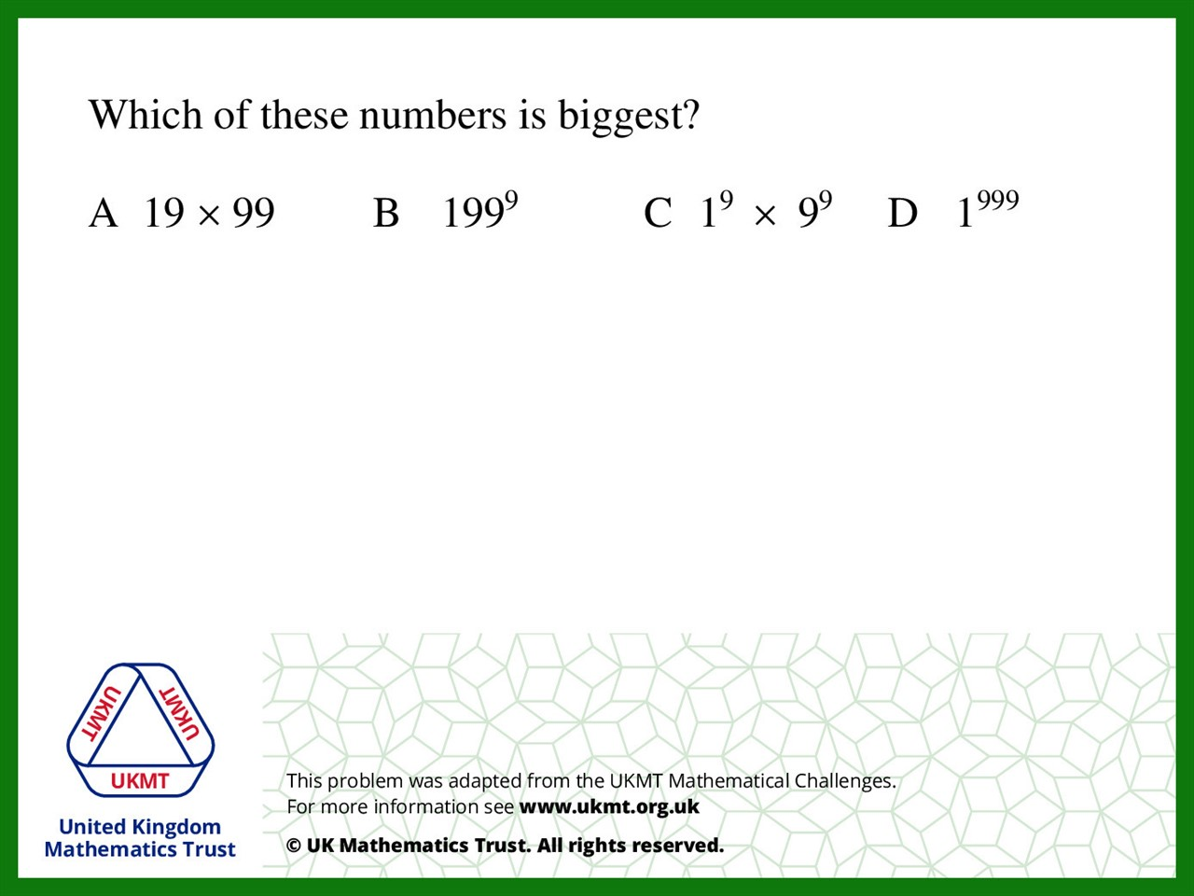
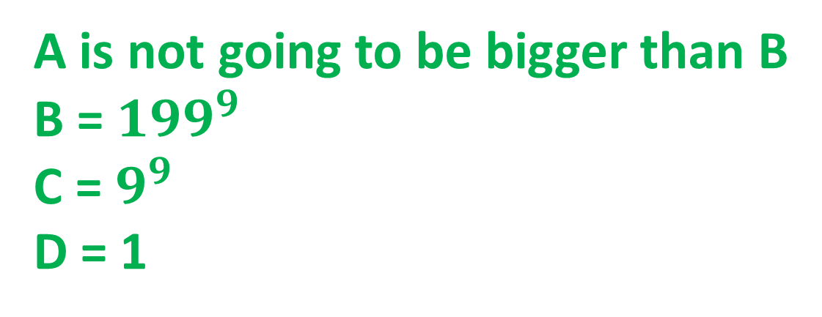
Q1.
A is not going to be bigger than B
B = ${199}^{9}$
C = $9^{9}$
D = 1

Slide 3
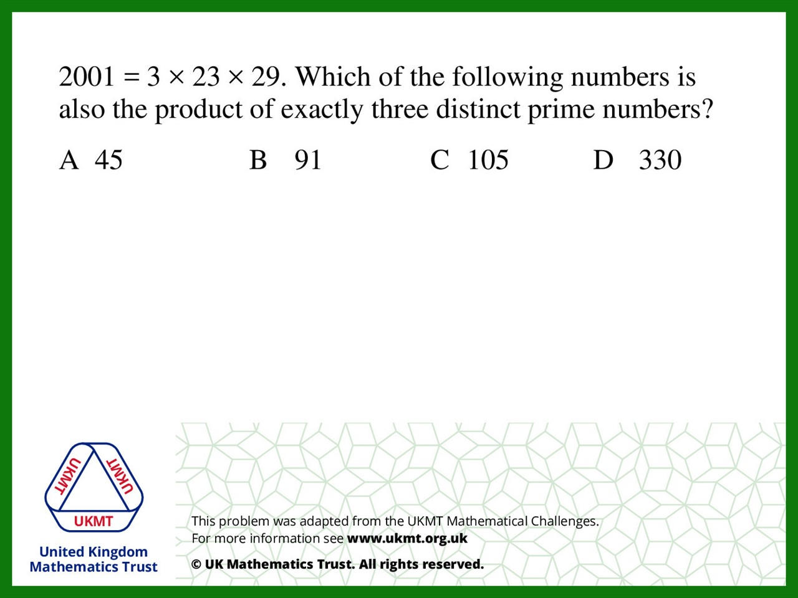
Q2.
3 x 5 x 7 = 105

Slide 4
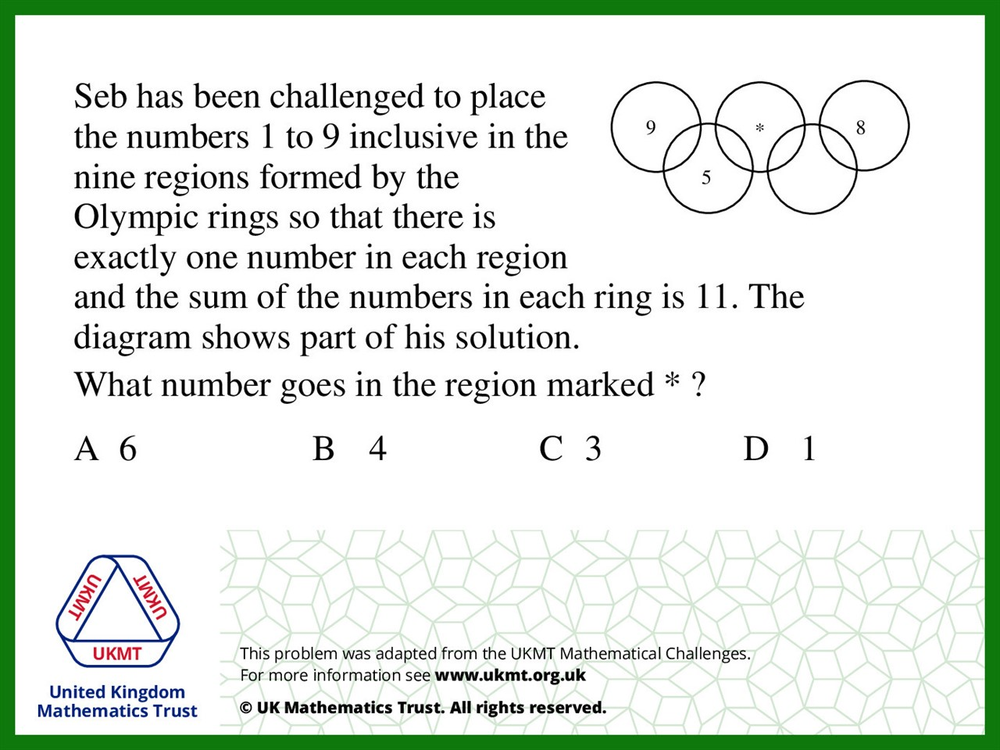
Q3.
From left to right: 9,2,5,4,6,1,7,3,8

Slide 5
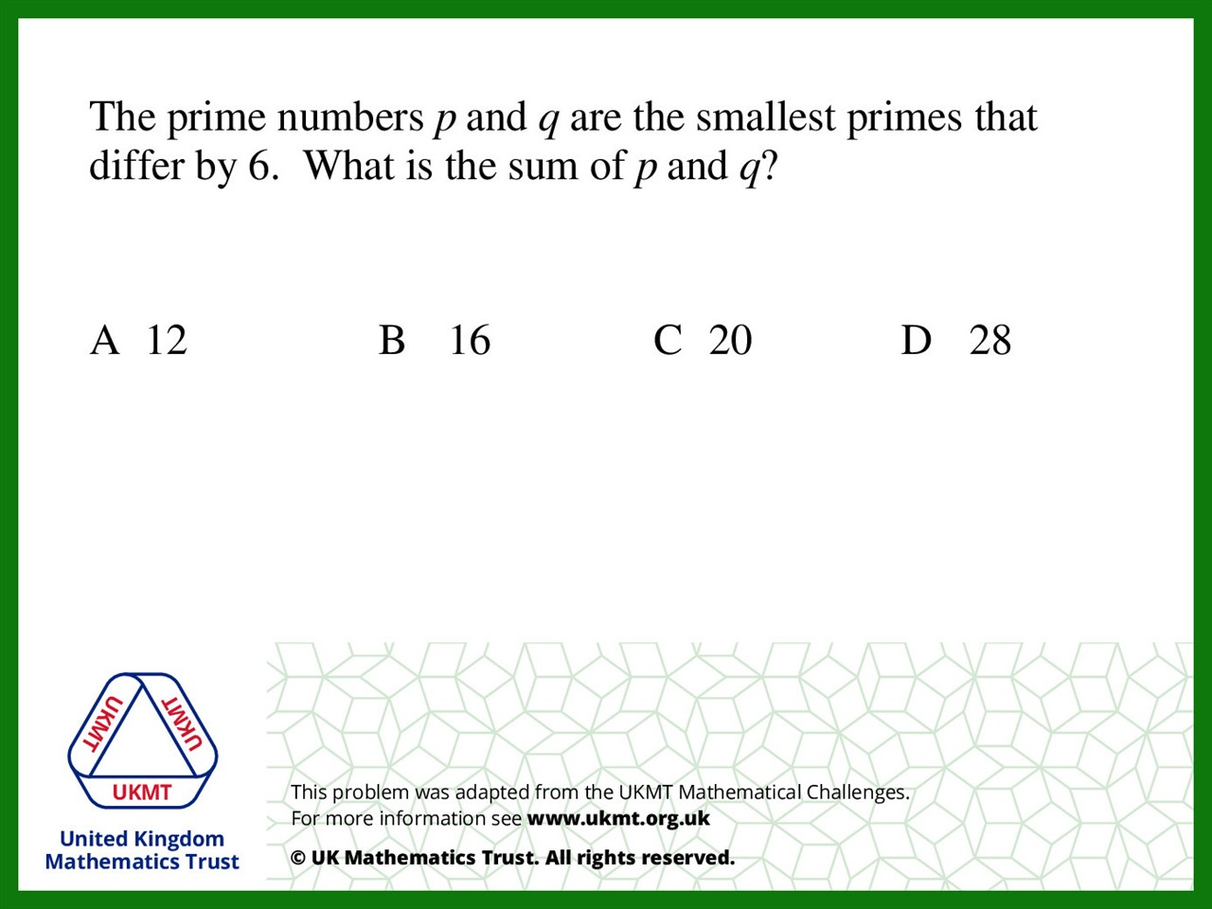
Q4.
The difference between 5 and 11 is 6 5 + 11 = 16

Slide 6
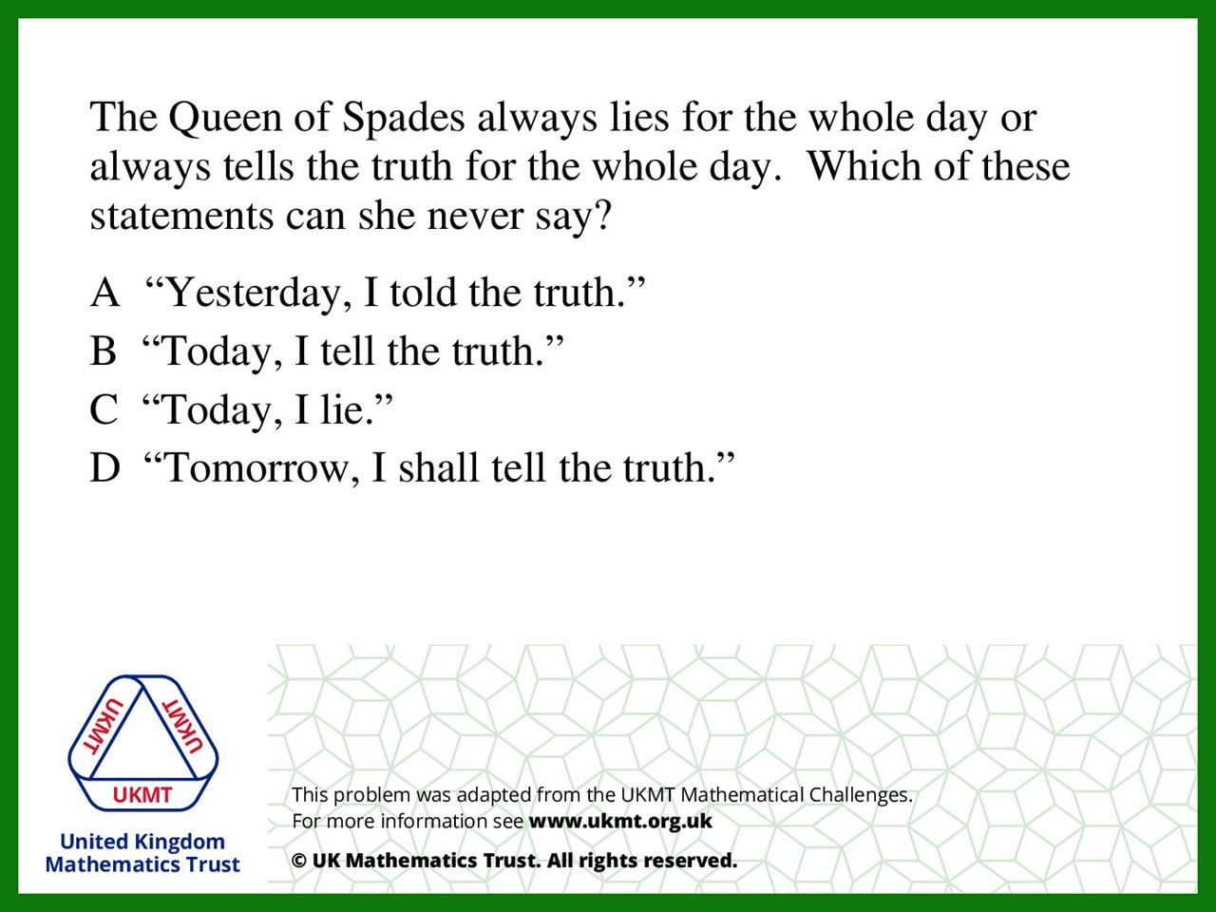
Q5.
If she has lied then she is telling the truth and
if she is telling the truth all day then she is lying

