Slide 1
LO: Sketching Cubic Graphs

Slide 2
Cubic Equation
or Not?
y = (x + 2)(x + 3)(x + 1)
Cubic Equation

Slide 3
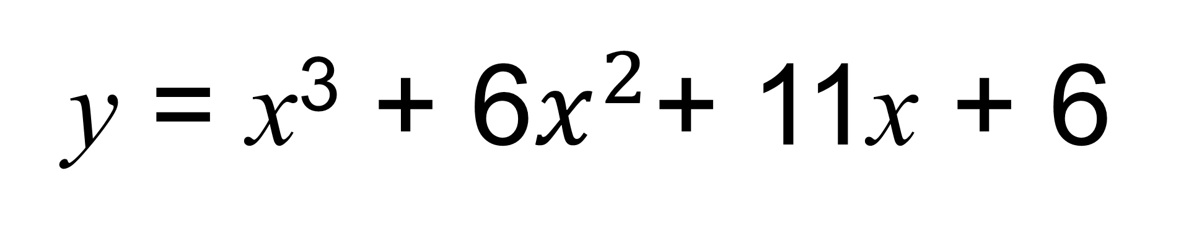
Cubic Equation
or Not?
y = x³ + 6$x^{2}$+ 11x + 6
Cubic Equation

Slide 4
Cubic Equation
or Not?
y = (x + 3)(x + 1)
Not

Slide 5
Cubic Equation
or Not?
y = x³ + 6
Cubic Equation

Slide 6
Cubic Equation
or Not?
y = x(x + 3)(x + 1)
Cubic Equation

Slide 7
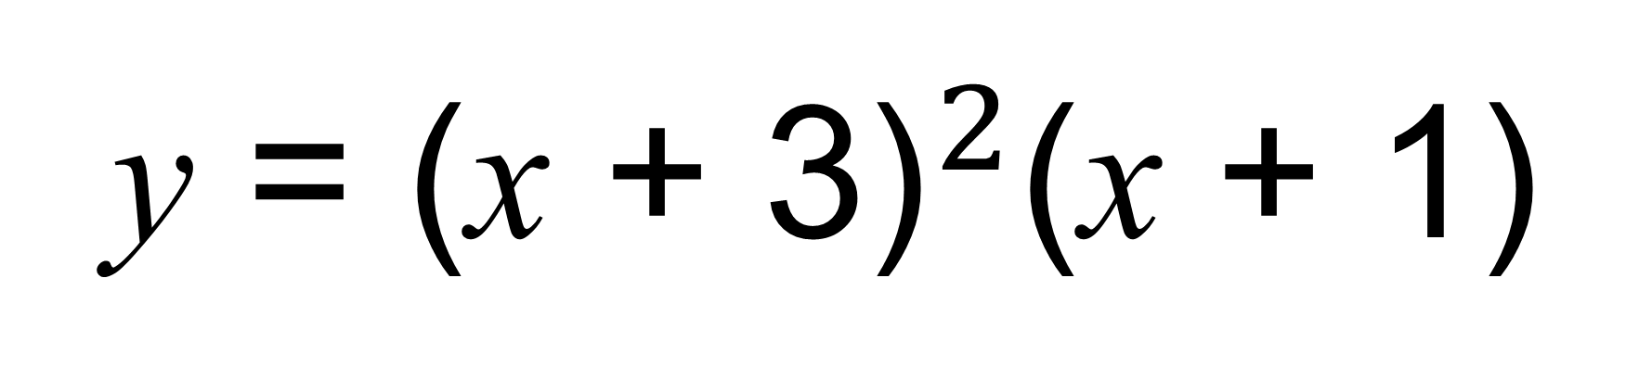
Cubic Equation
or Not?
y = ${\text{(}\text{x}\text{ + 3)}}^{2}$(x + 1)
Cubic Equation

Slide 8
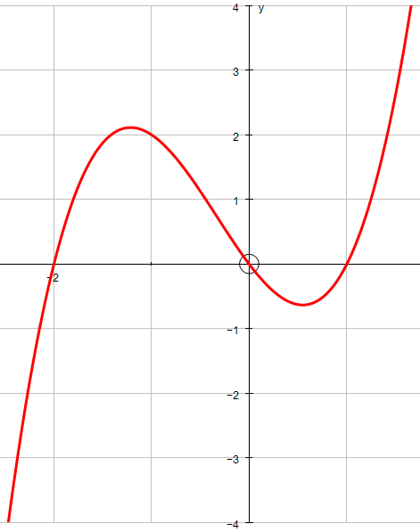
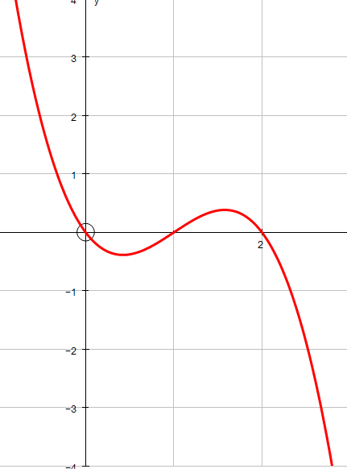
What is different about these graphs?

Slide 9
Positive gradient x³
Negative gradient -x³

Slide 10
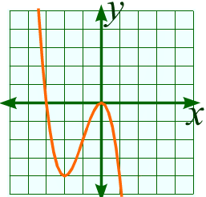
Positive or Negative Gradient?
Negative

Slide 11
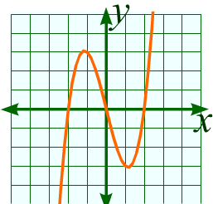
Positive or Negative Gradient?
Positive

Slide 12
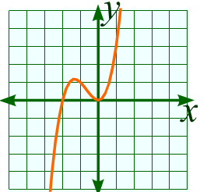
Positive or Negative Gradient?
Positive

Slide 13
Positive or Negative Gradient?
Negative

Slide 14
Positive or Negative Gradient?
y = x(x + 3)(x + 1)
Positive

Slide 15
Positive or Negative Gradient?
y = (x – 3)(x – 3)(x – 1)
Positive

Slide 16
Positive or Negative Gradient?
y = (3 – x)(x – 4)(x – 1)
Negative

Slide 17
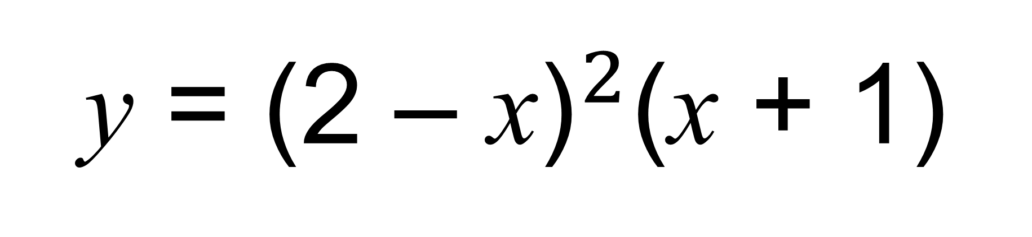
Positive or Negative Gradient?
y = ${\text{(}\text{2} \text{–} \text{x}\text{)}}^{2}$(x + 1)
Positive

Slide 18
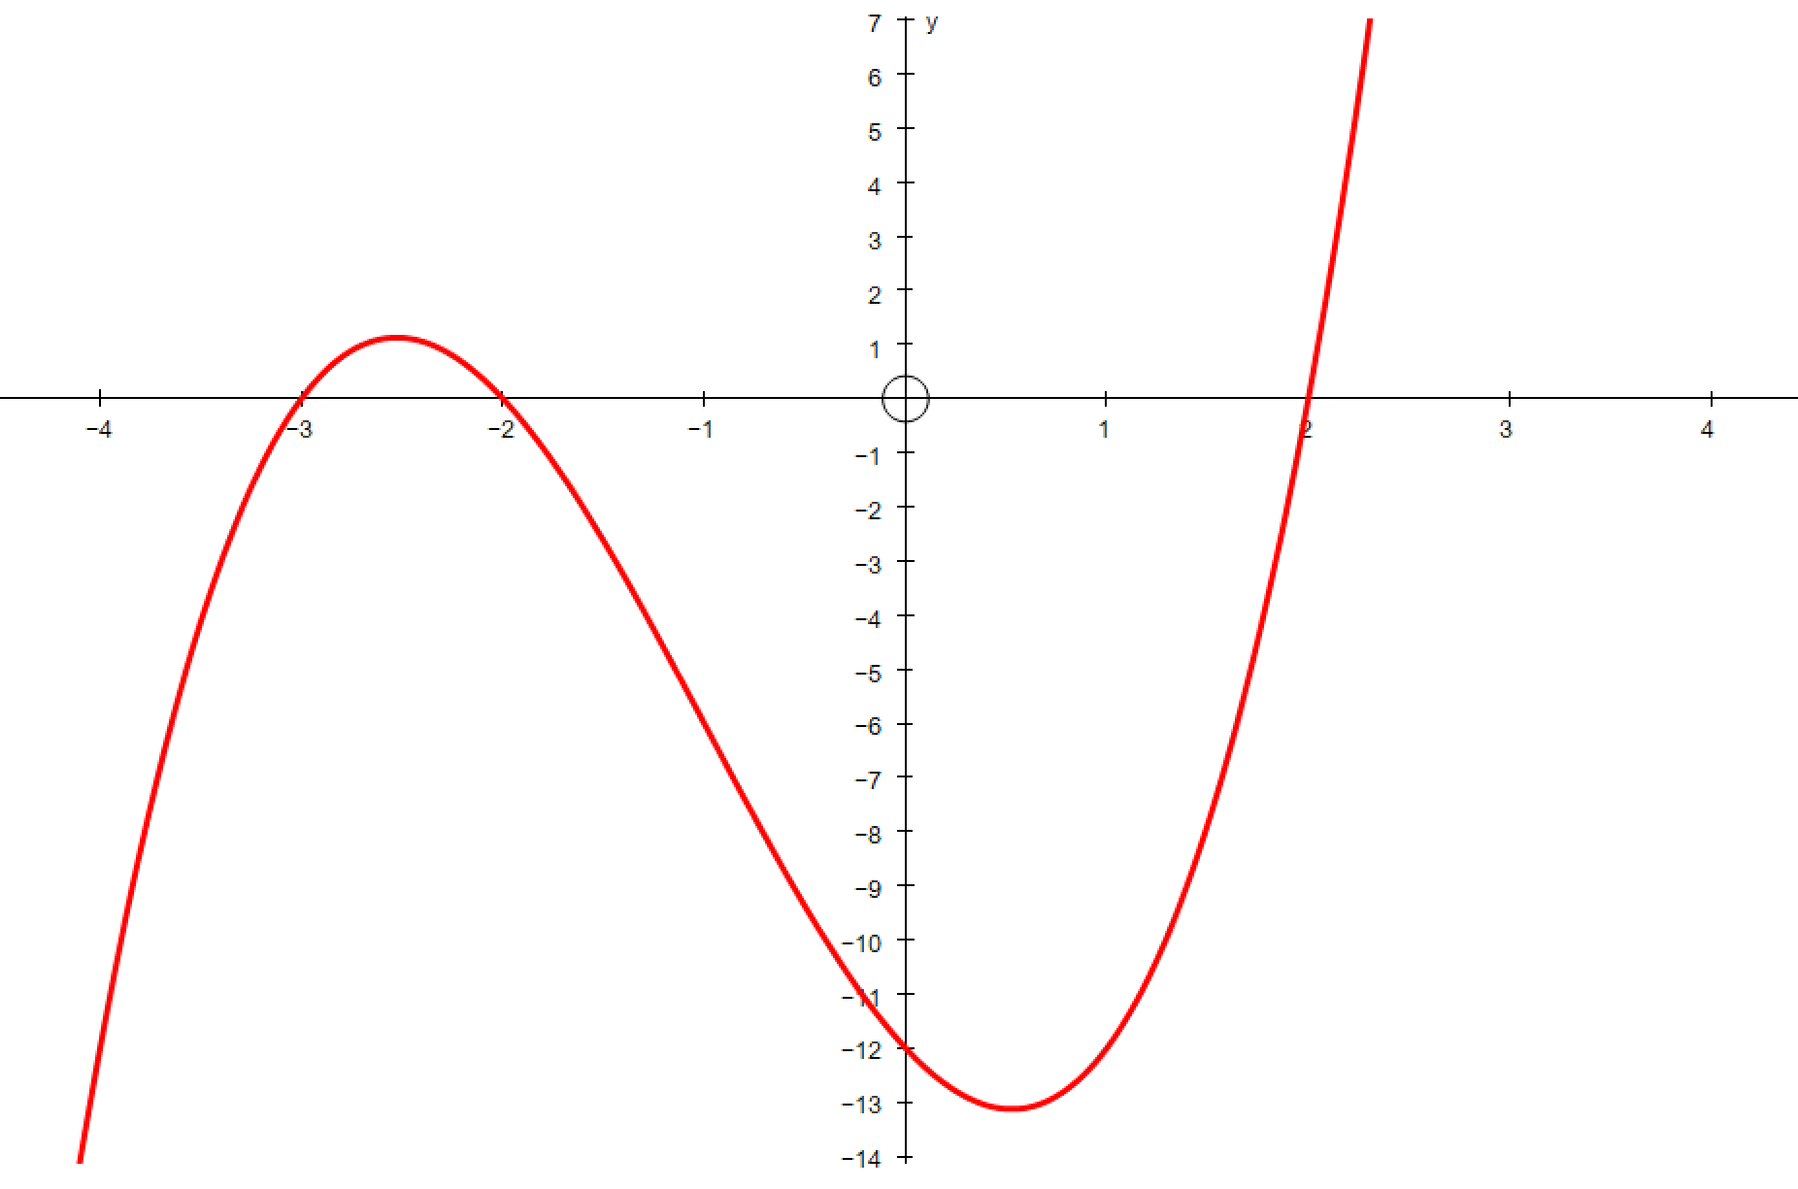
y = (x + 3)(x + 2)(x – 2)
What values of x will make
the equation equal to zero?
x = -3
x = -2
x = 2

Slide 19
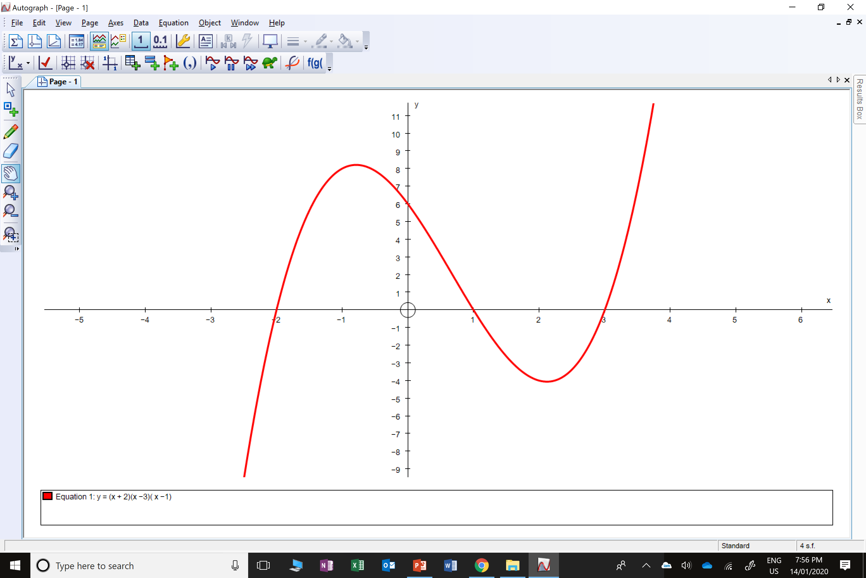
y = (x + 2)(x – 1)(x – 3)
What values of x will make
the equation equal to zero?
x = -2
x = 1
x = 3

Slide 20
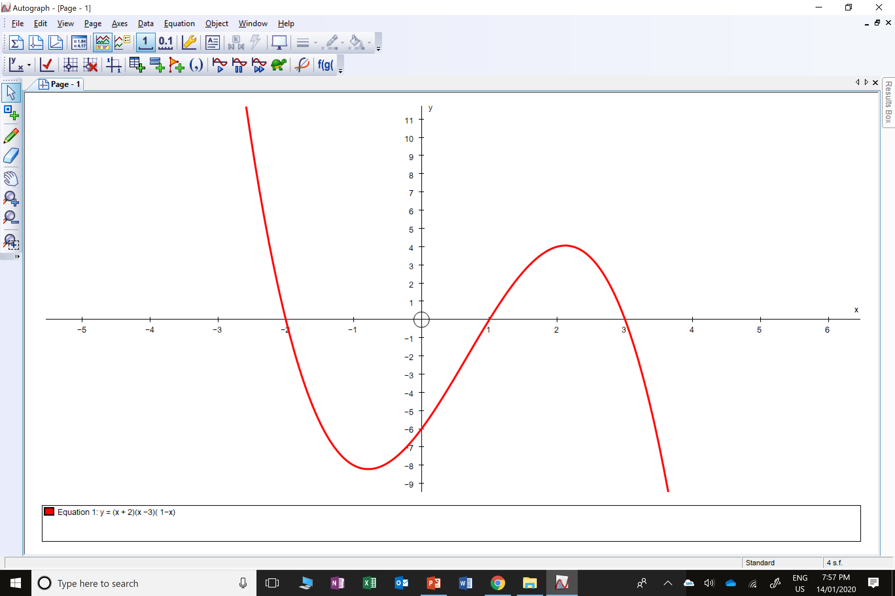
y = (x + 2)(x – 1)(3 – x)
What values of x will make
the equation equal to zero?
x = -2
x = 1
x = 3

Slide 21
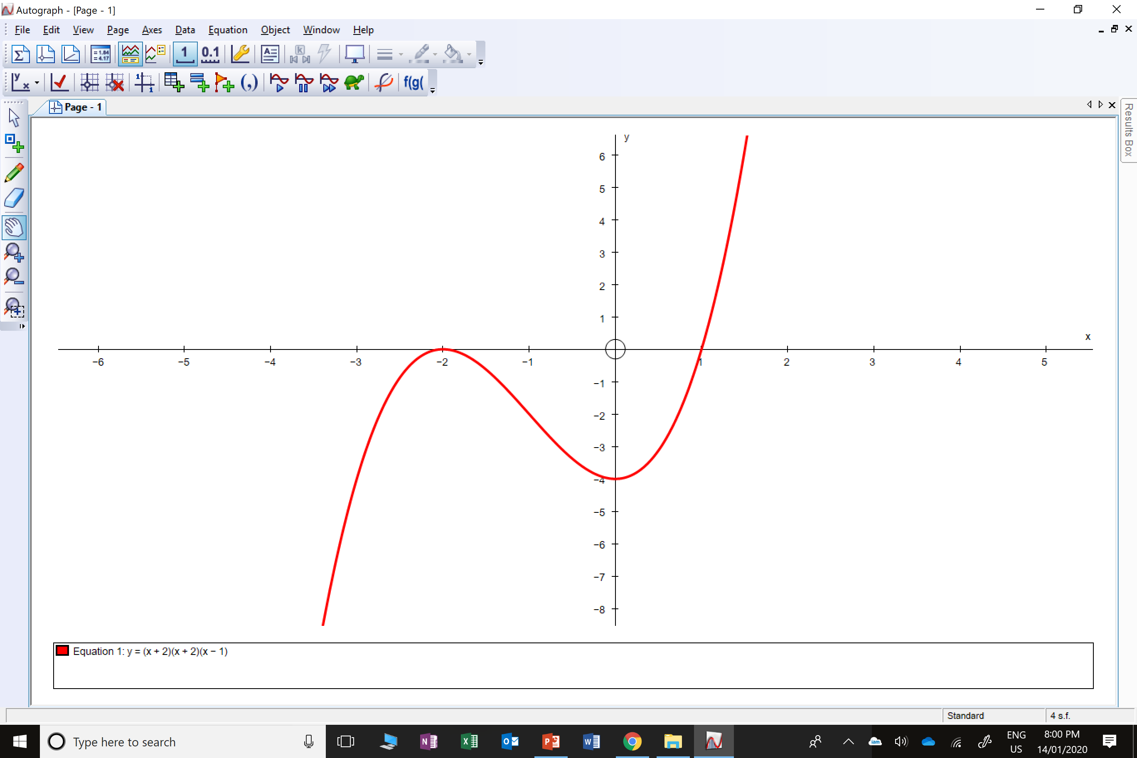
y = (x + 2)(x + 2)(x – 1)
What values of x will make
the equation equal to zero?
x = -2
x = -2
x = 1

Slide 22

y = (x + 1)(x – 3)(x – 3)
What values of x will make
the equation equal to zero?
x = -1
x = 3
x = 3

Slide 23
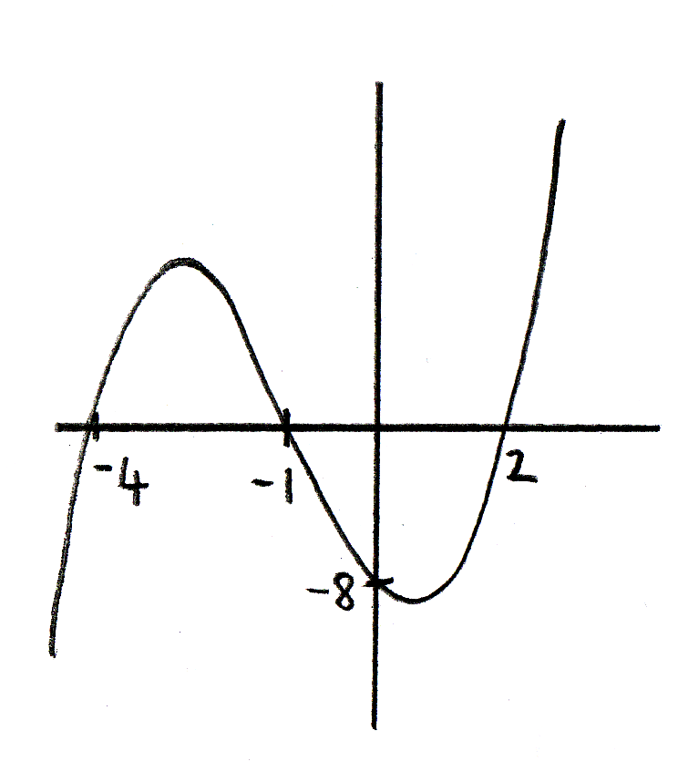
Which equation has been sketched here?
A
B
C
D

Slide 24
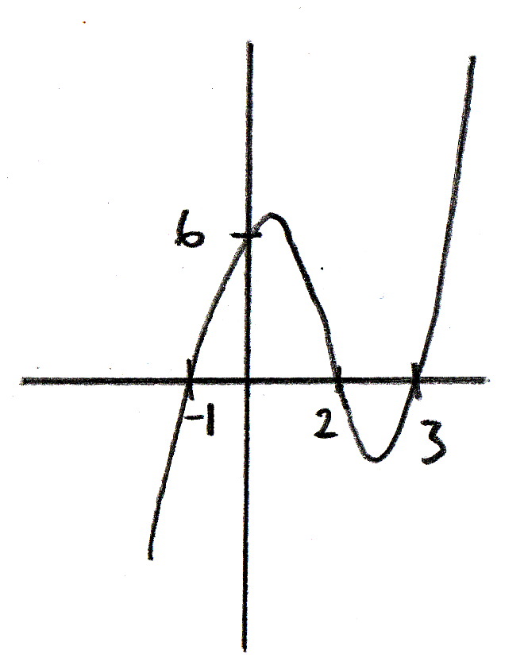
Which equation has been sketched here?
A
B
C
D

Slide 25
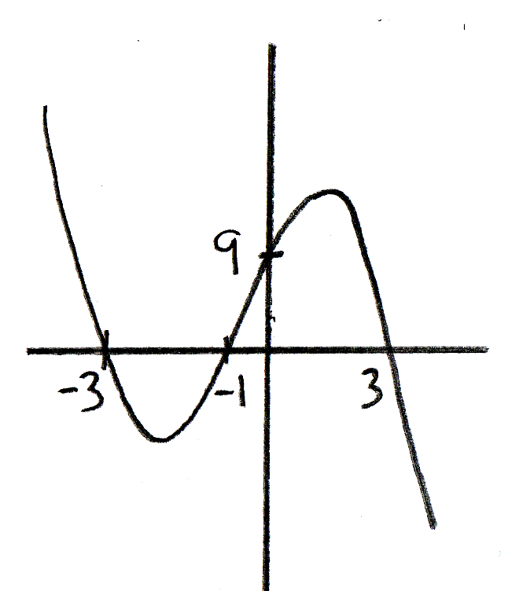
Which equation has been sketched here?
A
B
C
D

Slide 26
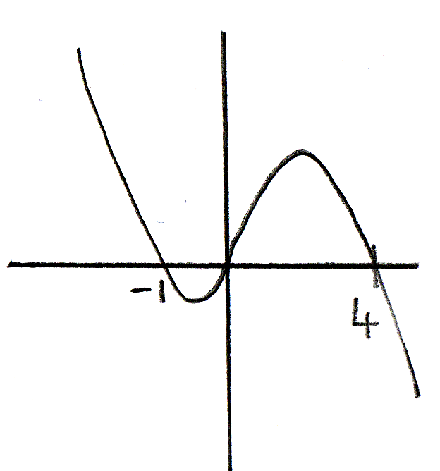
Which equation has been sketched here?
A
B
C
D

Slide 27
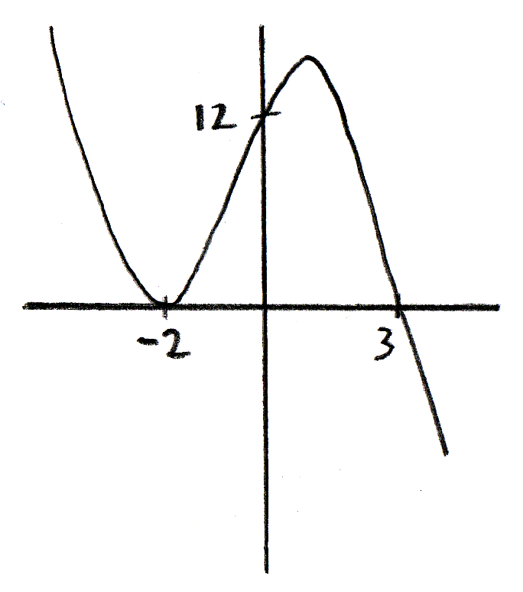
Which equation has been sketched here?
A
B
C
D

Slide 28
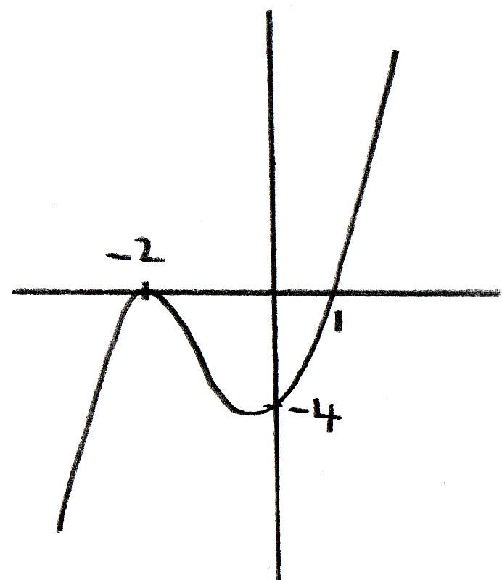
Which equation has been sketched here?
A
B
C
D

Slide 29
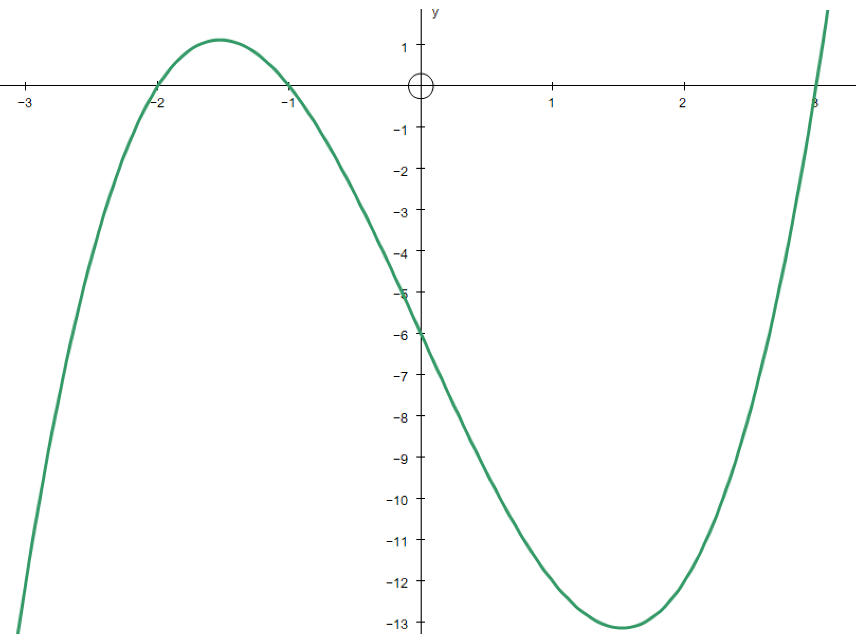
Sketch the graph.
y = (x + 2)(x + 1)(x – 3)

Slide 30
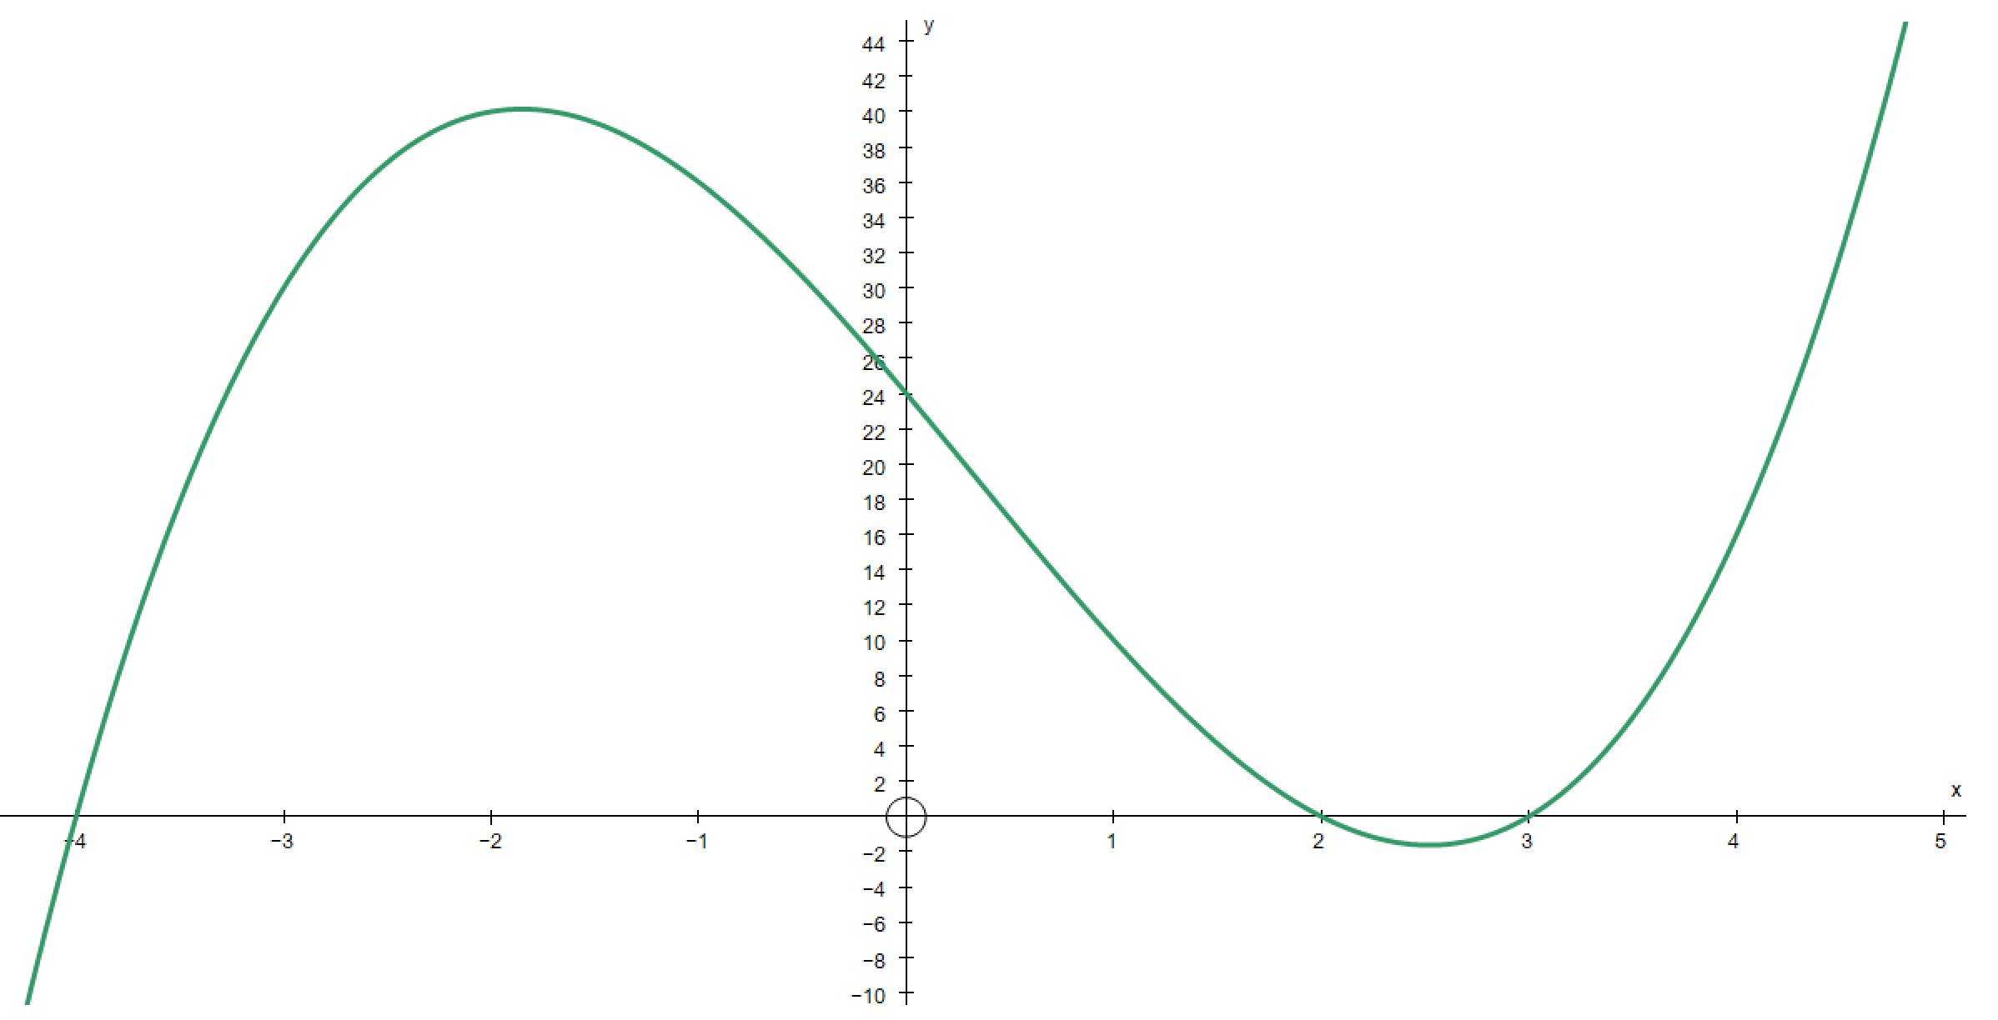
Sketch the graph.
y = (x + 4)(x – 2)(x – 3)

Slide 31
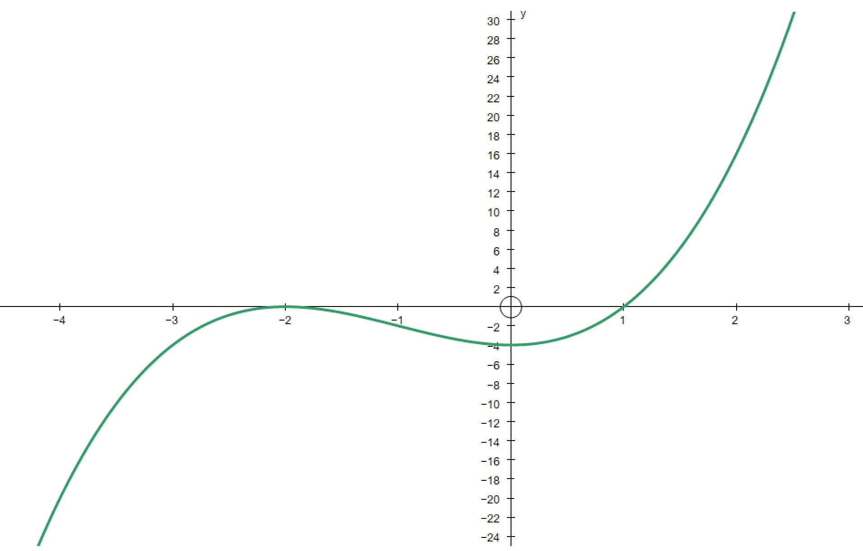
Sketch the graph.
y = (x + 2)(x + 2)(x – 1)

Slide 32
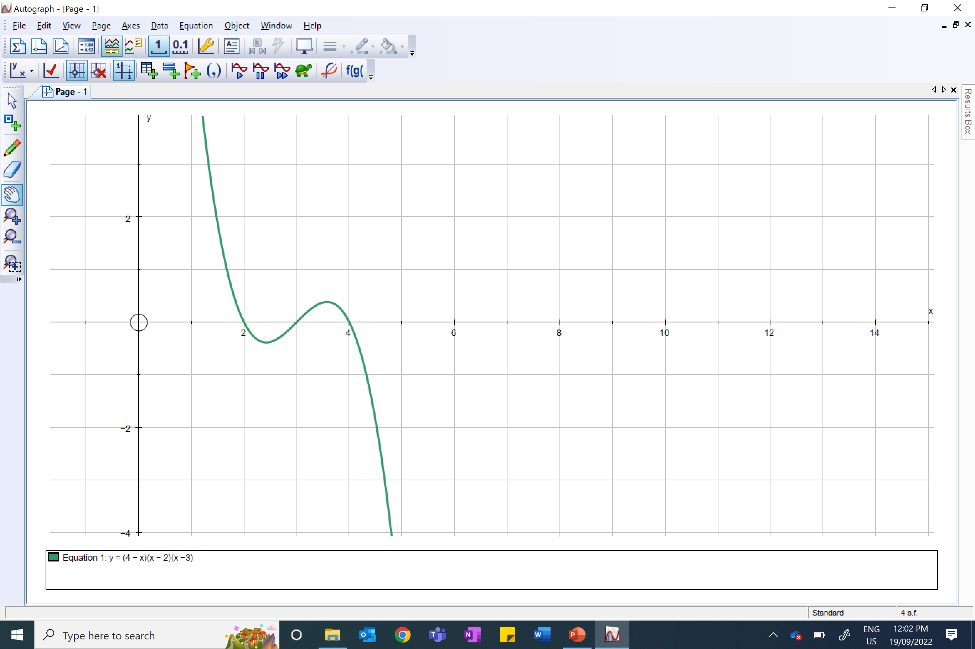
Sketch the graph.
y = (4 – x)(x – 2)(x – 3)

