Slide 1

Intermediate Challenge 1
GOLD

Slide 2
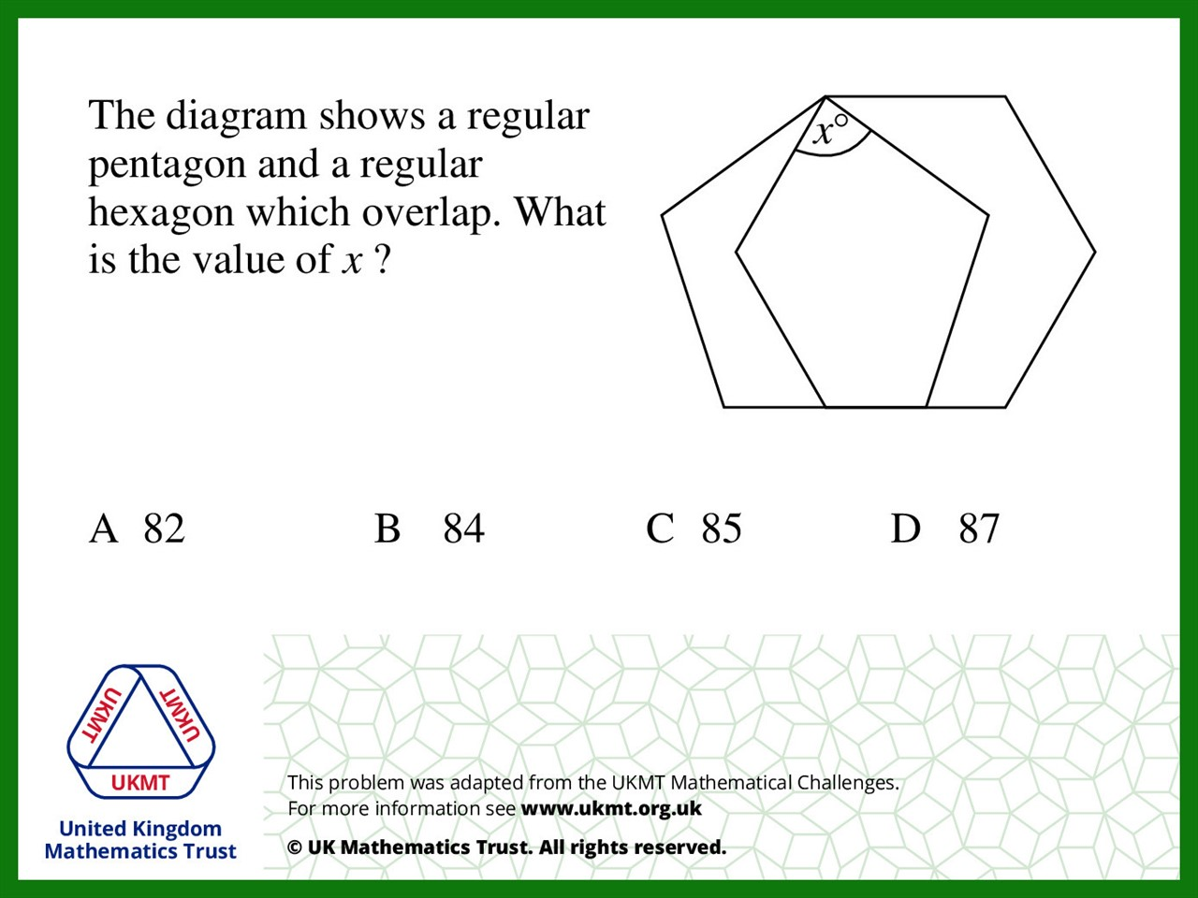
Q1.
Interior Angle Pentagon = 108
Interior Angle Hexagon = 120
(120 x 2) + (108 x 2) = 456.
540 – 456 = 84

Slide 3
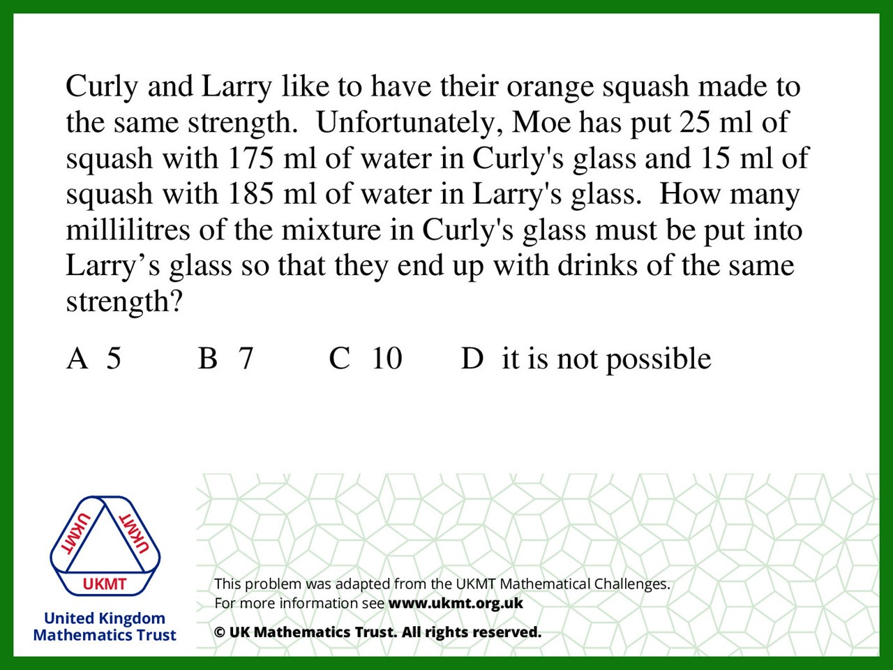
Q2.
Curly Ratio is 1:7
Larry Ratio is 3:37
Impossible to balance out

Slide 4
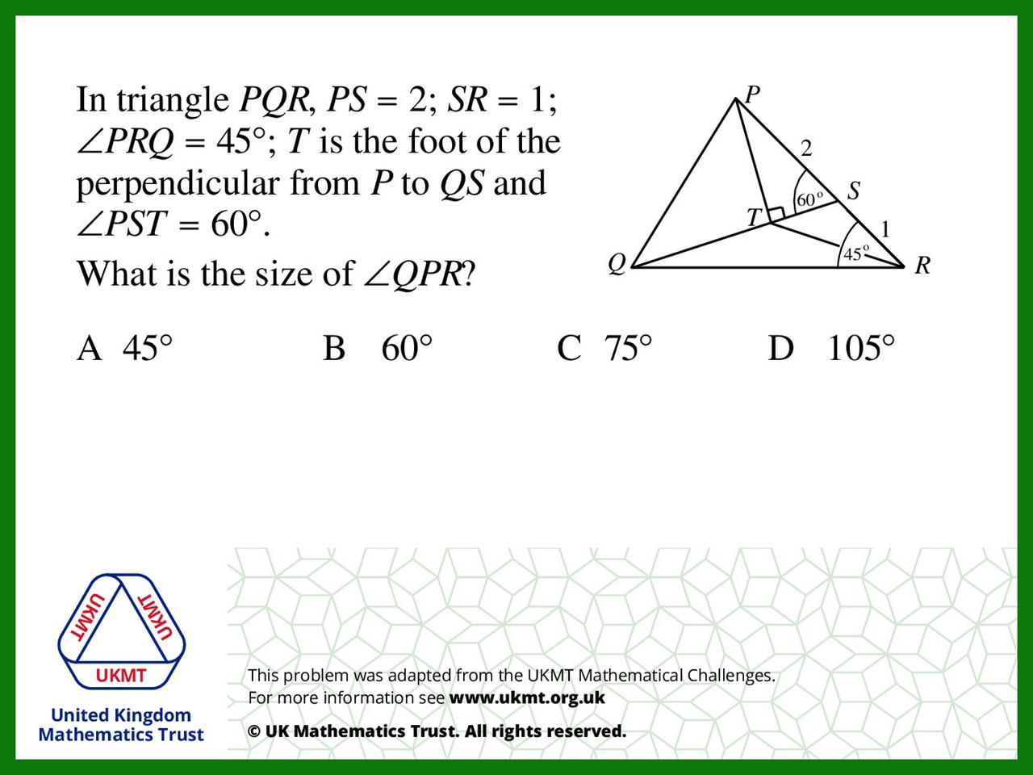
Q3.
45 + 60 = 105
180 – 105 = 75

Slide 5
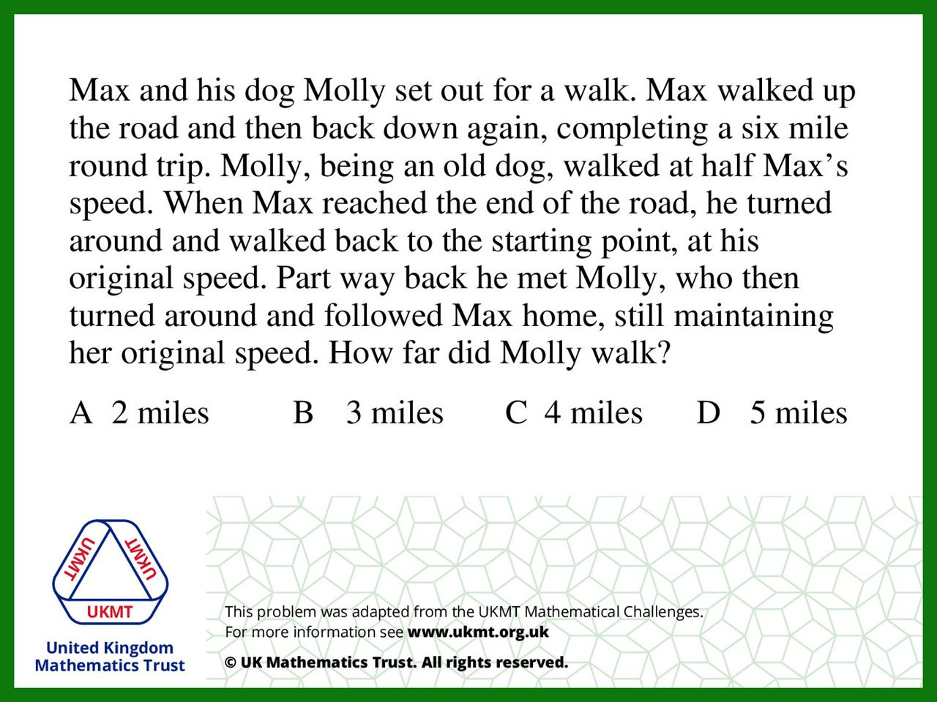
Q4.
He walked about 2 miles when meeting with max and 2 miles going back so that’s 4 miles

Slide 6
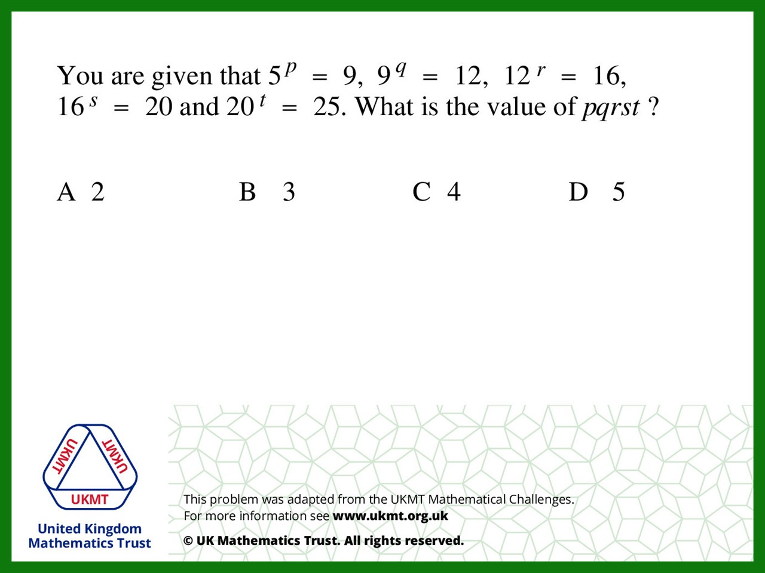

Q5.
$$5^{pqrst}=25$$
$$5^{pqrst}=5^{2}$$

