Slide 1
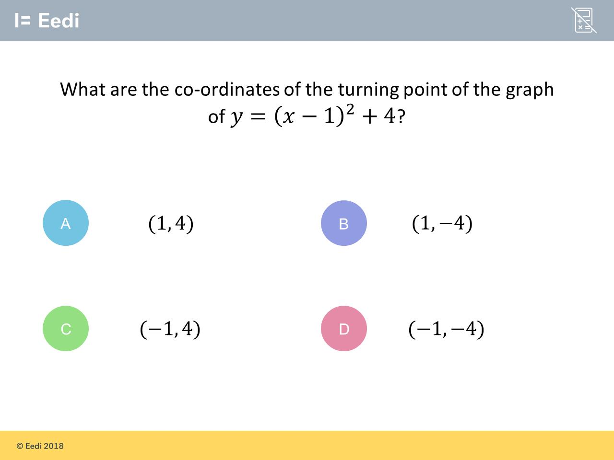
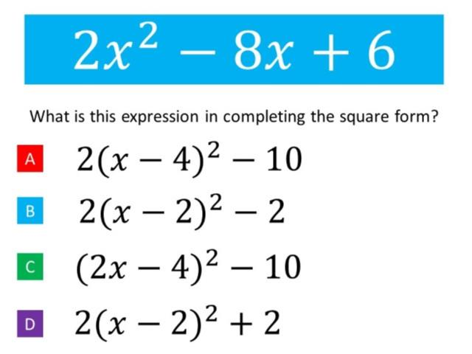
Worst answered question?
Most common wrong answer?

Slide 2
ANSWERS

Slide 3
Worst answered question?

Slide 4
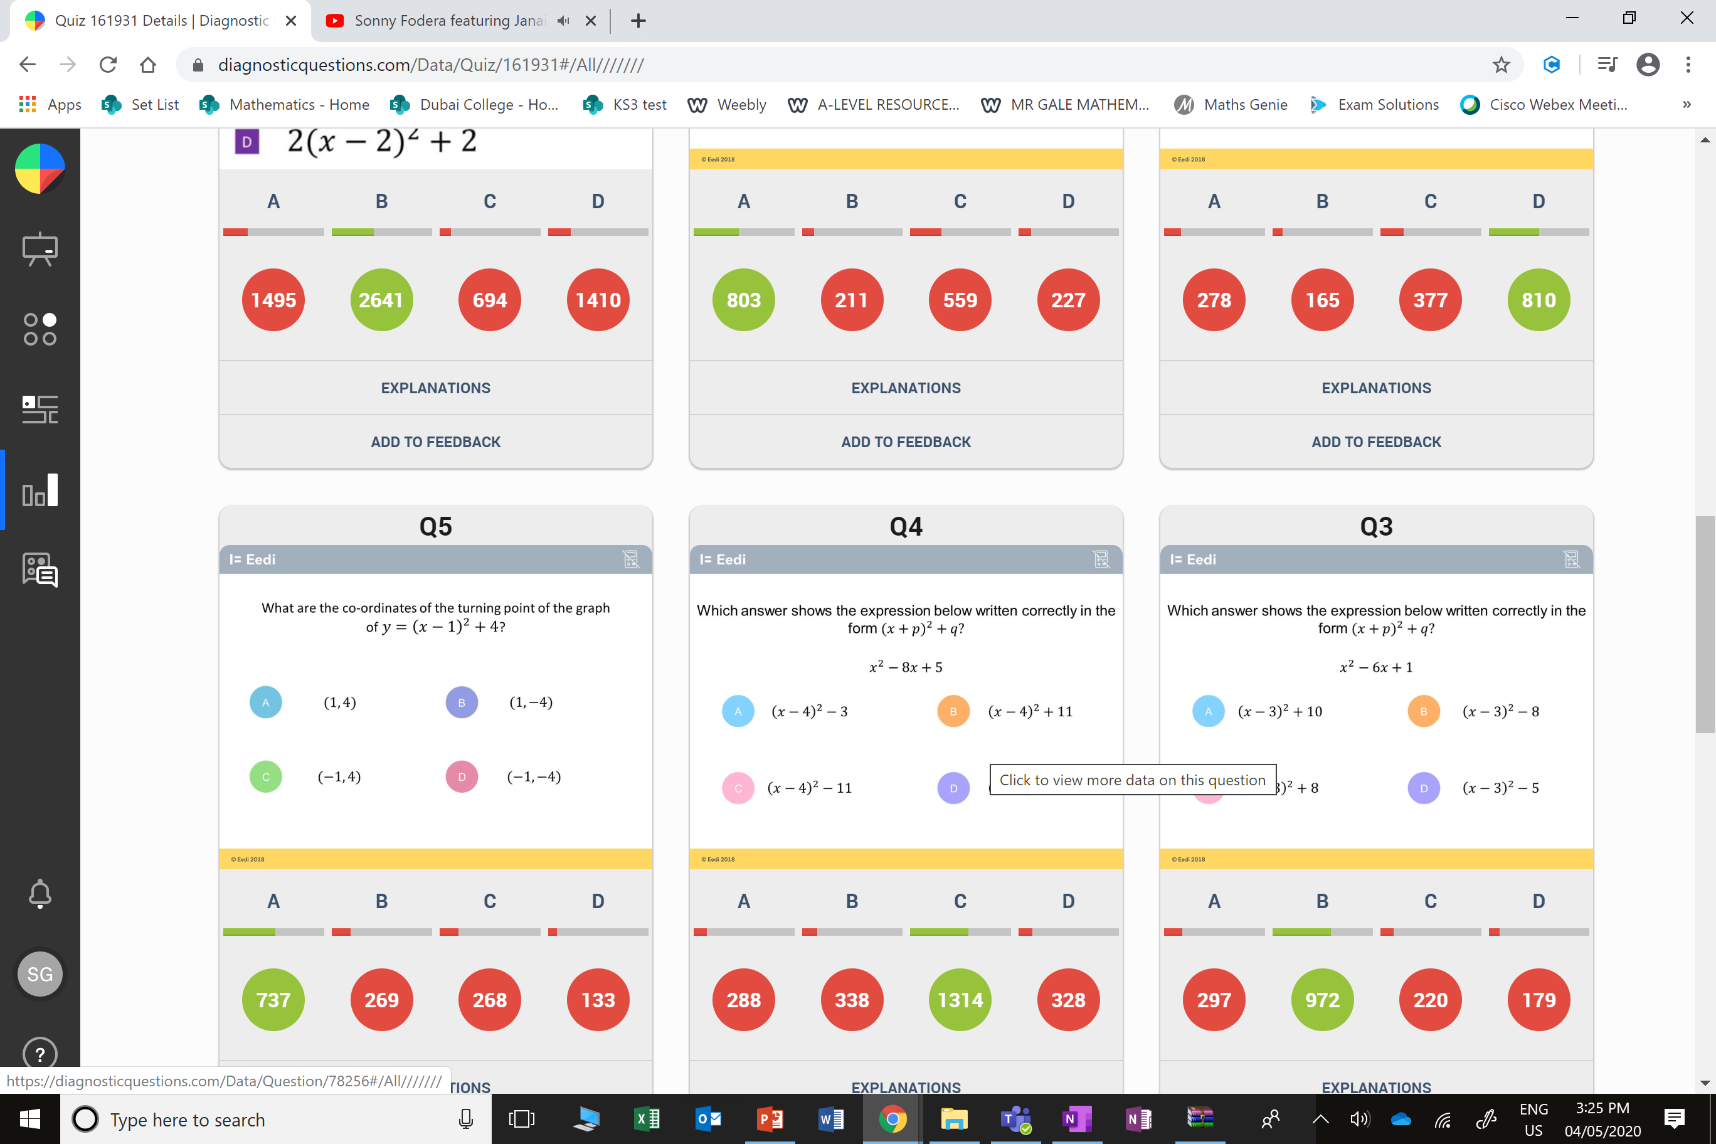
A
They did not factorise out
the 2 at the beginning.

Slide 5
B
The student has given the wrong sign on the y coordinate.

