Slide 1

Diagnostic
uestions
Misconceptions

Slide 2
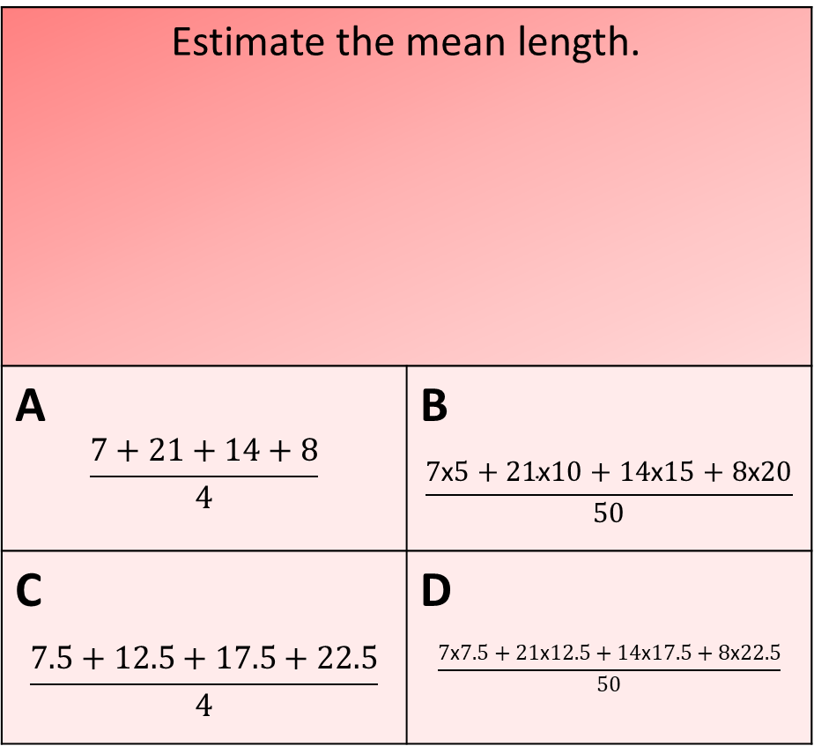
Worst answered question?
Estimate the mean length.
A $$\frac{7+21+14+8}{4}$$ | B $$\frac{7\text{x}5+21\text{x}10+14\text{x}15+8\text{x}20}{50}$$
C $$\frac{7.5+12.5+17.5+22.5}{4}$$ | D $$\frac{7\text{x}7.5+21\text{x}12.5+14\text{x}17.5+8\text{x}22.5}{50}$$
What is the modal class?
A 21 | B 19
C 5 < w ≤ 10 | D 20 < w ≤ 25
Weight | Frequency
0 < L ≤ 5 | 13
5 < L ≤ 10 | 21
10 < L ≤ 15 | 8
25 < L ≤ 20 | 4
20 < w ≤ 25 | 2
Length | Frequency
5 < L ≤ 10 | 7
10 < L ≤ 15 | 21
15 < L ≤ 20 | 14
20 < L ≤ 25 | 8
53% Incorrect
21% Incorrect

Slide 3
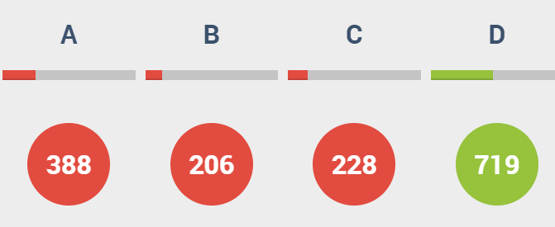
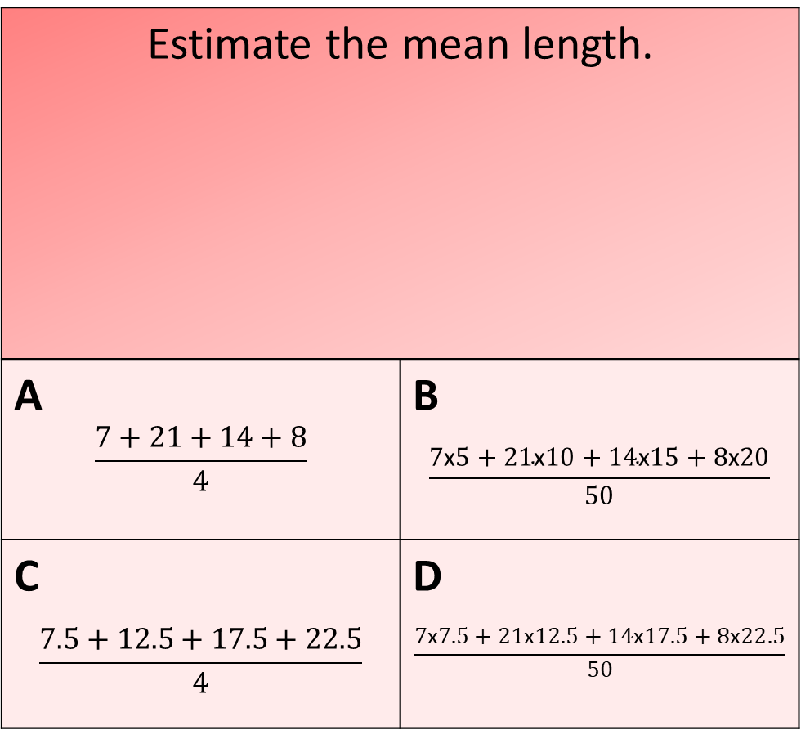
Most common wrong answer?
Estimate the mean length.
A $$\frac{7+21+14+8}{4}$$ | B $$\frac{7\text{x}5+21\text{x}10+14\text{x}15+8\text{x}20}{50}$$
C $$\frac{7.5+12.5+17.5+22.5}{4}$$ | D $$\frac{7\text{x}7.5+21\text{x}12.5+14\text{x}17.5+8\text{x}22.5}{50}$$
Length | Frequency
5 < L ≤ 10 | 7
10 < L ≤ 15 | 21
15 < L ≤ 20 | 14
20 < L ≤ 25 | 8
A
They did not multiply the mid point by the frequency .

Slide 4
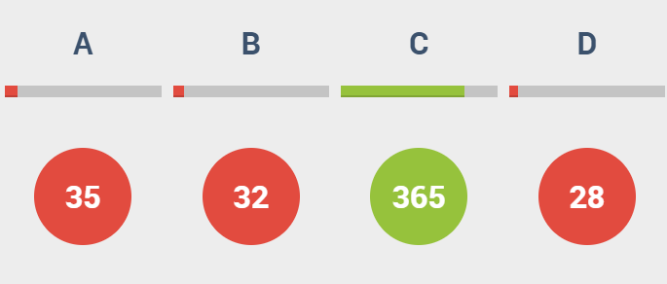
Most common wrong answer?
What is the modal class?
A 21 | B 19
C 5 < w ≤ 10 | D 20 < w ≤ 25
Weight | Frequency
0 < L ≤ 5 | 13
5 < L ≤ 10 | 21
10 < L ≤ 15 | 8
25 < L ≤ 20 | 4
20 < w ≤ 25 | 2
C
They went for the highest frequency value instead of the group.

