Slide 1
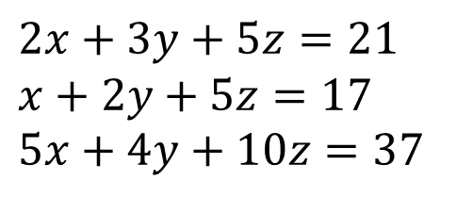
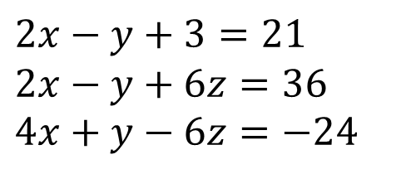
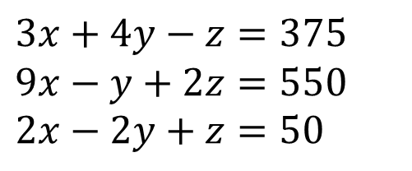
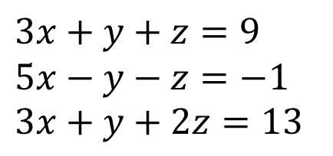
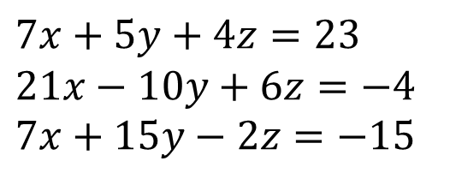
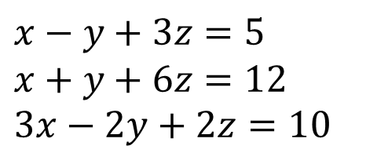
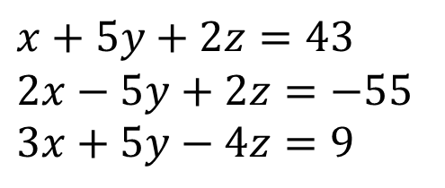
Solve the following.
5
$$7x+5y+4z=23 \\ 21x−10y+6z=−4 \\ 7x+15y−2z=−15$$
1
$$3x+y+z=9 \\ 5x−y−z=−1 \\ 3x+y+2z=13$$
6
$$3x+4y−z=375 \\ 9x−y+2z=550 \\ 2x−2y+z=50$$
2
$$2x−y+3=21 \\ 2x−y+6z=36 \\ 4x+y−6z=−24$$
3
$$x+5y+2z=43 \\ 2x−5y+2z=−55 \\ 3x+5y−4z=9$$
7
$$2x+3y+5z=21 \\ x+2y+5z=17 \\ 5x+4y+10z=37$$
4
$$x−y+3z=5 \\ x+y+6z=12 \\ 3x−2y+2z=10$$
8
N
James, Alison and Vivek go into a shop to buy some sweets. James spends £1 on four Fudge Bars, a Sparkle and a Chomper. Alison spends 70p on three Chompers, two Fudge Bars and a Sparkle. Vivek spends 50p on two Sparkles and a Fudge Bar. What is the cost of a Sparkle?

Slide 2
ANSWERS

Slide 3
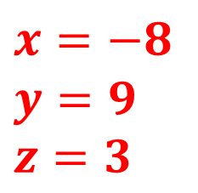
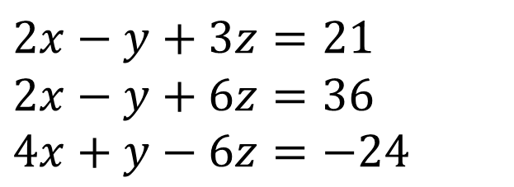
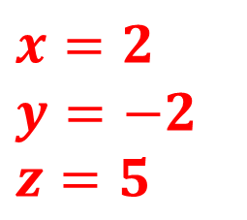
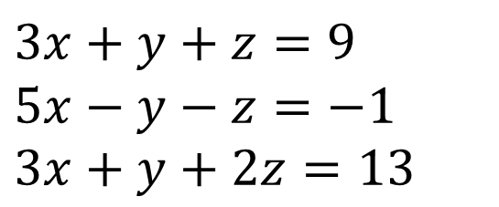
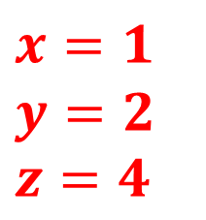
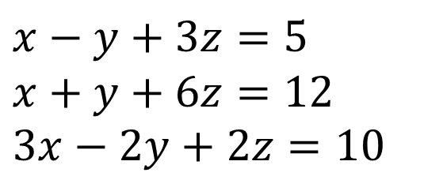
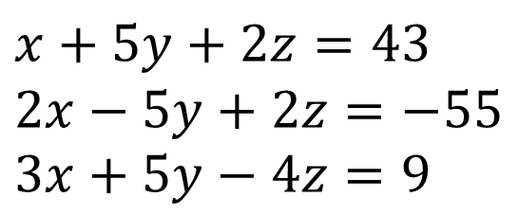
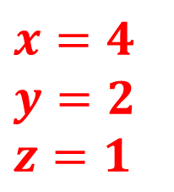
Solve the following.
$$3x+y+z=9 \\ 5x−y−z=−1 \\ 3x+y+2z=13$$
$$x=1$$
$$y=2$$
$$z=4$$
3
$$x+5y+2z=43 \\ 2x−5y+2z=−55 \\ 3x+5y−4z=9$$
$$x=−8$$
$$y=9$$
$$z=3$$
1
2
$$2x−y+3z=21 \\ 2x−y+6z=36 \\ 4x+y−6z=−24$$
$$x=2$$
$$y=−2$$
$$z=5$$
$$x−y+3z=5 \\ x+y+6z=12 \\ 3x−2y+2z=10$$
$$x=4$$
$$y=2$$
$$z=1$$
4
5
James, Alison and Vivek go into a shop to buy some sweets.
James spends £1 on four Fudge Bars, a Sparkle and a Chomper.
Alison spends 70p on three Chompers, two Fudge Bars and a Sparkle. Vivek spends 50p on two Sparkles and a Fudge Bar.
What is the cost of a Sparkle?
N
Solution: 15p

