Slide 1
Modelling in Mechanics
Vectors
Chapter 8
(Part 4 of 4)

Slide 2
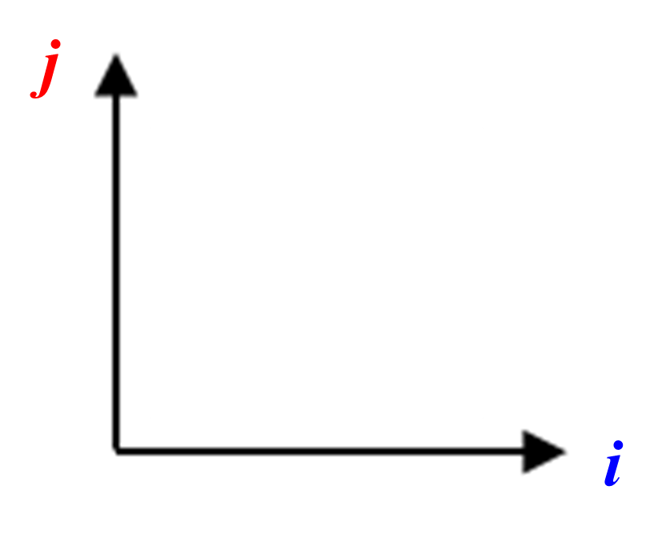
A vector describes how to get from A to B.
AB =
3i + 4j
B
4
A
3

Slide 3
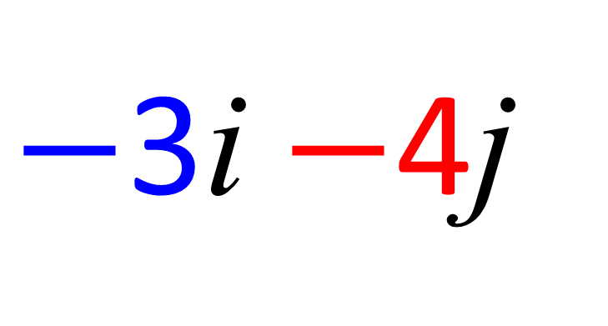
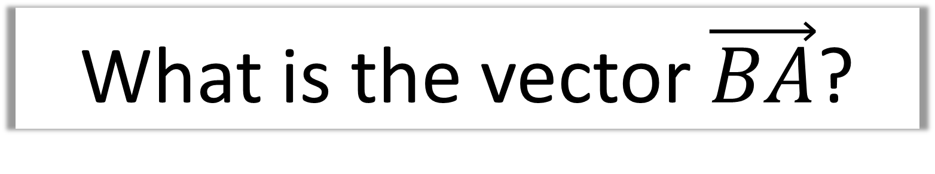
What is the vector $\vec{BA}$?
-3
B
$−$3i $−$4j
-4
A

Slide 4
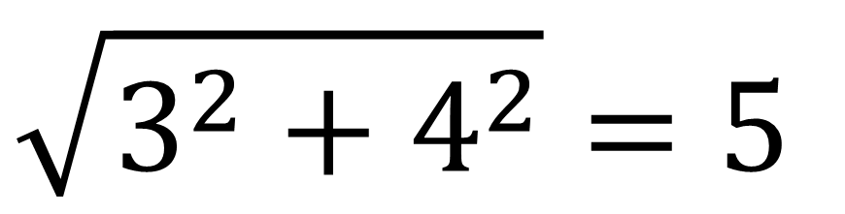
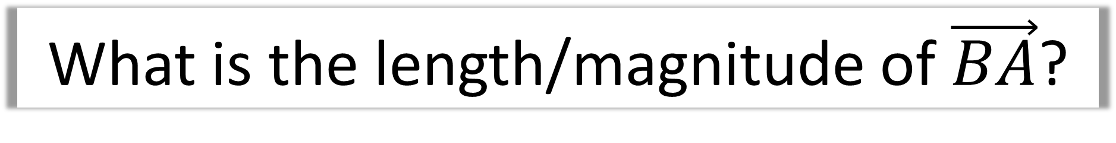
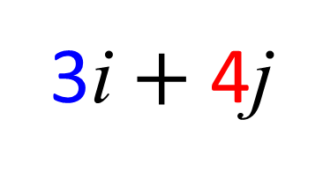
What is the length/magnitude of $\vec{BA}$?
B
$$\sqrt{3^{2}+4^{2}}=5$$
3i $+$ 4j
A

Slide 5
What is the difference between velocity and speed?
Velocity has a magnitude
and direction.
Speed is only a magnitude.

Slide 6
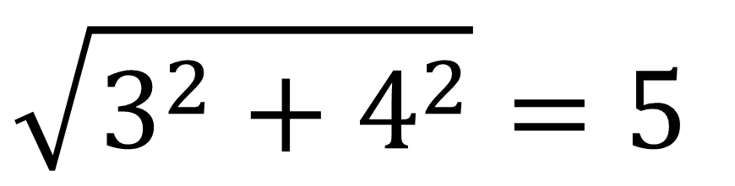
A velocity is given as 3i + 4j ms⁻¹,
what is its speed?
$$\sqrt{3^{2}+4^{2}}=5$$
5 ms⁻¹

Slide 7
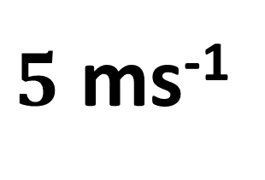
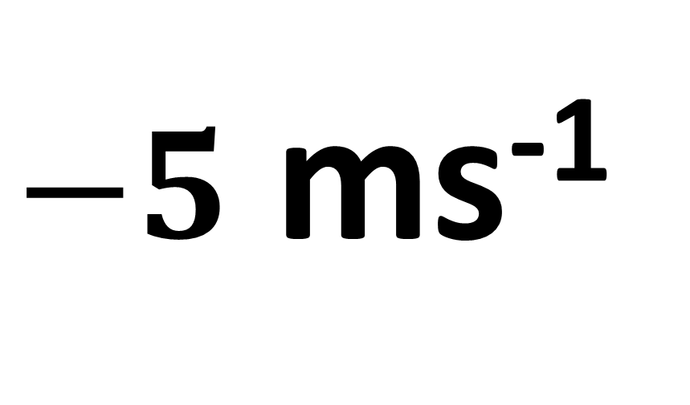
Positive Direction
$5$ ms⁻¹
What is the velocity of the particle?
$−5$ ms⁻¹

Slide 8
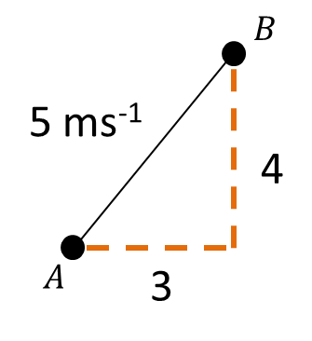

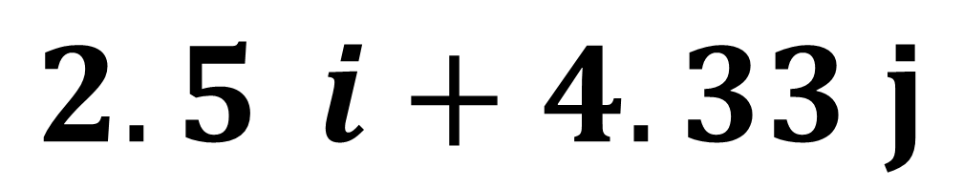
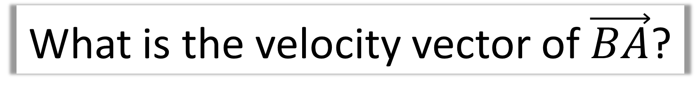


$$5\sin{60°}$$
$$60°$$
$$5\cos{60°}$$
What is the velocity vector of $\vec{BA}$?
$$2.5{ i+4.33 j}$$

Slide 9
Unit Vectors j
1j

Slide 10
Unit Vectors i
1i

Slide 11

Vectors $−$ Direction of a Vector
Use basic trigonometry to identify the angle of direction.

Slide 12
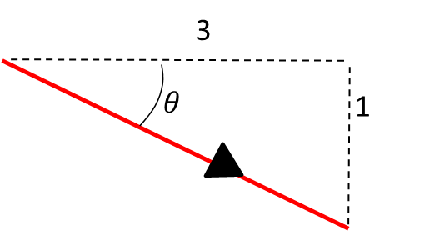
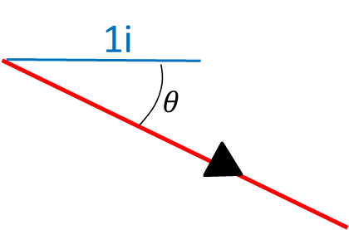
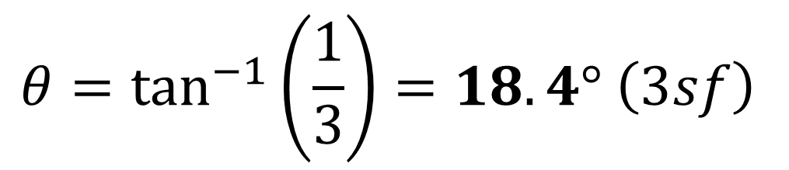
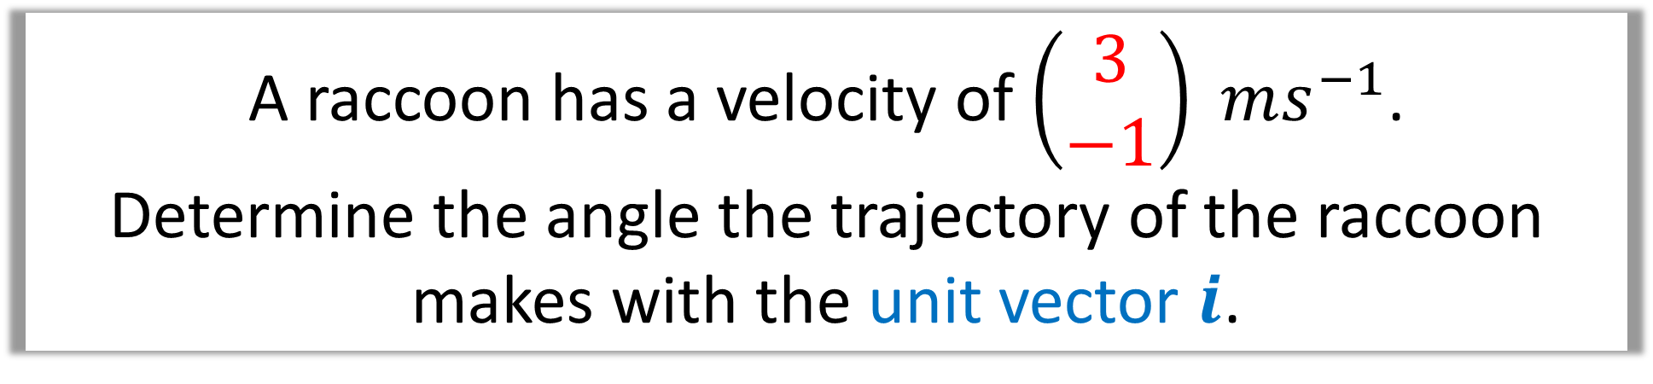
A raccoon has a velocity of $\left(\begin{matrix}3 \\ −1\end{matrix}\right) ms^{−1}$.
Determine the angle the trajectory of the raccoon
makes with the unit vector $i$.
$$θ=\tan^{−1}\left(\frac{1}{3}\right)=18.4° \left(3sf\right)$$

Slide 13
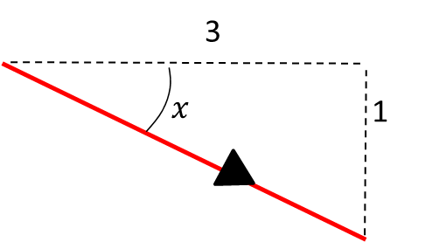
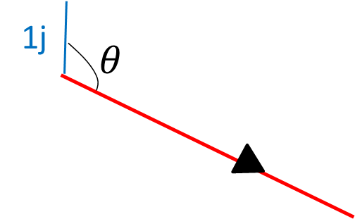
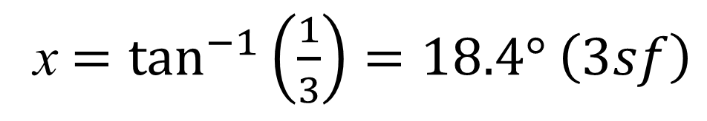
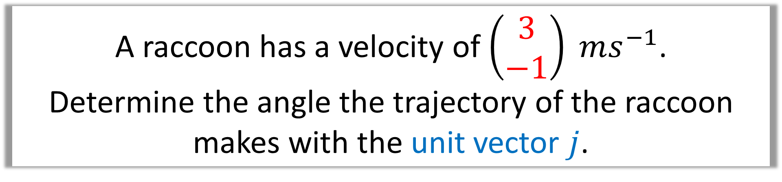
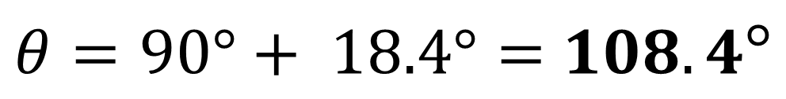
A raccoon has a velocity of $\left(\begin{matrix}3 \\ −1\end{matrix}\right) ms^{−1}$.
Determine the angle the trajectory of the raccoon
makes with the unit vector $j$.
x $=\tan^{−1}\left(\frac{1}{3}\right)=18.4° \left(3sf\right)$
$θ=90°+ 18.4°=$ $108.4°$

Slide 14
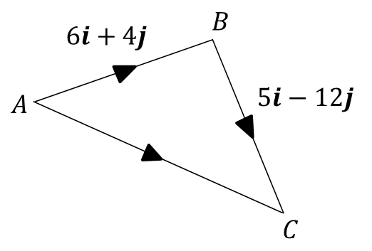
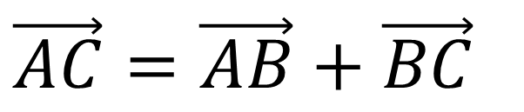
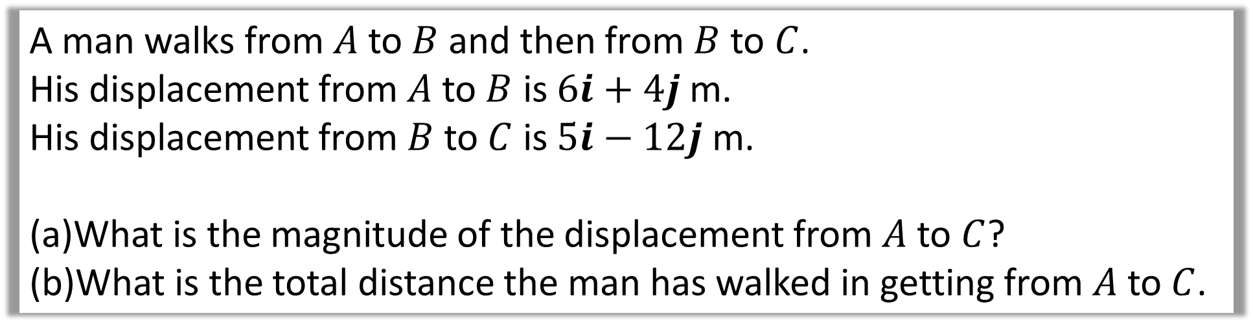
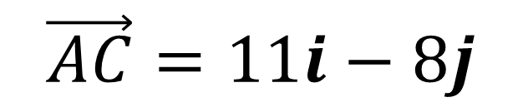
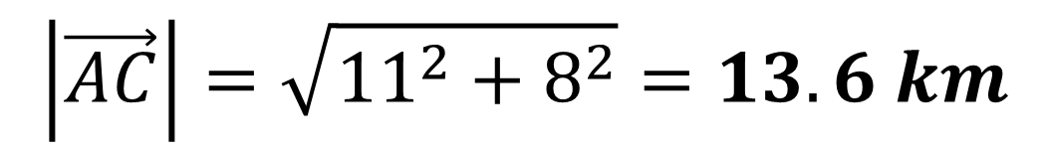
A man walks from $A$ to $B$ and then from $B$ to $C$.
His displacement from $A$ to $B$ is $6i+4j$ m.
His displacement from $B$ to $C$ is $5i−12j$ m.
What is the magnitude of the displacement from $A$ to $C$?
What is the total distance the man has walked in getting from $A$ to $C$.
a)
$$\vec{AC}=\vec{AB}+\vec{BC}$$
$$\vec{AC}=11i−8j$$
$$\left|\vec{AC}\right|=\sqrt{{11}^{2}+8^{2}}=13.6 km$$

Slide 15
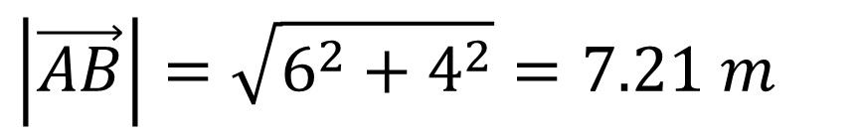
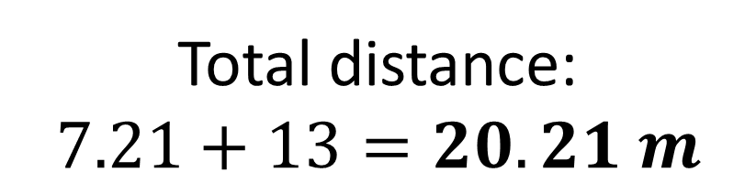
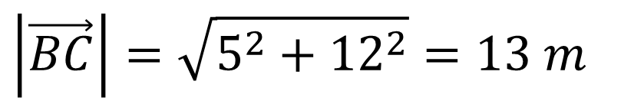
A man walks from $A$ to $B$ and then from $B$ to $C$.
His displacement from $A$ to $B$ is $6i+4j$ m.
His displacement from $B$ to $C$ is $5i−12j$ m.
What is the magnitude of the displacement from $A$ to $C$?
What is the total distance the man has walked in getting from $A$ to $C$.
b)
$$\left|\vec{AB}\right|=\sqrt{6^{2}+4^{2}}=7.21 m$$
$$\left|\vec{BC}\right|=\sqrt{5^{2}+{12}^{2}}=13 m$$
Total distance:
$$7.21+13=20.21 m$$

