Slide 1
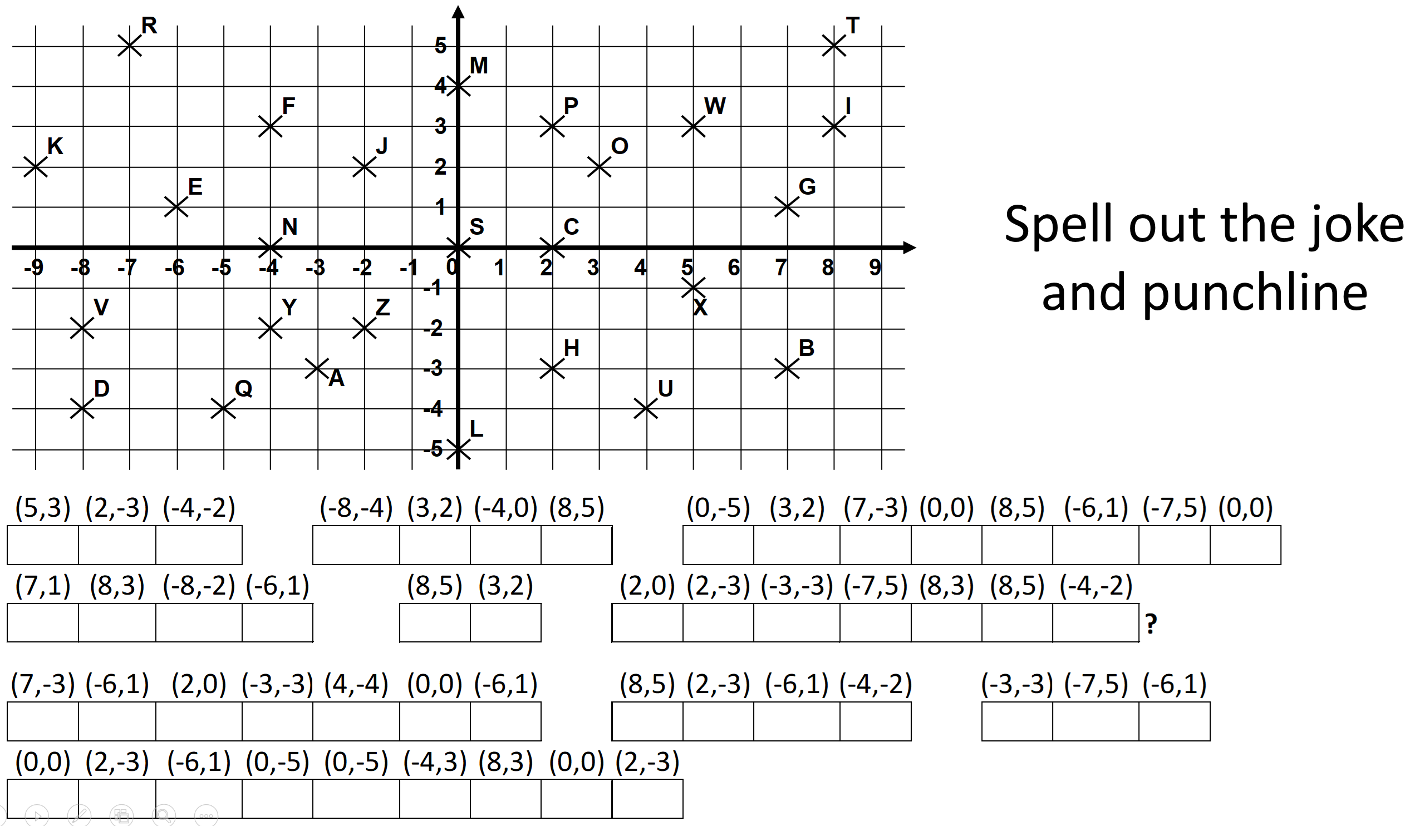

Slide 2
ANSWERS

