Slide 1
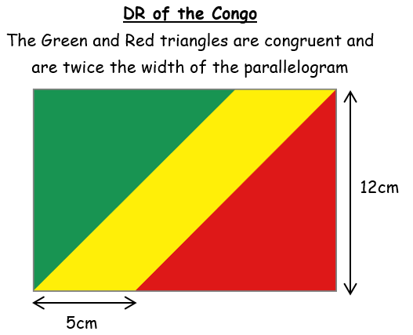
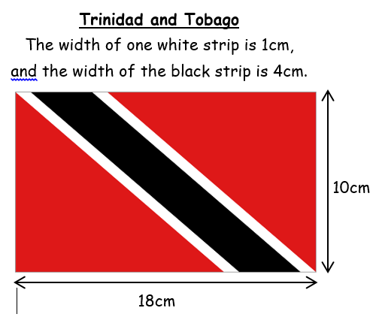
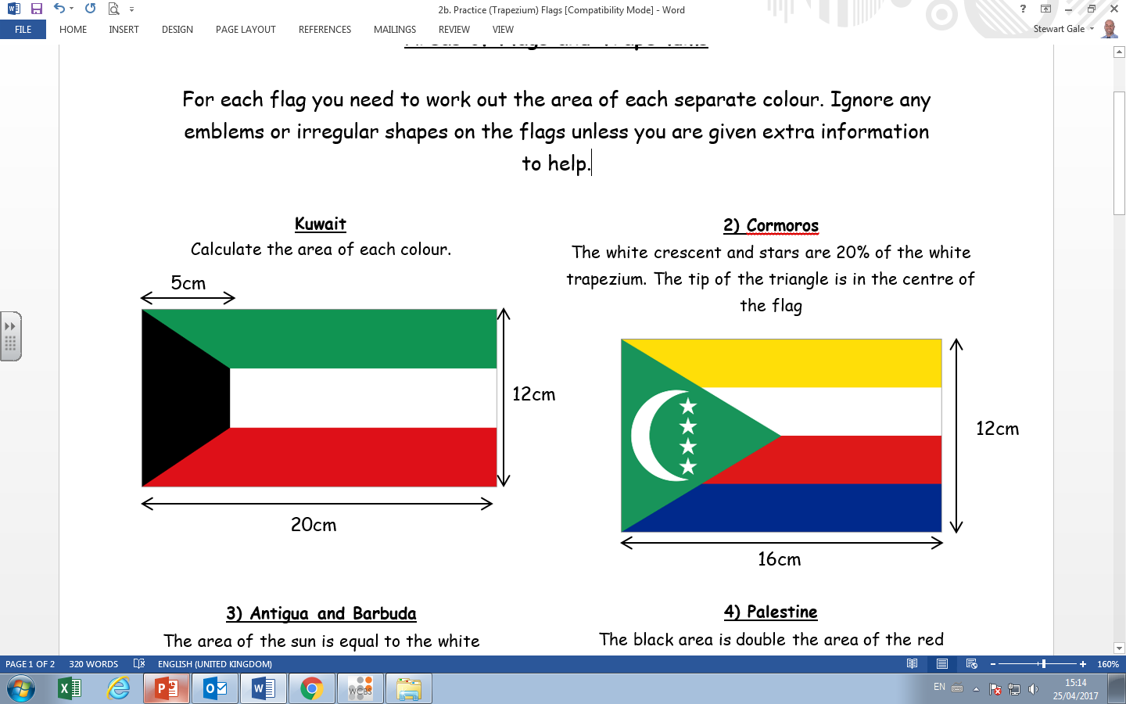
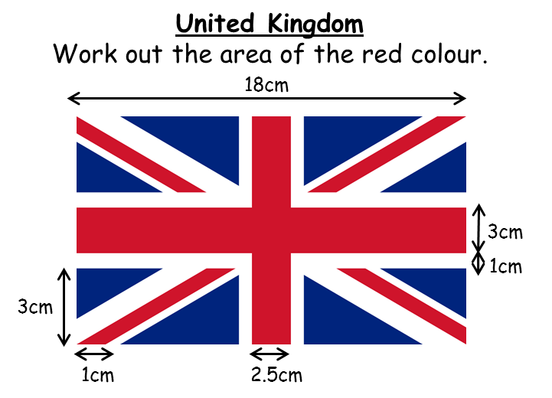

Slide 2
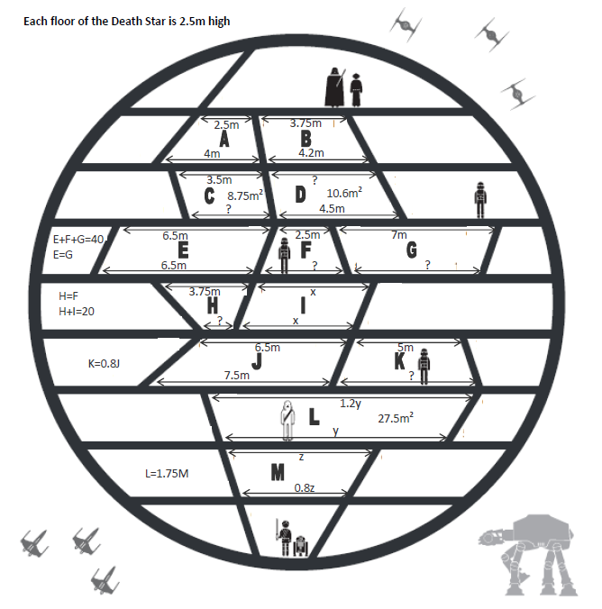

Slide 3
ANSWERS

Slide 4
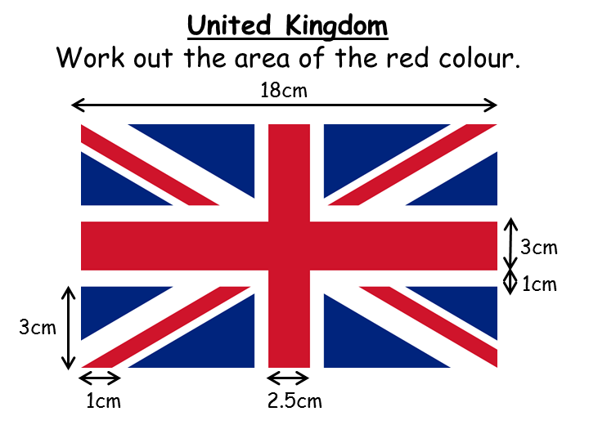
Trinidad and Tobago
White = 20cm², Black = 40cm²,
Red = 120cm²
DR of the Congo
All colours are 60cm²
Kuwait
Black = 40cm², Green/Red = 70cm², White = 60cm²
United Kingdom
Red = 86cm²

Slide 5
A = 8.125
B = 9.9375
C
? = 3.5
D
? = 3.98
E = 16.25
F = 7.5
? = 3.5
G = 16.25
? = 6
H = 7.5
? 2.25
I = 12.5
? = 5
J = 17.5
K = 14
? = 6.2
L
? = 10
M = 15.7
? 7
? 5.6

